Slide 1
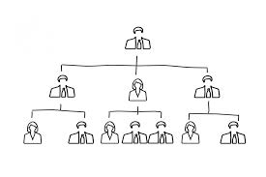
k
LECTURE # 27-28
Organizational structure
(PSYC-6223)
k

Slide 2
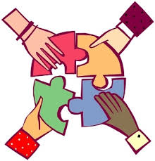
What is an organization
A social unit of a people systematically structured and managed to meet a need or to pursue collective goals on a continuing basis.

Slide 3
Why do we need an organizational structure?
All organizations have a management structure that determines the relationships between functions and positions and subdivides and delegates roles, responsibilities and authority to carry out defined task.

Slide 4
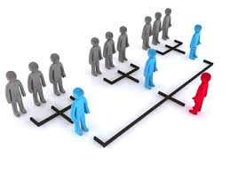
Organizational structure
It is a framework within which an organization arranges its lines of authorities and communications and allocates rights and duties

Slide 5
Types of organizational structure
1. Tall organizational
structure
2 . Flat organizational
structure
3 . virtual
organizational structure
4. Boundary less organizational structure

Slide 6
Tall organizational structure
Large complex organization often require a taller hierarchy
In its simplest form a tall structure results in one long chain of command similar to the military
As an organization grows the number of management level increases and the structure grows taller. In a tall structure managers form many ranks and each has small area of control.

Slide 7
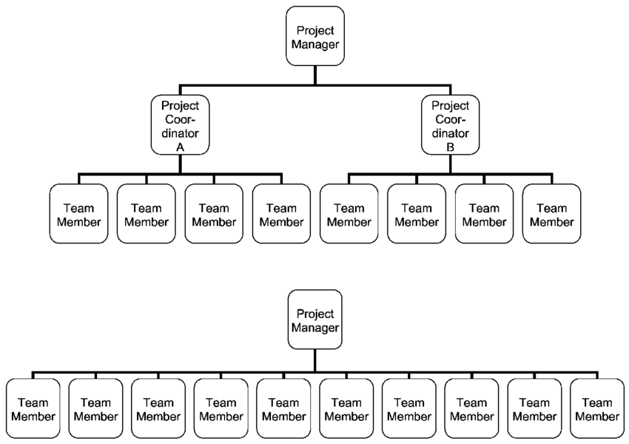
.

Slide 8
Flat organizational structure
A flat structure have fewer management levels which each level controlling a broad area or group
Flat organizations focus on empowering employees rather than adhering to chain of command
By encouraging autonomy and self direction flat structure attempt to tap into employees creative talents and to solve problems by collaboration.

Slide 9
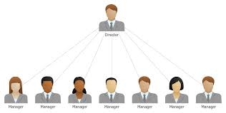
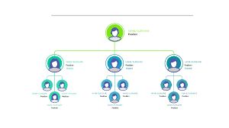
.

Slide 10
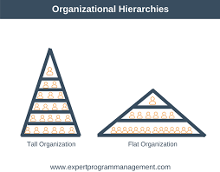
.
Tall structure
Flat structure
Large size
Small size

Slide 11
Virtual organizational structure
Virtual organizational structure can be thought of as a way in which an organization uses information and communication technologies to replace or augment some aspect of the organization
People who are virtually organized primarily primarily interact with electronic means

Slide 12
For example many customer help desks link customers and consultants
together via telephone or the internet and problem may be solved
without ever bringing
people together face to face

Slide 13
Boundary less organizational structure
A boundary less organizational structure is a contemporary approach in organizational designe
It is an organization that is not defined by or limited to the horizontal vertical or external boundaries imposed by a pre defined structure it behave more like an organism encouraging better integration among employees and closer partnership with stakeholders
It is highly flexible and responsive and draws on talent whatever its found

Slide 14
Features of organizational structure
Determines the manner and context to which roles power and responsibilities are delegated
Depends on objective and strategies
Act as a perspective through which individuals can see their organizations and its environment.

Slide 15
Importance organizational structure
Impact effectiveness and efficiency.
Reduces redundant actions.
Promotes teamwork.
Improves communication.
Contributes to success or failure.

Slide 16
Purpose of organizations
Divide work to be done in specific jobs and departments.
Assign tasks and responsibilities associated with individual jobs.
Coordinates divers organizational task
Establish relationship bw individual, groups and depts.
Establish formal lines of authority.
Allocates organizational resourses.

Slide 17
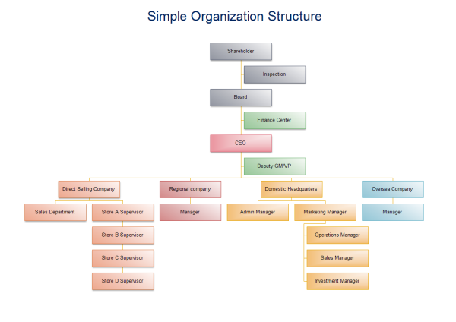

Slide 18
Chain of command:
The continuous line of authority that extends from upper level of organization to lowest level of organizational clarify who reports to whom.
Authority.
The rights inherent in a managerial position to tell people what to do and expect them to do

Slide 19
Responsibility:
The obligations or expectation to perform. Responsibility brings with it accountability
Unity of command:
The concept that a person should have one boss and should report only to him
Delegation:
the assignment of authority to another to carry out specific duties.

Slide 20
Departmentalization
When a company expands to….
Supply goods or services
Produces variety of different products
Engage in several different markets
In such conditions the company can adopt departmentalization.

Slide 21
Forms of departmentalization
Functional
Product
Customer
Geographic
Process

Slide 22
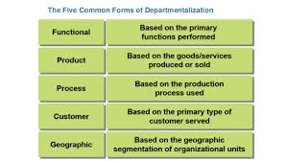

Slide 23
Functional departmentalization
Arranging the business according to what each section or department does.

Slide 24
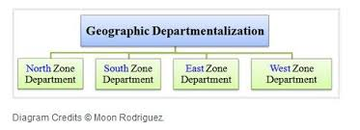
Geographic departmentalization It is base on geographical or regional structure
Process departmentalization.

Slide 25
.
Product departmentalization Where products have to go through stages as they are made

Slide 26
Process departmentalization
Organizing according to the different types of products produced

Slide 27
Customer departmentalization Where different customer groups have different needs

