Slide 1
VOWELS
Diphthongs

Slide 3
What is a Diphthong?
Diphthongs start at one vowel-position and move towards another.
The word di-phthong is from Greek: it means "two vowels".
There is a glide or movement of the tongue from one vowel position to the other.
a sound formed by the combination of two vowels in a single syllable, in which the sound begins as one vowel and moves towards another (as in coin, loud, and side ).

Slide 5
Diphthongs
Diphthongs are EIGHT in number.
They are divided into two categories.
Centering Diphthongs
Three
Closing / Rising Diphthongs
Five

Slide 6
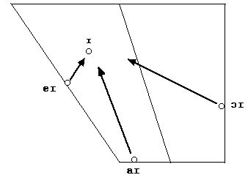
Closing / Rising to /i/

Slide 7
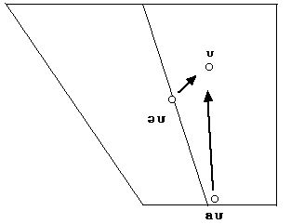
Closing / Rising to /u/

Slide 8
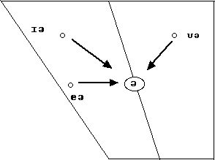
Centering

Slide 9
Diphthongs
/ei/ - play, neigh
/ai/ - buy, shy
/ɔi/- boy, toy
/əu/ - no, show
/au/ - now, cow
/iə/ - near, fear
/eə/ - hare, pair
/uə/ - tour, poor
Closing to /i/
Closing to /u/
Centering

Slide 11
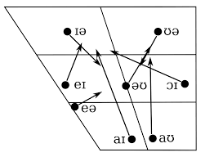

Slide 12
Triphthongs
In phonetics, a triphthong (from Greek, "triphthongos", literally "with three sounds," or "with three tones") is a monosyllabic vowel combination involving a quick but smooth movement of the articulator from one vowel quality to another that passes over a third.
Note: No triphthong in RP (Received Pronunciation) / British Standard English. In NAE (North American English) there are a few.

Slide 14
