Slide 1
DISEASES OF THE KIDNEY
(Nephrology & Urology)

Slide 2
PARAMETERS & DEFINITIONS
UTI
Acute renal failure
Chronic renal failure
Renal colic
Nephritic syndrome – proteinuria, hematuria, azotemia, edema, hypertension.
Nephrotic syndrome – proteinuria, hypoalbuminemia, edema, hyperlipidemia
Urine routine examination,
Blood urea & creatinine
Creatinine clearance.

Slide 3
DISEASES
Glomerular diseases – nephrotic & nephritic
Diseases affecting tubules & interstitium
Diseases involving in blood vessels.
Cystic disease of kidney – simple cyst, polycystic disease.
Urinary outflow obstruciton.
Tumours

Slide 4
NORMAL GLOMERULUS

Slide 5
GLOMERULAR DISEASES - GLOMERULUS
EM

Slide 6
HISTOLOGICAL CHANGES
HYPERCELLULARITY
cellular proliferation
leukocytic infiltration
formation of cresents
BASEMENT MEMBRANE THICKING
HYLINOSIS
after endothelial injury, accumulation of extracellular amorphous material deposition
SCLEROSIS
accumulation of collagenous material in mesengium

Slide 7
ANTIBODY MEDIATED GLOMERULAR INJURY

Slide 8
TWO PATTERNS OF DEPOSITION OF IMMUNE COMPLEXES

Slide 9
MEDIATORS OF IMMUNE GLOMERULAR INJURY

Slide 10
GLOMERULAR DISEASES
PRIMARY G N.
Acute proliferative GN.
Post infectious and others
Rapidly progressive(cresentic )GN.
Membranous GN.
Minimal change disease
Membranoproliferative GN.
Focal segmental GN.
IgA Nephropathy
Chronic GN
SECONDARY GN.
Systemic diseases eg SLE, Diabetes mellitus, Goodpasture Syndrome, Amyloidis
Hereditary Disorder.
Alport syndrome etc

Slide 11
NEPHRITIC SYNDROME
Acute post infectious glomerulonephritis
IgA nephropathy
Hereditary nephritis
Rapidly progressive GN (Crescentic)
It is like nephritic syndrome
Nephritic + Nephrotic lead to chronic glomerulonephritis

Slide 12
NEPHRITIC SYNDROME
ACUTE PROLIFERATIVE(POST STREPTOCOCCAL GM ).
Diffuse proliferation of glomerular cells with influx of acute inflammatory cells. Group a beta hemolytic stept cocci 12,4,1 by typing M protein (90% ).
Antibody mediated having high titer of ASO and low level of complement system.
Granular immune complex in affected glomeruli.

Slide 13
ACUTE POST STREPTOCOCCAL GN
Parameters:
Nephritic
ASOT
Hypo complementenemia

Slide 14
ACUTE POST STREPTOCOCCAL GN
Immune complex deposition in GBM
C3 deposition – hypo complementenemia
LM:
Increased cells of glomerular tuft – due to endothelial & mesangial prolifiration – neutrophilic & monocyte infltrate.
EM:
Immune deposits – sub endothelial, intramembranous, sub epithelial humps.
Immunoflouoresence:
Gralunar deposit of IgG & C with in capillary walls & mesangium.

Slide 15
POSTSTREPTOCOCCAL GN

Slide 16
RAPIDLY PROGRESSIVE GN Crescentic - CrGN
Severe oliguria & ARF in weeks to months – rapid & progressive loss of renal functions.
Nephritic features.
No specific etiology
Crescent formation by proliferation by perietal epithelium.
GBM breakdown
Immuoflourescence – linear deposits of IgG & C3 on GBM.

Slide 17
RAPIDLY PROLIFERATIVE (CRESENT) GM(RPGN)
Presence of cresents in most of glomeruli and auto immune in nature.
Three type
Type I ( anti GBM ab with linear deposits of IgG ) may react with alveolar basement producing pulmonary hemorrhage (GOOD PASTURE Syndrome)
Second type RPGN ( Immune complex deposition having granular staining pattern) eg SLE,
Type III RPGN ( pauci immune) defined as lack of anti GBM and immune complex.
ANCA circulating producing
cytoplasmic© or
perinuclear (p) which is seen in vasculitis.

Slide 18
RAPIDLY PROGRESSIVE GN Crescentic - CrGN

Slide 19
CRESCENTIC GN

Slide 20
NEPHROTIC SYNDROME
PATHOPHYSIOLOGY
MASSIVE PROTEINURIA= > 3.5 G/DAY
INCREASED PERMEABILITY TO PLAMA PROTEIN LEADING TO SELECTIVE PROTEINURIA
HYPOALBUMINEMIA = < 3 gm/dl
DECREASED COLLOID PRESSURE Na & water retention
GENERALIZED EDEMA
HYPERLIPIDEMIA AND LIPIDURIA
Increase synthesis of of lipoprotein, abnormal transport and deceased catabolism leading to lipiduria.

Slide 21
CAUSES OF NEPHROTIC SYNDROME

Slide 22
ETIOPATHOGENESIS
RESPIRATORY INFECTION & IMMUNIZATION
RESPONSE TO STEROID
ATOPIC DISORDER
HLA TYPES
HODGKIN LYMPHOMA
PROTEINURIA INDUCING FACTORS

Slide 23
MINIMAL CHANGE DISEASE
Selective proteinuria – microalbuminuria
Excelent response to steroids
< 5% develop CRF/CGN
Adults with MCD respond to steroid but relapse is common.

Slide 24
FOCAL SEGMENTAL GLOMERULOSCLEROSIS
Primary 20% to 30%
Secondary - HIV 70%
Proteinuria Non Selective
Steroid response Poor
Prognosis 50% develop CRF/CGN in 10 years
EM loss of podocytes
LM increased mesangial Matrix
obliteration of capillaries
hyalinosis & lipidosis
Pattern Focal & segmental

Slide 25
HIGH-POWER VIEW OF FOCAL AND SEGMENTAL GIOMERULOSCLEROSIS

Slide 26
MEMBRANOUS NEPHROPATHY
Sub epithelial immune deposits
Idiopathic in 85% of Patients
Sec. to HB, syphilis, malaria, SLE,
CA lungs, drugs – NSAIDS.
Proteinuria – nonselective
40% go to CRF 2 Years

Slide 27
MEMBRANOPROLIFERTIVE GN
10% Idiopathic
Lobulation 3+ due to:
Alteration in GBM
Mesangial prolifiration
Glomerular prolifiration
Types – type I (common) Type II
Pathogenetic factors – C3 nephritic factor (C3 Ab)
Factor H impairment by Ab/C
Prognosis – variable 60% complete remission
30% CRF

Slide 28
MEMBRANOPROLIFERTIVE GN

Slide 29
IgA NEPHROPATHY – BERGER DISEASE
Common in young adults & children
Most commonly seen in renal biopsies
Hematuria ++++
IgA depoits in Mesangium
Prognosis – 50% normal life
50% go to CRF in 20 years

Slide 30
IgA NEPHROPATHY

Slide 31
CHRONIC GN

Slide 32
DISEASES OF TUBULES & INTERSTITIUM
Inflammation - Tubulointerstitial nephritis
i. acute pyelonephritis
ii. Chronic pyelonephritis
iii. Drug induced interstitial nephritis
Acute tubular necrosis
i. Ischemic
ii. Toxic tubular injury

Slide 33
ACUTE PYELONEPHRITIS
Parameters:
Pain in costo vertebral angle
Chills, fever, malaise.
Pyuria
Bacteriuria.
Dysuria.
Frequency.
Urgency.

Slide 34
ACUTE PYELONEPHRITIS
Upper pyelonephrits
Cystitis
Prostatitis
Urethritis
Organisms: E.coli, proteus, klebsiella, enterobacter, pseudomonas, staph, strept. Faeclis.

Slide 35
PATHWAYS OF RENAL INFECTIONS
MECHANISMS :
Urinary obstruction
Instrumentation of urinary tract
Vesicoureteral reflux
Pregnency
Sex & age
Pre-existing renal lesions
Diabetes mellitus
Immuno suppression & immunodeficiency

Slide 36
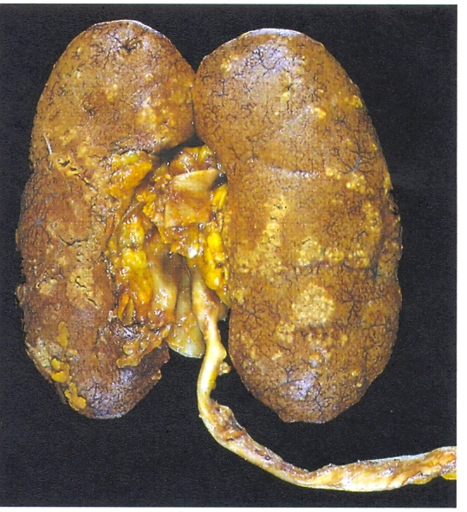
MORPHOLOGY
Abscesses on renal surface.
Suppurative necrosis
Glomeruli are not affected
Papillary necrosis – more common in diabetics.

Slide 37
CHRONIC PYELONEPHRITIS

Slide 38
DRUG INDUCED INTERSTITIAL NEPHRITIS
Acute TIN occurs with:
Synthetic penicillins
Synthetic antibiotics
Diuretics
NSAIDS
Pathogenesis:
Type I hypersensitivity
Type IV hypersensitivity
Morphology:
Edema, mononuclear cells, lymphocytes, macrophages, eosinophils, neutrophils.
Glomeruli are spared.
Analgesic nephropathy.

Slide 39
DRUG INDUCED INTERSTITIAL NEPHRITIS

Slide 40
ACUTE TUBULAR NECROSIS
Parameters:
Acute suppression of renal functions
Oliguria
Morphologically renal tubular damage

Slide 41
CAUSES OF ACUTE RENAL FAILURE
Most common cause: ATN
Other causes:
Rapidly progressive GN – cresentic
Renal vessel disease: polyangitis, thrombotic microangiopathies.
Acute papillary necrosis due to acute pyelonephritis
Acute drug induced interstitial nephritis.
Diffuse cortical necrosis

Slide 42
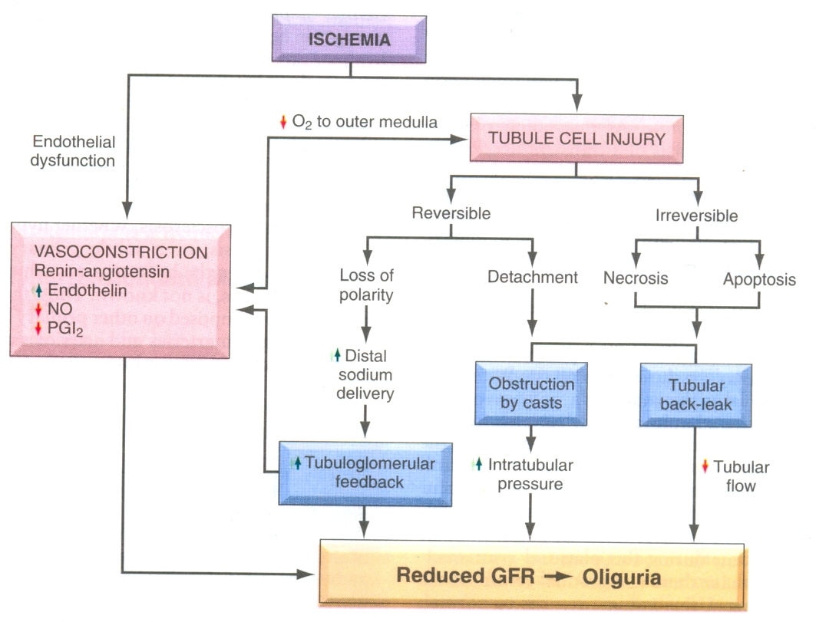
ACUTE TUBULAR NECROSIS
Ischemic ATN
Nephrotoxic ATN

Slide 43
STAGES OF ATN
Initiation phase – lasts about 36 hours
The maintenance phase – begins form 2nd to 6th day & characterized by OLIGURIA
Recovery or diuretic phase

Slide 44
DISEASES OF RENAL BLOOD VESSELS
Almost always secondary to systemic vascular disease like arteritis & hypertension.
1. Benign nephrosclerosis
2. Malignant hypertension & malignant
nephrosclerosis.
3. Thrombotic microangiopathies

Slide 45
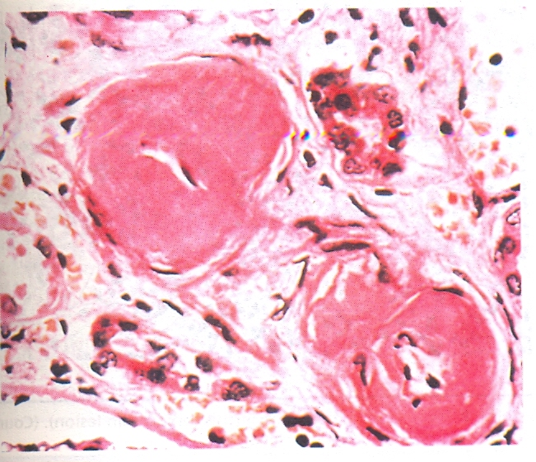
BENIGN NEPHROSECLIROSIS
It includes renal changes in benign hypertension.
Kidneys are symmetrically atrophic.
Hyaline arteriolosclerosis.
Fibro elastic hyperplasia of media & intima of larger vessels.
Variable degree of CRF

Slide 46
MALIGNANT NEPHROSCELROSIS
Due to hypertension there is injury to arteriolar walls.
Leads to increase permeability to fibrinogen & other proteins – endothelial injury, plt. dep.
Fibrinoid necorsis – hyperplastic arteriolosclerosis.
Pinpoint petechial cortical hemorrhages.
Diastolic above 120, papilledema, encephalopathy, CRF

Slide 47
THROMBOTIC MICROANGIOPATHIES
Widespread thrombosis in microcirculation.
Microangiopathic HA, low plt, renal failure.
Causes:
Childhood HUS
Adult HUS
TTP – fever, low plt, microangiopathic HA, neurologic deficits, renal failure.
Mechanisms.
TTP: matelloprotease deficiency – increase vWF, increase plt. Microagregates in blood vessels.
HUS: childhood – shiga toxin by E.coli, toxin binds to neutrophils in blood, binds to endiothelial cells of glomerulous – endothelial damage – cell death – thrombosis in glomerular capillaries, afferent arterioles.
Main cause of ARF in children.

Slide 48
DIABETIC MICROANGIOPATHY
Diffuse thickening of basement membrane which usually seen in capillaries of the skin skeletal muscle retina, renal glomeruli and renal medulla.
It is also seen nonvascular structures e.g. renal tubules, bowman capsule peripheral nerves and placenta.
It leads to development of diabetic nephropathy, retinopathy and neuropathy.

Slide 49
DIABETIC NEPHROPATHY
It includes
Glomerular lesions
Renal vascular lesions (arteriolosclerosis)
Pyelonephritis including necrotizing papillitis.
Diffuse mesangelial sclerosis
increase in mesangial matrix along with basement membrane thickening manifest the nephrotic syndrome characterized by proteinureia, hypoalbuminemia, and edema. s

Slide 50
NODULAR GLOMERULOSCLEROSIS
Ball like deposits of a laminated matrix (PAS+ve) which is called kimmelstiel wilson lesion seen in 15% to 30% of long term diabetics and major cause of morbidity and mortality & responsible for hyper tension along with sufficient ischemia leading to scarring of the kidneys.

Slide 51
CYSTIC DISEASES OF THE KIDNEY
Simple cyst
Adult polycystic kidney disease – autosomal dominant.
Childhood polycystic kidney disease – autosomal recessive.
Medullary cystic disease
PARAMETERS:
Major cause of CRF
Incidental finding on X-ray/ultrasound
Occasionally confused with malignant tumours.

Slide 52
ADULT POLYCYSTIC KIDNEY DISEASE
PARAMETERS:
Presents in 4th decade with flank pain, feeling of mass, hematuria, hypertension & urinary infections.
Ends with CRF
FEATURES
Seen in 1 in 500 – 1000 persons
Accounts for 10% cases of CRF
Defective gene is PKD 1& II on chromosome no. 16 & 4 encoding membrane associated protein – polycystin 1 & 2.
PKD I – 85% – 90% , PKD II – 10% – 15% cases
Resulting defect is cilia – centrosome complex of tubular epithelium.
Defecting fluid absortion resulting in cyst formation.

Slide 53
ADULT POLYCYSTIC KIDNEY DISEASE

Slide 54
CHILDHOOD/AUTOSOMAL RECESSIVE POLYCYSTIC KIDNEY DISEASE
I in 20000 live births
Defect in PKHD I gene coding for membrane receptor protein – fibrocystin – chromosome no. 16p
Fibrocystin is involved in function of Cilia in tubular epithelial cells
Numerous cysts seen in cortex & medulla..
Cysts lined by cubodial cells – from tubules.
Disease is bilateral & is perinatal, neonatal, infantile, juvenile
Liver is also having cysts.
Infants die quickly from renal failure.

Slide 55
HYDRONEPHROSIS
Dilation of renal pelvis & calyces
Causes:
Congenital – atresia of urethra, compression of ureter by kinking, torsion, aberrant renal artery
Acquired:
Foreign bodies: calculi, necrotic papillae,
Tumors: BPH, CA prostate, tumors of bladder, tumors of female genital tract
Inflammation: prostatitis, ureteritis, urethritis,fibrosis.
Neurogenic: paralysis of bladder
Normal pregnancy

Slide 56
HYDRONEPHROSIS

Slide 57
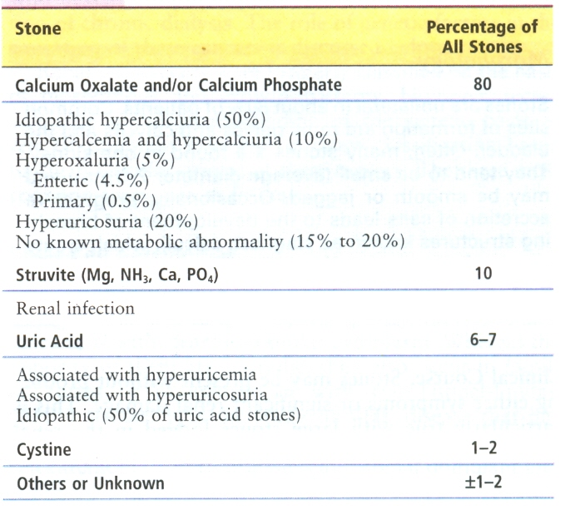
URINARY OUT FLOW OBSTRUCTIONS
Renal stones

Slide 58
PATHOGENESIS OF RENAL STONES
Increase urine conc. of stones constituents.
Hypercalciuria, hypercalcimia,
Hyperoxaluria,
UTI e.g. proteus, staph
Gout – uric acid stones, low pH
Lack of substances which inhibit mineral precipitation – osteopontin, pyrophosphate, mucopolysaccharides & nephrocalcin.

Slide 59
TUMORS OF KIDNEY
Parameters:
Hematuria: in 50% of patients
Palpable mass
Fever
Polycythemia
Incidental findings on X-ray/US

Slide 60
WHO CLASSIFICATION OF RENAL TUMORS

Slide 61
COMMON TUMOURS
Adenomas/papillaomas
Renal cell carcinoma → 80% to 85%
Clear cell carcinoma → 70% to 80%
Papillary cell carcinoma → 10% to 15%
Chromophobe renal carcinoma → 5%
Wilms tumours 3rd most common cancer in Children
Tumours of renal pelvis.
Papillomas
Transitional cell carcinoma/urothelial cell carcinoma
Squamous cell carcinoma

Slide 62
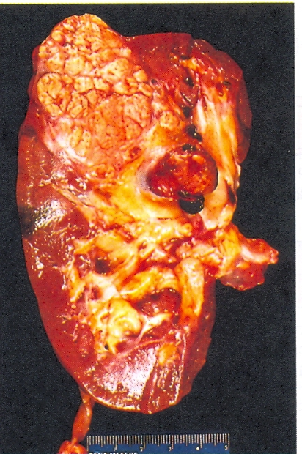
RENAL CELL CARCINOMA
Neoplasm on one pole of the kidney
Tumor invasion of renal vein
Areas of cystic & cystic softening & hemorrhage.

Slide 64
CLEAR CELL CARCINOMA

Slide 65
CLEAR CELL CARCINOMA
Risk factors:
Smokers
Hypertensive
Obese
Exposure to cadmium
30-fold increased risk in patients of acquired polycystic disease due to prolonged dialysis.
Genetic factors:
High incidence in association with VHL disease,
von Hippel – Lindua disease
VHL gene is present on chromosome no 3P25
Loss of this tumor suppressor gene gives rise to clear cell carcinoma.
Papillary renal cell carcinoma:
Culprit is MET proto-oncogene located on chromosome no 7q31.
Chromophobe renal cell carcinoma:
Chromosomes involved are 1, 2, 6 , 10, 13, 17, 21.

Slide 68
Papillary type.
Note: the papillae and foamy macrophages in the stalk

Slide 69
Chromophobe type.

Slide 70
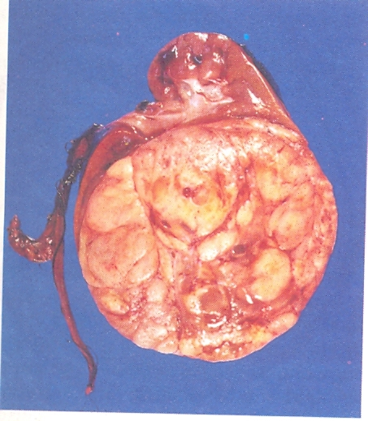
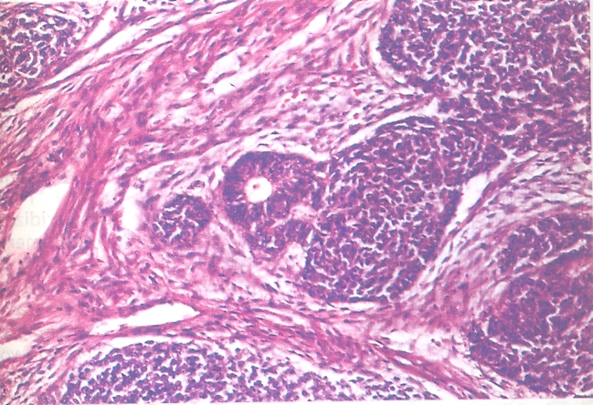
WILMS TUMOR (Nephroblastoma)
Seen in children between 2 to 5 of age.

Slide 71
UROTHELIAL CARCINOMA OF BLADDER
This neoplasm is the most common tumor of urinary tract.
Ranges from benign papilloma to invasive carcinoma.
Dominant clinical presentation feature is: Painless hematuria
Three times more common in men than women.
Seen at age of 50 to 70 years
50 times more common in those exposed to β-naphthylamine.
Associated with cigarette smoking, chronic cystitis, schistosomiasis of bladder, cyclophosphamide.

Slide 72
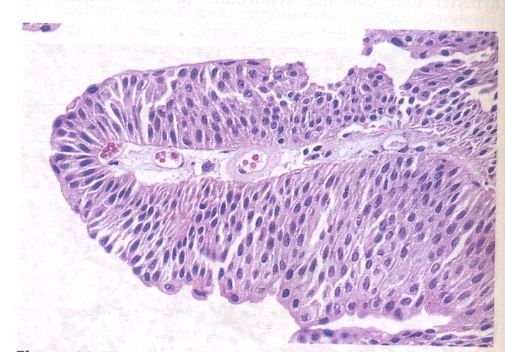
UROTHELIAL CARCINOMA OF BLADDER

