Slide 1
Spreading Print

Slide 6
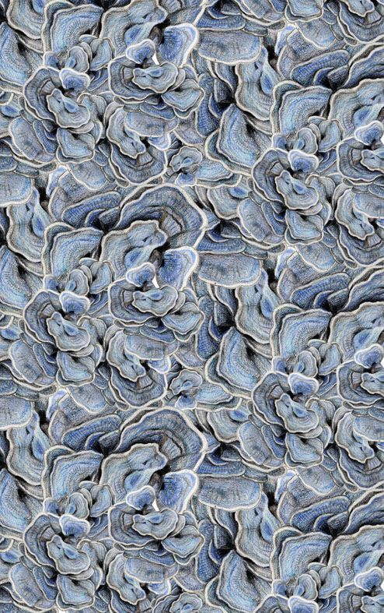

Slide 9
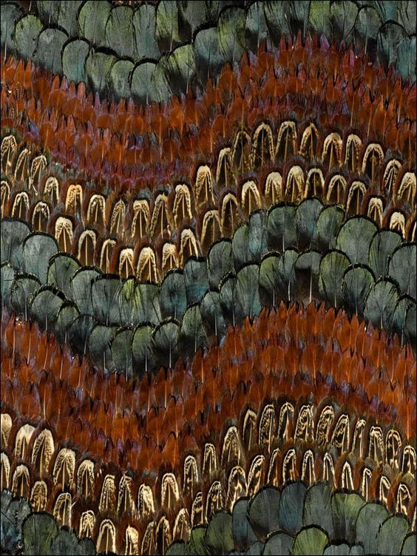

Slide 11
