Slide 1
Chapter 4: Variability

Slide 2
Variability
The goal for variability is to obtain a measure of how spread out the scores are in a distribution.
A measure of variability usually accompanies a measure of central tendency as basic descriptive statistics for a set of scores.

Slide 3
Central Tendency and Variability
Central tendency describes the central point of the distribution, and variability describes how the scores are scattered around that central point.
Together, central tendency and variability are the two primary values that are used to describe a distribution of scores.

Slide 4
Variability
Variability serves both as a descriptive measure and as an important component of most inferential statistics.
As a descriptive statistic, variability measures the degree to which the scores are spread out or clustered together in a distribution.
In the context of inferential statistics, variability provides a measure of how accurately any individual score or sample represents the entire population.

Slide 5
Variability (cont.)
When the population variability is small, all of the scores are clustered close together and any individual score or sample will necessarily provide a good representation of the entire set.
On the other hand, when variability is large and scores are widely spread, it is easy for one or two extreme scores to give a distorted picture of the general population.

Slide 6
Notes:
Figure 4.9
Graphs showing the results from two experiments. In Experiment A, the variability is small and it is easy to see the 5-point mean difference between the two treatments. In Experiment B, however, the 5-point mean difference between treatments is obscured by the large variability.

Slide 7
Measuring Variability
Variability can be measured with
the range
the interquartile range
the standard deviation/variance.
In each case, variability is determined by measuring distance.

Slide 8
The Range
The range is the total distance covered by the distribution, from the highest score to the lowest score (using the upper and lower real limits of the range).

Slide 9
The Interquartile Range
The interquartile range is the distance covered by the middle 50% of the distribution (the difference between Q1 and Q3).

Slide 10
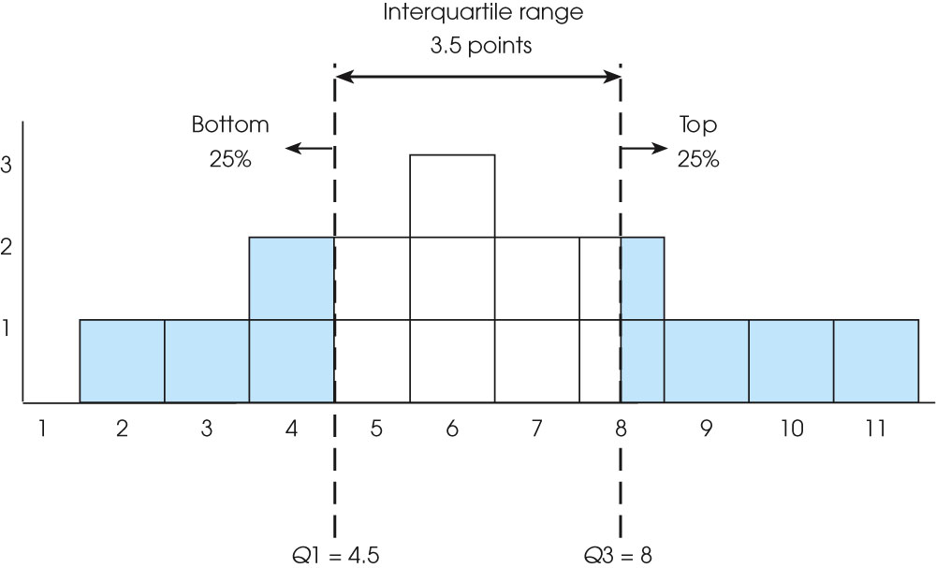
Notes:
Figure 4.2
Frequency distribution for a population of N = 16 scores. The first quartile is Q1 = 4.5. The third quartile is Q3 = 8.0. The interquartile range is 3.5 points. Note that the third quartile (Q3) divides the two boxes at X = 8 exactly in half, so that a total of 4 boxes are above Q3 and 12 boxes are below it.

Slide 11
The Standard Deviation
Standard deviation measures the standard distance between a score and the mean.
The calculation of standard deviation can be summarized as a four-step process:

Slide 12
The Standard Deviation (cont.)
1. Compute the deviation (distance from the mean) for each score.
2. Square each deviation.
3. Compute the mean of the squared deviations. For a population, this involves summing the squared deviations (sum of squares, SS) and then dividing by N. The resulting value is called the variance or mean square and measures the average squared distance from the mean.
For samples, variance is computed by dividing the sum of the squared deviations (SS) by n - 1, rather than N. The value, n - 1, is know as degrees of freedom (df) and is used so that the sample variance will provide an unbiased estimate of the population variance.
4. Finally, take the square root of the variance to obtain the standard deviation.

Slide 13
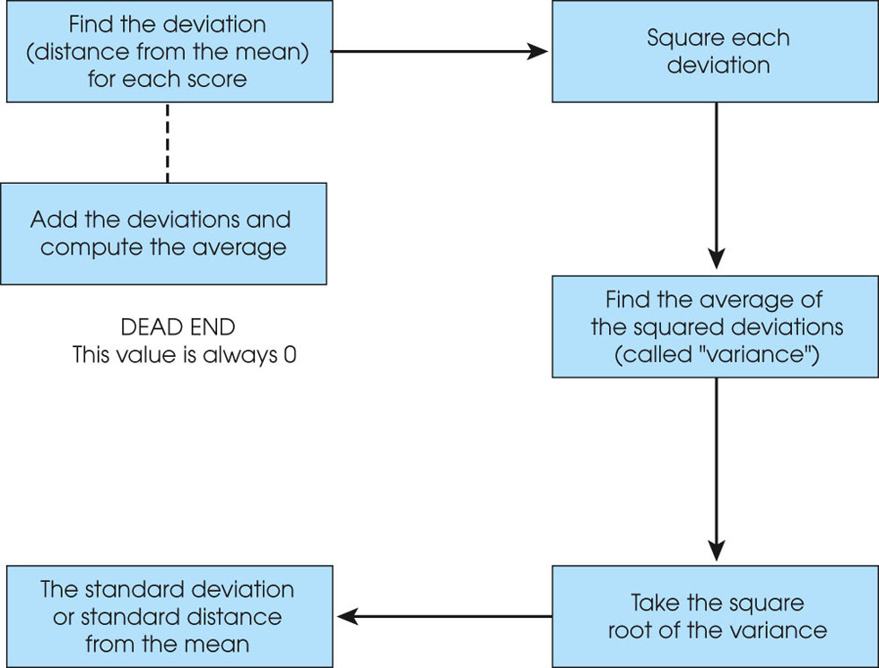
Notes:
Figure 4.3
The calculation of variance and standard deviation.

Slide 14
Properties of the Standard Deviation
If a constant is added to every score in a distribution, the standard deviation will not be changed.
If you visualize the scores in a frequency distribution histogram, then adding a constant will move each score so that the entire distribution is shifted to a new location.
The center of the distribution (the mean) changes, but the standard deviation remains the same.

Slide 15
Properties of the Standard Deviation (cont.)
If each score is multiplied by a constant, the standard deviation will be multiplied by the same constant.
Multiplying by a constant will multiply the distance between scores, and because the standard deviation is a measure of distance, it will also be multiplied.

Slide 16
The Mean and Standard Deviation as Descriptive Statistics
If you are given numerical values for the mean and the standard deviation, you should be able to construct a visual image (or a sketch) of the distribution of scores.
As a general rule, about 70% of the scores will be within one standard deviation of the mean, and about 95% of the scores will be within a distance of two standard deviations of the mean.

