Slide 1
History of Miniature Painting

Slide 2
Miniature painting is a traditional style of art that is very detailed, often referred to as painting or working “in miniature”. Because of their origins as illuminations, they are also painted to have as smooth of a surface as possible. (It is also suggested that miniature art may have been influenced by the medals of ancient Rome as well) Miniature art can be traced back to ancient Egyptian manuscripts on papyrus scrolls. Monks are also often highlighted for their contributions to early miniature painting with their beautifully illuminated manuscripts such as the Celtic Book of Kells and England's Lindisfarne Gospels (both of which measure around 9" x 12"). Some early manuscripts contain miniature paintings on their pages that depict beautiful arrangements of life sized flower arrangements on their borders. The history of miniature painting is also seen throughout the world in various other cultures.

Slide 3
Miniature painting began out of necessity for illustrating documents and manuscripts to aid those reading them during a time when many were not able to, before printing was invented. The miniature helped to convey the story and meaning of the written word. Therefore, the art of miniature painting is directly connected to the book arts. The various sized illuminations (pictures) were cut out of these books or documents so that they could be carried more easily. Later, developing from the carried miniature, portrait miniature artists were commissioned to paint small portraits – paintings that were used as we use wallet sized photographs today. These sizes of miniature paintings became popular with collectors and are often referred to as “hand held miniatures”. Portrait miniatures were painted in larger sizes as well, for example master miniaturist, Nicholas Hilliard, Peter Oliver, and Sir Charles William Ross all painted works that were of a larger size.

Slide 4
Persian miniature A Persian miniature is a small painting, whether a book illustration or a separate work of art intended to be kept in an album of such works. The techniques are broadly comparable to the Western and Byzantine traditions of miniatures in illuminated manuscripts. Although there is an equally well-established Persian tradition of wall-painting, the survival rate and state of preservation of miniatures is better, and miniatures are much the best-known form of Persian painting in the West. Miniature painting became a significant Persian form in the 13th century, and the highest point in the tradition was reached in the 15th and 16th centuries. The tradition continued, under some Western influence, after this, and has many modern exponents. The Persian miniature was the dominant influence on other Islamic miniature traditions, principally the Ottoman miniature in Turkey, and the Mughal miniature in the Indian sub-continent.

Slide 5
The origin of the Persian miniature is difficult to trace. The art form reached its peak mainly during the Mongol and Timurid periods (13th-16th century), and was heavily influenced by Chinese paintings as the Mongol rulers of Persia brought with them numerous Chinese artists to the court. In Ilkhanid and Timurid Mongol-Persian mythological miniatures, the mythical animals buraq and dragon was portrayed in a style reminiscent of the Chinese qilin and Chinese dragon, reflecting the Chinese background of painters who introduced watercolor techniques to Iran and initiated several medieval schools of Persian miniature painting. In fact, many religious paintings, including a famous one portraying the Prophet Muhammad's Miraj from the Dome of the Rock in Jerusalem into the heavens, displays stylistic elements of undoubtedly Chinese origins. Islamic angels are depicted as wearing the tight robes of northern Chinese style. Persian miniature paintings of the Ilkhanid and Timurid periods, especially ones related to the Shahnameh stories, usually borrow landscape painting techniques from contemporary Chinese schools, developed during the Song Dynasty and Yuan Dynasty.

Slide 6
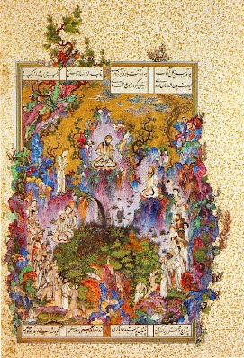
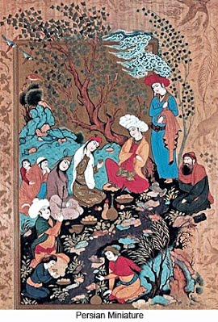

Slide 7
Indian Miniature
The history of Indian Miniature Paintings can be traced to the 6-7th century AD, the time, when Kashmiri Miniatures first marked their apperance. Indian Paintings can be broadly classified as the murals and miniatures. Murals are huge works executed on the walls of solid structures, as in the Ajanta Caves and the Kailashnath temple.

Slide 8
Themes of Miniature Art Paintings. After the Mughal reign, which lasted 200 years, by the second part of the 18th century, the Rajput Maharajahs became independent. They employed these highly skilled artists to replace their own artisans, leading to a sort of painting renaissance in northern India. The whole of Rajasthan divided into numerous princely states, patronized miniature art painting. These states had evolved a characteristic style of their own. The paintings of this era have their own unique style, being influenced by the surroundings- the deserts, lakes, hills and valleys, as the case may. Colorful glimpses of history are provided by these paintings depicting hunting and court scenes, festivals, processions, animal and bird life, and scenes from the Raagmala and Raaslila -- Lord Krishna´s life story. Also, courtly lavishness and prosperity have been displayed.

Slide 9
Mughal painting Mughal painting is a particular style of Indian painting, generally confined to illustrations on the book and done in miniatures, and which emerged, developed and took shape during the period of the Mughal Empire 16th -19th centuries). Mughal paintings were a unique blend of Indian, Persian and Islamic styles. Because the Mughal kings wanted visual records of their deeds as hunters and conquerors, their artists accompanied them on military expeditions or missions of state, or recorded their prowess as animal slayers, or depicted them in the great dynastic ceremonies of marriages...The painters focused mostly on court scenes, royal portraits, natural scenes and landscapes.

Slide 10
Rajput painting The Rajput School of Miniature Painting imbibed inspiration from the Krishna legends. The emphasis was more on the man and woman relationship and paintings were aesthetic portrayal of their emotion, love and passion. The lovemaking scenes of Lord Krishna and Goddess Radha are some of the finest specimens of the paintings. Rajput painting, a style of Indian painting, evolved and flourished, during the 18th century, in the royal courts of Rajputana, India. Each Rajput kingdom evolved a distinct style, but with certain common features.

Slide 11
Rajput paintings depict a number of themes, events of epics like the Ramayana and the Mahabharata, Krishna's life, beautiful landscapes, and humans. Miniatures were the preferred medium of Rajput painting, but several manuscripts also contain Rajput paintings, and paintings were even done on the walls of palaces, inner chambers of the forts, havelies, particularly, the havelis of Shekhawat. The colors extracted from certain minerals, plant sources, conch shells, and were even derived by processing precious stones, gold and silver were used. The preparation of desired colors was a lengthy process, sometimes taking weeks. Brushes used were very fine.

Slide 12
Jodhpur School: The Centre of this hand made paintings are love scenes then the other art figures. The Jodhpur School of Miniature paintings depict love scenes of lovers Dhola and Maru on camel back. There are hunting scenes with elephants and horses. The major colors used in this style of painting are gold and stone color.

Slide 13
Jaipur School: Gods and goddesses, kings and durbars are very attractively painted on hand made papers by the artists.
Kangra School: Real gold, stone, and water colors are squirrel-hair brushes are used. Glittering effect is extended using silver and golden colors.
Mewar School of Painting: These represent hunting scenes which are painted on cloth and handmade paper using stone colors.

