Slide 1
Topic : Cell adhesion

Slide 2
Introduction :
The attachment of a cell, either to another cell or to an underlying substrate such as the extracellular matrix via cell adhesion
This process can occur either through direct contact between cell surfaces or indirect interaction
Cells attach to surrounding extracellular matrix
A gel-like structure containing molecules released by cell into spaces between them
Cell adhesion occurs from the interactions between cell-adhesion molecules (CAMs) , transmembrane protein located on the cell surface

Slide 3
Cell adhesion links cell in different ways
It can be involved in signal transduction for cell to detect and respond to changes in the surroundings
Other cellular processes and lead to variety of diseases including cancer and arthritis
Cell adhesion is also essential for infectious organisms, such as bacteria or viruses, to cause disease

Slide 4
General Mechanism:
CAMs are classified into four major families : integrins , immunoglobulin(Ig) superfamily , cadherins and selectins
Each of these adhesion molecules have different functions and recognizes different ligands
Cadherins and immunoglobins are homophilic CAMs, as they bind to the same kind of CAMs to the other cell
While integrins and selectins are heterophilic CAMs that bind to different types of CAMs

Slide 5
In multicellular organisms, binding between CAMs allow cells to adhere to one another and creates structure called cell junction
According to their function , the cell junctions may be classified as:
Anchoring junctions ( adherens junction, desmosomes and hemidesmosomes), which maintain cells together and strengthens contact between cells
Occluding junctions (tight junctions) , which seal gaps between cells through cell- cell contact, making an impermeable barrier of diffusion
Channel – forming junctions ( gap junctions) , which links cytoplasm of adjacent cells allowing transport of molecules to occur between cells
Signal – relaying junctions, which can be synapses in the nervous system

Slide 6
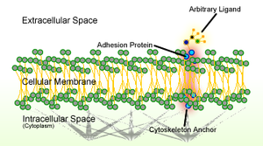
Cell junctions can be categorized into two main types according to what interacts with the cell :
cell-cell junctions, mainly mediated by cadherins
cell-matrix junction, mainly mediated by integrins
Fig 1 CELL ADHESION

Slide 7
Cell-cell Junctions:
In anchoring junctions between cells such as adherens junctions and desmosomes, the main CAMs present are the cadherins
This family of CAMs are membrane proteins that mediate cell-cell adhesion through its extracellular domains and require extracellular Ca²⁺ ions to function correctly
Cadherens form homophilic attachment between themselves , which results in the cells of a similar type sticking together
Which lead to selective adhesion

Slide 8
Cadherins are essential for cell-cell adhesion and cell signaling in multicellular animals
Aherens junction :
Cell junction at which anchoring proteins (cadherins or integrins ) extend through the plasma membrane and are attached to actin filaments.
They can appear as bands encircling the cell
Or as spots of attachment to the extracellular matrix (adhesion plaques)

Slide 9
They mainly maintain the shape of tissues and hold the cell together
Cadherins between the neighboring cells interacts through the extracellular domains
Which share a conserved calcium sensitive region in their extracellular domains
Hence this region encounters the calcium ions
This association with actin filament is essential for adherens junction of stabilize cell-cell adhesion

Slide 10
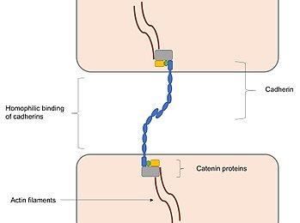
Fig 2 -Adheren_junction_showing_homophilic_binding_between_cadherins

Slide 11
Interactions with actin filaments can also promote clustering cadherins, which are involved in the assembly of adherens junction
b) Desmosomes:
Strong cell junction involved in cell-cell adhesion
They are localized sot like adhesion randomly arranged on the lateral side of plasma membrane
They are one of the stronger cell-cell adhesions types and are found in tissue that experience intense mechanical stress, such as cardiac muscle tissue , bladder tissue, gastrointestinal mucosa and epithelia

Slide 12
They are usually structurally similar to adherens junctions but composed if different components
They are linked to intermediate filaments instead of actin filaments
Desmosomes provide strength and resistance to mechanical stress by unloading forces onto the flexible intermediate filament
Something that cannot occur with the rigid actin filaments

Slide 13
c) Tight junction:
Tight junctions are (also known as occluding junctions) are multiprotein junctional complexes
Their general function is to prevent leakage of transported solutes and water seals the paracellular pathway
Tight junctions may also serve as leaky pathways by forming selective channels from small cations , anions or water
Tight junctions are present mostly in vertebrates

Slide 14
Functions :
They hold cells together.
They can be further subdivided into protective barriers and functional barriers serving purpose such as material transport and maintenance of osmotic balance
Tight junctions prevent the passage of molecules and ions through the space between plasma membrane of adjacent cells
So materials must actually enter the cells ( by diffusion or active transport) in order to pass through the tissue

Slide 15
d) Gap junctions:
Cell-cell junction composed of two different families of channel-forming proteins.
It is a specialized intercellular connection between a multitude of animal cell types
They directly connect the cytoplasm of two cells , which allows various molecules , ions and electrical impulses to directly pass through the regulated gate between cells
Gap junctions are composed of channels called connexons
They consist of transmembrane proteins called connexins clustered in groups of six

Slide 16
Gap junctions occur in virtually all tissues of the body ,with the exception of fully developed skeletal muscle and mobile cell types such as sperms or erythrocytes
Gap junctions are however not found in simpler organisms such as sponges and slime molds
Functions :
Connexons are from adjacent cells form continuous channels when they come in contact and align with each other

Slide 17
These ions allow transport of ions and small molecules between cytoplasm of two adjacent cells
Apart from holding cells together and provide structural stability like anchoring junctions
Gap junctions channels are selectively permeable to specific ions depending on which connexins form the connexons
Which allows gap junctions to be involved in cell signaling cascades

Slide 18
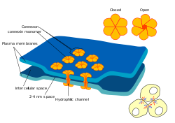
Fig 3 Gap_cell_junction

Slide 19
e) Adhesion mediated by selectins:
All selectins are single chain transmembrane glycoproteins that share similar properties to C-type lectins due to a related amino terminus and calcium dependent binding
They bind to sugar moieties and so are considered to be a type of lectin, cell adhesion proteins that binds to sugar polymers
They mainly mediate the movement of white blood cells in blood stream by allowing the white blood cells to roll on endothelial cells through reversible binding of selectins

Slide 20
They undergoes heterophilic bindings , as its extracellular domain binds to carbohydrates on adjacent cells instead of other selectins
It also require cells instead of other selectins
It also require Ca2+ ions to function same as cadherins
Cell-cell adhesion of leukocytes to endothelial cells is important for immune responses as leukocytes can travel to sites off infection or injury through this mechanism
At these sites, integrins on the rolling white blood cells are activated and bind firmly to the local endothelial cells
Allowing the leucocytes to stop migrating and move across the endothelial barrier

Slide 21
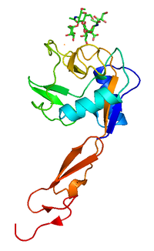
Fig 4 Pselectin

Slide 22
f) Adhesion mediated by members of immunoglobin superfamily :
Molecules are categorized as members of this superfamily based on shared structural features with immunoglobins ( also known as antibodies)
They all possess a domain known as an immunoglobulin domain members of IgSF include cell surface antigen receptors, co-receptors and co-stimulatory molecules of the immune system
Molecules involved in antigen presentation to lymphocytes , cell-adhesion molecules

Slide 23
Some IgSF CAMs, such as neural cell adhesion molecules (NCAMs) can perform homophilic binding
While intercellular cell adhesion molecules (ICAMs) or vascular cell adhesion molecules (VCAMs) undergo heterophilic binding with molecules like carbohydrates or integrins
They interact with integrins on the leukocytes to assist leukocyte attachment and its movement across the endothelial barrier

Slide 24
g) Cell-matrix junction :
Cell junctions (or intercellular bridges) are a class of cellular structures consisting of multiprotein complexes
Provide contact or adhesion between neighboring cells or between a cell and the extracellular matrix in animals
They also maintain the paracellular barrier of epithelia and control paracellular transport
Cell junctions are especially abundant in epithelial tissues
Combined with cell adhesion molecules and extracellular matrix cell junctions help hold animal cells together

Slide 25
Cell junctions are also especially important in enabling communication between neighboring cells via specialized protein complexes called communicating (gap) junctions
Cell junctions are also important in reducing stress placed upon cells
In plants, similar communication channels are known as plasmodesmata
In fungi they are called septal pores

Slide 26
h) Hemidesmosomes:
Hemidesmosomes are very small stud-like structures found in keratinocytes of the epidermis of skin
They are similar in form to desmosomes when visualized by electron microscopy
Hemidesmosomes are also comparable to focal adhesions, as they both attach cells to the extracellular matrix
Hemidesmosomes are found in epithelial cells connecting the basal epithelial cells to the lamina lucida which is part of the basal lamina
Hemidesmosomes are also involved in signaling pathways

Slide 27
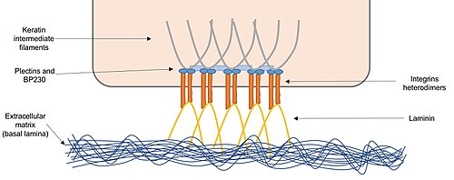
Fig 6 -Hemidesmosomes_showing_interaction_between_integrins_and_laminin

Slide 28
i) Focal adhesions:
Focal adhesions (also cell–matrix adhesions or FAs) are large macromolecular assemblies through which mechanical force and regulatory signals are transmitted between the extracellular matrix (ECM) and an interacting cell
In sessile cells, focal adhesions are quite stable under normal conditions, while in moving cells their stability is reduced
This is because in motile cells, focal adhesions are being constantly assembled and disassembled as the cell establishes new contacts

Slide 29
In focal adhesions, integrins attach fibronectins a component in the extracellular matrix, to actin filaments inside cells
Adapter proteins , form a complex at the intracellular zone of integrins and bind to actin filaments
This multi-protein complex linking integrins to actin filaments is important for assembly of signaling complexes
That act as signals for cell growth and cell motility

Slide 30
Other organisms:
Eukaryotes:
Plants cells adhere closely to each other and are connected through plasmodesma
Molecules that are either nutrients or signals required for growth are transported, either passively or selectively, between plant cells through plasmodesmata
Protozoans express multiple adhesion molecules with different specificities that bind to carbohydrates located on surfaces of their host cells
Cell–cell adhesion is key for pathogenic protozoans to attach and enter their host cells
Pathogenic fungi use adhesion molecules present on its cell wall to attach, either through protein-protein or protein-carbohydrate interactions, to host cells

Slide 31
Prokaryotes:
Prokaryotes have adhesion molecules on their cell surface termed bacterial adhesins, apart from using its pili (fimbriae) and flagella for cell adhesion
Adhesins can recognize a variety of ligands present on the host cell surfaces and components in the extracellular matrix
These molecules also control host specificity

Slide 32
Viruses:
Viruses also have adhesion molecules required for viral binding to host cells
For example:
influenza virus has a hemagglutinin on its surface that is required for recognition of the sugar sialic acid on host cell surface molecules
HIV has an adhesion molecule termed gp120 that binds to its ligand CD4, which is expressed on lymphocytes
Viruses can also target components of cell junctions to enter host cells
Which is what happens when the hepatitis C virus targets occluding and claudins in tight junctions to enter liver cells

