Slide 1
South Asian Association For Regional Cooperation

Slide 2
Introduction
The South | Asian | Association for | Regional
Cooperation | (SAARC) | is an organization | of South
Asian nations, founded in December 1985 and dedicated to economic, technological, social, and cultural development emphasizing collective self- reliance.
The 11 stated areas of cooperation are agriculture; education, culture, and sports; health, population, and
technology; communications
child | welfare; the | environment and | meteorology;
rural | development; | tourism; transport; | science and

Slide 3
The idea of regional political and economical cooperation in South Asia was first coined in 1980 and the first summit held in Dhaka on 8 December in 1985 led to its official establishment by the governments of Bangladesh, Bhutan, India, Maldives, Nepal, Pakistan, and Sri Lanka.
Afghanistan joined SAARC as an eighth member state in April 2007, increasing members of SAARC from seven to eight.
Its secretariat is headquartered in Kathmandu, Nepal.

Slide 4
SAARC comprises 3% of the world's area, 22.5% of the world's population and 4% (US $3.35 trillion GDP) of the global economy, as of 2020. It has total population of 1.75 billion.

Slide 5
SAARC Secretariat
The SAARC Secretariat is based in Kathmandu, Nepal. It coordinates and monitors implementation of activities, prepares for and services meetings, and serves as a channel of communication between the Association and its Member States as well as other regional organisation.
The Secretariat is headed by the Secretary General. Amjad Hussain B. Sial is the current Secretary General since March 2017. The Secretary General is assisted by eight Directors from the Member SAARC Secretariat and Member States observe 8th of December as the SAARC Charter Day.

Slide 6
OBJECTIVES OF SAARC
Promoting the welfare of the people of South Asia and to improve their quality of life.
Accelerating economic growth, social progress and cultural development in the region and to provide all individuals the opportunity to live in dignity and to realize their full potential.
Promote and strengthen collective self-reliance among the countries of South Asia.
Contribute to mutual trust, understanding and appreciation of one another's problems.

Slide 7
Promoting active collaboration and mutual assistance in the economic, social, cultural, technical and scientific fields.
Strengthening cooperation with other developing countries.
Strengthening cooperation among themselves in international forums on matters of common interest
Cooperation with international and regional organizations with similar aim and purpose.

Slide 8
Principles of SAARC
The principles are as follows:
Respect for sovereignty, territorial integrity, political equality and independence of all members states.
Non-interference in the internal matters is one of its objectives.
Cooperation for mutual benefit.
All decisions to be taken unanimously and need a quorum of all eight members.
All bilateral issues to be kept aside and only multilateral issues to be discussed without being prejudiced by bilateral issues.

Slide 9
Future members
China has | shown interest in | joining SAARC. Pakistan | &
Bangladesh | support china’s | candidature. While India | is
opposing.
Indonesia supported by Sri Lanka intends to become a
observer of SAARC.
Myanmar has expressed it’s desire to become a full time member of SAARC. Myanmar’s military regime officially applied for full SAARC membership in May 2008. However, the application is still being considered and the government is currently restricted to observer status.
Russia and Turkey intends to become observer.
Iran because of it’s strong cultural, economic and political relationships with Afghanistan and Pakistan and has expressed its desire to become a member of the South Asian

Slide 10
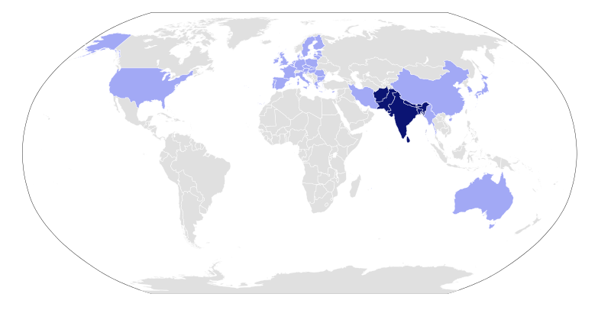

Slide 11
SAARC Preferential Trading Arrangement (SAPTA)
The Agreement on SAARC Preferential Trading Arrangement (SAPTA) was signed on 11 April 1993 to promote and sustain mutual trade and economic cooperation within the SAARC region through the exchange of concessions. The basic principles underlying SAPTA are:
Overall reciprocity of advantages.
Trade reform.
Preferential measures in favour of Least Developed Contracting States.
Inclusion of all products, manufactures and commodities in
their raw, semi-processed and processed forms.

Slide 12
South Asian Free Trade Area (SAFTA)
The Agreement on the South Asian Free Trade Area was reached at the 12th SAARC summit at Islamabad, Pakistan. It creates a framework for the creation of a free trade area covering 8 nation’s people in the region. Zero customs duty on the trade of practically all products in the region by the end of 2016.
India, Pakistan and Sri Lanka decreased their duties down to 20% in the first phase of the two-year period ended 2007, and it was planned to bring the custom duties to zero by 2016. (3 extra years for less developed countries in both the cases)

Slide 13
Why SAARC has failed to achieve most of its objectives(criticism)
Policy of non-interference Article II clearly states, “Cooperation within the framework of the Association shall be based on non-interference in the internal affairs of other States and mutual benefit.” It strictly limits the member nation’s ability to push an agenda if there is any opposition. The biggest example of the stagnation was Kargil War (1999) and Pulwana attack (2019) and its consequences.

Slide 14
Cont.…..
SAARC could have taken a decisive step to resolve the dispute. But it did not. It is one of the numerous incidents of security violations across the region. Political deadlock Despite several promises to resolve the political differences among the member states, those especially between India and Pakistan continue and have stalled progress on many projects including the South Asia Free Trade Agreement (SAFTA). If operative, it would allow the free movement of people, goods, services and ideas.

Slide 15
Geopolitical equation matters
Most of the decisions taken in SAARC depend more on geopolitical equations rather than cooperation on certain issues.
Example- India, tries to keep China away from the organization by saying that the mere observer status of China limits the scope of SAARC opportunities
India’s push for the full membership of Myanmar and Iran who have observer status at present. One can easily assume that the push is because of the rising oil demand in India.

Slide 16
Summit of SAARC
The 20th SAARC summit is the 20th meeting of the heads of state of the eight SAARC countries which takes place in Colombo in 2019. The 2020 SAARC Summit (21st) will take place in Islamabad.
Pakistan is aggressively seeking support from smaller South Asian nations to host the SAARC summit in Islamabad. Sri Lanka and Nepal have already shown support. But analysts doubt India will agree as it holds Pakistan responsible for numerous terrorist activities.

Slide 17
Conclusion
The SAARC’s balance sheet of success is very limited to adoption of several conventions like SAARC regional conventions on suppressions of terrorism, SAARC convention on narcotic drugs and smuggling across boarders.
There have also been breakthroughs in the form of agreements forming SAFTA and SAPTA , but their success at operational level is still expected.
SAARC totally exclude political issues from its summits, this is also one of its inherent weakness.

Slide 18
References
www.Saarc-sec.org
http://www.saglobalaffairs.com/back- issues/347-challenges-for-saarc.html
www.pakistantimes.net/pt/detail.php?newsId= 8311

Slide 19
