Slide 1
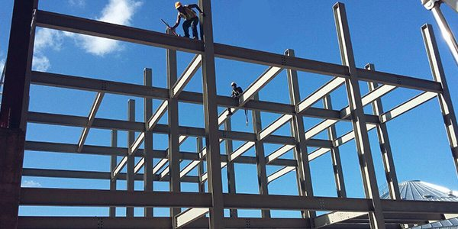
COLLEGE OF ENGINEERING AND TECHNOLOGY UNIVERSITY OF SARGODHA Theory Of Structures (CT-226) (B.S TECHNOLOGY)
29-April-2020
ONLINE LECTURE-7
Cables and Arches
Engr. Aqeel Ahmed
Lecturer, CET, UOS, Sargodha

Slide 3
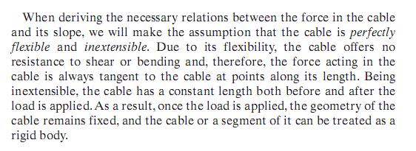

Slide 9
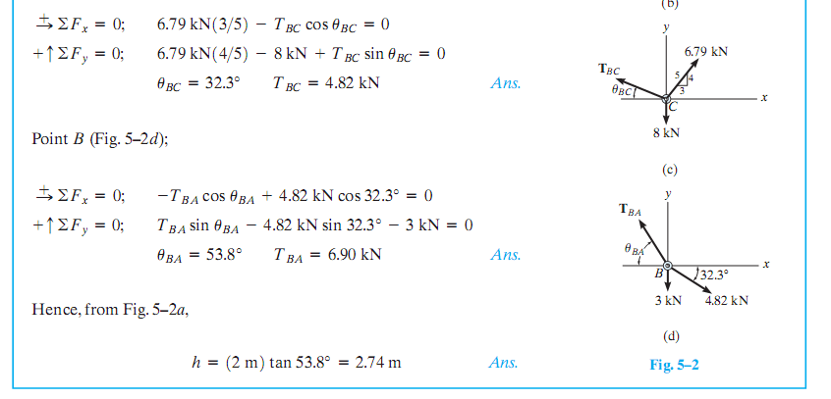

Slide 11
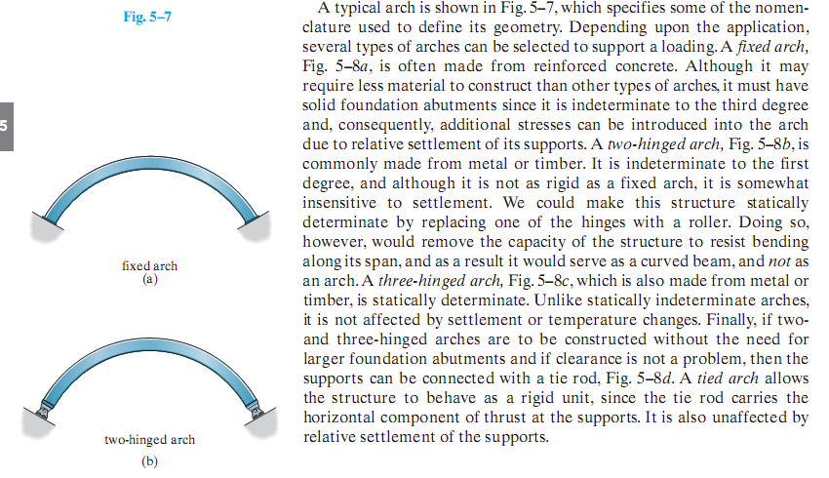

Slide 14
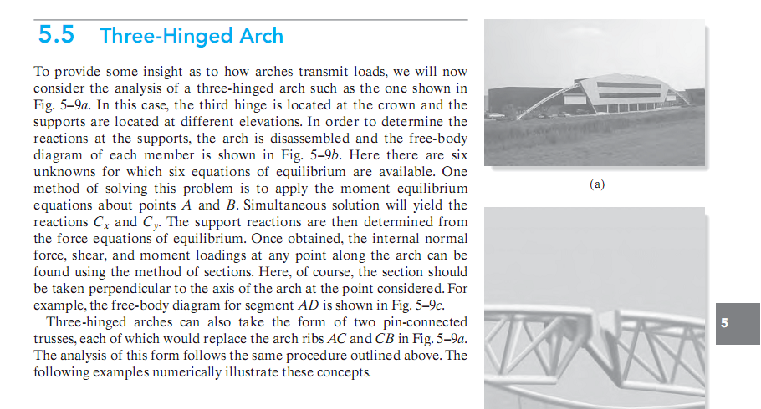

Slide 15
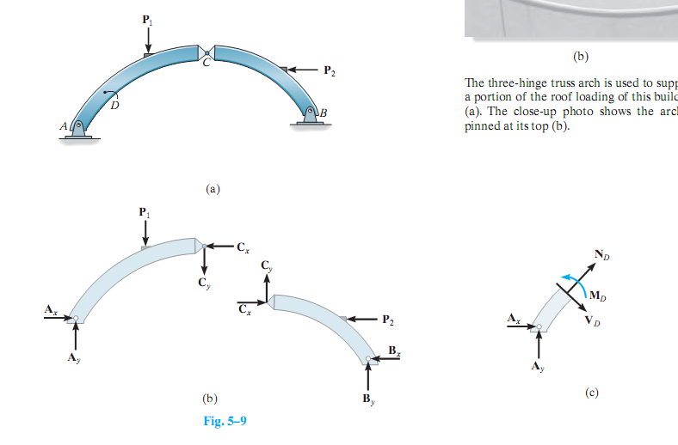

Slide 17
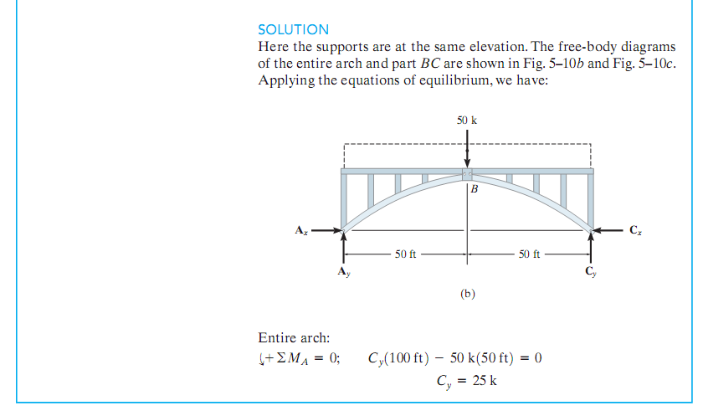

Slide 18
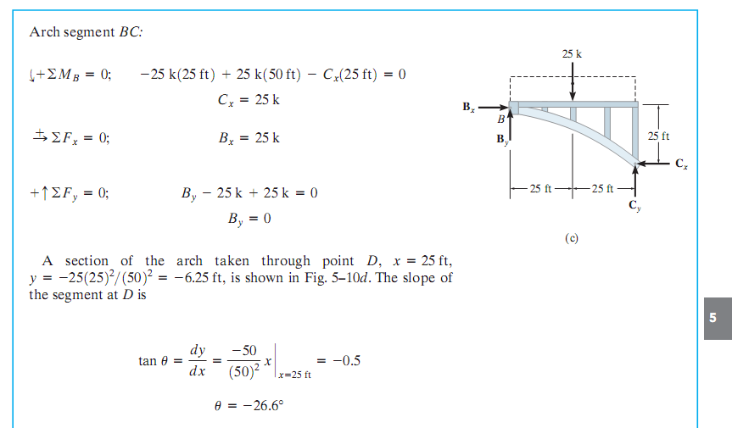

Slide 19
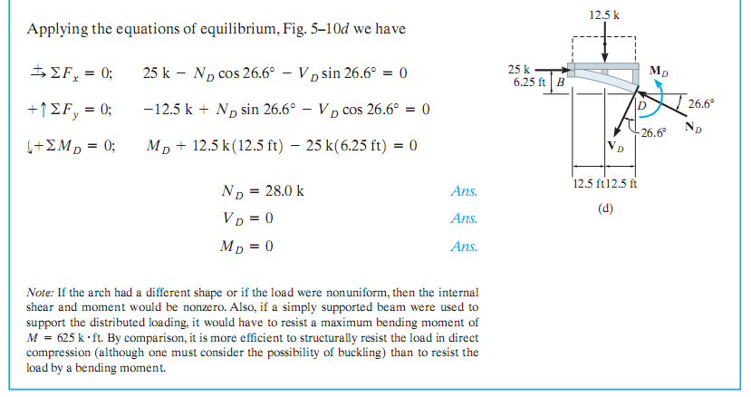

Slide 20
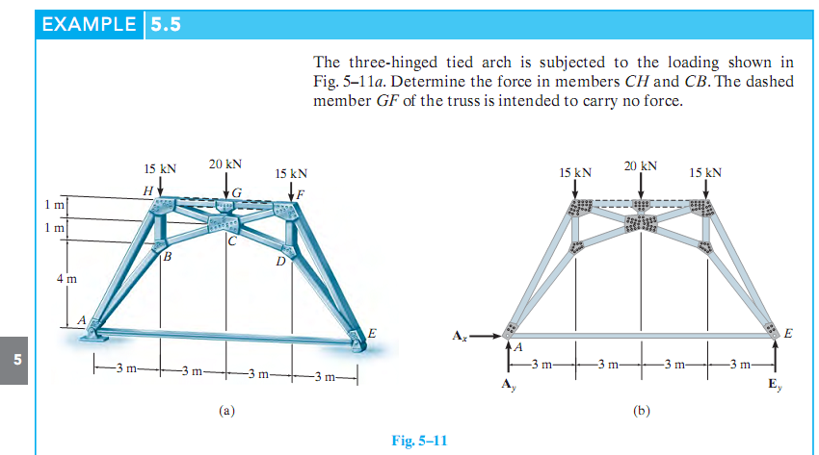

Slide 21
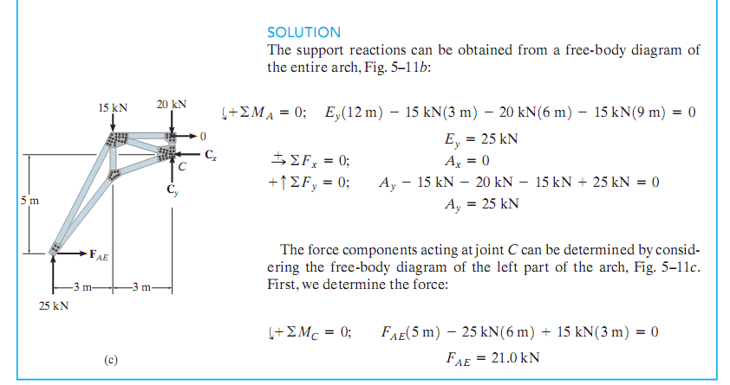

Slide 22
