Slide 1
Modern Teaching Aids BS Education-V Teaching Mathematics (EDU-511)
Department of Education University of Sargodha

Slide 2
Some important modern teaching aids for mathematics including computer
Faiza Arif (Roll no BEUF18M014)
Teaching of Mathematics(EDU-511)
BS Education (semester 5th)
Department of Education
University of Sargodha, 40100 Sargodha Pakistan
October 2020

Slide 3
Teaching aids
A teaching aid is anything used by a teacher to help teach a lesson or make it more interesting to students. Teaching aids can come in almost any form. Some of the most common are pictures, videos, charts, flashcards, and objects, like three-dimensional models or educational toys.

Slide 4
Importance of teaching aids
Teaching aid is important because they create a visual and interactive experience for the students.
As the students become more engaged , they are more likely to understand the topic being taught.
Teaching aids assist student in learning.

Slide 5
Teaching aids in mathematics
Clock dials, stop watches and sand timers
Telling time is taken for granted especially as technology brings the ease of digital clocks. However, telling time with analogue clocks, as well as counting and subtracting timings can be a much-needed skill for a variety of other mathematical problems such as problem solving. It is also an essential life skill.

Slide 6
2D and 3D shapes – tangrams, pattern blocks and attribute blocks
Linked to geometry, shape blocks are another math aid which are especially useful, particularly for younger children identifying shapes. These types of aids also allow students to use the shapes to problem solve area puzzles, create and breakdown patterns, learn about symmetry and classification.

Slide 7
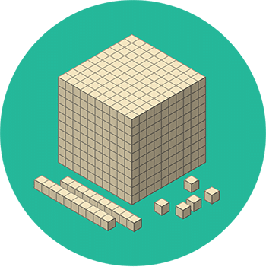
MAB – place value cards and physical items such as matchsticks, buttons, ping pong balls, corks
The iconic MAB wooden prisms, columns and blocks have been used to support children’s developing ability to work with numbers that are hypothetical i.e. numbers in a maths problem. Each piece represents a number value that they are working with (hundreds, tens or ones) and for processes such as subtraction they are an excellent way to practice borrowing and paying back. Children who struggle with the concept of visualising numbers and problems in their mind can continue to use the physical items to assist with their counting early into high school.

Slide 8
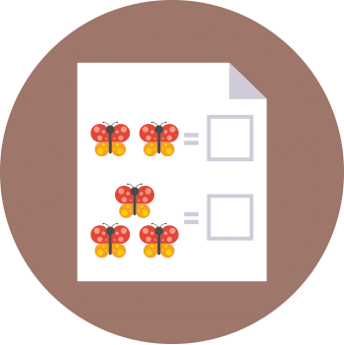
Online and Worksheet resources for primary aged students
Whether you are a teacher, parent or tutor sometimes having some ready-made worksheets can be a great jumping off point to begin lessons. There is no point in reinventing the wheel and the convenience of printable sheets is a tried and tested aid both at home and in the classroom.

Slide 9
Uses of computer in mathematics
There are two broad categories of the applications of computers in the field of mathematics education:
computer assisted instruction (CAI).
general purpose educational tools such as spreadsheets, databases and computer algebra systems (CAS).

