Slide 1
Haemolytic anaemia
Spleen malfunctioning- Normal cells destruction-------Hyperspleenism
Causes for Hyperspleenism
Spleen –RBC interaction
Moderate Haemolytic components
Frequent causes- Hypertension and Rheumatoid arthiritis
Infections like Malaria and Kala Azar(Leishmenia donovani)
In Reticuloendothelial phagocytosis, spleen record both old and new cells similar to other types of phagocytosis (neutrophilic one)
Reticuloendothelial cells break down RBCs,
Break their membrane
Breakdown of Hb and release of Iron and subsequent phagocyotosis

Slide 2
Intravascular Haemolysis
Breakdown of RBCs within blood vessels
Factors– External or internal, biochemical or physical
Autoimmune intravascular haemolysis- --Own Immune system attack RBCs
Mechanism not clear- Failure of immune system, possible mechanism
-Drastic change in membrane of RBC, hence failure of immune system
-Defect in immune system, ---- manufacturing antibodies agains RBCs
-Presence of antigenic structure on RBCs
Specific factors – Unknown for intravascular haemolysis
May be diagnose by Coomb’s test (Two types : Direct and Indirect)
In direct Coomb’s antisera used - RBC is checked for presence of antigen on their surface
In indirect RBCs presence of free floating antibody is determine

Slide 3
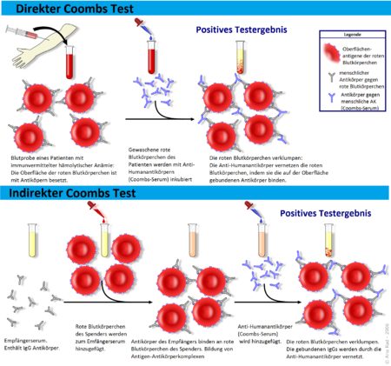
Intravascular Haemolysis
Direct Coombs test : patient erythrocytes carry antibodies on their cell membrane and incubated with the Coombs serum. Consequence the red blood cells clump together.
Indirect coombs test : Patient contains floating antibodies – Added with donor erythrocytes (blood to be transfused). The free serum antibodies bind to the donor erythrocytes and after the addition of the Coombserum agglutination occurs
Notes:
%

Slide 4
Intravascular Haemolysis
This type of haemolytic anaemia is controlable
By destroying induced antibodies
The main causes of intravascular haemolysis could be
Introduction of some hypotonic agent in the body
By complex toxins produced by bacteria , e.g. Clostridium tetani
Rh incompatibility between mother and foetus

