Slide 1
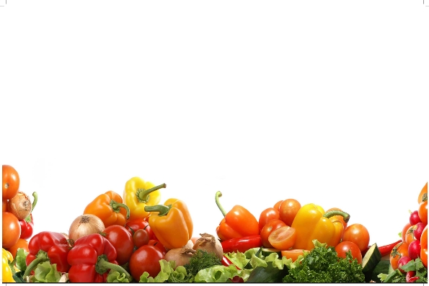
Fruit & Vegetable Processing Technology-FST 303
Dr. SARFRAZ HUSSAIN
Professor
Institute of Food Science & Nutrition

Slide 2
Canning Technology
Definition
It is a safe method of food preservation in which the fruits & vegetables are packed in air tight (hermatically sealed) metal containers and heated to kill microorganisms in side the container at a high temperature of 121 ⁰ C and 15 PSI/240 0 F for certain period of time.

Slide 3
History of Canning
Nicholas Appert (1752–1841) french confectioner is credited with the thermal process of canning, which was discovered (1809) as a result of a need to feed Napoleon’s troops.
Nicholas Appert, in 1809, was awarded a prize of 1500 Franks by the French government for developing a new method for heat preservation of food.
The method has since been recognized as Appertization (named after Appert), sterilization, or more commonly, canning.
One year later Peter Durand received a patent for the tin-plated can.

Slide 4
Understanding canning
Decades later, Louis Pasteur understood the principle of microbial destruction and was able to provide the explanation for canning as a means of preservation.
Samuel Prescott and William Underwood in the United States established further scientific applications for canning, including time and temperature interactions, in the late 19th century.
Nicholas Appert (1752–1841) utilized his method to preserve more than 50 kinds of foods, some of which included fruits, vegetables, and meats.
In the early stages of the method, food was filled into wide-mouthed glass bottles or jars and carefully corked, after which they were cooked in boiling water.
The process time varied according to the product type.

Slide 5
Pasteurization
Although the method was successful in producing shelf-stable foods which did not undergo spoilage,
The scientific basis for the preservation was not really known until almost half a century later,
when another Frenchman, Louis Pasteur, discovered that food spoilage was caused by microorganisms which are destroyed at elevated temperatures.
The technique which bears his name, pasteurization,
As we know today, refers to a relatively mild heat treatment intended to destroy pathogenic microorganisms in foods,
Pasteurization providing short-term extension of shelf life under refrigerated conditions.

Slide 6
Packaging of Canned Foods
Hermetically sealed container means a container that is designed and intended to be secure against the entry of microorganisms,
Maintain the commercial sterility of its contents after processing.
The container is an essential factor in the preservation of foods by canning.
After canned foods are sterilized, it is the container that protects the canned food from spoilage by recontamination with icroorganisms.

Slide 7
Packaging of canned foods
It is then most important for the success of the canning operation to use good-quality, reliable containers and properly adjusted closing machines.
Thus, the seams and closures produced will be within the guidelines necessary to prevent access to microorganisms into the container during the cooling operation and during the shelf life of the product.

Slide 8
Tin-Plate Can Choices
tin-plate body and two ends,
tin-plate body and one end with aluminum convenience end,
three-piece aluminum can (rare, but available and used, with adhesive side seam, for alcoholic cocktails),
tin-free steel with tin end, tin-free steel end, aluminum end, or a combination,

Slide 9
Tin-Plate Can Choices
tin-free steel body,
Adhesive joined side seam,
Welded side seam,
Draw and iron two-piece aluminum can,
Conventional top chime,
neck-in top flange so that chime is flush with body,
draw and iron two-piece steel cans not commercially available except in small sizes for aerosol cans.

Slide 10
TWO PIECE CANS
The amount of metal used would be reduced below that used for a three-piece. Two-piece steel cans offer the advantages of a two-piece aluminum can at a lower price.

Slide 11
THREE PIECE CANS
Three-piece “sanitary cans” consisting of a can body and two end pieces,
Used to seal heat-sterilized foods hermetically and also for other food products such as powders, syrups,
Presently, the three-piece cans are being widely used,
Other cans such as two-piece cans, aluminum cans, and other flexible containers are slowly replacing them.

Slide 12
Aluminum Cans
The main application of aluminum cans is where inherent advantage can be realized over the tin plate such as lower shipping expense,
freedom from food and can black-sulfide discoloration or rust,
easier puncture opening, and where special easy opening features are desirable.
Steel cans are so well established in the canning industry that exceptionally good reasons are required before a change of material is considered.
The future use of aluminum for cans, for processed food use, to a great extent depends on the price at which it may be sold to the users, relative to that of an equivalent steel can,

Slide 13
Aluminum cans con.....
Aluminum cans offer advantages of product quality and economy for the canning of certain food products.
The use of easy-open lids is also a significant point, which has a strong appeal.
Aluminum cans do not rust and their appearance, always bright, can be an important sales argument.
An important advantage of aluminum cans is that they are lead free.
Nevertheless, aluminum cans dent easily, abrade, and are not interchangeable with steel cans.

Slide 14
Can body

Slide 15
Mode of heat transfer

Slide 16
Components of can seam

Slide 17
Prior – first roller – second roller operations

Slide 18
1st & 2nd operation of seaming

Slide 19
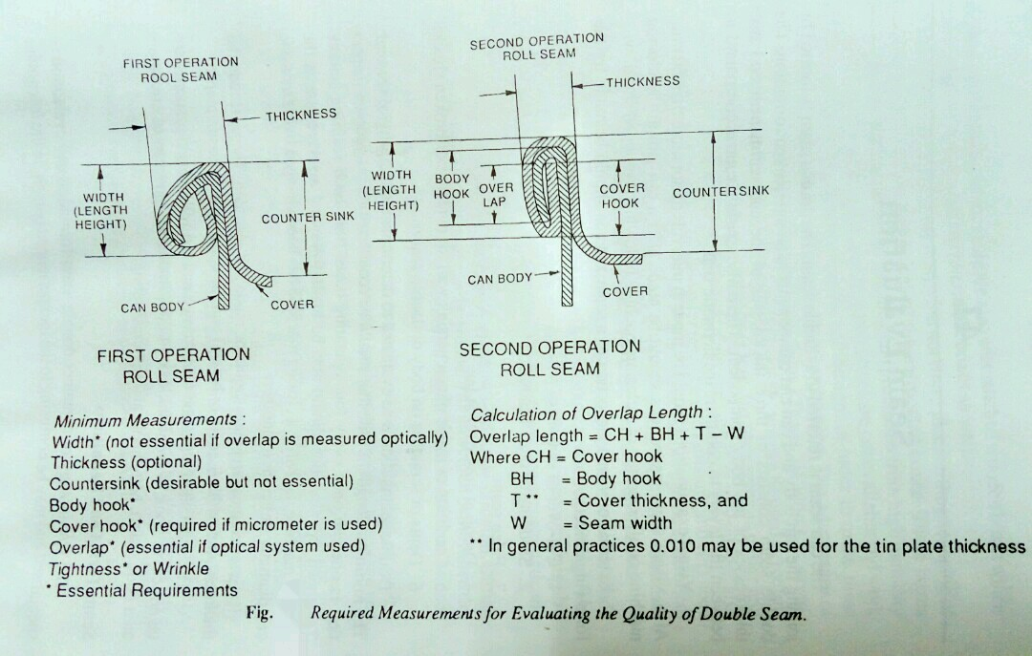

Slide 20
Five layers of double seaming

Slide 21
Measurements of seam
Seam length 0.117 – 0.125 Inch
Cover Hook 0.075 – 0.088 Inch
Body hook 0.075 – 0.085 Inch
Counter Sink 0.028 Inch

Slide 22
Flow sheet of canning
Recieving – washing – grading – peeling – cutting – blanching – cooling – filling in cans – syruping /brining – exhausting – sealing – processing – cooling – incubation – wiping/labelling – secondry packing – marketting

