Slide 1
HORT 308
MEDICINAL AND AROMATIC PLANTS

Slide 2
Garlic

Slide 3
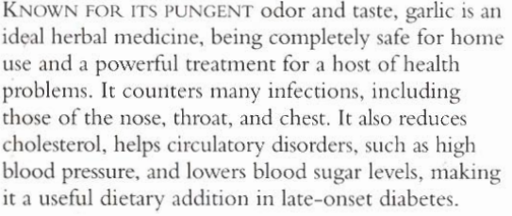
B.N Allium sativum Family Liliaceae

Slide 4
Habitat and cultivation
Originally from Central Asia, garlic is now grown worldwide
It’s grown by dividing the bulb and is harvested late, the following summer

Slide 5
Key constituents
V.Oil
Scordinins
Selenium
Vitamin A B C and E

Slide 6
Key Actions
Antibiotic
Expectorant
Increase sweating
Lowers B P
Reduce blood clotting
Anti diabetic
Expel worms

Slide 7
Research
In Germany and Japan and USA since 1980 it is proved that when fresh clove is crushed alline is broken into allicine by alinase which is highly anticeptic.Trails also proved that it reduces blood lipids and B P.

Slide 8
Traditional and current uses
As antibiotic agent against T B, Typhoide, infections
Chest infections
Digestive tract infections
Circulatory remedy(Blood thinner)
Against high B P and cholesterol
Against Diabetic

Slide 9
Parts Used
Bulbs
Cloves
Dried and fresh

Slide 10
Key preparations
Garlic syrup (1 tsp 4 hourly
Chopped cloves
Pearls(Oil)
Capsules
Tablets

Slide 11
Aloe Vera

Slide 12
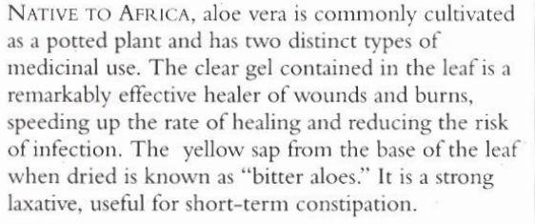
Syn. A. barbadensis Family: Lilaceae

Slide 13
Habitat and cultivation
Native to Eastern and Southern Africa,
Grows wild in tropics
Cultivated Worldwide

Slide 14
Key Constituents
Anthraquinones
Resins
Tannis
Polysaccharides
Aloectin B

Slide 15
Key Actions
Heal Wounds
Emollient
Stimulates secretions of bile
Laxative

Slide 16
Research
Proved healing wounds, ulcers and burns since 1930. Due to presence of aloectin B, which stimulates immune system

Slide 17
Traditional and Current Uses
Beauty Treatment (Cleopatra)
Heal Burns
First Air for burns
Skin conditions
Ulcers
Laxatives

Slide 18
Parts Used
Leaves

Slide 19
Key Preparations
Juice (Peptic ulcers)
Gel: For burns, ecezema
Tincture: From bitter aloes to stimulate appetite

