Slide 2
•
•
•
•
•
•

Slide 3
But in Modern Word Technology adds value

Slide 4
–
–
–
•

Slide 5
•
•
•
•
•

Slide 6
•
•
•
•

Slide 7
•
•
•
•
•
•
•

Slide 9
•
•
•

Slide 10
•
•
•

Slide 11
•
•
•

Slide 12
•
•
•
•
•

Slide 13
•
–
–
–
–
–
–
–
–

Slide 14
•
•

Slide 15
•
•
•

Slide 16
•
–
–
–
–
–
Notes:
At National Level --- main obejective of is to assure that the nation and its business firms gain sustainable technological compeitiveness in the international markets and maintain strong position in the international business on long-term basis.

Slide 17
•
–
–
–
–
–
Notes:
At Enterprise Level ---- main obejective is to assure that the firm gains & maintains a srong position in its core technologies which are relevant to its product-market relationship and that these technologies support the firm’s competitive strategies.

Slide 18
•
•
–
–
–

Slide 19
Innovation Types
Product Innovation
Process Innovation
Marketing Innovation
Organizational Innovation

Slide 20
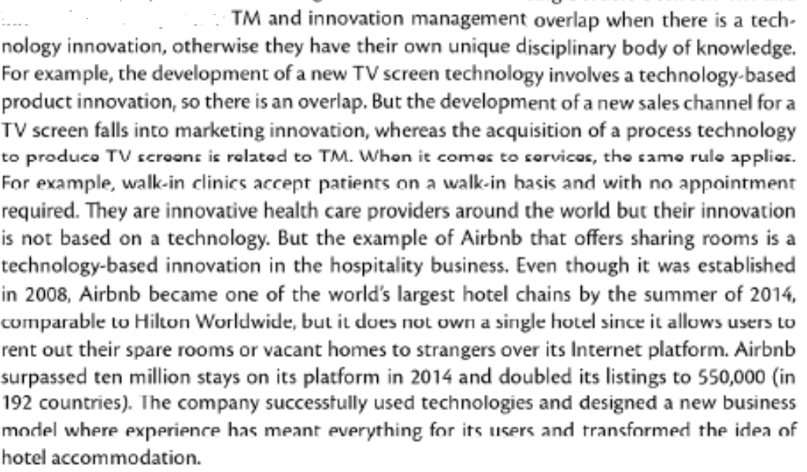
Technology Innovation

Slide 21
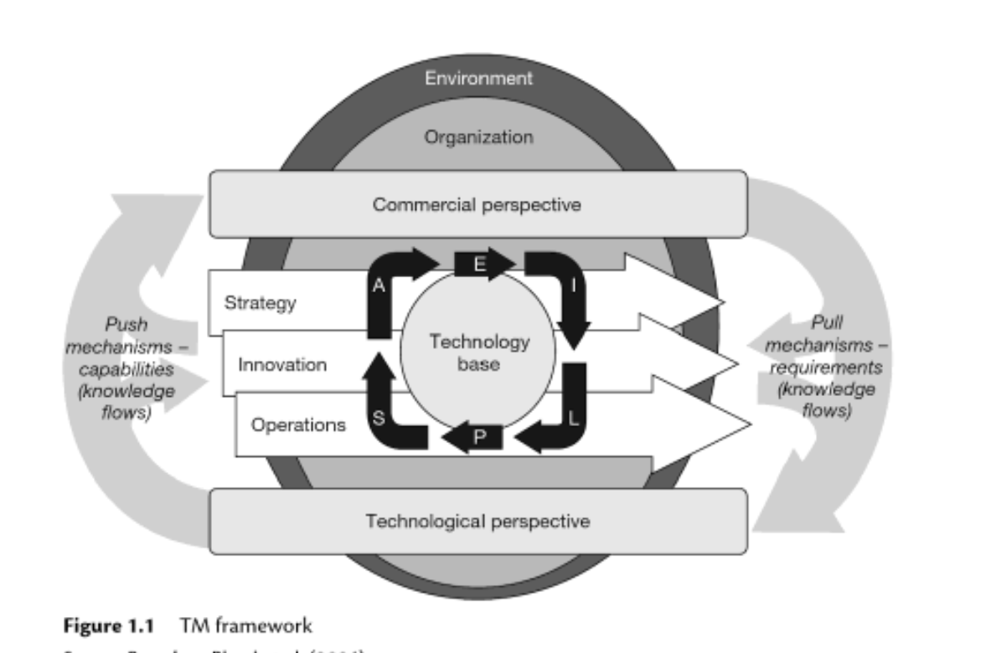

Slide 22
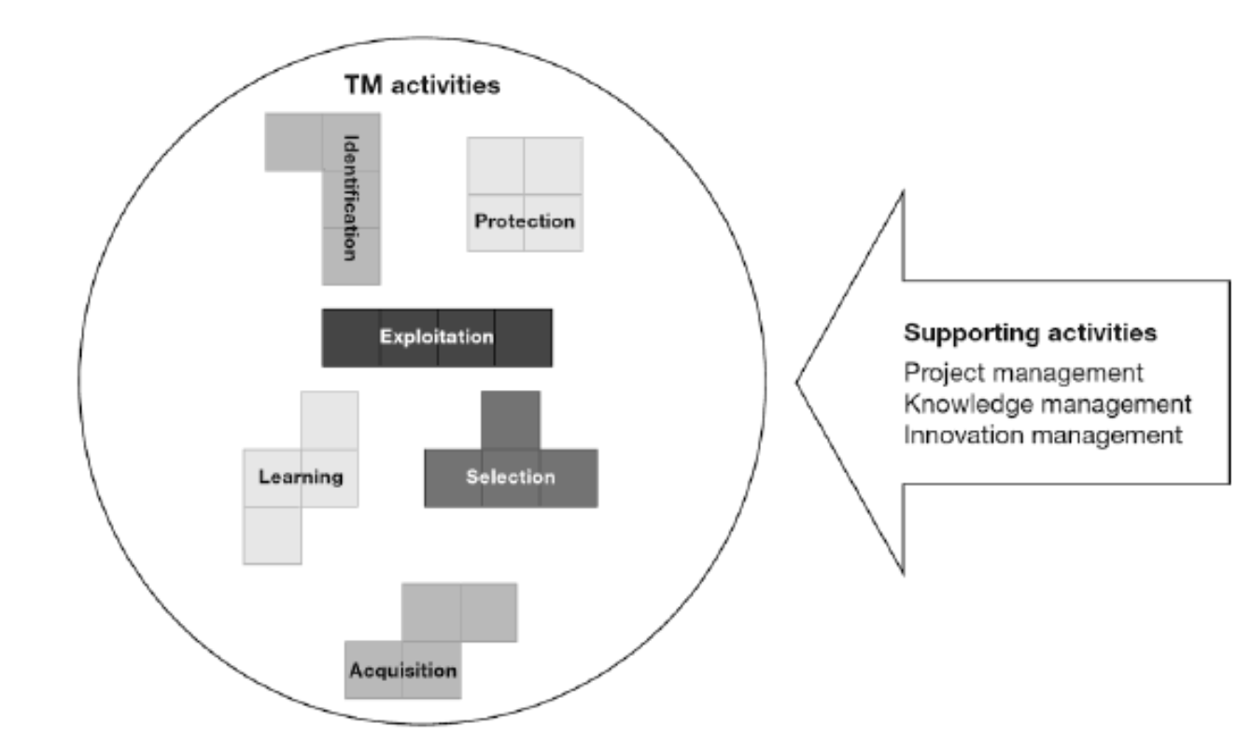
Non-linearity of TM activities

Slide 23
•
•
•
•
•
•
•
•
•
•
•

Slide 24
TM Tools
Patent Analysis
Portfolio Management
Roadmapping
S-curve
Stage-gate
Value analysis

Slide 25
