Slide 1
Chapter 5
Availability

Slide 2
Availability
Availability builds upon the concept of reliability by adding the notion of recovery—that is, when the system breaks, it repairs itself.
“Availability refers to the ability of a system to mask or repair faults such that the cumulative service outage period does not exceed a required value over a specified time interval.”

Slide 3
Availability
Availability is closely related to security. A denial-of-service attack is explicitly designed to make a system fail—that is, to make it unavailable.
Availability is also closely related to performance, because it may be difficult to tell when a system has failed and when it is simply being outrageously slow to respond.

Slide 4
Availability
One of the most demanding tasks in building a high-availability, fault-tolerant system is to understand the nature of the failures that can arise during operation.

Slide 5
Fault
A failure’s cause is called a fault. A fault can be either internal or external to the system under consideration.
Intermediate states between the occurrence of a fault and the occurrence of a failure are called errors.
Faults can be prevented, tolerated, removed, or forecast. In this way a system becomes “resilient” to faults.

Slide 6
steady-state availability
MTBF / (MTBF + MTTR)
where MTBF refers to the mean time between failures and MTTR refers to the mean time to repair.
In the software world, this formula should be interpreted to mean that when thinking about availability, you should think about what will make your system fail, how likely that is to occur, and that there will be some time required to repair it.

Slide 7
Fault
Fault correlation logic will categorize a fault according to its severity (critical, major, or minor) and service impact (service-affecting or non-service-affecting) in order to provide the system operator with timely and accurate system status and allow for the appropriate repair strategy to be employed.
The repair strategy may be automated or may require manual intervention.

Slide 8
service-level agreement
The availability provided by a computer system or hosting service is frequently expressed as a service-level agreement.
This SLA specifies the availability level that is guaranteed and, usually, the penalties that the computer system or hosting service will suffer if the SLA is violated

Slide 9
Planning for Failure
What will make your system safe and available is planning for the occurrence of failure or (more likely) failures, and handling them with aplomb.
The first step is to understand what kinds of failures your system is prone to, and what the consequences of each will be. Here are some well-known techniques for getting a handle on this.

Slide 10
Hazard analysis
Hazard analysis is a technique that attempts to catalog the hazards that can occur during the operation of a system.
It categorizes each hazard according to its severity.
For example, the DO-178B standard used in the aeronautics industry defines these failure condition levels in terms of their effects on the aircraft, crew, and passengers.

Slide 11
Hazard analysis
Catastrophic.
This kind of failure may cause a crash. This failure represents the loss of critical function required to safely fly and land aircraft.
Hazardous.
This kind of failure has a large negative impact on safety or performance, or reduces the ability of the crew to operate the aircraft due to physical distress or a higher workload, or causes serious or fatal injuries among the passengers.

Slide 12
Hazard analysis
Major.
This kind of failure is significant, but has a lesser impact than a Hazardous failure (for example, leads to passenger discomfort rather than injuries) or significantly increases crew workload to the point where safety is affected.
Minor. This kind of failure is noticeable, but has a lesser impact than a Major failure (for example, causing passenger inconvenience or a routine flight plan change).
No effect. This kind of failure has no impact on safety, aircraft operation, or crew workload.

Slide 13
2. Fault tree analysis
Fault tree analysis is an analytical technique that specifies a state of the system that negatively impacts safety or reliability, and then analyzes the system’s context and operation to find all the ways that the undesired state could occur.

Slide 14
2. Fault tree analysis
The technique uses a graphic construct (the fault tree) that helps identify all sequential and parallel sequences of contributing faults that will result in the occurrence of the undesired state, which is listed at the top of the tree (the “top event”).
The contributing faults might be hardware failures, human errors, software errors, or any other pertinent events that can lead to the undesired state.

Slide 15
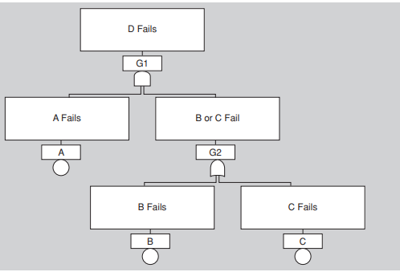
2. Fault tree analysis
Figure 5.1, taken from a NASA handbook on fault tree analysis, shows a very simple fault tree for which the top event is failure of component D. It shows that component D can fail if A fails and either B or C fails.

Slide 16
Figure 5.2: Fault tree gate symbols

Slide 17
Availability General Scenario
Source of stimulus. We differentiate between internal and external origins of faults or failure because the desired system response may be different.
Stimulus. A fault of one of the following classes occurs:
Omission. A component fails to respond to an input.
Crash. The component repeatedly suffers omission faults.
Timing. A component responds but the response is early or late.
Response. A component responds with an incorrect value.

Slide 18
Availability General Scenario
Artifact. This specifies the resource that is required to be highly available, such as a processor, communication channel, process, or storage.
Environment. The state of the system when the fault or failure occurs may also affect the desired system response.
For example, if the system has already seen some faults and is operating in other than normal mode, it may be desirable to shut it down totally.

Slide 19
Availability General Scenario
Response. There are a number of possible reactions to a system fault.
First, the fault must be detected and isolated (correlated) before any other response is possible. (One exception to this is when the fault is prevented before it occurs.)
After the fault is detected, the system must recover from it.
Actions associated with these possibilities include
logging the failure,
notifying selected users or other systems,
taking actions to limit the damage caused by the fault,
switching to a degraded mode with either less capacity or less function,
shutting down external systems,
or becoming unavailable during repair.

Slide 20
Availability General Scenario
Response measure.
The response measure can specify an availability percentage,
or it can specify a time to detect the fault,
time to repair the fault,
times or time intervals during which the system must be available,
or the duration for which the system must be available.

Slide 21
Concrete availability scenario
Figure 5.3 shows a concrete scenario generated from the general scenario:
The heartbeat monitor determines that the server is nonresponsive during normal operations. The system informs the operator and continues to operate with no downtime.

Slide 22
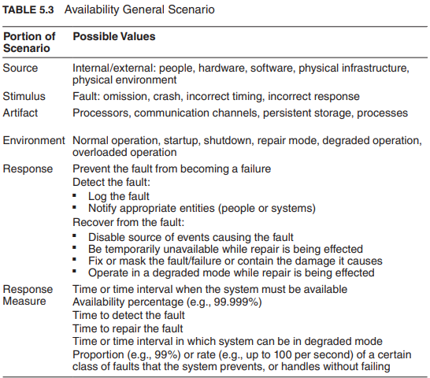

Slide 23
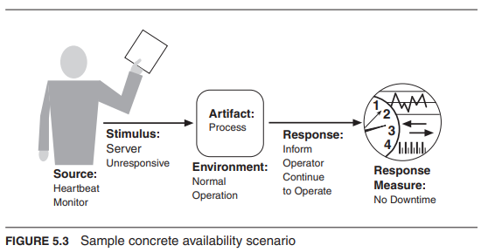

Slide 24
Tactics for Availability
A failure occurs when the system no longer delivers a service that is consistent with its specification; this failure is observable by the system’s actors.
A fault (or combination of faults) has the potential to cause a failure.
Availability tactics, therefore, are designed to enable a system to endure system faults so that a service being delivered by the system remains compliant with its specification.
The tactics we discuss in this section will keep faults from becoming failures or at least bound the effects of the fault and make repair possible.

Slide 25
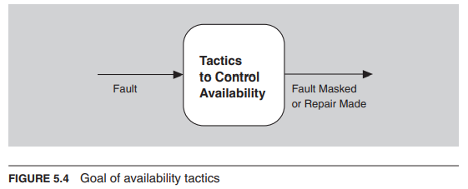

Slide 26
Tactics for Availability
Availability tactics may be categorized as addressing one of three categories:
fault detection, fault recovery, and fault prevention. The tactics categorization for availability is shown in Figure 5.5

Slide 28
1. Detect Faults
Before any system can take action regarding a fault, the presence of the fault must be detected or anticipated. Tactics in this category include the following:
Ping/echo refers to an asynchronous request/response message pair exchanged between nodes, used to determine reachability and the round-trip delay through the associated network path.
But the echo also determines that the pinged component is alive and responding correctly.
The ping is often sent by a system monitor.
Ping/echo requires a time threshold to be set; this threshold tells the pinging component how long to wait for the echo before considering the pinged component to have failed (“timed out”).
Standard implementations of ping/echo are available for nodes interconnected via IP.

Slide 29
1. Detect Faults
Monitor. A monitor is a component that is used to monitor the state of health of various other parts of the system: processors, processes, I/O, memory, and so on.
A system monitor can detect failure or congestion in the network or other shared resources, such as from a denial-of-service attack.
For example, the system monitor can initiate self-tests, or be the component that detects faulty time stamps or missed heartbeats.

Slide 30
1. Detect Faults
Heartbeat is a fault detection mechanism that employs a periodic message exchange between a system monitor and a process being monitored.
A special case of heartbeat is when the process being monitored periodically resets the watchdog timer in its monitor to prevent it from expiring and thus signaling a fault.
The big difference between heartbeat and ping/echo is who holds the responsibility for initiating the health check—the monitor or the component itself.

Slide 31
watchdog timer
A watchdog timer (WDT) is a hardware timer that automatically generates a system reset if the main program neglects to periodically service it.
It is often used to automatically reset an embedded device that hangs because of a software or hardware fault.

Slide 32
1. Detect Faults
Time stamp. This tactic is used to detect incorrect sequences of events, primarily in distributed message-passing systems.
A time stamp of an event can be established by assigning the state of a local clock to the event immediately after the event occurs.
Simple sequence numbers can also be used for this purpose, if time information is not important.

Slide 33
1. Detect Faults
Sanity checking checks the validity or reasonableness of specific operations or outputs of a component.
This tactic is typically based on a knowledge of the internal design, the state of the system, or the nature of the information under scrutiny.
It is most often employed at interfaces, to examine a specific information flow.

Slide 34
1. Detect Faults
Condition monitoring involves checking conditions in a process or device, or validating assumptions made during the design.
By monitoring conditions, this tactic prevents a system from producing faulty behavior.
The computation of checksums is a common example of this tactic.
However, the monitor must itself be simple (and, ideally, provable) to ensure that it does not introduce new software errors.

Slide 35
1. Detect Faults
Voting. The most common realization of this tactic is referred to as triple modular redundancy (TMR), which employs three components that do the same thing, each of which receives identical inputs, and forwards their output to voting logic, used to detect any inconsistency among the three output states.
Faced with an inconsistency, the voter reports a fault.
It must also decide what output to use. It can let the majority rule, or choose some computed average of the disparate outputs.
This tactic depends critically on the voting logic, which is usually realized as a simple, rigorously reviewed and tested singleton so that the probability of error is low.

Slide 36
1. Detect Faults
Replication is the simplest form of voting; here, the components are exact clones of each other.
Having multiple copies of identical components can be effective in protecting against random failures of hardware, but this cannot protect against design or implementation errors, in hardware or software, because there is no form of diversity embedded in this tactic.

Slide 37
1. Detect Faults
Functional redundancy is a form of voting intended to address the issue of common-mode failures (design or implementation faults) in hardware or software components.
Here, the components must always give the same output given the same input, but they are diversely designed and diversely implemented.

Slide 38
1. Detect Faults
Analytic redundancy permits not only diversity among components’ private sides, but also diversity among the components’ inputs and outputs.
This tactic is intended to tolerate specification errors by using separate requirement specifications.
In embedded systems, analytic redundancy also helps when some input sources are likely to be unavailable at times.

Slide 39
1. Detect Faults
Exception detection refers to the detection of a system condition that alters the normal flow of execution. The exception detection tactic can be further refined:
System exceptions will vary according to the processor hardware architecture employed and include faults such as divide by zero, bus and address faults, illegal program instructions, and so forth.
The parameter fence tactic incorporates an a priori data pattern (such as 0xDEADBEEF) placed immediately after any variable-length parameters of an object.
This allows for runtime detection of overwriting the memory allocated for the object’s variable-length parameters.

Slide 40
1. Detect Faults
Parameter typing employs a base class that defines functions that add, find, and iterate over type-length-value (TLV) formatted message parameters.
Derived classes use the base class functions to implement functions that provide parameter typing according to each parameter’s structure.

Slide 41
1. Detect Faults
Timeout is a tactic that raises an exception when a component detects that it or another component has failed to meet its timing constraints.
For example, a component awaiting a response from another component can raise an exception if the wait time exceeds a certain value.

Slide 42
1. Detect Faults
Self-test. Components (or, more likely, whole subsystems) can run procedures to test themselves for correct operation. Self-test procedures can be initiated by the component itself, or invoked from time to time by a system monitor.
These may involve employing some of the techniques found in condition monitoring, such as checksums.

Slide 43
2. Recover from Faults
Recover-from-faults tactics are refined into preparation-and-repair tactics and reintroduction tactics.
The latter are concerned with reintroducing a failed (but rehabilitated) component back into normal operation.
Preparation-and-repair tactics are based on a variety of combinations of retrying a computation or introducing redundancy. They include the following:

Slide 44
2. Recover from Faults
Active redundancy (hot spare).
This refers to a configuration where all of the nodes (active or redundant spare) in a protection group2 receive and process identical inputs in parallel, allowing the redundant spare(s) to maintain synchronous state with the active node(s).
Because the redundant spare possesses an identical state to the active processor, it can take over from a failed component in a matter of milliseconds.
The simple case of one active node and one redundant spare node is commonly referred to as 1+1 (“one plus one”) redundancy.
Active redundancy can also be used for facilities protection, where active and standby network links are used to ensure highly available network connectivity.

Slide 45
2. Recover from Faults
Passive redundancy (warm spare).
This refers to a configuration where only the active members of the protection group process input traffic; one of their duties is to provide the redundant spare(s) with periodic state updates.
Because the state maintained by the redundant spares is only loosely coupled with that of the active node(s) in the protection group (with the looseness of the coupling being a function of the check pointing mechanism employed between active and redundant nodes), the redundant nodes are referred to as warm spares.
Depending on a system’s availability requirements, passive redundancy provides a solution that achieves a balance between the more highly available but more compute-intensive (and expensive) active redundancy tactic and the less available but significantly less complex cold spare tactic (which is also significantly cheaper).

Slide 46
2. Recover from Faults
Spare (cold spare).
Cold sparing refers to a configuration where the redundant spares of a protection group remain out of service until a fail-over occurs, at which point a power-on-reset procedure is initiated on the redundant spare prior to its being placed in service.
Due to its poor recovery performance, cold sparing is better suited for systems having only high-reliability (MTBF) requirements as opposed to those also having high-availability requirements.

Slide 47
2. Recover from Faults
Exception handling.
Once an exception has been detected, the system must handle it in some fashion.
The easiest thing it can do is simply to crash, but of course that’s a terrible idea from the point of availability, usability, testability, and plain good sense.
There are much more productive possibilities.
The mechanism employed for exception handling depends largely on the programming environment employed, ranging from simple function return codes (error codes) to the use of exception classes that contain information helpful in fault correlation, such as the name of the exception thrown, the origin of the exception, and the cause of the exception thrown.
Software can then use this information to mask the fault, usually by correcting the cause of the exception and retrying the operation.

Slide 48
2. Recover from Faults
Rollback.
This tactic permits the system to revert to a previous known good state, referred to as the “rollback line”—rolling back time—upon the detection of a failure.
Once the good state is reached, then execution can continue.
This tactic is often combined with active or passive redundancy tactics so that after a rollback has occurred, a standby version of the failed component is promoted to active status.
Rollback depends on a copy of a previous good state (a checkpoint) being available to the components that are rolling back.
Checkpoints can be stored in a fixed location and updated at regular intervals, or at convenient or significant times in the processing, such as at the completion of a complex operation.

Slide 49
2. Recover from Faults
Software upgrade is another preparation-and-repair tactic whose goal is to achieve in-service upgrades to executable code images in a non-service-affecting manner.
This may be realized as a function patch, a class patch, or a hitless in-service software upgrade (ISSU).
A function patch is used in procedural programming and employs an incremental linker/loader to store an updated software function into a pre-allocated segment of target memory.
The new version of the software function will employ the entry and exit points of the deprecated function.
Also, upon loading the new software function, the symbol table must be updated and the instruction cache invalidated.
The class patch tactic is applicable for targets executing object-oriented code, where the class definitions include a back-door mechanism that enables the runtime addition of member data and functions.
Hitless in-service software upgrade leverages the active redundancy or passive redundancy tactics to achieve non-service-affecting upgrades to software and associated schema.

Slide 50
2. Recover from Faults
In practice, the function patch and class patch are used to deliver bug fixes, while the hitless in-service software upgrade is used to deliver new features and capabilities.

Slide 51
2. Recover from Faults
Retry.
The retry tactic assumes that the fault that caused a failure is transient and retrying the operation may lead to success.
This tactic is used in networks and in server farms where failures are expected and common.
There should be a limit on the number of retries that are attempted before a permanent failure is declared.

Slide 52
2. Recover from Faults
Ignore faulty behavior.
This tactic calls for ignoring messages sent from a particular source when we determine that those messages are spurious (fake).
For example, we would like to ignore the messages of an external component launching a denial-of-service attack by establishing Access Control List filters.

Slide 53
2. Recover from Faults
The degradation tactic maintains the most critical system functions in the presence of component failures, dropping less critical functions.
This is done in circumstances where individual component failures gracefully reduce system functionality rather than causing a complete system failure.

Slide 54
2. Recover from Faults
Reconfiguration attempts to recover from component failures by reassigning responsibilities to the (potentially restricted) resources left functioning, while maintaining as much functionality as possible.

Slide 55
2. Reintroduction
Reintroduction is where a failed component is reintroduced after it has been corrected. Reintroduction tactics include the following:

Slide 56
2. Reintroduction
The shadow tactic refers to operating a previously failed or in-service upgraded component in a “shadow mode” for a predefined duration of time prior to reverting the component back to an active role.
During this duration its behavior can be monitored for correctness and it can repopulate its state incrementally.

Slide 57
2. Reintroduction
State resynchronization is a reintroduction partner to the active redundancy and passive redundancy preparation-and-repair tactics.
When used alongside the active redundancy tactic, the state resynchronization occurs organically, because the active and standby components each receive and process identical inputs in parallel.
In practice, the states of the active and standby components are periodically compared to ensure synchronization.

Slide 58
2. Reintroduction
State resynchronization (continue …)
This comparison may be based on a cyclic redundancy check calculation (checksum) ‎or, for systems providing safety-critical services, a message digest calculation (a one-way hash function).
When used alongside the passive redundancy (warm spare) tactic, state resynchronization is based solely on periodic state information transmitted from the active component(s) to the standby component(s), typically via check pointing.
A special case of this tactic is found in stateless services, whereby any resource can handle a request from another (failed) resource.

Slide 59
2. Reintroduction
Escalating restart is a reintroduction tactic that allows the system to recover from faults by varying the granularity of the component(s) restarted and minimizing the level of service affected.
For example, consider a system that supports four levels of restart, as follows.
The lowest level of restart (call it Level 0), and hence having the least impact on services, employs passive redundancy (warm spare), where all child threads of the faulty component are killed and recreated.
In this way, only data associated with the child threads is freed and reinitialized.

Slide 60
2. Reintroduction
Escalating restart( continue …)
The next level of restart (Level 1) frees and reinitializes all unprotected memory (protected memory would remain untouched).
The next level of restart (Level 2) frees and reinitializes all memory, both protected and unprotected, forcing all applications to reload and reinitialize.
And the final level of restart (Level 3) would involve completely reloading and reinitializing the executable image and associated data segments.
Support for the escalating restart tactic is particularly useful for the concept of graceful degradation, where a system is able to degrade the services it provides while maintaining support for mission-critical or safety-critical applications.

Slide 61
2. Reintroduction
Non-stop forwarding (NSF) is a concept that originated in router design.
In this design functionality is split into two parts:
supervisory, or control plane (which manages connectivity and routing information), and data plane (which does the actual work of routing packets from sender to receiver).
If a router experiences the failure of an active supervisor, it can continue forwarding packets along known routes—with neighboring routers—while the routing protocol information is recovered and validated.
When the control plane is restarted, it implements what is sometimes called “graceful restart,” incrementally rebuilding its routing protocol database even as the data plane continues to operate.

Slide 62
3. Prevent Faults
Instead of detecting faults and then try to recover from them.
Removal from service.
This tactic refers to temporarily placing a system component in an out-of-service state for the purpose of mitigating potential system failures.
One example involves taking a component of a system out of service and resetting the component in order to scrub latent faults (such as memory leaks, fragmentation, or soft errors in an unprotected cache) before the accumulation of faults affects service (resulting in system failure).
Another term for this tactic is software rejuvenation.

Slide 63
3. Prevent Faults
Transactions.
Systems targeting high-availability services leverage transactional semantics to ensure that asynchronous messages exchanged between distributed components are atomic, consistent, isolated, and durable.
These four properties are called the “ACID properties.” The most common realization of the transactions tactic is “two-phase commit” (a.k.a. 2PC) protocol.
This tactic prevents race conditions caused by two processes attempting to update the same data item.

Slide 64
3. Prevent Faults
Predictive model.
A predictive model, when combined with a monitor, is employed to monitor the state of health of a system process to ensure that the system is operating within its nominal operating parameters, and to take corrective action when conditions are detected that are predictive of likely future faults.
The operational performance metrics monitored are used to predict the onset of faults; examples include session establishment rate (in an HTTP server), threshold crossing (monitoring high and low water marks for some constrained, shared resource), or maintaining statistics for process state (in service, out of service, under maintenance, idle), message queue length statistics, and so on.

Slide 65
3. Prevent Faults
Exception prevention.
This tactic refers to techniques employed for the purpose of preventing system exceptions from occurring.
The use of exception classes, which allows a system to transparently recover from system exceptions, was discussed previously.
Other examples of exception prevention include abstract data types, such as smart pointers, and the use of wrappers to prevent faults, such as dangling pointers and semaphore access violations from occurring.
Smart pointers prevent exceptions by doing bounds checking on pointers, and by ensuring that resources are automatically de allocated when no data refers to it. In this way resource leaks are avoided.

Slide 66
3. Prevent Faults
Increase competence set.
A program’s competence set is the set of states in which it is “competent” to operate.
For example, the state when the denominator is zero is outside the competence set of most divide programs.
When a component raises an exception, it is signaling that it has discovered itself to be outside its competence set; in essence, it doesn’t know what to do and is throwing in the towel.
Increasing a component’s competence set means designing it to handle more cases—faults—as part of its normal operation.
For example, a component that assumes it has access to a shared resource might throw an exception if it discovers that access is blocked.
Another component might simply wait for access, or return immediately with an indication that it will complete its operation on its own the next time it does have access.
In this example, the second component has a larger competence set than the first.

Slide 67
A Design Checklist for Availability

Slide 68
A Design Checklist for Availability

Slide 69
A Design Checklist for Availability

Slide 70
A Design Checklist for Availability

