Slide 1
Chapter 8: Introduction to Hypothesis Testing

Slide 2
Hypothesis Testing
The general goal of a hypothesis test is to rule out chance (sampling error) as a plausible explanation for the results from a research study.
Hypothesis testing is a technique to help determine whether a specific treatment has an effect on the individuals in a population.

Slide 3
Hypothesis Testing
The hypothesis test is used to evaluate the results from a research study in which
1. A sample is selected from the population.
2. The treatment is administered to the sample.
3. After treatment, the individuals in the sample are measured.

Slide 4
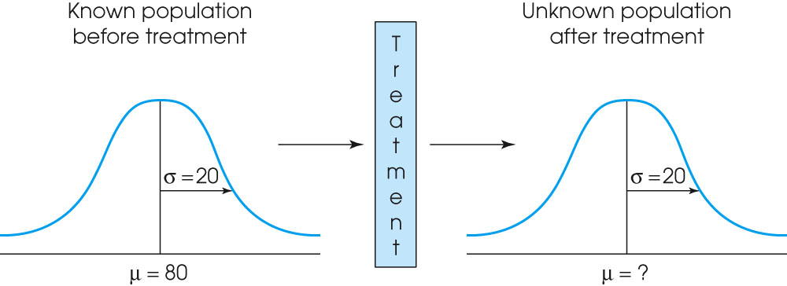
Notes:
Figure 8.1
The basic experimental situation for hypothesis testing. It is assumed that the parameter μ is known for the population before treatment. The purpose of the experiment is to determine whether or not the treatment has an effect on the population mean.

Slide 5
Hypothesis Testing (cont.)
If the individuals in the sample are noticeably different from the individuals in the original population, we have evidence that the treatment has an effect.
However, it is also possible that the difference between the sample and the population is simply sampling error

Slide 6
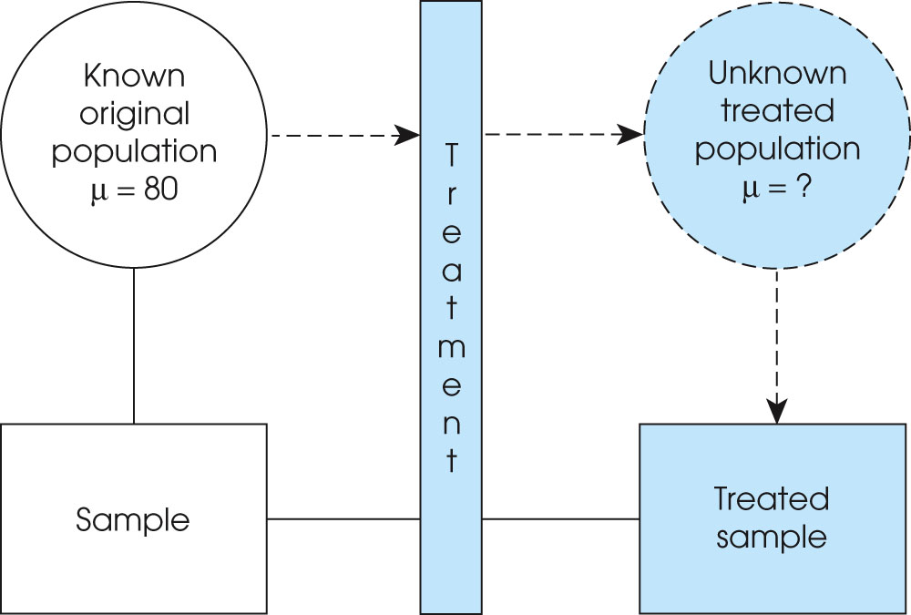
Notes:
Figure 8.2
From the point of view of the hypothesis test, the entire population receives the treatment and then a sample is selected from the treated population. In the actual research study, a sample is selected from the original population and the treatment is administered to the sample. From either perspective, the result is a treated sample that represents the treated population.

Slide 7
Hypothesis Testing (cont.)
The purpose of the hypothesis test is to decide between two explanations:
1. The difference between the sample and the population can be explained by sampling error (there does not appear to be a treatment effect)
2. The difference between the sample and the population is too large to be
explained by sampling error (there does appear to be a treatment effect).

Slide 8
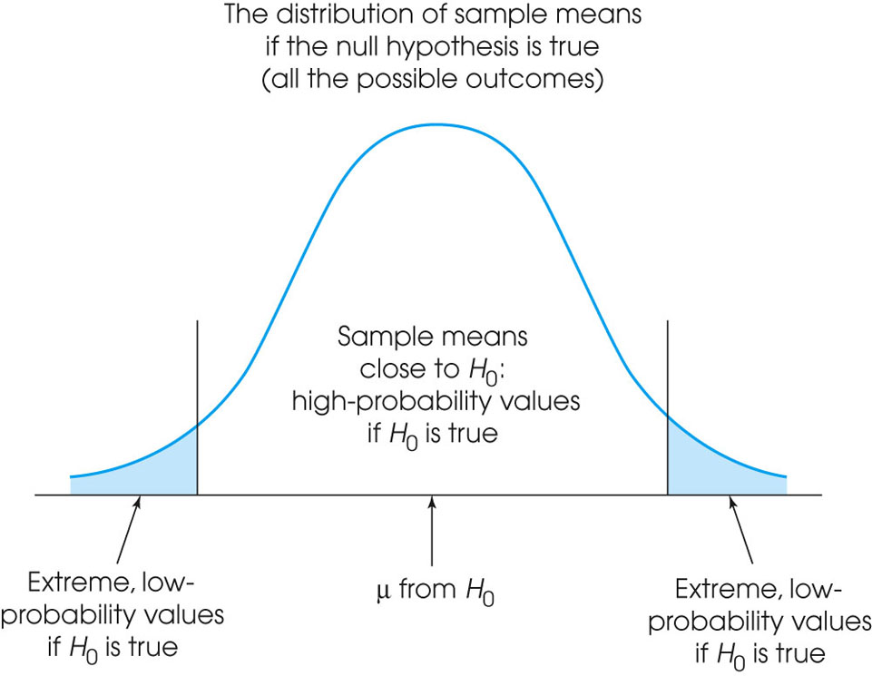
Notes:
Figure 8.3
The set of potential samples is divided into those that are likely to be obtained and those that are very unlikely to be obtained if the null hypothesis is true.

Slide 9
The Null Hypothesis, the Alpha Level, the Critical Region, and the Test Statistic
The following four steps outline the process of hypothesis testing and introduce some of the new terminology:

Slide 10
Step 1
State the hypotheses and select an α level. The null hypothesis, H0, always states that the treatment has no effect (no change, no difference). According to the null hypothesis, the population mean after treatment is the same is it was before treatment. The α level establishes a criterion, or "cut-off", for making a decision about the null hypothesis. The alpha level also determines the risk of a Type I error.

Slide 11
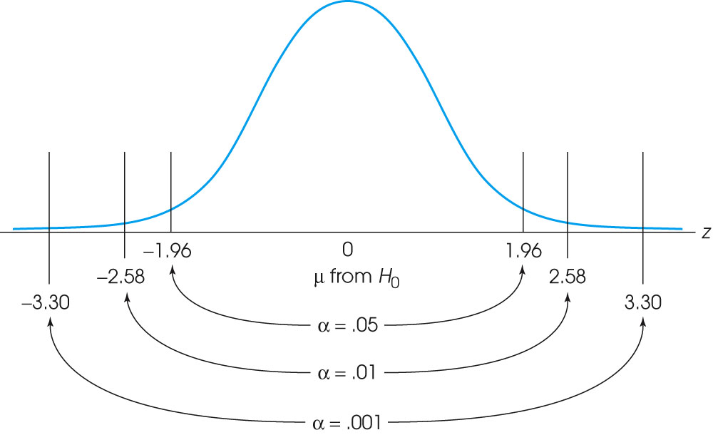
Notes:
Figure 8.5
The locations of the critical region boundaries for three different levels of significance: α = .05, α = .01, and α = .001.

Slide 12
Step 2
Locate the critical region. The critical region consists of outcomes that are very unlikely to occur if the null hypothesis is true. That is, the critical region is defined by sample means that are almost impossible to obtain if the treatment has no effect. The phrase “almost impossible” means that these samples have a probability (p) that is less than the alpha level.

Slide 13
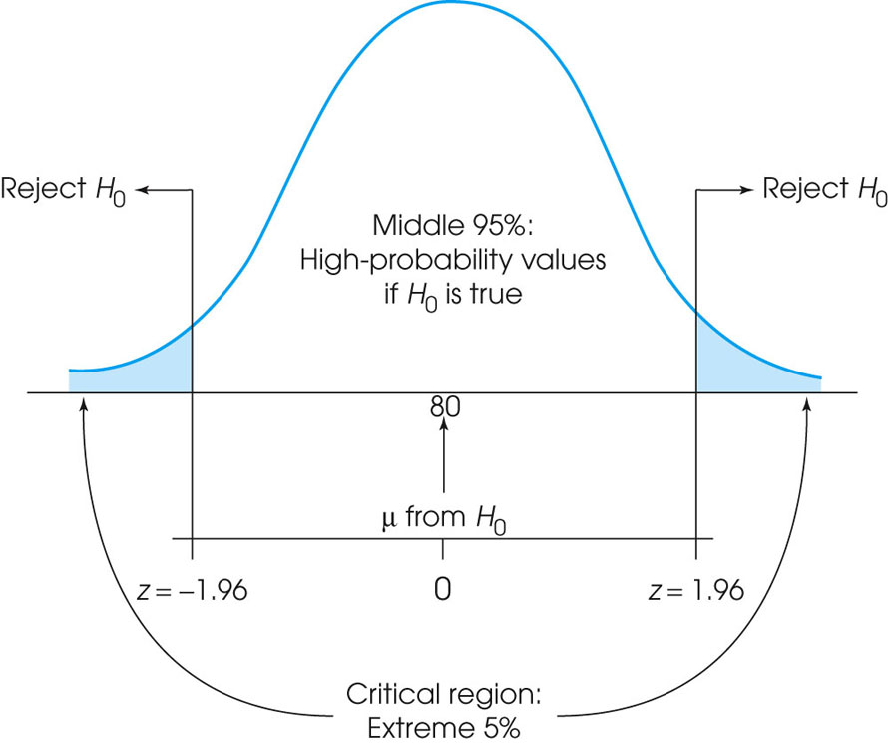
Notes:
Figure 8.4
The critical region (very unlikely outcomes) for α = .05.

Slide 14
Step 3
Compute the test statistic. The test statistic (in this chapter a z-score) forms a ratio comparing the obtained difference between the sample mean and the hypothesized population mean versus the amount of difference we would expect without any treatment effect (the standard error).

Slide 15
Step 4
A large value for the test statistic shows that the obtained mean difference is more than would be expected if there is no treatment effect. If it is large enough to be in the critical region, we conclude that the difference is significant or that the treatment has a significant effect. In this case we reject the null hypothesis. If the mean difference is relatively small, then the test statistic will have a low value. In this case, we conclude that the evidence from the sample is not sufficient, and the decision is fail to reject the null hypothesis.

Slide 16
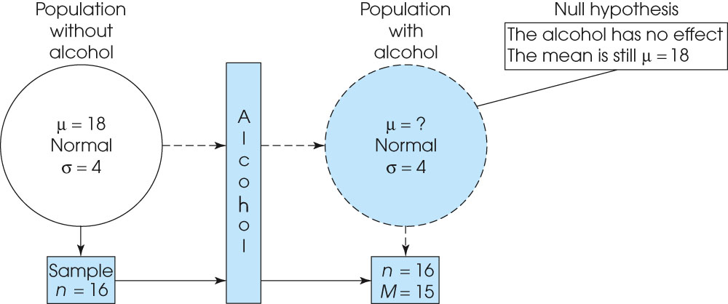
Notes:
Figure 8.6
The structure of a research study to determine whether prenatal alcohol affects birth weight. A sample is selected from the original population and is given alcohol. The question is what would happen if the entire population were given alcohol. The treated sample provides information about the unkonwn treated population.

Slide 17
Errors in Hypothesis Tests
Just because the sample mean (following treatment) is different from the original population mean does not necessarily indicate that the treatment has caused a change.
You should recall that there usually is some discrepancy between a sample mean and the population mean simply as a result of sampling error.

Slide 18
Errors in Hypothesis Tests (cont.)
Because the hypothesis test relies on sample data, and because sample data are not completely reliable, there is always the risk that misleading data will cause the hypothesis test to reach a wrong conclusion.
Two types of error are possible.

Slide 19
Type I Errors
A Type I error occurs when the sample data appear to show a treatment effect when, in fact, there is none.
In this case the researcher will reject the null hypothesis and falsely conclude that the treatment has an effect.
Type I errors are caused by unusual, unrepresentative samples. Just by chance the researcher selects an extreme sample with the result that the sample falls in the critical region even though the treatment has no effect.
The hypothesis test is structured so that Type I errors are very unlikely; specifically, the probability of a Type I error is equal to the alpha level.

Slide 20
Type II Errors
A Type II error occurs when the sample does not appear to have been affected by the treatment when, in fact, the treatment does have an effect.
In this case, the researcher will fail to reject the null hypothesis and falsely conclude that the treatment does not have an effect.
Type II errors are commonly the result of a very small treatment effect. Although the treatment does have an effect, it is not large enough to show up in the research study.

Slide 22
Directional Tests
When a research study predicts a specific direction for the treatment effect (increase or decrease), it is possible to incorporate the directional prediction into the hypothesis test.
The result is called a directional test or a one-tailed test. A directional test includes the directional prediction in the statement of the hypotheses and in the location of the critical region.

Slide 23
Directional Tests (cont.)
For example, if the original population has a mean of μ = 80 and the treatment is predicted to increase the scores, then the null hypothesis would state that after treatment:
H0: μ < 80 (there is no increase)
In this case, the entire critical region would be located in the right-hand tail of the distribution because large values for M would demonstrate that there is an increase and would tend to reject the null hypothesis.

Slide 24
Measuring Effect Size
A hypothesis test evaluates the statistical significance of the results from a research study.
That is, the test determines whether or not it is likely that the obtained sample mean occurred without any contribution from a treatment effect.
The hypothesis test is influenced not only by the size of the treatment effect but also by the size of the sample.
Thus, even a very small effect can be significant if it is observed in a very large sample.

Slide 25
Measuring Effect Size
Because a significant effect does not necessarily mean a large effect, it is recommended that the hypothesis test be accompanied by a measure of the effect size.
We use Cohen=s d as a standardized measure of effect size.
Much like a z-score, Cohen=s d measures the size of the mean difference in terms of the standard deviation.

Slide 26
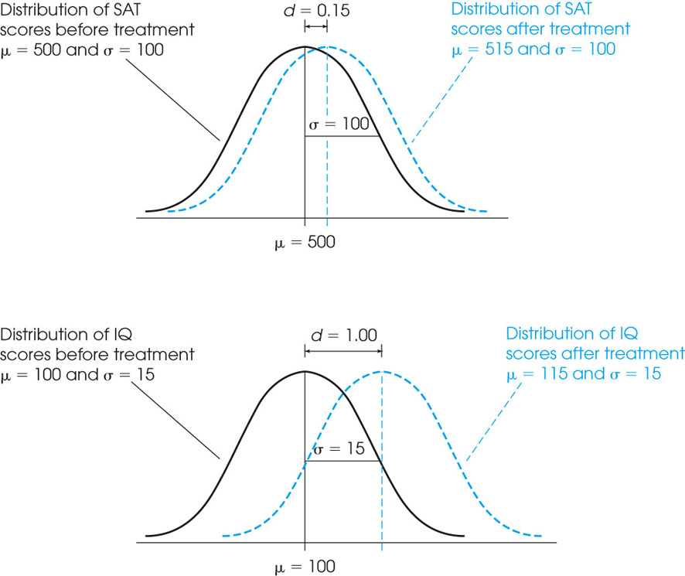
Notes:
Figure 8.11
The appearance of a 15-point treatment effect in two different situations. In part (a), the standard deviation is σ = 100 and the 15-point effect is relatively small. In part (b), the standard deviation is σ = 15 and the 15-point effect is relatively large. Cohen’s d uses the standard deviation to help measure effect size.

Slide 27
Power of a Hypothesis Test
The power of a hypothesis test is defined is the probability that the test will reject the null hypothesis when the treatment does have an effect.
The power of a test depends on a variety of factors including the size of the treatment effect and the size of the sample.

Slide 28
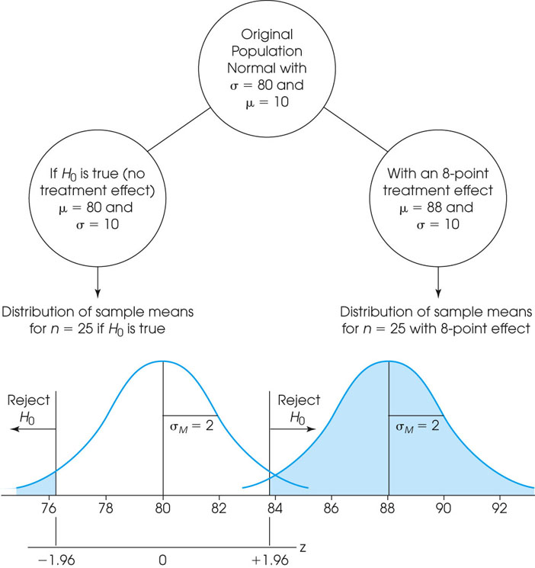
Notes:
Figure 8.12
A demonstration of measuring power for a hypothesis test. The left-hand side shows the distribution of sample means that would occur if the null hypothesis is true. The critical region is defined for this distribution. The right-hand side shows the distribution of sample means that would be obtained if there were an 8-point treatment effect. Notice that if there is an 8-point effect, essentially all of the sample means would be in the critical region. Thus, the probability of rejecting H₀ (the power of the test) would be nearly 100% for an 8-point treatment effect.

