Slide 1
walnut
COA, UOS

Slide 2
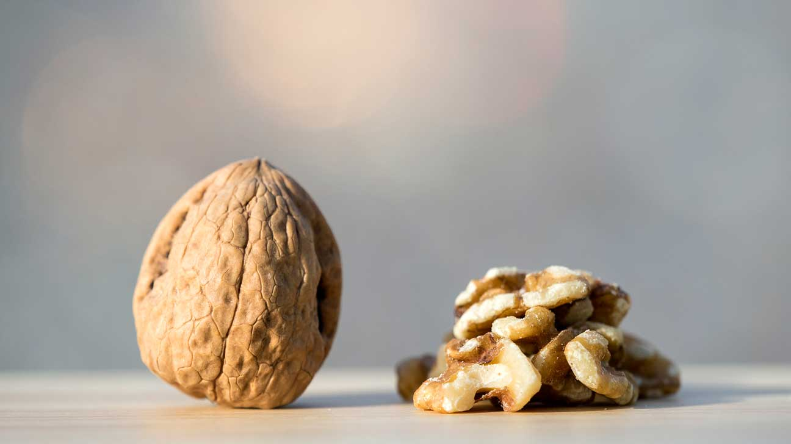

Slide 3
Introduction
The Walnut (Juglans regia) also known as “AKHROT”.
Belong to Family “Juglandaceae”.
A Walnut is the edible seed of drupe and not a botanical nut.
It is commonly consumed as a nut.
After full ripening for its edible seed, when the shell has been discarded, it is used as a ‘garnish’ or as a ‘snack’.

Slide 4
Origin and Cultivation
Walunts are the oldest tree found known to man, dating back to 7000 B.C.
It is native to North and South America, Southern Europe, Asia and the West Indies.
Commercially cultivated in Pakistan and all over the different country such as China, USA, Italy, India etc.
It is found in Northern areas of our country such as
KPK ---- Swat, Dir, Bunir, Chitral
Gilgit Baltistan province have a number of Walnut cluster.
AJK ---- Neelum valley, Muzaffarabad and Leepa.
50 different genotypes cultivated in Pakistan.

Slide 5
Botany
Walnut is a deciduous tree.
Leaves are alternate, large aromatic and flower are monoecios.
The family Juglandaceae has 60 species and 7 genera among some are monoecios and some are dioceious.
Flower are develop before and after the leaves.
Its fruit is drupe, in which nut is enclosed inside the husk, which vary un colour from green to yellow.
Fruit shape vary from sub globose to globose, having diameter of 3.5cm to 8cm, fruit may be glandular hairs.

Slide 6
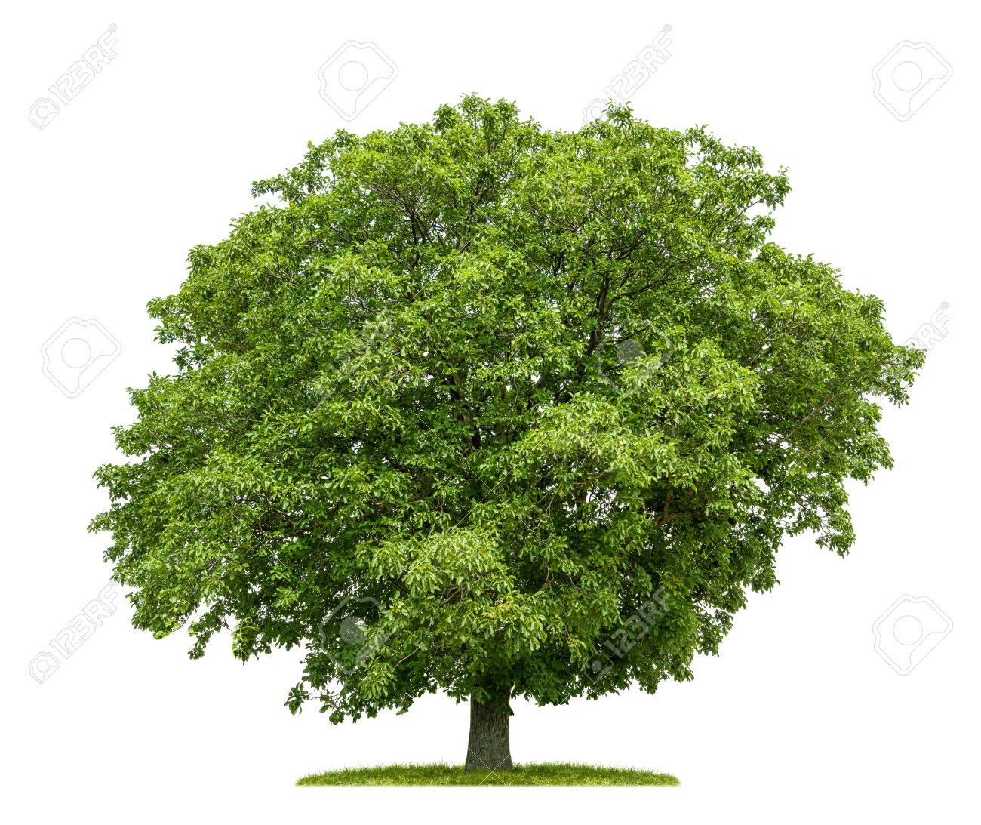

Slide 7
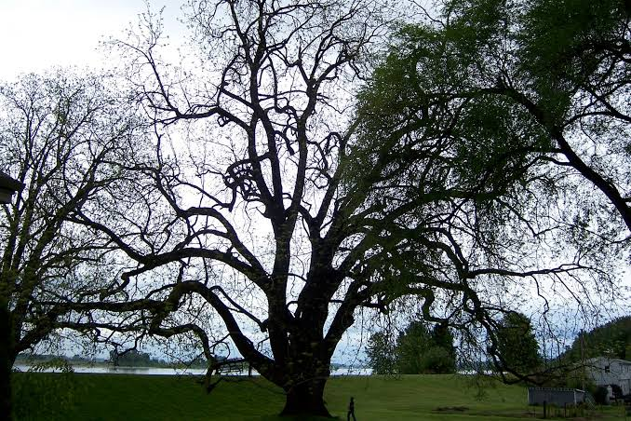
Climate
Mostly grown in the himalayan region
between the elevation of 1200 to 2100m
above sea level.
It is Temperate fruit.
Its climate requirement is free from
frost in summer and extreme heat
in summer.
Its good growth requires rainfall of about
76cm or more.
High temperature during maturity caused
sun burn of walnut.
Near the harvest time, warm temperature
having 27-30cm.

Slide 8
Soil
Silt loam soil with well drain, deep,
aerated soil for deep rooted
system and have high organic matter.
pH of 6-7.
Depth must be 2-3m.
Alkaliney and sandy sub-soil
should be avoided.

Slide 9
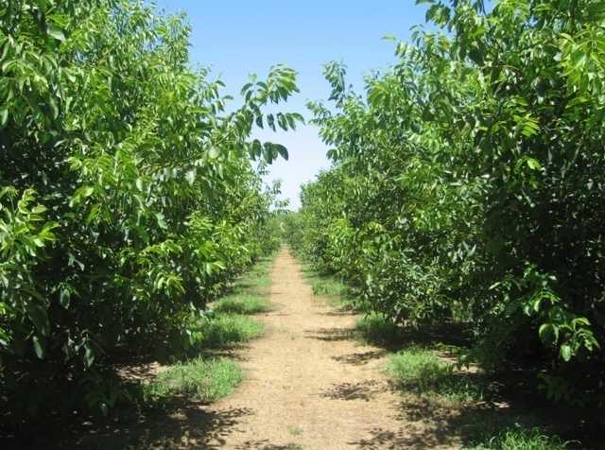
Planting Distance
30 feet between the rows and 9 feet in the rows.
For wood, planting distance of walnut trees are 8 * 8feet which results in 681 trees per acre or 1682 trees per hactare.
For nut, 17 * 17feet, 151 trees per acre and 373 trees per hactare.

Slide 10
Propagation
Sexual and Asexual.
Sexual :
Through seeds.
Asexual :
Micropropagation, Budding, Grafting, Cutting.
Whip and tongue grafting is the most common graft to propagate Collect scion wood from dormant trees between December and February from the basal portions of the previous season's growth with well-developed buds. Place collected scion wood in moist wood shavings or a plastic bag and refrigerate.

Slide 12
Fertilizer Application
Usually fertilizer is not done but it is good to apply NPK.
Apply 25-50 kg FYM for non- bearing trees and 50-100kg FYM for bearing trees.
NPK 400-200-200 g per bearing tree.
Sometimes Phosphorus and Potassiun are used.
The trees must be watered after soil fertilization is done.
Excellent fertilization of mature walnut trees can be managed by adding manure.

Slide 13
Irrigation
Basically walnut tree is grown under rainfed condition.
Low water supply to the tree result in slow growth reduces yield and
low nut quality.
More irrigation is needed at during fruit setting and development stages.
Walnut trees need more than 50% of the annual water supply during summer (June, July and August).
But excessive supply of water causes root and crown diseases.

Slide 14
Training and Pruning
Training is done to a centeral leader or modified leader.
Very little annual pruning is done expect removing weak branches.
Some thining–out pruning is usually done in the heavy bearing cultivars.
Training young walnut trees occurs in first 1-6 years in the life of orchard.

Slide 15
Mulching
Mulching is essential in walnut orchard when the Plants are younger.
It also important in after fertilizer is applied to older trees.
Mulching material around the plant or tree to help conserve soil moisture, regulated soil temperature, reduce weed growth.
Mulch the surrounding area with organic mulch, like wood chips, bark or sawdust.
Keep the mulch 2 inches away from your new tree.

Slide 16
Varieties

Slide 17
Payne
Tree is small to medium.
Hartley
Trees are medium to tall with large fruits.
Ashley
Small and good for faliur tree.

Slide 18
Maturity Level

Slide 20
Harvesting
Walnut are mature 1-4 week before hull dehiscence.
The hull split at the time of maturity in sep-oct.
Dropped food are collected in sep-oct.
Hulls should be removed immediately to avoid discoloration in quality.
Drying the nuts increases in fatty acid and bring favorable change.

Slide 21
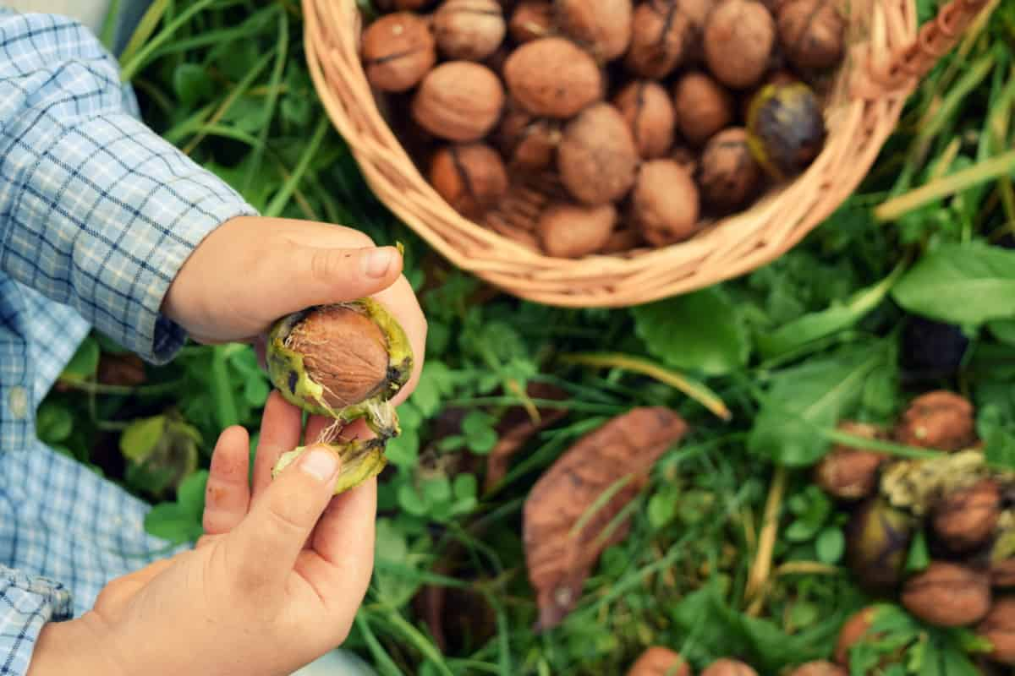

Slide 22
Production
In 2017, World production of Walnut (in shell) was 3.8 million tonnes, with China contributing 51% of the total.
In Pakistan, walnut production is about 20,000 tons per year. The bulk is produced in Azad Kashmir and KPK. The average number of walnut trees per household is 5 and average nut production per tree is 115 kg. The production is consumed within the country and a small portion is also exported in international markets.
Due to its increasing market demand in international market, its price in local market is 600-800/kg.

Slide 23
Uses
Dry fruits are included in daily use, particularly during winters in Pakistan.
The taste and nutritional quality make them more desirable.
Walnut kernels are more favourite.
Kernels are also used in different types of confectionery such as biscuits, cakes, sweets and other dishes.
Pakistan has many indigenous walnut genotypes, which are aggresively being cut for multiple uses of their bark and wood for the manufacture of high quality furniture.
Also bark being used as tooth cleaner and whitener locally known as Meswak.
Its oil also used as a skin protector against dryness.
Used in cooking, and as “carrier or base oil” in traditional medicines, in massage therapy, aromatherapy, pharmaceutical and cosmetic industry.

Slide 24
Yield
A tree may bear for about 100 year or more from age of 8-10 after planting.
Grafted and budding plants gives fruiting about 4 to 5 years.
A growing up tree yield an average 50 to 80 kg per tree and mature trees yield is 80-100 kg per tree.

