Slide 1
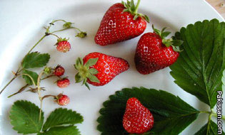
University of Sargodha
Faculty of Agriculture
Production Technology of Strawberry
Department of Horticulture

Slide 2
Introduction:
University of Sargodha
Faculty of Agriculture
Strawberry (Fragaria x ananassa Duch). It belongs to the family of rosacea and it is one of the most popular soft fruit and is cultivated in plains as well as in the hills up to an elevation of 3000 meters in humid or dry region.
Strawberry is considered as complete fruit with 98% edible portion. The fruits are attractive with distinct and pleasant aroma and flavor, rich in vitamin C (39 to 89 mg/100 g of pulp), Vitamin B, proteins and minerals like P, K, Ca and F.
Strawberries are one of the best natural sources of antioxidant and it is also anticarcinogenic and antidiabetic.
Crushed strawberry and strawberry syrup are used in soda fountain beverages, ice cream, chocolate, confectioneries and cosmetics.
Department of Horticulture

Slide 3
University of Sargodha
Faculty of Agriculture
Nutritive value of strawberry fruits (/100g of edible portion):
Energy (calorie) 44
Water (%) 87-90
Fat (%) 0.2-0.5
Protein (%) 0.23-0.70
Total sugars (%) 3.3-9.1
Fiber (%) 1.1
Vitamin A (LU.) 60.0
Vitamin C (mg) 26-120
Calcium (mg) 21.0
Phosphorus (mg) 21.0
Potassium (mg) 164.0
Department of Horticulture

Slide 4
University of Sargodha
Faculty of Agriculture
Origin and distribution:
Strawberry is originated in France and its popularity can be judged from the very fact that the total area and production of the world has increased considerably over the past decade. It occupies an area of 2,17,766 thousand hectares with a total production of 29,86,8l3 MIT Anonymous, 2001). Europe and North America accounts for 50 and 30% of the total production, respectively.
Among the European countries, France, Italy and Poland are the leading producer of the strawberries. World top growing countries are America, Turkey, Spain, Egypt and south Korea.
Department of Horticulture

Slide 5
University of Sargodha
Faculty of Agriculture
IN PAKISTAN:
In Pakistan first time strawberry was grown in 1951, After trials, two verities were recommended for cultivation. These verities were Missionary and Klondike.
Now its cultivation is increasing in Pakistan. In Punjab growing regions are Sheikhupura, Nankana, Gujranwala, Sialkot, Gujrat, Kasur, Mendi bhawaldeen, Sargodha, Rawalpindi, Jhelum and Chakwal. In KPK, strawberry is cultivated in Swat, Abbottabad, Manshera, Mirpur, Mardaan Charsada and Peshawar.
Department of Horticulture

Slide 6
University of Sargodha
Faculty of Agriculture
Botany and taxonomy:
The strawberry plant is an herbaceous perennial rosette, has compressed stem called crown. The stem or crowns has a central pitch core and can survive for several years because of secondary cambium activity.
The internodes are very short and numbers of long petiole trifoliate leaves at various stages of development are arranged spirally on the axis.
The leaves are compound, pinnate and trifoliate with leaflets that vary in shape from wedge to ovate. The axillary meristem may develop in to stolon's or branch crowns, with a regular positioning along the axis and in strict relation with crown growth rate.
Crown is a primary stem. originated by stolon, in which the leaves, roots and stolon's are cyclically formed.
Stolon is a specialized true stem with long internodes and vascular structure, which is markedly different from that of the short internode crowns. During growing season, the axillary buds of the crown produce prostrate growth called runners or stolon's
Department of Horticulture

Slide 7
University of Sargodha
Faculty of Agriculture
Strawberry history goes back over 2200 years ago.
It is thought that the name "strawberry" came from the practice of growers spreading a layer of straw around the plants when the berries begin to form.
The 600 strawberry varieties available today are derived from five or six original wild species (Fragaria spp) and are a member of the rose family. The cultivated strawberry (Fragaria X ananassa Duch.) is a monoecious octoploid hybrid of two largely dioecious octoploid species, Fragaria chiloensis Duch. and Fragaria virginiana Duch.
It is assumed that hybridization between Fragaria chiloensis Duch. and Fragaria virginiana had taken place spontaneously in Europe in early seventeen century.
It belongs to the family Rosacea, and all cultivated varieties of strawberry are octoploid (2n=56) with a basic chromosome number of X =7.
In addition to F x ananassa, the genus Fragaria include at least 17 other species. Out of 17 species, 4 species, viz. F chiloensis, F daltoniana, F niigerrensis and F vesca,
Department of Horticulture

Slide 8
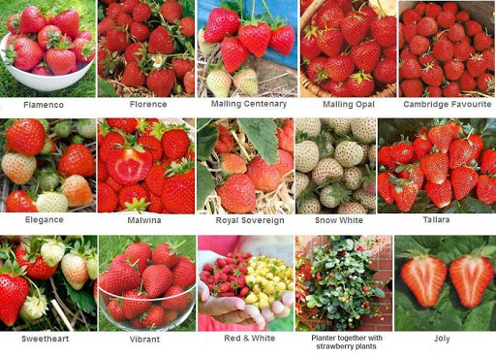
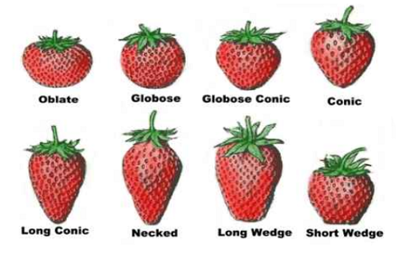
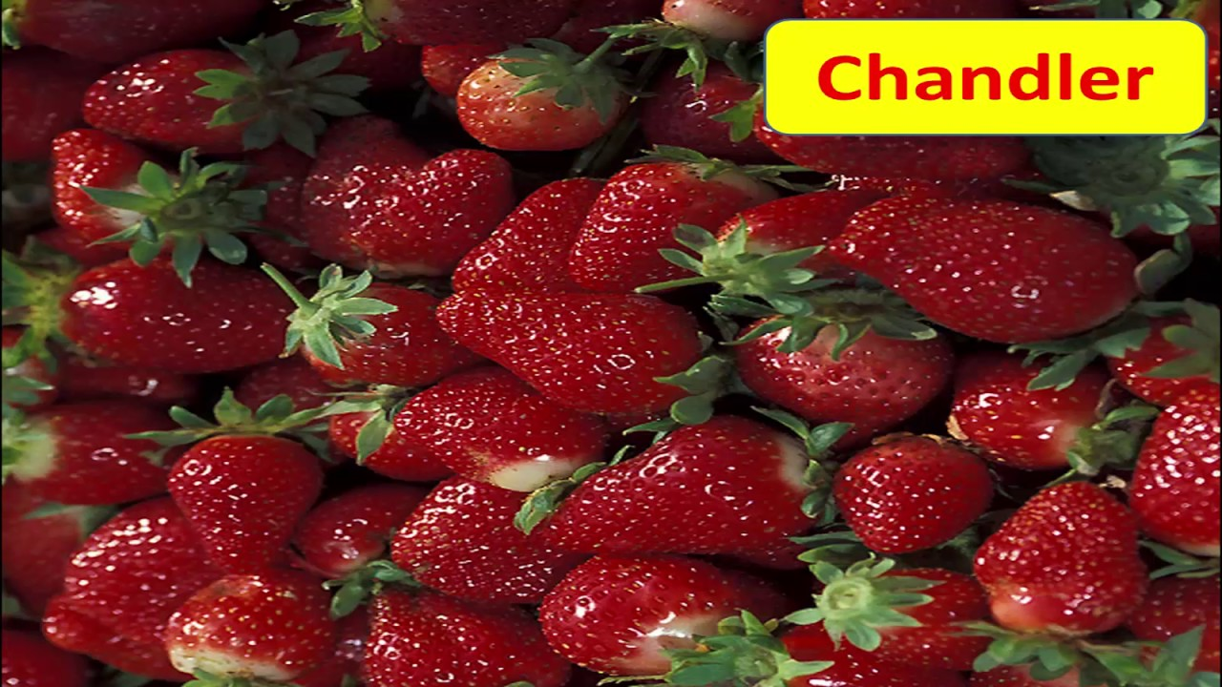
University of Sargodha
Faculty of Agriculture
Varieties:
Strawberry is reported to be the only crop in which all cultivars have been developed hybridization.
Most important varieties are Camarosa, Ofra, Sweet Charlie, Chandler, Elista, Fair Fox, Seascape, Blackmore and Douglas .
Department of Horticulture

Slide 9
University of Sargodha
Faculty of Agriculture
Soil and climate:
Soil:
Strawberry plant grows best in sandy loam soil on very light soil frequent irrigation is needed for establishment of runners. The heavier soil with sufficient soil moisture is better than lighter soil.
Strawberry prefers soil reasonably rich in humus because of 70-90 % of its roots were found in the top 15cm soil.
It grows well on soil with pH 5.0-7.5. However the plant thrives best in slightly acidic soil (pH 5.5-6.5). Soil with pH value of 4.5-5.5 needs liming. Lime should not be applied directly to strawberry plant. It has been shown that an excess of lime dwarf the plants and reduce the size of berry
Department of Horticulture

Slide 10
University of Sargodha
Faculty of Agriculture
Climate:
The strawberry plants are strongly affected by the environmental parameters like temperature, photoperiod and light intensity.
It requires optimum day temperature of 22°C to 25°C and night temperature of 7°C to 13°C.
In cold climate, frost as well as winter injury seriously reduce yield of strawberry. Frost may damage center of the open flowers, causing the characteristics black eye. The frost injury may be reduced using mulch, covering row with plastic and by creating good air drainage. Photoperiod has a marked effect on strawberry vegetative growth, plant morphology and yield. Stolon formation, petiole length, leaf area and yield increases with the increase in photoperiod.
Department of Horticulture

Slide 11
University of Sargodha
Faculty of Agriculture
Propagation :
Strawberry can be propagated through Seed, Vegetative means as well as through Tissue culture.
Propagation through seed is not advisable because they not produce true to type plant. A single berry produces thousands of seed. Seeds require stratification to break the dormancy _ The effective chilling temperature for breaking dormancy ranges from -2 to 6.50C for 2-4 weeks.
Strawberry is propagated through runners, which is considered as natural vegetative propagation. The stolon, a creeping stalk is produced in the leaf axils and grows out from parent plant during summer. At the second node of stolon a runner plants is formed an new stolon arises on the runner plants. Initially runner plants produce fewer roots but thereafter put forth excessive fibrous roots. When acquired sufficient growth and roots, runner separated from the mother plant and can be planted elsewhere.
Department of Horticulture

Slide 12
University of Sargodha
Faculty of Agriculture
Techniques for runner production :
Although runner produces true to type plant, but viral diseases are quite often transmitted through runners only. So, a separate bed should be used for runner production. The site and soil where the strawberry had not been grown for at least 3-4 years should be selected. The planting should be done at 1.2 x 1.2m or 1.8 x1.8 m distance. All the cultural practices should be strictly followed. Usually 30-40 runners per plant are considered satisfactory rate of production. Rate of runner production can be enhanced by GA3 (50-100 ppm) spray. For greater survival and fast growth, the runners should be lifted in September and planted in poly bags or poly tubes using the potting media of 1 soil: 1 Sand: 2 FYM for one month. In this method mortality is less in field and growth picks up with in 3-4 days after transplanting.
Department of Horticulture

Slide 13
University of Sargodha
Faculty of Agriculture
Land preparation and planting :
The soil for strawberry cultivation should be prepared thoroughly before planting and made free from weeds as much as possible. FYM or other bulky manures should not be deeply ploughed because that works best when applied on the top soil. Soil fumigation with methyl bromide (67%) or chloropicrin (33%) prior to planting can check the populations of nematodes, verticillium wilt and even some weeds.
Health runners with a medium to large crown and well-developed root y tern are planted in the field. The outer leave should be striped off and soil of the roots of the runner should be washed.
Time of Planting :
Although planting can be done at any time between mid - October to mid-December but early planting ensure good crop.
Department of Horticulture

Slide 14
University of Sargodha
Faculty of Agriculture
Method of Planting and Spacing :
Basically three methods are used in the world for planting:
Matted rows
Spaced beds
Hill rows
But in Pakistan commonly used method is Matted row method because in this method cultural practices like weed control, harvesting easier than other methods ,less fruit rot, and fewer foliage diseases than other methods. The raised bed provides higher spring soil temperatures and better drainage, allowing faster establishment and earlier cropping.
The main planting system used for strawberry cultivars is the matted row. Set the plants 11/2 to 21/2 feet apart in rows spaced 3 to 4 feet apart. Let the runners develop until the row is 1 to 11/2 feet wide.
Department of Horticulture

Slide 15
Irrigation:
University of Sargodha
Faculty of Agriculture
Sprinkler irrigation is crucial to prevent frost damage in June bearing varieties after the mulch is removed in early spring. Irrigate whenever the air temperature drops below 34' F. Apply 0. 1 inch of water per hour with one sprinkler head revolution per minute. Sprinkler irrigation should protect flowers and developing fruit down to 20' F. Spring frost protection is unnecessary during the planting year in day-neutral strawberries because the flowers are usually removed until the danger of frost is past. Frost protection may, however, be desired in the fall to extend the harvest season.
Day-neutral strawberries require more careful irrigation and water management than June-bearing strawberries, especially on raised beds. During the summer apply 0.75 to 1.5 inches of water per week depending on the weather, soil type, and effectiveness of mulch in preventing evaporation.
Use trickle irrigation with plastic mulch to ensure sufficient water in the root zone. Overhead irrigation may be used with straw or other organic mulches. Fertilizer can be applied through the irrigation system. Higher levels of certain nutrients such as nitrogen may be needed if trickle irrigation is used because of increased leaching through the soil profile.
Department of Horticulture

Slide 16
University of Sargodha
Faculty of Agriculture
Fertilizers:
Nitrogen, phosphorus, potassium, and other soil nutrients are required for vigorous crown and runner development. Soil tests will identify the nutrient needs. Generally phosphorus, potassium, and part of the nitrogen should be applied at or before planting. On most soils and under most conditions strawberry plants will be benefited by the application of commercial fertilizers, particularly by nitrogen, during the first growing season.
Organic manures applied in sufficient quantity(70 -80 t/ha) may fulfill the nutritional requirement, if planted for annual cropping. The pre planting application of 20tonnes of FYM and 20-40-40 NPK kg/ha and annual application of 40 kg P/ha and 80kg K/ha is recommended to ensure a good crop of strawberry. In addition to recommended dose of manures and fertilizers. foliar application of urea (2%), zin sulphate (0.5%), calcium sulphate (0.5%) and boric acid (0.2%) is beneficial for higher and better yield.
Department of Horticulture

Slide 17
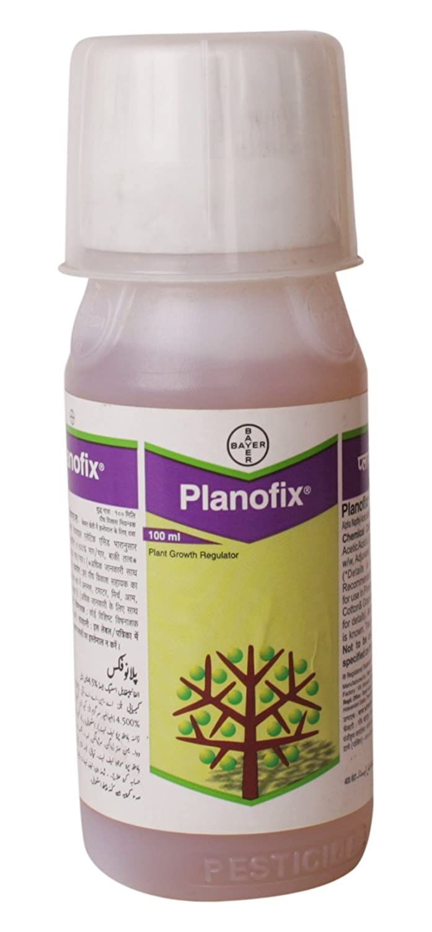
University of Sargodha
Faculty of Agriculture
Use of plant growth regulators :
Certain growth substances can be successfully utilized for increasing the yield, fruit quality and runner production of strawberry. GA3 (50-100 ppm) has been found to the best treatment for production of quality runners and proper plant growth. Triacontanol at 5 ppm before flower emergence also increased leaf area, leaf number and runner production .. GA3 @ 75ppm advance flowering, fruiting and increases yield when applied in December-January.
Department of Horticulture

Slide 18
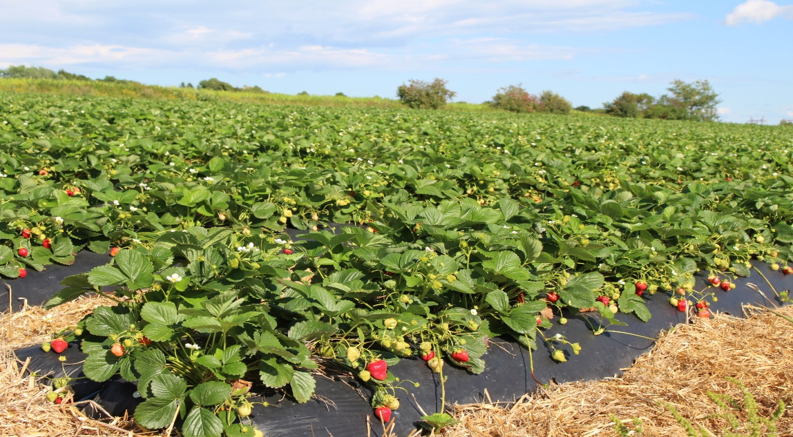
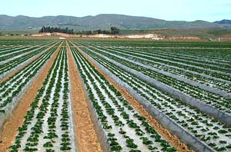
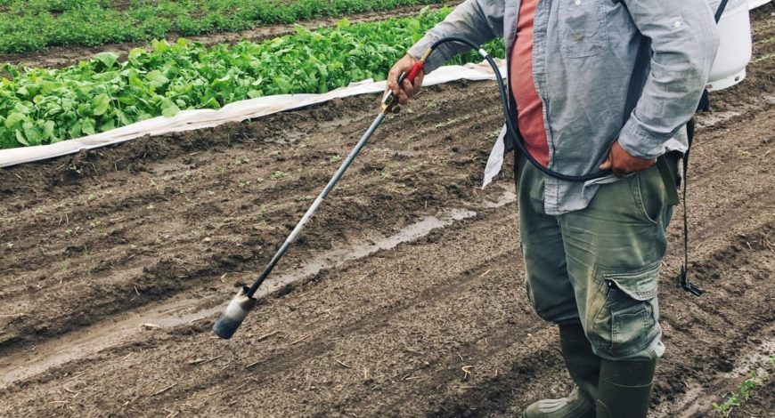
University of Sargodha
Faculty of Agriculture
Weed control:
A weed eradication programmed one year prior to planting is recommended if perennial weeds are a problem. Herbicides, mechanical control methods, and a green manure smother crop can be used effectively. Consult herbicide labels to avoid potential carry-over problems for the new strawberry planting. Preplan harrowing of a prepared field will reduce weed populations.
Weeds pose a great threat and it becomes unmanageable during wet weather. Weed control is considered as one of the most expensive management practices. Weedicide like Simazine @ 3kg/ha and Pendimethalin @330g /L can be used to keep the weeds under control.
Department of Horticulture

Slide 19
University of Sargodha
Faculty of Agriculture
Insect control:
Not all insects found in a strawberry patch injure the plants and many of those that do can be controlled by preventive measures more easily than by chemicals. Rotation of strawberries with other cultivated crops is useful in controlling insects.
Strawberries are affected by several diseases that vary widely in their occurrence and severity; it is necessary to recognize common strawberry insect and disease problems in order to treat them quickly and effectively. Prevention is the best way to hold disease and insect problems in check. The use of good cultural practices, varieties adapted to the area, and disease-free stock will help reduce insect and disease problems.
Department of Horticulture

Slide 20
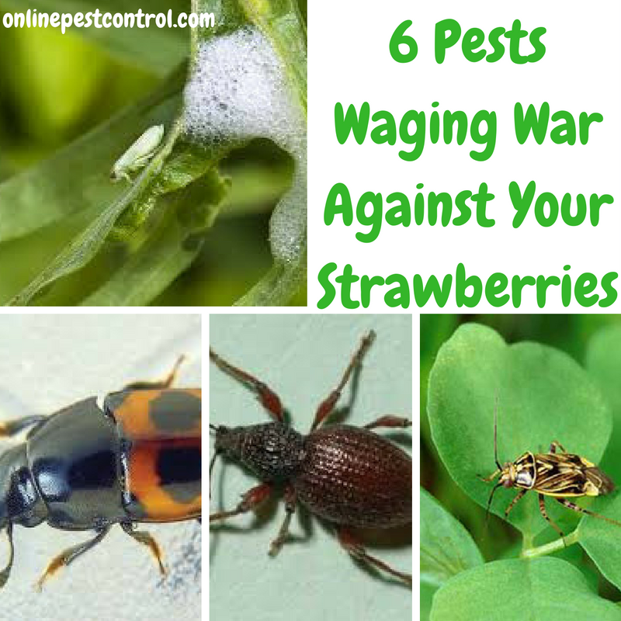
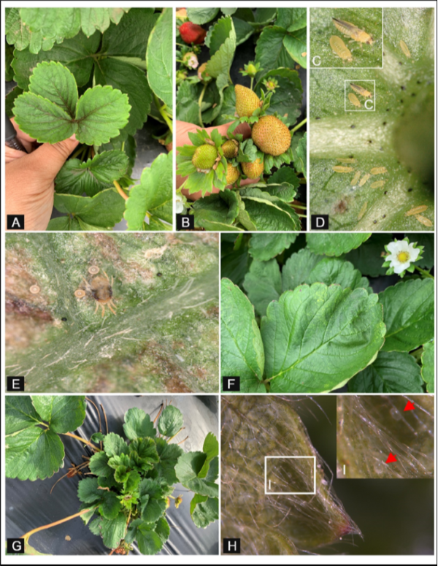
University of Sargodha
Faculty of Agriculture
Department of Horticulture

Slide 21
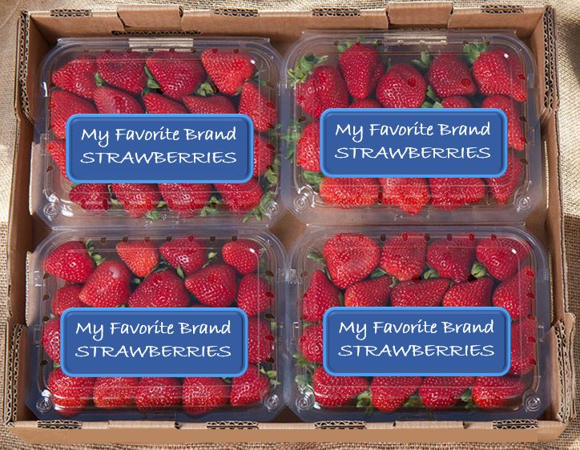
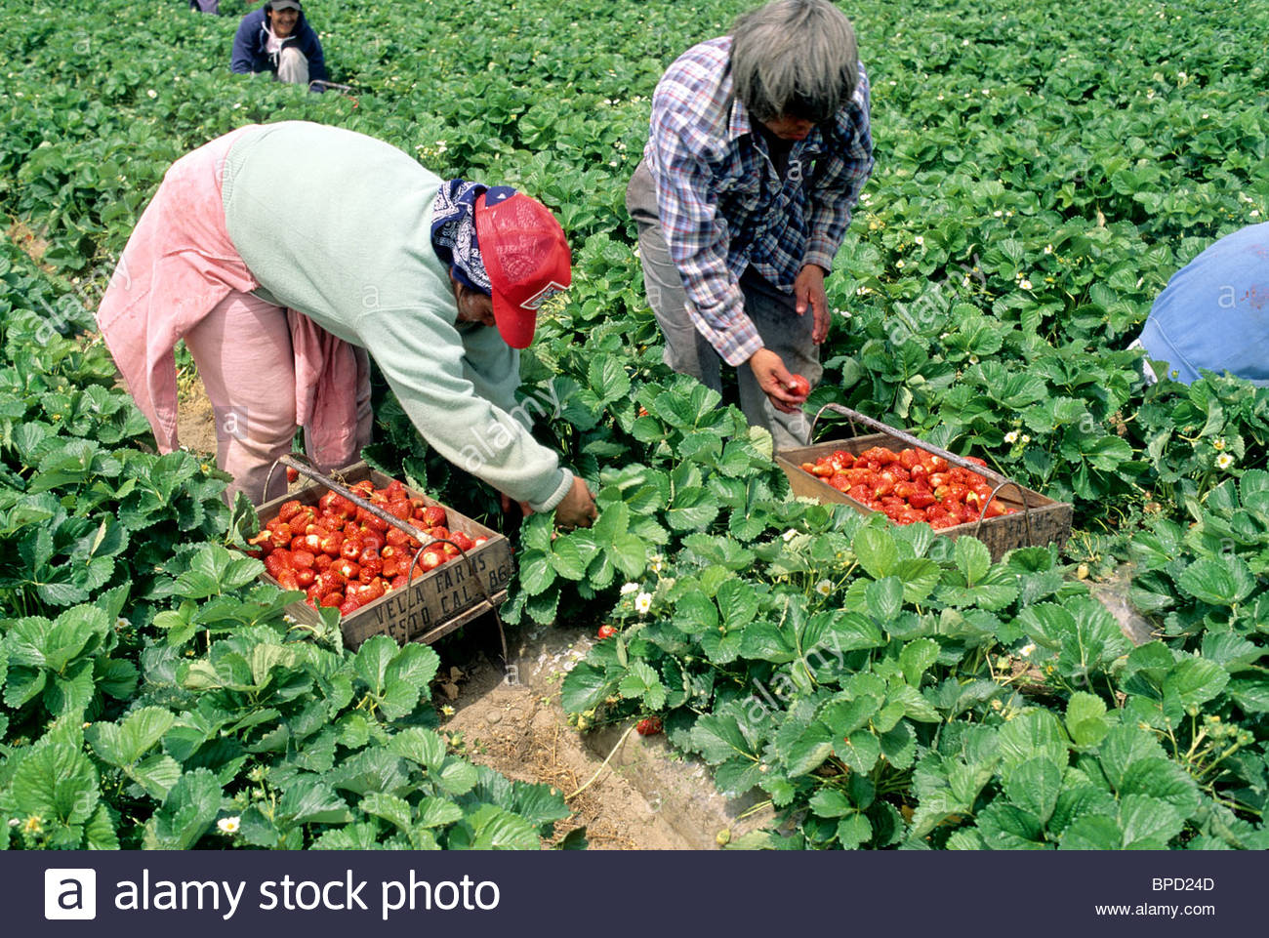
University of Sargodha
Faculty of Agriculture
Harvesting/marketing :
Proper picking, grading, and packing are as essential as good cultural practices to success. The harvest frequency and duration depend on weather conditions, varieties, soil factors, and cultural practices. Strawberries are almost entirely hand picked. As a general rule for wholesale operations, six to nine pickers are needed for one acre.
Department of Horticulture

Slide 22
University of Sargodha
Faculty of Agriculture
Department of Horticulture

