Slide 1
Computer Studies
Khansa Saleem
Lecturer in CS & IT department
khansasaleem1234@gmail.com

Slide 2
Book: Discovering Computers Living in a Digital World FUNDAMENTALS, 2011 EDITION
By
Gary B. Shelly
Misty E. Vermaat

Slide 3
Chapter 1
Introduction to computer

Slide 4
What is Computer?
A computer is an electronic device, operating under the control of instructions stored in its own memory, that can accept data, process the data according to specified rules, produce results, and store the results for future use.

Slide 5
Data & Information
Computers process data into information.
Data is a collection of unprocessed items, which can include text, numbers, images, audio, and video.
Information conveys meaning and is useful to people.

Slide 6
The Components of a Computer

Slide 7
system unit
system unit is a case that contains electronic components of the computer that are used to process data.
The circuitry of the system unit usually is part of or is connected to a circuit board called the motherboard.
Two main components on the motherboard are the processor and memory.
The processor, also called the CPU (central processing unit), is the electronic component that interprets and carries out the basic instructions that operate the computer.
Memory consists of electronic components that store instructions waiting to be executed and data needed by those instructions.

Slide 8
Storage Devices
Storage holds data, instructions, and information for future use
A computer keeps data, instructions, and information on storage media. Examples of storage media are USB flash drives, hard disks, optical discs, and memory cards.
A storage device records (writes) and/or retrieves (reads) items to and from storage media.
The average USB flash drive can hold about 4 billion characters.
The average hard disk can hold more than 320 billion characters.
A CD can hold from 650 million to 1 billion characters.
Some DVDs can store two full-length movies or 17 billion characters.
Blu-ray Discs can store about 46 hours of standard video, or 100 billion characters.

Slide 9
Communications Devices
A communications device is a hardware component that enables a computer to send (transmit) and receive data, instructions, and information to and from one or more computers or mobile devices.
A widely used communications device is a modem.
Communications occur over cables, telephone lines, cellular radio networks, satellites, and other transmission media.
Some transmission media, such as satellites and cellular radio networks, are wireless, which means they have no physical lines or wires

Slide 10
Advantages of Using Computers
Speed: Many computers process billions or trillions of operations in a single second.
Reliability: The electronic components in modern computers are reliable because they rarely break or fail.
Consistency: Computers generate error-free results, provided the input is correct and the instructions work.
Storage: Computers store enormous amounts of data and make this data available for processing anytime it is needed.
Communications: Most computers today can communicate with other computers, often wirelessly.

Slide 11
Disadvantages of Using Computers
Violation of Privacy: In many instances, where personal and confidential records stored on computers were not protected properly, individuals have found their privacy violated and identities stolen.
Public Safety: Adults, teens, and children around the world are using computers to share publicly their photos, videos, journals, music, and other personal information.
Health Risks: Computer users can protect themselves from health risks through proper workplace design, good posture while at the computer, and appropriately spaced work breaks. Two behavioral health risks are computer addiction and technology overload.
Impact on Environment: Green computing involves reducing the electricity consumed and environmental waste generated when using a computer. Strategies that support green computing include recycling, regulating manufacturing processes, extending the life of computers, and immediately donating or properly disposing of replaced computers.

Slide 12
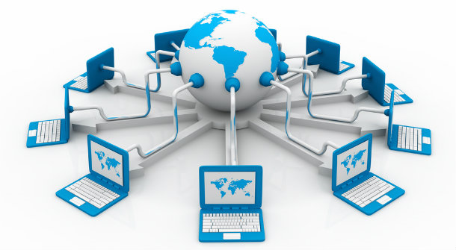
Networks and the Internet
A network is a collection of computers and devices connected together, often wirelessly, via communications devices and transmission media.
Networks allow computers to share resources, such as hardware, software, data, and information. Sharing resources saves time and money.
The Internet is a worldwide collection of networks that connects millions of businesses, government agencies, educational institutions, and individuals.

Slide 13
social networking Website
The Web, short for World Wide Web, is one of the more popular services on the Internet.
The Web contains billions of documents called Web pages.
A Web page can contain text, graphics, animation, audio, and video.
A Website is a collection of related Web pages.
Millions of people worldwide join online communities, each called a social networking Website or online social network, that encourage members to share their interests, ideas, stories, photos, music, and videos with other registered users.

Slide 14
social networking Website
A blog is an informal Web site consisting of time stamped articles in a diary or journal format, usually listed in reverse chronological order.
A microblog, such as Twitter, allows users to publish short messages, usually between 100 and 200 characters, for others to read.
A podcast is recorded audio stored on a Web site that can be downloaded to a computer or a portable media player such as an iPod.
A Web application is a Web site that allows users to access and interact with software from any computer or device that is connected to the Internet. Examples of software available as Web applications include those that allow you to send and receive e-mail messages, prepare your taxes, organize digital photos, create documents, and play games.

Slide 15
Computer Software
Software, also called a program, is a series of related instructions, organized for a common purpose, that tells the computer what task(s) to perform and how to perform them. You interact with a program through its user interface.
The two categories of software are
System software
Operating system
Utility Programs
Application software.

Slide 16
Installing and Running Programs
Installing is the process of setting up software to work with the computer, printer, and other hardware.
When you instruct the computer to run an installed program, the computer loads it, which means the program is copied from storage to memory.
Once in memory, the computer can carry out, or execute, the instructions in the program so that you can use the program.

Slide 17
Software Development
A programmer, sometimes called a developer, is someone who develops software or writes the instructions that direct the computer to process data into information.
Popular programming languages include C++, Visual C#, Visual Basic, JavaScript, and Java.

Slide 18
Categories of computer
Personal computers (desktop)
Mobile computers and mobile devices
Game
Mainframes
Supercomputers
Embedded computers

Slide 19
personal computer
A personal computer is a computer that can perform all of its input, processing, output, and storage activities by itself.
Two popular architectures of personal computers are the PC and the Apple.
Two types of personal computers are desktop computers and notebook computers.
A desktop computer is designed so that the system unit, input devices, output devices, and any other devices fit entirely on or under a desk or table

Slide 20
Mobile computers and mobile devices

Slide 21
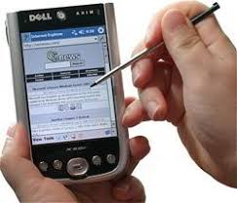
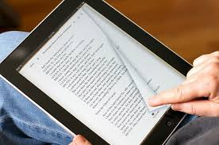
Mobile computers and mobile devices
Notebook computer
Tablet PC
Smart phones, PDAs
E-book reader
Handheld computers
Portable media players (I pod)
Digital cameras

Slide 22
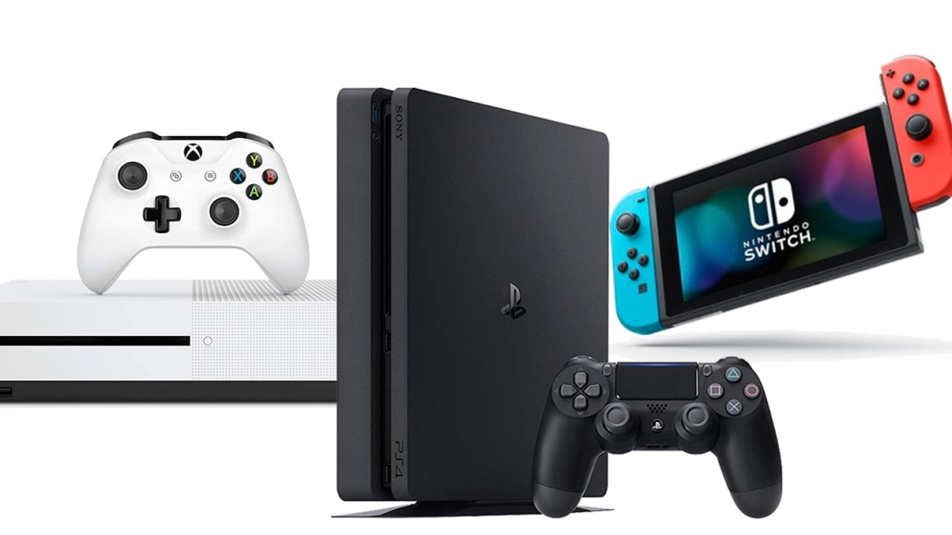
Game console
A game console is a mobile computing device designed for single player or multiplayer video games.
Xbox
Play stations

Slide 23
server
A server controls access to the hardware, software, and other resources on a network and provides a centralized storage area for programs, data, and information.
Servers support from two to several thousand connected computers at the same time.

Slide 24
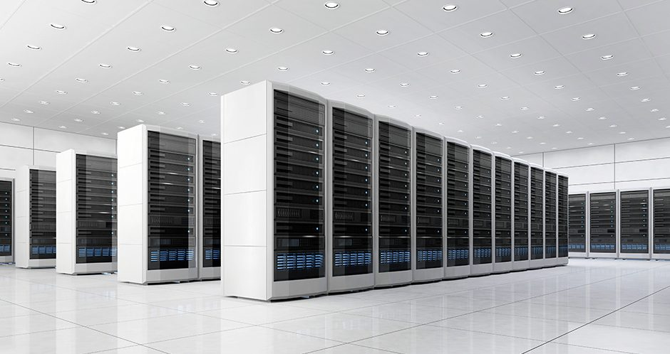
Mainframe
A mainframe is a large, expensive, powerful computer that can handle hundreds or thousands of connected users simultaneously.

Slide 25
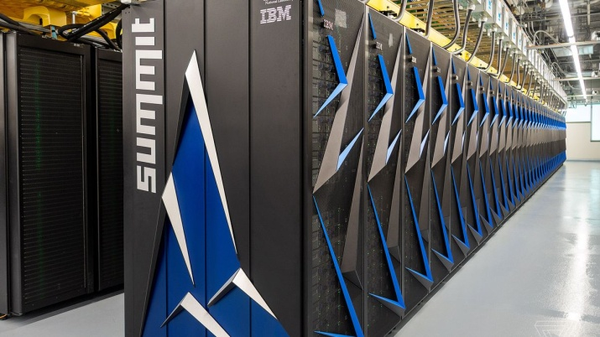
Supercomputer
A supercomputer is the fastest, most powerful computer and the most expensive.
The fastest supercomputers are capable of processing more than one quadrillion instructions in a single second.
Applications requiring complex, sophisticated mathematical calculations use super computers.
Large-scale simulations and applications in medicine, aerospace, automotive design, online banking, weather forecasting, nuclear energy research, and petroleum exploration use a supercomputer

Slide 26
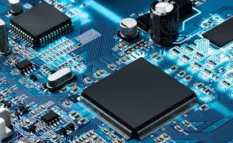
Embedded Computers
An embedded computer is a special-purpose computer that functions as a component in a larger product.
A variety of everyday products contain embedded computers:
Consumer electronics
Home automation devices
Automobiles
Process controllers and robotics
Computer devices and office machines

Slide 27
Examples of computer usage

Slide 28
Examples of computer usage

Slide 29
Computer Applications in Society
Education
Finance
Government
Health care
Science
Publishing
Manufacturing
Travel

