Slide 1
Presentation Topic
Cytoskeleton

Slide 2
Contents
Cytoskeleton
Components of Cytoskeleton
Conclusion

Slide 5
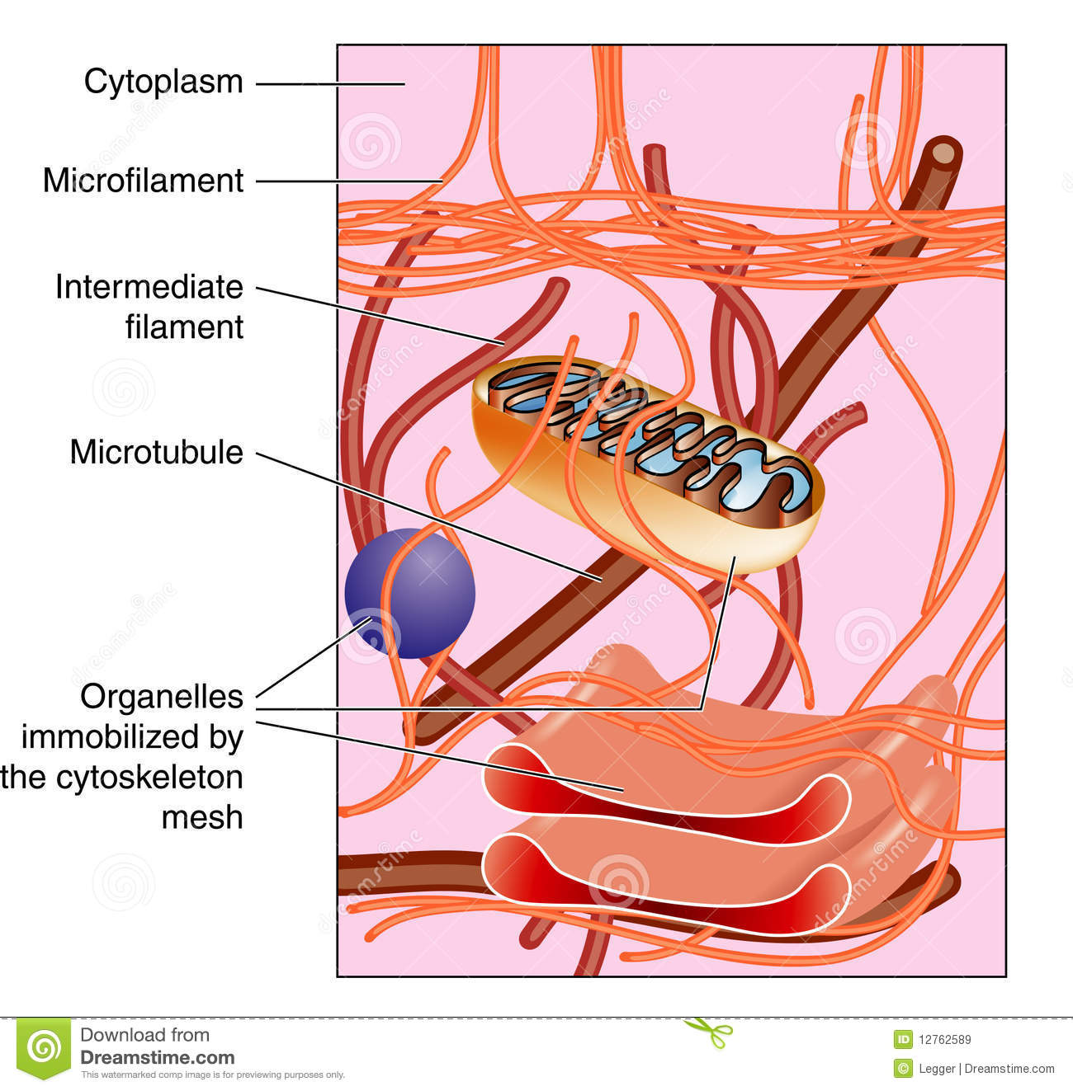
Cytoskeleton

Slide 11
Thank you

