Slide 2
Impact of genetics on Parkinsons Disease

Slide 3
PARKINSONS DISEASE
Parkinson’S disease (PD) is an age- related neurodegenerative disorder. It affects 1% of people over 60 years of age in the west and has an incidence rate of 18 per 100000 per year (Twelves et al., 2003).
Many Parkinson disease symptoms occur when nerve cells (neurons) in the substantia nigra die or become impaired.
Normally, these cells produce a chemical messenger called dopamine, which transmits signals within the brain to produce smooth physical movements.
Eventually, the brain becomes unable to control muscle movement.

Slide 4
Lewy Bodies and Parkinson’s Disease
Lewy body dementia is characterized by the abnormal buildup of proteins into masses known as Lewy bodies. This protein is associated with Parkinson's disease which appear in dead or dying dopamine- producing neurons & are found mainly in the substantia nigra which is in the mid-brain
LB are largely composed of misfolded α-synuclein and also include ubiquitin and small amounts of several other proteins
Cases without Lewy bodies are sometimes referred to as parkinsonism instead of Parkinson disease. It is unclear whether Lewy bodies play a role in killing nerve cells, or if they are part of a protective process.
(Rocca WA etal

Slide 5
Signs of disease
Classical signs are :
resting tremor
rigidity,
bradykinesia
postural instability
• Additional symptoms include flexed posture, loss of postural reflexes
• 70% of PD patients show a resting tremor of 3-5 Hz frequency ab

Slide 6
DEVELOPMENT OF A DISEASE
Development of a disease does not follow a standard pattern
• As the disease progresses, significant motor disability is seen in PD patients even when treated with symptomatic medications
. • Symptoms like hypomimia, dysphagia, sialorrhoea, microphagia, dystonia, are also noted.
• cognitive (dementia)
• neuropsychiatric (depression, apathy, psychosis, anxiety and fatigue)
• Sleep dysfunction (rapid eye movement sleep behaviour disorder, sleep attacks, daytime sleepiness, advanced sleep phase syndrome and early morning awakenings) (Fenelon,2008)

Slide 7
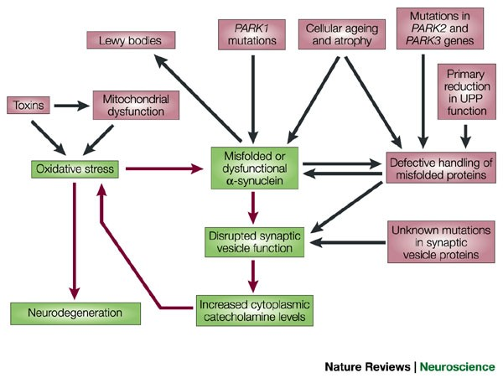
PATHOPHYSIOLOGY OF PARKINSONS DISEASE
Increased levels of cytoplasmic dopamine: a final common pathway leading to nigral degeneration in Parkinson’s disease

Slide 8
In the late 1990s, the discovery of the gene that causes a rare autosomal-dominant form of Parkinson's disease.The mutated gene encodes α-synuclein, a synaptic protein recycling of vesicles that have released their neurotransmitter content into the synaptic cleft. raises the levels of superoxide radicals in the cytoplasm WHICH INDUCED THE OXIDATIVE STRESS.
Also the mutations in parkin and ubiquitin carboxy-terminal hydrolase L1. These proteins participate in the ubiquitin–proteasome pathway, which is responsible for the degradation of unwanted proteins.
So the impaired synaptic vesicle function and misfolding of α-synuclein, due to mutations or to oxidative damage to this protein, that eventually leads to the demise of dopaminergic neurons.

Slide 9
Genetics and PD
Most people affected with PD are not aware of any relatives with the condition but in a number of families, there is a family history. When three or more people are affected in a family, especially if they are diagnosed at an early age (under 50 years) we suspect that there may be a gene making this family more likely to develop the condition.
Approximately 15 percent of people with Parkinson disease have a family history of this disorder. These familial cases are caused by mutations in the LRRK2, PARK2, PARK7, PINK1, or SNCA gene, or by alterations in genes that have not been identified.
Mutations in some of these genes may also play a role in cases that appear to be sporadic. In some families, alterations in the GBA, SNCAIP, or UCHL1 gene appear to modify the risk of developing Parkinson disease.
https://medlineplus.gov/genetics/condition/parkinson-disease/#reference

Slide 10
GBA gene
Official name:
“glucosidase, beta, acid.”
• The GBA gene provides instructions for making an enzyme called beta- glucocerebrosidase.
This enzyme is active in lysosomes, which are structures inside cells that act as recycling centers.
• Cytogenetic Location: 1q21
People with Gaucher disease have mutations in both copies of the GBA gene in each cell, while those with a mutation in just one copy of the gene are called carriers.
Some studies suggest that people with Gaucher disease and GBA mutation carriers have an increased risk of developing Parkinson disease or parkinsonism.
(Alessio B. Di Fonzo etal)

Slide 11
LRRK2 gene
Official name:
“leucine-rich repeat kinase 2.”
• The LRRK2 gene provides instructions for making a protein called dardarin. The LRRK2 gene is active in the brain and other tissues throughout the body, but little is known about this gene or the dardarin protein.
• Cytogenetic Location: 12q12
• Researchers have identified at least 20 LRRK2 mutations in families with late- onset Parkinson disease.
These mutations replace one amino acid with another amino acid in the dardarin protein, which affects the protein's structure and function. It is unclear how LRRK2 mutations lead to Parkinson disease.
(Jin-Tai Yu etal)

Slide 12
PARK2 gene
• Official name: “parkinson protein 2, E3 ubiquitin protein ligase (parkin).”
• The PARK2 gene, one of the largest human genes, provides instructions for making a protein called parkin. Parkin plays a role in the cell machinery that breaks down (degrades) unwanted proteins by tagging damaged and excess proteins with molecules called ubiquitin. .
• Cytogenetic Location: 6q25.2-q27
• Researchers have identified more than 100 PARK2 mutations that cause juvenile Parkinson disease and some adult-onset cases.
Some mutations lead to an abnormally small parkin protein, which is nonfunctional and degrades rapidly.
Other mutations change the building blocks (amino acids) used to make parkin, and the altered protein cannot function properly. PARK2 mutations usually lead to a loss of parkin activity.
(S. N. Illarioshkin etal)

Slide 13
PARK7 gene
• Official name: “parkinson protein 7.”
• The PARK7 gene provides instructions for making the DJ-1 protein.
Studies indicate that this protein has several functions, although none are fully understood.
The DJ- 1 protein may help protect cells, particularly brain cells, from oxidative stress.
• Cytogenetic Location: 1p36.23
• Researchers have identified more than 10 PARK7 mutations that cause early-onset Parkinson disease.
In some cases, a large portion of the PARK7 gene is deleted, and no functional DJ-1 protein is made.
Other mutations lead to an abnormally small DJ-1 protein or change the building blocks (amino acids) used to make the protein.
The altered protein is unstable and does not function properly, if at all.

Slide 14
PINK1 gene
• Official name: “PTEN induced putative kinase 1.”
• The PINK1 gene produces a protein called PTEN.
It appears to help protect mitochondria from malfunctioning during periods of cellular stress, such as unusually high energy demands.
• Cytogenetic Location: 1p36
• More than 20 PINK1 mutations that cause early-onset Parkinson disease.
Many PINK1 mutations alter or eliminate the kinase domain, leading to a loss of protein function.
At least one mutation affects the mitochondrial-targeting motif and may disrupt delivery of the protein to mitochondria.

Slide 15
SNCA gene
• Official name: “synuclein, alpha”
• The SNCA gene provides instructions for making a small protein called alpha- synuclein.
Studies suggest that it plays an important role in maintaining a supply of synaptic vesicles in presynaptic terminals.
It may also help regulate the release of dopamin.
• Cytogenetic Location: 4q21

Slide 16
Researchers have described two types of alterations of the SNCA gene that can cause early-onset Parkinson disease.
One type changes a single protein building block (amino acid) used to make alpha-synuclein.
In some cases, the amino acid alanine is replaced with the amino acid threonine at protein position 53 (written as Ala53Thr) or with the amino acid proline at position 30 (written as Ala30Pro).
In a few cases, the amino acid glutamic acid is replaced with the amino acid lysine at position 46 (written as Glu46Lys).
These mutations cause the alpha-synuclein protein to take on an incorrect 3- dimensional shape (misfold).
• In the other type of alteration, one of the two SNCA genes in each cell is inappropriately duplicated or triplicated. The extra copies of the SNCA gene lead to an excess of alpha-synuclein.
https://medlineplus.gov/genetics/gene/snca/#references

Slide 17
SNCAIP gene
• Official name: “synuclein, alpha interacting protein.”
• The SNCAIP gene provides instructions for making a protein called synphilin-1 and a slightly different version of this protein called synphilin-1A.
These proteins are produced in the brain.
• Cytogenetic Location: 5q23.2
• One SNCAIP mutation has been identified in a small number of people with Parkinson disease.
This mutation leads to a change in one of the building blocks (amino acids) used to make synphilin-1.
Specifically, the amino acid arginine is replaced by the amino acid cysteine at position 621 in the protein's chain of amino acids (written as Arg621Cys or R621C).
• Because the Arg621Cys mutation has been reported in so few cases, it is unclear whether the mutation affects the risk of Parkinson disease.

Slide 18
UCHL1 gene
• Official name: “ubiquitin carboxyl-terminal esterase L1”
• The UCHL1 gene provides instructions for making an enzyme called ubiquitin carboxyl- terminal esterase L1.
Ubiquitin carboxyl- terminal esterase L1 is probably involved in the cell machinery that breaks down (degrades) unwanted proteins.
• Cytogenetic Location: 4p14
• A normal variation (polymorphism) in the UCHL1 gene appears to reduce the risk of developing Parkinson disease, particularly in young adults.
• By contrast, a particular mutation in the UCHL1 gene may increase the risk of Parkinson disease.
A single UCHL1 mutation has been reported in two siblings with this disease.

Slide 19
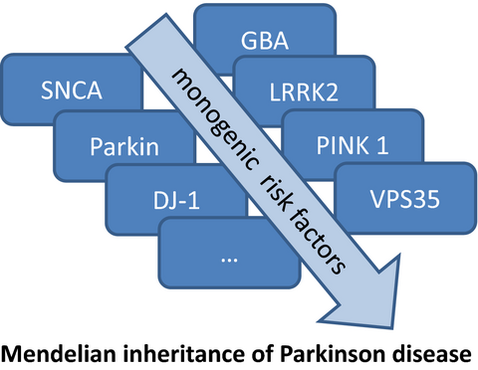
Risk factors for parkinsons disease
Highly penetrant mutations in SNCA, Parkin, DJ‐1, PINK 1, LRRK2 and VPS35 produce rare, monogenic forms of the disease, while unique variants within LRRK2 and GBA show incomplete penetrance and are strong risk factors for PD.

Slide 20
Two Categories of Genes
• “Causal genes” actually cause the disease. A causal gene alone, without the influence of other genes or environmental factors, guarantees that a person who inherits it will develop PD. Only 2% of people with PD. • Examples: SNCA, PARK 2, PARK7
• “Associated genes,” do not cause Parkinson’s on their own, but increase the risk of developing it. A person may have these genes and never develop PD, while people who do not have these genes can still end up being diagnosed with Parkinson’s. • Examples: LRRK2, GBA, SNCAIP (A. B. Singleton etal)

Slide 21
Inheritance
Most cases of Parkinson disease occur in people with no family history of the disorder. The inheritance pattern, if any, is unknown. Inheritance pattern differs depending on the gene that is altered.
If the LRRK2 or SNCA gene is involved, the disorder is inherited in an autosomal dominant pattern, which means one copy of an altered gene in each cell is sufficient to cause the disorder.
Parkinson disease is inherited in an autosomal recessive pattern if the PARK2, PARK7, or PINK1 gene is involved. This type of inheritance means that two copies of the gene in each cell are altered
Most often, the parents of an individual with autosomal recessive Parkinson disease each carry one copy of the altered gene but do not show signs and symptoms of the disorder.

Slide 22
Conclusion:
The value of screening for mutations in asymptomatic family members of LRRK2-mutation carriers are still questionable because until now no neuroprotective therapy has been implemented and symptomatic treatment is performed regardless of the presence or absence of mutations in known genes (Kruger, 2008)
Specific polymorphic variants have been validated as genetic susceptibility factors and protective factors (Xiromerisiou G et al, 2010)
Knowledge of genetic basis of PD will discover key facts of the pathogenesis and lead to new targeted therapeutic strategies in the future (Xiromerisiou G et al, 2010)

Slide 23
References:
Savica R, Grossardt BR, Bower JH, Boeve BF, Ahlskog JE, Rocca WA. Incidence of dementia with Lewy bodies and Parkinson disease dementia. JAMA Neurol. 2013 Nov;70(11):1396-402.
Krüger R. LRRK2 in Parkinson's disease - drawing the curtain of penetrance: a commentary. BMC Med. 2008 Nov 5;6:33.
Thomas B, Beal MF. Parkinson's disease. Hum Mol Genet. 2007 Oct 15;16 Spec No. 2:R183-94. Review.
Xiromerisiou G, Dardiotis E, Tsimourtou V, Kountra PM, Paterakis KN, Kapsalaki EZ, Fountas KN, Hadjigeorgiou GM. Genetic basis of Parkinson disease. Neurosurg Focus. 2010 Jan
https://www.ncbi.nlm.nih.gov/pmc/articles/PMC3681179/

