Slide 1
Process Groups
The Project Management Process Groups: A Case Study

Slide 2
Learning Objectives
Describe the five project management (PM) process groups, the typical level of activity for each, and the interactions among them.
Understand how the PM process groups relate to the PM knowledge areas.
Discuss how organizations develop information technology PM methodologies to meet their needs.

Slide 3
Learning Objectives
Review a case study of an organization applying the PM process groups to manage an information technology project, and understand the contribution that effective project initiation, project planning, project execution, project monitoring and controlling, and project closing make to project success.

Slide 4
Project Management Process Groups
A process is a series of actions directed toward a particular result.
Project management can be viewed as a number of interlinked processes.
The project management process groups include:
Initiating processes
Planning processes
Executing processes
Monitoring and controlling processes
Closing processes

Slide 5
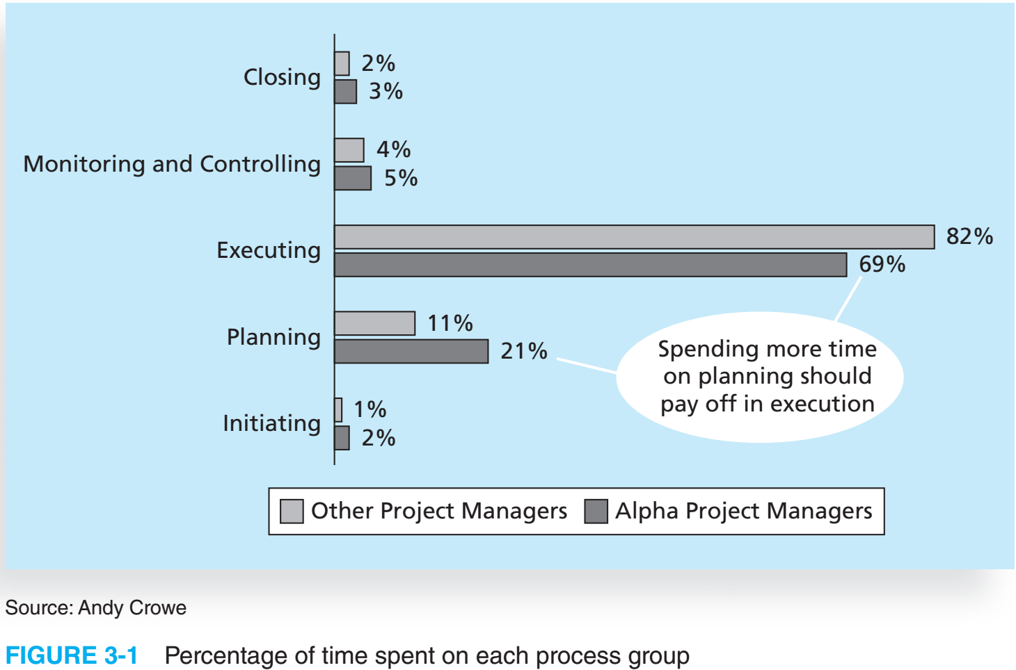

Slide 6
Process Groups
Initiating
Processes
Planning
Processes
Executing
Processes
Controlling
Processes
Closing
Processes

Slide 7
Process Interactions
Inputs
Tools and techniques
Outputs
Taxonomy
Notes:
-Taxonomy – “Arrangement”

Slide 8
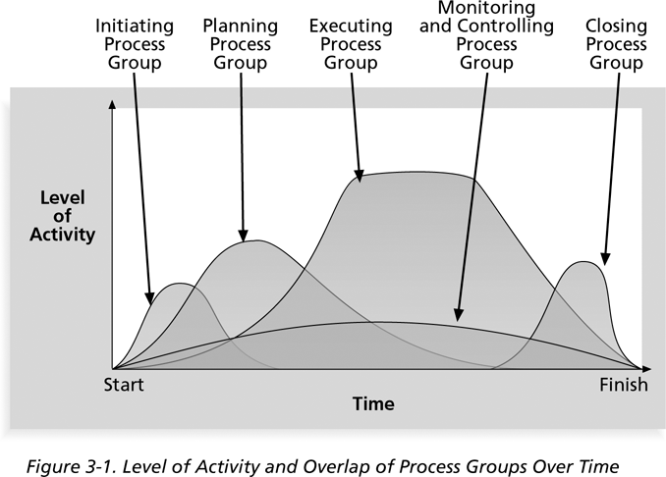
Level of Activity and Overlap of Process Groups Over Time

Slide 9
What Went Wrong?
Philip A. Pell, PMP, commented on how the U.S. IRS needed to improve its project management process. “Pure and simple, good, methodology-centric, predictable, and repeatable project management is the SINGLE greatest factor in the success (or in this case failure) of any project…The project manager is ultimately responsible for the success or failure of the project.”*
*Pell, Phillip A., Comments posted on CIO Magazine Web site on article “For the IRS, There’s No EZ Fix” (April 1, 2004).
Notes:
Internal Revenue Service (IRS)

Slide 10
Media Snapshot
Just as information technology projects need to follow the project management process groups, so do other projects, such as the production of a movie. Processes involved in making movies might include screenwriting (initiating), producing (planning), acting and directing (executing), editing (monitoring and controlling), and releasing the movie to theaters (closing). Many people enjoy watching the extra features on a DVD that describe how these processes lead to the creation of a movie…This acted “…not as promotional filler but as a serious and meticulously detailed examination of the entire filmmaking process.”* Project managers in any field know how important it is to follow a good process.
*Jacks, Brian, “Lord of the Rings: The Two Towers Extended Edition (New Line),” Underground Online (accessed from www.ugo.com August 4, 2004).

Slide 11
Mapping the Process Groups to the Knowledge Areas
You can map the main activities of each PM process group into the ten knowledge areas by using the PMBOK® Guide 2004.
Note that there are activities from each knowledge area under the planning process group.
All initiating activities are part of the project integration management knowledge area.

Slide 12
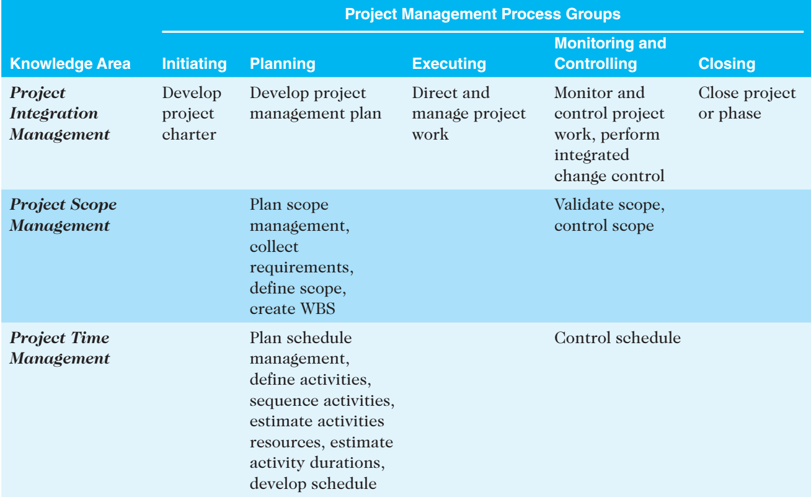
Relationships Among Process Groups and Knowledge Areas
PMBOK® Guide 2004, p. 69

Slide 13
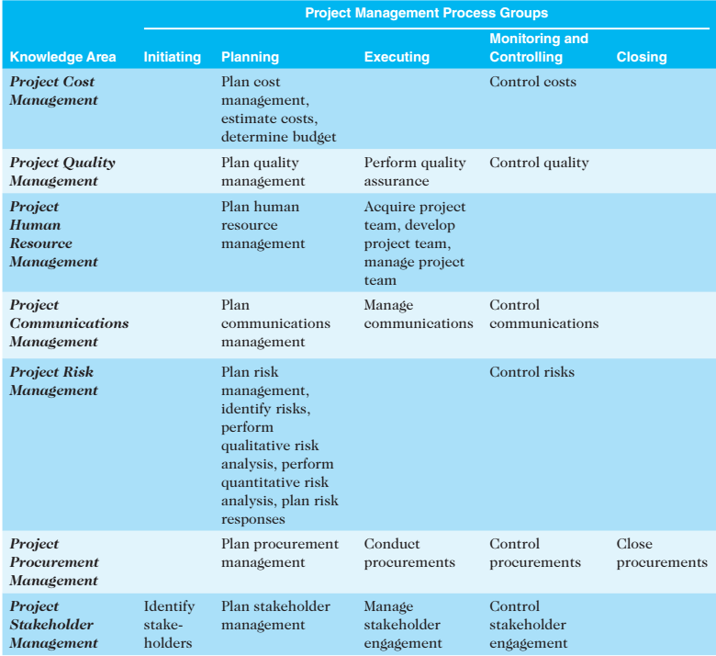
Relationships Among Process Groups and Knowledge Areas (cont’d)

Slide 14
Developing an IT Project Management Methodology
Just as projects are unique, so are approaches to project management.
Many organizations develop their own project management methodologies, especially for IT projects.
BlueCross BlueShield of Michigan used the PMBOK® Guide 2000 to develop their IT project management methodology.
Six Sigma projects and the Rational Unified Process (RUP) framework use project management methodologies.
Notes:
- PRojects IN Controlled Environments (PRINCE2) - Agile methods - Rational Unified Process (RUP) framework: - Six Sigma methodologies:

Slide 15
What Went Right?
Jordan Telecom (JT), Jordan’s only telecom operator, introduced new customized project management processes to improve efficiency and reduce costs in its Information Technology department…JT created three lines of processes based on the size of the project: high, medium, or low...Rula Ammuri, JT’s Chief Information Officer, believes this new methodology will result in a 40-50 percent increase in productivity.*
Al-Tamimi, Fairooz, “Jordanian Company Uses PMI Methods to ‘Go Global’, Improve Productivity,” PMI Today (August 2004).

Slide 16
Case Study: JWD Consulting’s Project Management Intranet Site
This case study provides an example of what’s involved in initiating, planning, executing, controlling, and closing an IT project.
You can download templates for creating your own project management documents from the companion Web site for this text.
This case study provides a big picture view of managing a project. Later chapters provide detailed information on each knowledge area.

Slide 17
Project Initiation
Initiating
Processes
Planning
Processes
Executing
Processes
Controlling
Processes
Closing
Processes

Slide 18
Project Initiation
Initiating a project includes recognizing and starting a new project or project phase.
Some organizations use a pre-initiation phase, while others include items such as developing a business case as part of the initiation.
The main goal is to formally select and start off projects.
Key outputs include:
Assigning the project manager.
Identifying key stakeholders.
Completing a business case.
Completing a project charter and getting signatures on it.

Slide 19
Purpose of Initiation Process
To commit the organization to a project or phase
To set the overall solution direction
To define top-level project objectives
To secure the necessary approvals and resources
Validate alignment with strategic objectives
To assign a project manager

Slide 20
Process Group Overview

Slide 21
Initiating Core Process—Initiation

Slide 22
Business case information:
Introduction/background
Business objective
Current situation and problem/opportunity statement
Critical assumptions and constraints
Analysis of options and recommendation
Preliminary project requirements
Budget estimate and financial analysis
Schedule estimate
Potential risks

Slide 23
JWD Consulting’s Business Case

Slide 26
Project Charter
“A document issued by senior management that provides the project manager with the authority to apply organizational resources to project activities.”

Slide 27
Project Charter Content
Business need
Project objectives
Project deliverables
Assumptions
Constraints
Key staff
Written authorization

Slide 28
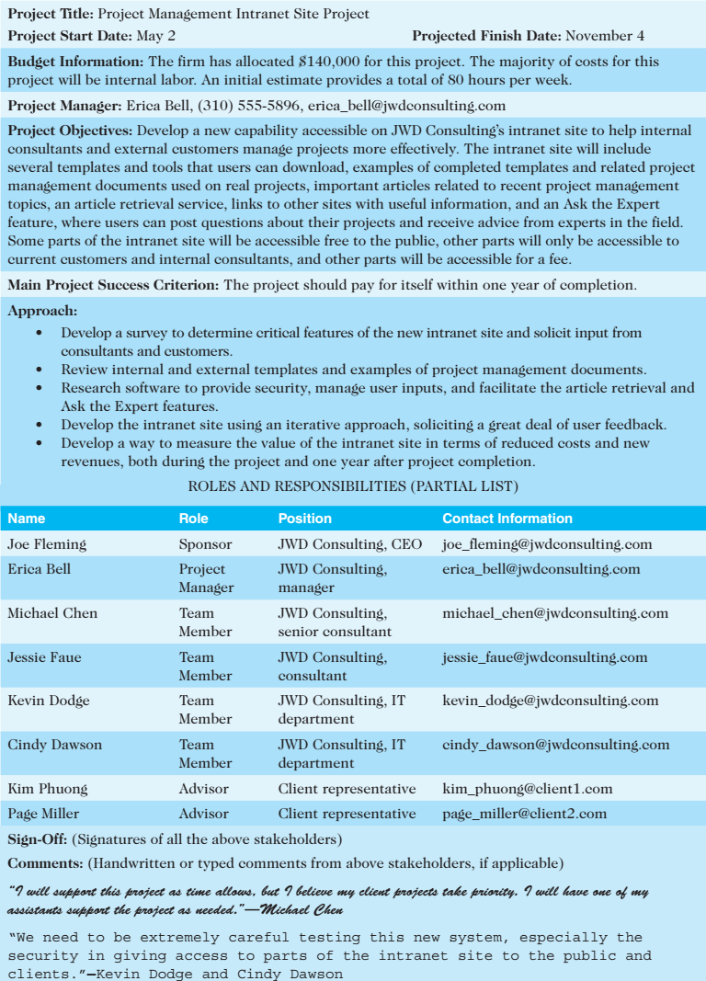

Slide 29
Project Initiation Documents
Business case:
Charter:
Every organization has its own variations of what documents are required to initiate a project. It’s important to identify the project need, stakeholders, and main goals.

Slide 30
Exercise: Project Charter
Using the handout, complete the sample project charter of your project
Assume you are the project manager
Sample Initiating Activities
Negotiate, write, and refine the project charter
Confirm how the project links to the business need
Identify management responsibilities
Identify geographic locations involved
Test top-level objectives versus strategic business plans
Make strategic procurement decisions, e.g., make, buy, or identify qualified vendors

Slide 31
Key Outputs of Initiation Process
Project charter
Project manager identified/assigned
Other key positions identified/assigned
Constraints identified
Assumptions identified

Slide 32
Planning Process Group

Slide 33
Purpose of Planning Processes
To develop a project plan that:
Facilitates later accomplishment*
Ensures project wide integration
Monitors change effectively
Provides decision support information to stakeholders
Can be updated by iterative planning activities

Slide 34
Project Planning
The main purpose of project planning is to guide execution.
Every knowledge area includes planning information
Key outputs included in the JWD project include:
A team contract.
A scope statement.
A work breakdown structure (WBS).
A project schedule, in the form of a Gantt chart with all dependencies and resources entered.
A list of prioritized risks (part of a risk register).

Slide 36
WBS
JWD Consulting intranet project work breakdown structure (WBS)

Slide 37
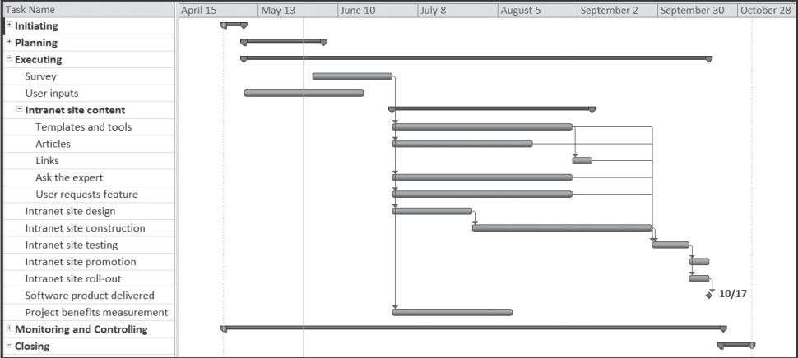
JWD Consulting Intranet Site Project Baseline Gantt Chart

Slide 38
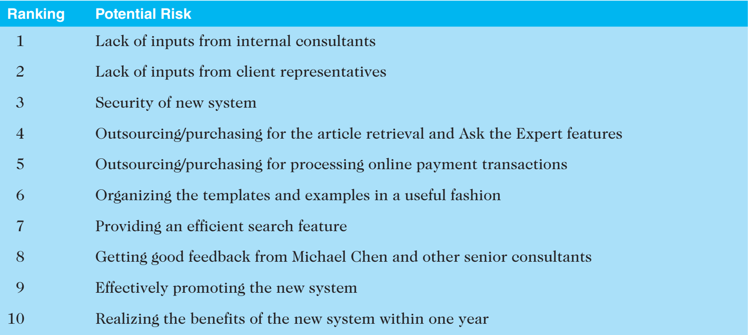
List of Prioritized Risks

Slide 39
Initiating
Processes
Planning
Processes
Executing
Processes
Executing
Processes
Controlling
Processes
Closing
Processes

Slide 40
Project Executing
Project execution usually takes the most time and resources.
Project managers must use their leadership skills to handle the many challenges that occur during project execution.
Many project sponsors and customers focus on deliverables related to providing the products, services, or results desired from the project.
A milestone report can keep the focus on completing major milestones.

Slide 41
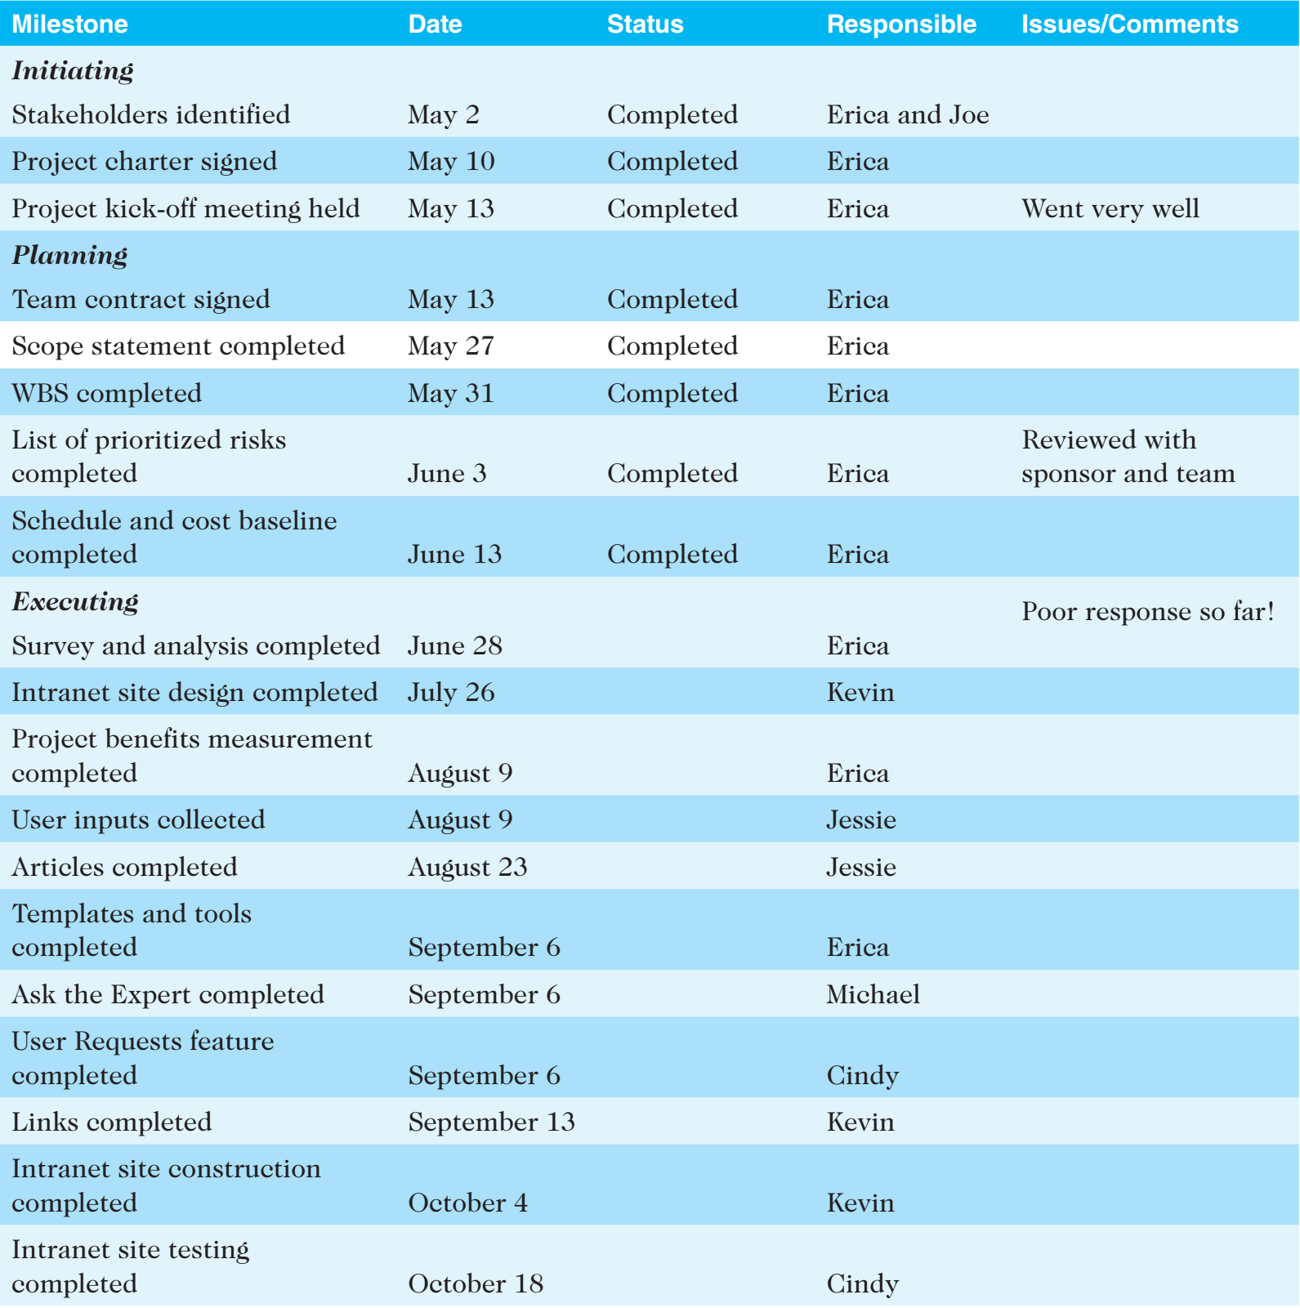
Part of Milestone Report

Slide 43
Initiating
Processes
Planning
Processes
Executing
Processes
Controlling
Processes
Closing
Processes

Slide 44
Project Monitoring and Controlling
Involves measuring progress toward project objectives, monitoring deviation from the plan, and taking corrective action to match progress with the plan.
Affects all other process groups and occurs during all phases of the project life cycle.
Outputs include performance reports, requested changes, and updates to various plans.

Slide 46
Initiating
Processes
Planning
Processes
Executing
Processes
Controlling
Processes
Closing
Processes

Slide 47
Project Closing
Involves gaining stakeholder and customer acceptance of the final products and services.
Even if projects are not completed, they should be formally closed in order to reflect on what can be learned to improve future projects.
Outputs include project archives and lessons learned, which are part of organizational process assets.
Most projects also include a final report and presentation to the sponsor or senior management.

Slide 49
Communication Flow

Slide 50
Chapter Summary
The five project management process groups are initiating, planning, executing, monitoring and controlling, and closing.
You can map the main activities of each process group to the nine knowledge areas.
Some organizations develop their own information technology project management methodologies.
The JWD Consulting case study provides an example of using the process groups and shows several important project documents.

Slide 51
Bibliography
[1] Information Technology Project Management | 7th Edition by Kathy Schwalbe
Chapter No: 3
[2] A Guide to the Project Management body of knowledge (PMBOK ® Guide) | Fifth Edition
Chapter No: 3

