Slide 1
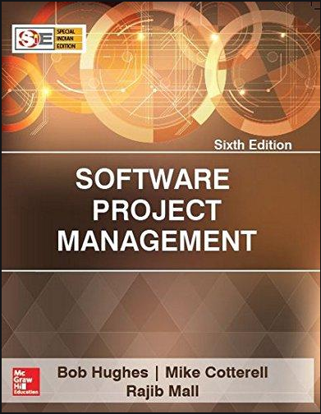
Software Project Management
6th Edition
Lecture 6
Chapter 3
Project Planning
Scope Management (WBS)
Project Management Institute

Slide 2
Objectives – Lecture 6
Project Planning
Project Selection
Project Scope
Project Infrastructure
Analyse Project Characteristics
Identify Project & Product Activities
Work Break Down Structure

Slide 3
‘Step Wise’ - aspirations
Practicality
tries to answer the question ‘what do I do now?’
Scalability
useful for small project as well as large
Range of application
Accepted techniques
e.g. borrowed from PRINCE etc

Slide 4
‘Step Wise’ - an overview
0.Select
project
1. Identify
project objectives
2. Identify project
infrastructure
3. Analyse
project
characteristics
Review
4. Identify products
and activities
5. Estimate effort
for activity
Lower level detail
For each
activity
6. Identify activity
risks
10. Lower level
planning
7. Allocate
resources
9. Execute plan
8. Review/ publicize
plan
Notes:
This is an overview of the main steps, details of which will be discussed in the following overheads:
0. Select project There must be some process by which the project to be executed was selected. Chapter 2 on project evaluation looks at this in more detail.
1. Identify project objectives It is important that at the outset the main stakeholders are all aware of the precise objectives of the project. This has already been discussed in Chapter 1.
2. Identify project infrastructure This may not be a significant step where you are working on an in-house project in a very familiar environment. However, where the project is being carried out for external clients then you may need to investigate the characteristics of the environment in which the project is to be carried out.
3. Analyse project characteristics Different types of project will need different technical and management approaches. For example, a project to implement control software embedded in industrial equipment will need a different set of methods than a project to implement a business information system. A multimedia application would again need a different set of activities. (This is not to say that there could not be considerable overlaps in the approaches).
4. Identify products and activities With software projects, it is best to start by listing the products, both deliverable and intermediate, to be created. The activities needed to create the products can then be identified
5. Estimate effort for activity.
6. Identify activity risks Having assessed the amount of effort and the elapsed time for a project, the reasons why these might be vary during the actual execution of the project need to be considered. Where there is a very high risk of additional effort/time being needed then actions to reduce this risk may be formulated.
7. Allocate resources With software projects, these resources will mainly be staff, but could be equipment etc.
8. Review/publicize It is no good having a plan if no one knows about it
9. Execute Plan
10. Lower level planning Not all of a project, especially when it is large, can be planned in detail at the outset. Not all the information needed to plan the later stages will be available at the beginning: for example software development cannot be broken down into precise sub-tasks with realistic target times until more is known about what the overall design of the system is known.

Slide 5
Step 1: Identify project scope and objectives Step 1.1 : Identify objectives and practical measures of the effectiveness in meeting those objectives Step 1.2 : Establish a project authority Step 1.3 : Stakeholder analysis - identify all stakeholders in the project and their interests. Step 1.4 : Modify objectives in the light of stakeholder analysis. Step 1.5 : Establish methods of communication with all parties. Step 2 : Identify project infrastructure Step 2.2 : Identify installation standard and procedures Step 2.3 : Identify project team organization Step 3 : Analyse project characteristics Step 3.1 : Distinguish the project as either objectives- or product-driven. Step 3.2 : Analyse other project characteristics Step 3.3 : Identify high-level project risks Step 3.4 : Take into account use requirements concerning implementation Step 3.5 : Select development methodology and life-cycle approach Step 3.6 : Review overall resource estimates Step 4 : Identify project products and activities Step 4.1 : Identify and describe project products Step 4.2 : Document generic product flows Step 4.3 : Recognize product instances Step 4.4 : Produce ideal activity network Step 4.5 : Modify the ideal to take into account need for stages and checkpoints Step 5 : Estimate effort for each activity Step 5.1 : Carry out bottom-up estimates - distinguish carefully between effort and elapsed time Step 5.2 : Revise plan to create ontrollable activities - breakup very long activities into a series of smaller ones - bundle up very short activities Step 6 : Identify activity risks Step 6.1 : Identify and quantify activity based risks - damage if risk occurs - likelihood if risk occuring Step 6.2 : Plan risk reduction and contingency measures - risk reduction : activity to stop risk occuring - contingency : action if risk does occurs Step 6.3 : Adjust overall plans and estimates to take account of risks Step 7 : Allocate resources Step 7.1 : Identify and allocate resources Step 7.2 : Revise plans and estimates to take into account resource constraints Step 8 : Review/ Publicize plans Step 8.1 : Review quality aspects of the project plan Step 8.2 : Documentr plans and obtain agreement Step 9 and 10 : Execute plan. Lower levels of planning

Slide 6
Step 1 establish project scope and objectives
This step is the corner stone of all the subsequent steps. If the stakeholders did not conduct regular meetings put hands on objectives, deliverables and confirm the scope before the project being kick started, the project members will struggle throughout the course of the project.
it is about making sure that project stakeholders understand and confirm the scope of the project that includes goals, deliverables, tasks, costs and deadlines.
This step is divided into series of sub steps that try to spot the key elements of having successful project initiation.

Slide 7
Step 1 continued
1.1 Identify objectives and measures of effectiveness | ‘how do we know if we have succeeded?’
1.2 Establish a project authority | ‘who is the boss?’
1.3 Identify all stakeholders in the project and their interests | ‘who will be affected/involved in the project?’
1.4 Modify objectives in the light of stakeholder analysis | ‘do we need to do things to win over stakeholders?’
1.5 Establish methods of communication with all parties | ‘how do we keep in contact?’

Slide 8
Step 2 Establish project infrastructure
Infrastructure here refers to the physical and logical grounds where the project will be based on. For the physical ground, the project manager should survey the systems and hardware that the project will operate on while considering the compatibility issue. For the logical ground, the connection between the project and the other running projects and the strategic objectives while considering the team organization who will handle the project operations
Notes:
At the same time as establishing exactly what the project objectives are, the person responsible may know little about the organizational environment in which the application is to be developed and implemented. The actions in Step 2 address this problem.

Slide 9
Step 2 continued
2.1 Establish link between project and any strategic plan | ‘why did they want the project?’
2.2 Identify installation standards and procedures | ‘what standards do we have to follow?’
2.3. Identify project team organization | ‘where do I fit in?’

Slide 10
Step 3 Analysis of project characteristics
Once the major elements of the project such as scope, objectives, features and infrastructure are surveyed and documented, it is time to kick start the implementation.
There is no typical way to implement a software product or service it all depends on the nature of the project.
Consequently, the project manager would choose the best development methodology, the proper life cycle approach, the way of handling risks and estimating efforts.
---------------------------------------------------------------------------------------------------
This step digests the project nature either product or objective driven, spots risks that affect the outcome of the project and considers the client’s standards and procedures. This is done to carefully select the development methodology and the lifecycle approach while giving the project manager a better understanding on the current situation on the efforts estimation.
Notes:
Step 3 is about examining the nature of the application to be built and the environment in which it is to be built and implemented and identifying the most appropriate technical approach.
3.1 Objective-based versus product-based projects. With a product-based project the developers have to create a product, the specification of which is often (but not always) clearly defined. In an objective-based project, a problem is defined that needs to be solved but there could be more than one solution.
3.2 Analyse other project characteristics – such as is it an information system or an embedded real time or a multimedia application? Is it safety-critical? Etc etc

Slide 11
Step 3 continued
3.1 Distinguish the project as either objective or product-based. | Is there more than one way of achieving success?
3.2 Analyse other project characteristics (including quality based ones)/non-functional requirement. | what is different about this project? e.g. It could be safety critical where malfunction could threaten human lives.
3.3 Identify high level project risks Risks are raised from operational environment or due to technicalities | ‘what could go wrong?’ ‘what can we do to stop it?’
3.4 Take into account user requirements concerning implementation. | ‘whether client has its own procedural requirements’?
3.5 Select general life cycle approach | waterfall? Increments? Prototypes?
3.6 Review overall resource estimates | ‘does all this increase the cost?’ This means efforts and resources required to implement the project should be roughly re-calculated considering and revising cost estimates and the team organization.
Notes:
Step 3.2 is concerned with the critical part of the system that is not listed in the functional requirements. For example, the safety system of closing the tubes door once the passengers hop in
Step 3.3
Operational environment : Some senior staff consider installing new system that absorbs their knowledge and experience they gained along many years is a threat. This is because fresh candidates with the minimal time of experience could in short time act as seniors.
Technicalities : An example of the technicalities risks, the backward compatibility with the existing systems as it requires extensive programming and customizations.

Slide 12
Step 4 Identify project products and activities
4.1 Identify and describe project products - ‘what do we have to produce?’
A Product is the result of an activity
A Product Could be (among other things)
physical thing (‘installed pc’),
a document (‘logical data structure’)
a person (‘trained user’)
a new version of an old product (‘updated software’)
The following are NOT normally products:
activities (e.g. ‘training’)
events (e.g. ‘interviews completed’)
resources and actors (e.g. ‘software developer’) - may be exceptions to this
Products can be deliverable (training Material, Operating instruction) or intermediate (sub-product is used in the process of creating another deliverable)

Slide 13
4.1 Identify and describe project products
In order to identify the project deliverables, Product Breakdown Structure (PBS) is developed and continuously refined until all deliverable are identified. It is breaking the grand product into sub products and the sub-products are broken into smaller sub-products. The only boxes that represent tangible products are at the bottom of the hierarchy, that are not further sub divided as shown in below figure.
Project Products
System products
Module Products
Management Products
Module Design Documents
Module
Code
Progress Reports
Overall Specification
Integration Test Cases
Test integrated Software

Slide 14
Product description (PD)
Product identity
Description - what is it?
Derivation - what is it based on?
Composition - what does it contain?
Format
Relevant standards
Quality criteria
Create a PD for ‘test data’
Notes:
The names of products on the PBS can be rather vague. If you were to ask someone to produce, for example, the ‘analysis report’ in the usability testing scenario, then you would need to explain exactly what you mean by that. This is done via a Product Description. PDs can usually be re-used from one project to another.

Slide 15
Step 4.2 : Document Generic Product Flow
Product Flow how activity and flow is linked or has dependencies.
For example, if you are going to develop a software system according to the user requirements; firstly, you should collect the product specification. Secondly, developing the module design. Thirdly, Module coding. These products are dependent on each other. You could develop separately the test cases.
These relationships are depicted in a Product Flow Diagram (PFD)
User requirements
Modules Design
Module Coding
Integrated and tested Software System
System Specifications
Integration System Test cases

Slide 16
Step 4.3 Recognize product instances
In step 4.2 example, for modules design, as the software system is naturally composed of multiple modules, so it is expected to have a design for each module. This means for the product “Module Design” multiple instances based on the number of modules. And the same for Product “Module Coding” as each module design needed to be coded, the instances of product “Module Coding” will be the same as the product “Module Design” as shown in the figure below.

Slide 17
4.4. Produce ideal activity network
In order to generate one product from another there must be one or more activities that carryout the transformation .By identifying these activities we can create an activity network which shows the tasks that have to be carried out and the order in which they have to be executed.
The activity networks are ‘ideal’ in the sense that no account has been taken of resource constraints. In the figure below, designer and developers are available for Modules A and B where these modules are developed in parallel. All activities are labeled as verbs on the contrary of the PDF that is labeled as nouns
Design integration test cases
S
Specify overall system
Test Integrated Software System
S
Design Module A
Code Module A
Design Module B
Code Module B

Slide 18
Step 4.5 Add check-points if needed
Design
module A
Code
module A
Design
system
Design
module B
Code
module B
Test
system
Design
module C
Code
module C
put in a
check point
Design
module A
Code
module A
Design
system
Design
module B
Check-point
Code
module B
Test
system
Design
module C
Code
module C

Slide 19
Step 5:Estimate effort for each activity
5.1 Carry out bottom-up estimates
distinguish carefully between effort and elapsed time
5.2. Revise plan to create controllable activities
break up very long activities into a series of smaller ones
bundle up very short activities (create check lists?)
Notes:
Effort is the total number of staff-hours (or days etc) needed to complete a task. Elapsed time is the calendar time between the time task starts and when it ends. If 2 people work on the same task for 5 days without any interruption, then the effort is 10 staff-days and the elapsed time is 5 days.
Using the PBS/PFD to generate the activities often means that some activities are very small and others are huge. Often there is an activity called ‘write software’ which is 70% of a software development project. These large activities need to be broken down into more manageable small tasks. You should aim for the average length of your activities to be about the time between progress meetings e.g. if you have team progress meeting once a fortnight, try to make the tasks last about 2 weeks.

Slide 20
Step 6: Identify activity risks
6.1.Identify and quantify risks for activities
damage if risk occurs (measure in time lost or money)
likelihood if risk occurring
6.2. Plan risk reduction and contingency measures
risk reduction: activity to stop risk occurring
contingency: action if risk does occur
Notes:
Note that we have already considered some high level risks that could affect the project as a whole at Step 3. Estimates of the effort and duration of activities can be quite tricky. When you produce an estimate for an activity it is worth reflecting about the events which could cause the assumptions upon which you have based your estimate to be wrong. Where the risk seems very high, then you might try to introduce new activities specifically designed to reduce the risk, or to formulate a contingency action if the risk should materialize. For example, there is not much you can do to stop people getting the flu at a critical time in the project, but you might be able to have a plan to bring in temporary cover for sickness in the case of time-critical activities.
Lecture/chapter 7 focuses particularly on risk.

Slide 21
6.3 Adjust overall plans and estimates to take account of risks
e.g. add new activities which reduce risks associated with other activities e.g. training, pilot trials, information gathering

Slide 22
Step 7: Allocate resources
7.1 Identify and allocate resources to activities
7.2 Revise plans and estimates to take into account resource constraints
e.g. staff not being available until a later date
non-project activities
Notes:
You now need to allocate resources (in particular, staff) to the activities in the plan. Where there is a resource constraint, that is there are not enough staff (or other resource) of the right type to start all the activities that run in parallel at the planned time, then the start of some activities may need to be delayed until the appropriate resources are available.

Slide 23
Gantt charts
LT = lead tester
Week commencing
MARCH
APRIL
TA = testing assistant
5
12
19
26
2
9
16
Plan testing
LT
Select subjects
TA
Design questionnaire
LT
Book machine
TA
Conduct tests
TA
Analyse results
LT
Draft changes
LT
Notes:
We now have the basic information needed to produce a plan. One way of presenting the plan is by means of a Gantt chart (named after Henry Gantt).

Slide 24
Step 8: Review/publicise plan
8.1 Review quality aspects of project plan
8.2 Document plan and obtain agreement
Step 9 and 10: Execute plan and create lower level plans
Notes:
We have noted already that it is not feasible to produce a detailed plan for all stages of the project right at the beginning of the project planning process and not all the information needed for the detailed planning of the later stages is available at the outset. Initially an outline plan for the whole project would be produced, plus a detailed plan for the first stage.

Slide 25
Work breakdown structure - WBS
Create WBS is the process of subdividing project deliverables and project work into smaller, more manageable components. The key beneﬁt of this process is that it provides a framework of what has to be delivered. This process is performed once or at predeﬁned points in the project. The inputs, tools and techniques, and outputs of this process are depicted in Figure 1. which describes the data ﬂow diagram of the process.
Figure 1. Create WBS: Inputs, Tools & Techniques, and Outputs

Slide 26
Work breakdown structure - WBS
Definition: “The WBS is a hierarchical decomposition of the total scope of work to be carried out by the project team to accomplish the project objectives and create the required deliverables. “
Work Package: The planned work is contained within the lowest level of WBS components, which are called work packages.
The work package is the work deﬁned at the lowest level of the WBS for which cost and duration can be estimated and managed.
In the context of the WBS, work refers to work products or deliverables that are the result of activity and not to the activity itself.
The WBS represents all product and project work, including the project management work. The total of the work at the lowest levels should roll up to the higher levels so that nothing is left out and no extra work is performed. This is sometimes called the 100 percent rule.
Product Scope: Requirements that relate to the product, service or result of the project. Example Train terminal should meet technical specifications.
Project Scope: The work project team will do to deliver the product of the project. Example Train terminal should meet technical specifications plus all the work like planning, coordination , management etc.
Notes:
Project scope statement: The project scope statement includes the description of the project scope, major deliverables, assumptions, and constraints.
Scope baseline: is the approved version of a scope statement, WBS, and its associated WBS dictionary, which can be changed only through formal change control procedures and is used as a basis for comparison. It is a component of the project management plan.

Slide 27
WBS - Tools and Techniques
Decomposition: is a technique used for dividing and subdividing the project scope and project deliverables into smaller, more manageable parts. The level of decomposition is often guided by the degree of control needed to effectively manage the project. As the work is decomposed to greater level of details, the ability to plan, manage and control the work is enhanced. However, excessive decomposition can lead to non productive management effort, inefficient use of resources, decreased efficiency in performing the work and difficulty aggregating data over different levels of the WBS.
A WBS structure may be created through various approaches. Some of the popular methods include Top-down method and Bottom up approach.
Top-down approach:To use the top-down approach, start with the largest items of the project and break them into their subordinate items. This process involves refining the work into greater and greater levels of detail. After finishing the process, all resources should be assigned at the work package level. The top-down approach is best suited to project managers who have vast technical insight and a big-picture perspective.

Slide 28
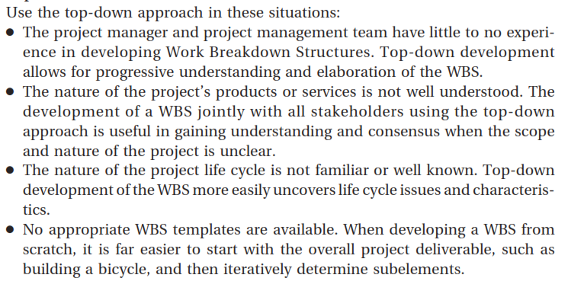
Notes:
The

Slide 29
Bottom-up approach can be used to group subcomponents. In the bottom-up approach, team members first identify as many specific tasks related to the project as possible. They then aggregate the specific tasks and organize them into summary activities, or higher levels in the WBS. For example, a group of people might be responsible for creating a WBS to create an e-commerce application. Instead of looking for guidelines on how to create a WBS or viewing similar projects WBSs, they could begin by listing detailed tasks they think they would need to do in order to create the application. After listing these detailed tasks, they would group the tasks into categories. Then they would group these categories into higher-level categories.
Some people have found that writing all possible tasks down on notes and then placing them on a wall helps them see all the work required for the project and develop logical groupings for performing the work. For example, a business analyst on the project team might know that they had to define user requirements and con- tent requirements for the e-commerce application. These tasks might be part of the requirements documents they would have to create as one of the project deliverables. A hardware specialist might know they had to define system requirements and server requirements, which would also be part of a requirements document. As a group, they might decide to put all four of these tasks under a higher-level item called define requirements that would result in the delivery of a requirements document. Later, they might realize that defining requirements should fall under a broader category of concept design for the e-commerce application, along with other groups of tasks related to the concept design. The bottom-up approach can be very time-consuming, but it can also be a very effective way to create a WBS. Project managers often use the bottom-up approach for projects that represent entirely new systems or approaches to doing a job, or to help create buy-in and synergy with a project team.

Slide 30
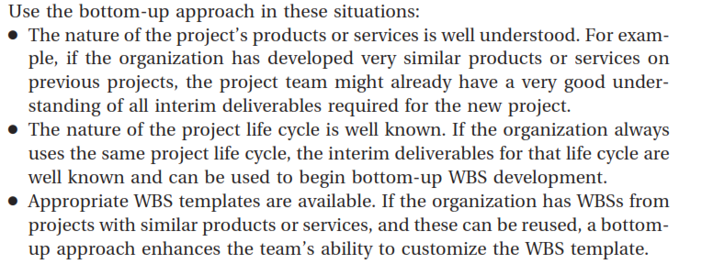

Slide 31
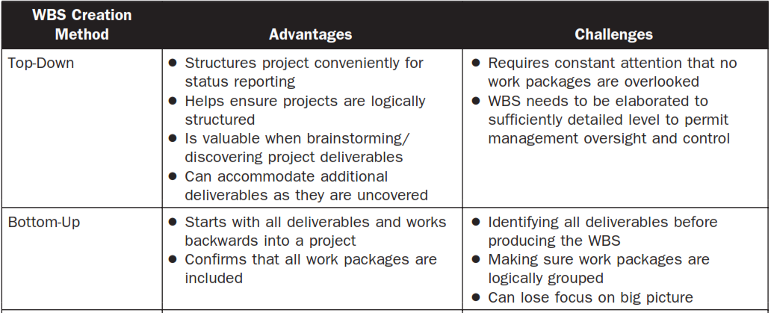
Advantages / Disadvantages

Slide 32
Representation of WBS/decomposition
The WBS structure can be represented in a number of forms, such as:
Using phases of the project life cycle as the second level of decomposition, with the product and project deliverables inserted at the third level, as shown in Figure 2; (refer to next slides)
Using major deliverables as the second level of decomposition, as shown in Figure 3; (refer to next slides)

Slide 33
Decomposition Development Approaches –Figure 2
Figure 2. Sample WBS Organized by Phase

Slide 34
Decomposition Development Approaches –Figure 3
Figure 3. Sample WBS with Major Deliverables

Slide 35
