Slide 1
Dr. Muhammad Ali-ur-Rasheed
Lecturer , Department of Physiotherapy.
Sargodha Medical College.

Slide 2
SENSORY INTEGRATION
If all of the sensory stimuli which enter the central nervous system were allowed to bombard the higher centres of the brain, the individual would be rendered utterly ineffective. It is the brain’s task to filter, organize, and integrate a mass of sensory information so that it can be used for the development and execution of the brain’s functions
Sensory integration is the ability of the brain to organize, interpret, and use sensory information.
This integration provides an internal representation of the environment that informs and guides motor responses.
This sensory representations provide the foundation on which motor programs for purposeful movements are planned, coordinated, and implemented

Slide 3
Ayers defined sensory integration as “the neurological process that organizes sensation from one’s own body and from the environment and makes it possible to use the body effectively within the environment.”

Slide 4
SENSATION AND MOVEMENT
The CNS uses this information to influence movement by both feedback and feedforward control.
Feedforward
control is a proactive strategy that uses sensory information obtained from experience. Signals are sent in advance of movement allowing for anticipatory adjustments in postural control or movement.
Feedback
Feedback control uses sensory information received during the movement to monitor and adjust output.

Slide 5
SENSORY INTEGRITY
The term somatosensation (somatosensory) refers to sensation received from the skin and musculoskeletal system
Examination of sensory function involves testing sensory integrity by determining the patient’s ability to interpret and discriminate among incoming sensory information.

Slide 6
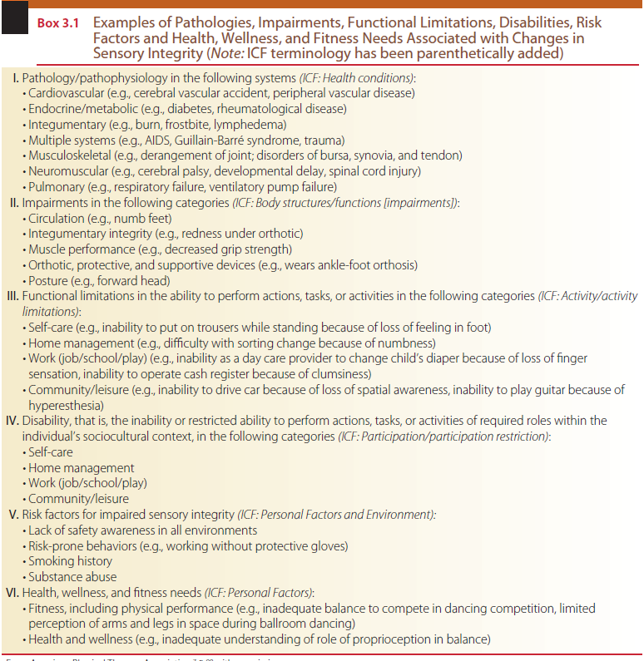

Slide 7
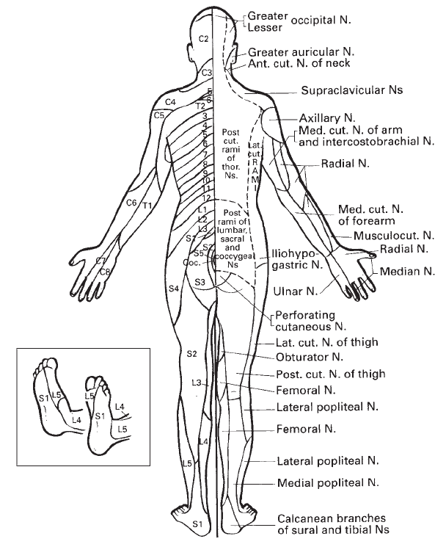
Pattem (Distribution) of Sensory Impairment
Sensory dermatomes

Slide 8
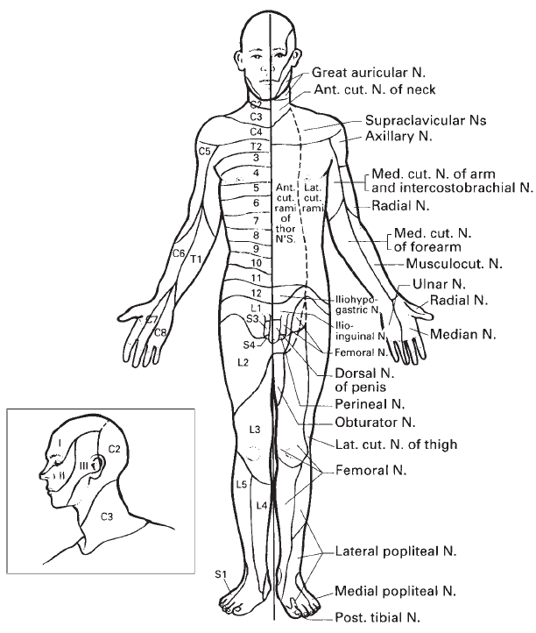

Slide 9
PRELIMINARY CONSIDERATIONS
(1) Arousal level, Attention span, Orientation, and Cognition
(2) memory, hearing, and visual acuity. these preliminary tests are typically considered with sensory involvement associated with CNS lesions.

Slide 10
AROUSAL
Arousal is the physiological readiness of the human system for activity.
Alert. the patient is awake and attentive to normal levels of stimulation. Interactions with the therapist are normal and appropriate.
Lethargic. the patient appears drowsy and may fall asleep if not stimulated in some way. Interactions with the therapist may get diverted. Patient may have difficulty in focusing or maintaining attention on a question or task.

Slide 11
Obtunded. the patient is difficult to arouse from a somnolent state and is frequently confused when awake. Repeated stimulation is required to maintain consciousness. Interactions with the therapist may be largely unproductive.
Stupor (semicoma). the patient responds only to strong, generally noxious stimuli and returns to the unconscious state when stimulation is stopped. When aroused, the patient is unable to interact with the therapist.
Coma (deep coma). the patient cannot be aroused by any type of stimulation. Reflex motor responses may or may not be seen.

Slide 12
ATTENTION
Attention is selective awareness of the environment or responsiveness to a stimulus or task without being distracted by other stimuli.
Attention can be examined by asking the patient to repeat items on a progressively more challenging list.

Slide 13
ORIENTATION
Orientation refers to the patient’s awareness of time, person, and place. In medical record documentation the results of this mental status screening are often abbreviated “oriented × 3,” referring to the three parameters of time, person, and place. If a patient is not fully oriented to one or more domains, the notation would read “oriented × 2 (time)” or “oriented × 1 (time, place).”

Slide 14
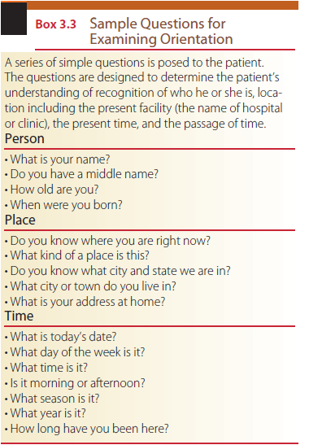

Slide 15
COGNITION
Cognition is defined as the process of knowing and includes both awareness and judgment.
three areas for testing cognition-dependent functions:
(1) fund of knowledge,
(2) calculation ability,
and (3) proverb interpretation.

Slide 16
Memory, Hearing, and Visual Acuity
Long-term (remote) memory can be examined by requesting information on date and place of birth, number of siblings, date of marriage, schools attended, and historical facts.
Short-term memory can be addressed by verbally providing the patient with a series of words or numbers. For example, a series of words might include “car, book, cup”; use of numbers could include a seven digit list; a short sentence could also be used to test short-term memory.

Slide 17
CLASSIFICATION OF THE SENSORY SYSTEM
Sensory Receptors
The three divisions of sensory receptors include those that mediate the
(1) superficial,
(2) deep, and
(3) combined (cortical) sensations.
Spinal pathways
Anterolateral Spinothalamic
Dorsal Column–Medial Lemniscal System

Slide 18
Anterolateral Spinothalamic Pathway
The three major tracts of the spinothalamic system are the
(1) anterior (ventral) spinothalamic tract, which carries the sensations of crudely localized touch and pressure;
(2) the lateral spinothalamic tract, which carries pain and temperature; and
(3) the spinoreticular tract, which is involved with diffuse pain sensations

Slide 19
Dorsal Column–Medial Lemniscal Pathway
Sensations transmitted by the dorsal column–medial lemniscal pathway include
discriminative touch,
stereognosis,
tactile pressure,
barognosis,
graphesthesia,
kinesthesia,
two-point discrimination,
proprioception,
and vibration.

Slide 20
Modalities of sensation to be tested
Superficial Sensations
Pain Perception This test is also referred to as sharp/dull discrimination and indicates function of protective sensation
ResponseThe patient is asked to verbally indicate sharp or dull when a stimulus is felt. All areas of the body may be tested.
Temperature Awareness Ideal temperatures for cold are between (5°C) and (10°C) and for warmth, between (40°C) and (45°C).
Response The patient is asked to reply hot or cold after each stimulus application.

Slide 21
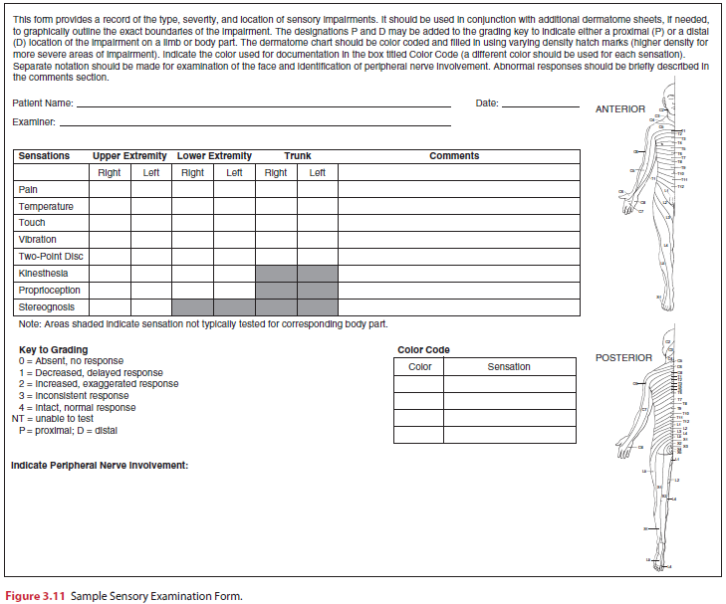

Slide 22
Touch Awareness This test determines perception of tactile touch input. A camel-hair brush, piece of cotton (ball or swab), or tissue is used. The area to be tested is lightly touched or stroked.
Response The patient is asked to indicate when he or she recognizes that a stimulus has been applied by responding “yes” or “now.”
Pressure Perception The therapist’s fingertip or a double-tipped cotton swab is used to apply a firm pressure on the skin surface. This pressure should be firm enough to indent the skin and to stimulate the deep receptors.
Response The patient is asked to indicate when an applied stimulus is recognized by responding “yes” or “now.”

Slide 23
Deep Sensations
The deep sensations include kinesthesia, Proprioception, and vibration.
Kinesthesia Awareness This test examines awareness of movement. The extremity or joint(s) is moved passively through a relatively small range of motion (ROM).
Response The patient is asked to describe verbally the direction (up, down, in, out, and so forth) and range of movement in terms previously discussed with the therapist while the extremity is in motion. The patient may also respond by simultaneously duplicating the movement with the contra lateral extremity

Slide 24
Proprioceptive Awareness This test examines joint position sense and the awareness of joints at rest. The extremity or joint(s) is moved through a ROM and held in a static position.
Response While the extremity or joint(s) is held in a static position by the therapist, the patient is asked to describe the position verbally or to duplicate the position of the extremity or joint(s) with the contralateral extremity (position matching).

Slide 25
Vibration Perception This test requires a tuning fork that vibrates at 128 Hz. The ability to perceive a vibratory stimulus is tested by placing the base of a vibrating tuning fork on a bony prominence (such as the sternum, elbow, or ankle).
Response The patient is asked to respond by verbally identifying or otherwise indicating if the stimulus is vibrating or non-vibrating each time the fork makes contact.

Slide 26
Combined Cortical Sensations
Stereognosis Perception This test determines the ability to recognize the form of objects by touch (Stereognosis). A variety of small, easily obtainable, and culturally familiar objects of differing size and shape are required (e.g., keys, coins, combs, safety pins, pencils)
Response The patient is asked to name the object verbally. For patients with speech impairments, sensory testing shields can be used. Alternatively, the item manipulated can be identified from a group of images presented after each test.

Slide 27
Tactile Localization
Two-Point Discrimination
Double Simultaneous Stimulation
Graphesthesia (Traced Figure Identification)
Recognition of Texture
Barognosis (Recognition of Weight)

