Slide 1
Extensions of Mendelian Genetics

Slide 2
Types of Mendelian Inheritance Patterns Involving Single Genes
Simple Mendelian Inheritance: This term is commonly applied to the inheritance of alleles that obey Mendel’s laws and follow a strict dominant/recessive relationship. Some genes can be found in three or more alleles, making the relationship more complex. Molecular: 50% of the protein encoded by two copies of the dominant (functional) allele is sufficient to produce the dominant trait Incomplete dominance Inheritance: This pattern occurs when the heterozygote has a phenotype that is intermediate between either corresponding homozygote. For example, a cross between homozygous red-flowered and homozygous white-flowered parents will have heterozygous offspring with pink flowers. Molecular: 50% of the protein encoded by two copies of the functional allele is not sufficient to produce the same trait as the homozygote making 100%.

Slide 3
Incomplete penetrance Inheritance: This pattern occurs when a dominant phenotype is not expressed even though an individual carries a dominant allele. An example is an individual who carries the polydactyly allele but has a normal number of fingers and toes. Molecular: Even though a dominant gene may be present, the protein encoded by the gene may not exert its effects. This can be due to environmental influences or due to other genes that may encode proteins that counteract the effects of the protein encoded by the dominant allele. Overdominance Inheritance: This pattern occurs when the heterozygote has a trait that is more beneficial than either homozygote. Molecular: Three common ways that heterozygotes gain benefits: (1) Their cells may have increased resistance to infection by microorganisms; (2) they may produce more forms of protein dimers, with enhanced function; or (3) they may produce proteins that function under a wider range of conditions.

Slide 4
Codominance Inheritance: This pattern occurs when the heterozygote expresses both alleles simultaneously. For example, in blood typing, an individual carrying the A and B alleles will have an AB blood type. Molecular: The codominant alleles encode proteins that function slightly differently from each other, and the function of each protein in the heterozygote affects the phenotype uniquely. X linked Inheritance: This pattern involves the inheritance of genes that are located on the X chromosome. In mammals and fruit flies, males are hemizygous for X-linked genes, while females have two copies. Molecular: If a pair of X-linked alleles shows a simple dominant/recessive relationship, 50% of the protein encoded by two copies of the dominant allele is sufficient to produce the dominant trait (in the female)

Slide 5
Sex-influenced inheritance : This pattern refers to the impact of sex on the phenotype of the individual. Some alleles are recessive in one sex and dominant in the opposite sex. An example would be pattern baldness in humans. Molecular: Sex hormones may regulate the molecular expression of genes. This can have an impact on the phenotypic effects of alleles. Sex-limited inheritance : This refers to traits that occur in only one of the two sexes. An example would be breast development in mammals. Molecular: Sex hormones may regulate the molecular expression of genes. This can have an impact on the phenotypic effects of alleles. In this case, sex hormones that are primarily produced in only one sex are essential to produce a particular phenotype. Lethal alleles Inheritance: An allele that has the potential of causing the death of an organism. Molecular: Lethal alleles are most commonly loss-of-function alleles that encode proteins that are necessary for survival. In rare cases, the allele may be due to a mutation in a nonessential gene that changes a protein to function with abnormal and detrimental consequences.

Slide 6
Geneticists Use a Variety of Symbols for Alleles

Slide 7
Neither Allele Is Dominant in Incomplete, or Partial, Dominance

Slide 8
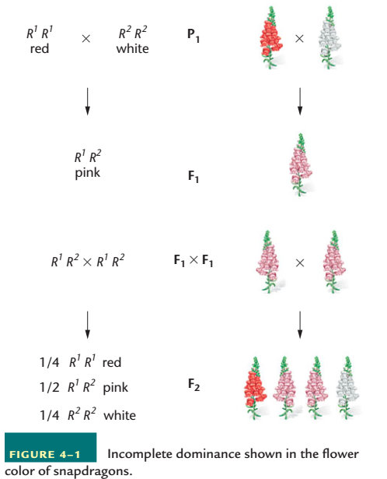

Slide 9
In Codominance, the Influence of Both Alleles in a Heterozygote Is Clearly Evident

Slide 10
Multiple Alleles of a Gene May Exist in a Population

Slide 11
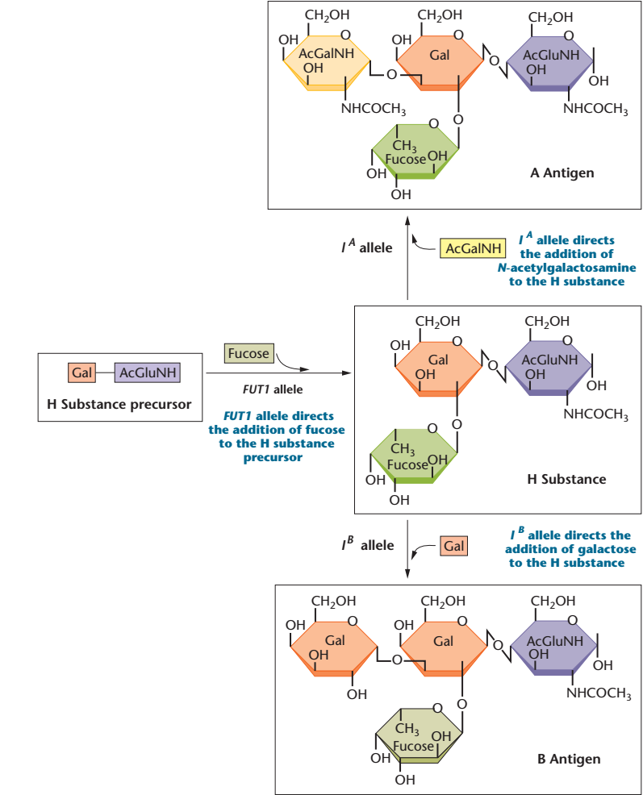

Slide 12
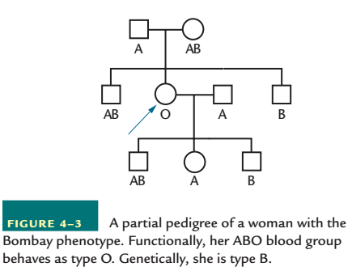

Slide 13
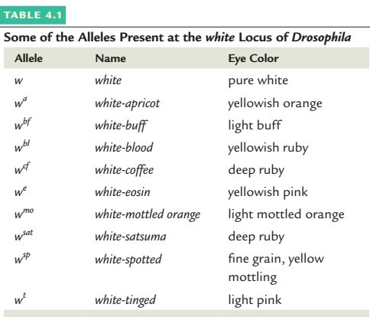

Slide 14
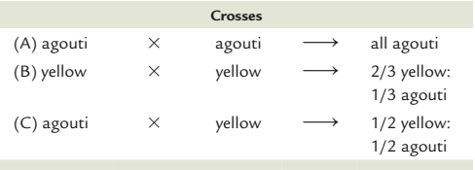
Lethal Alleles Represent Essential Genes
Recessive lethal allele: For example, a mutation that causes a yellow coat in mice
Dominant lethal allele: In humans, a disorder called Huntington disease is due to a dominant autosomal allele H

Slide 15
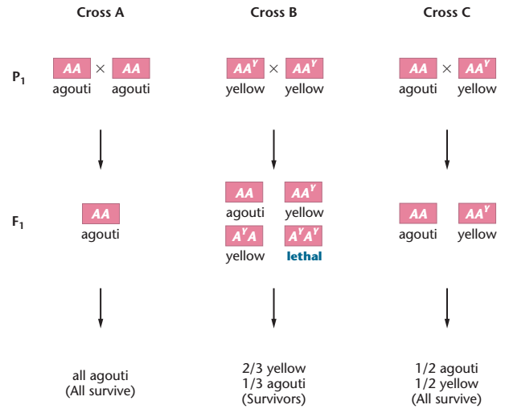

Slide 16
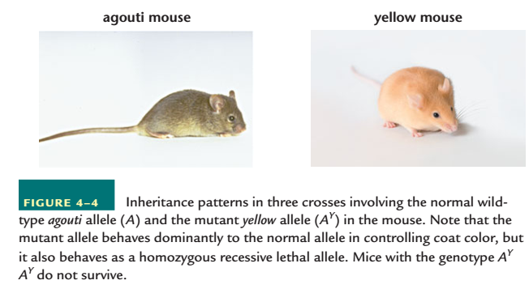

Slide 17
Combinations of Two Gene Pairs with Two Modes of Inheritance Modify the 9:3:3:1 Ratio

Slide 18
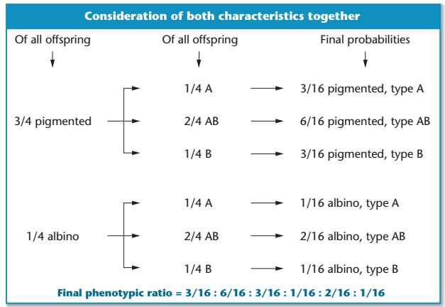

Slide 19
Epistasis
The expression of one gene pair masks or modifies the effect of another
Antagonistic manner
complementary, or cooperative, fashion
Epistatic
Hypostatic

Slide 20
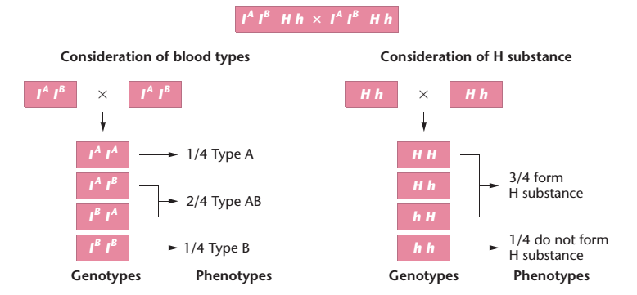

Slide 21
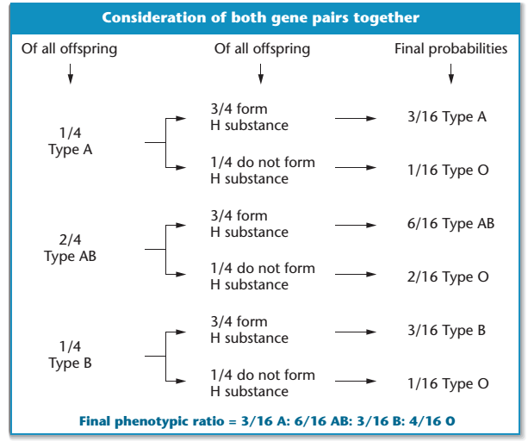

Slide 22
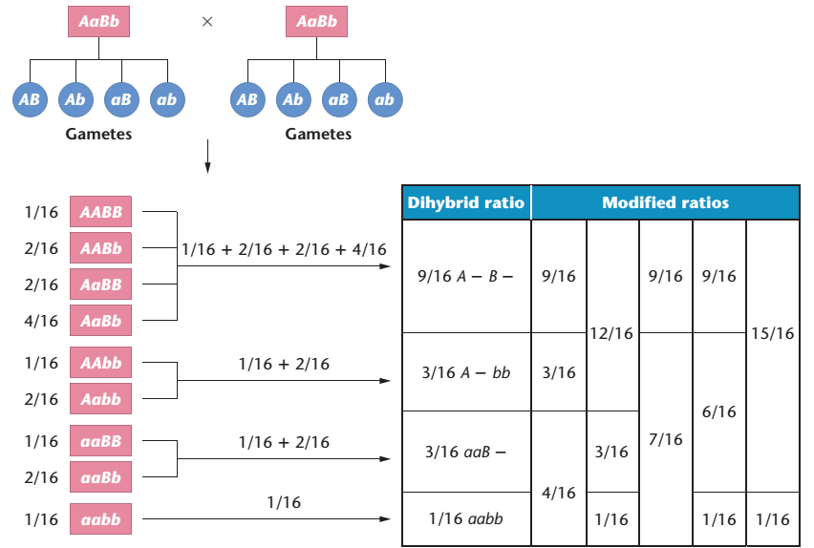

Slide 23
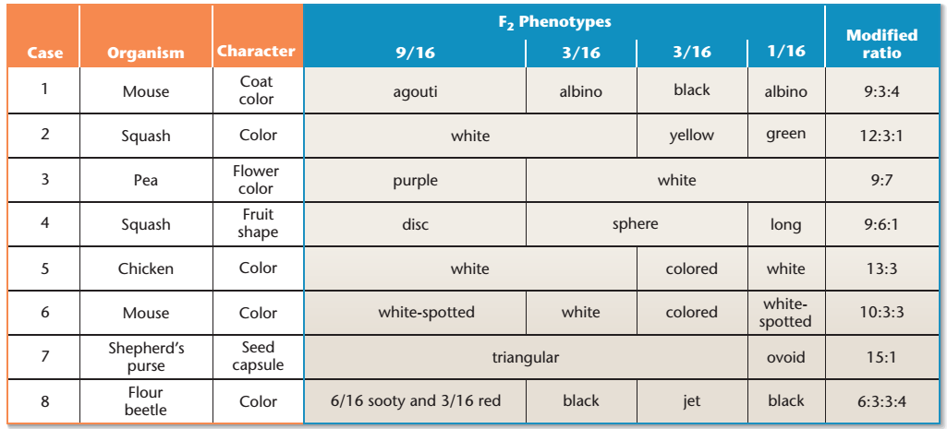

Slide 24
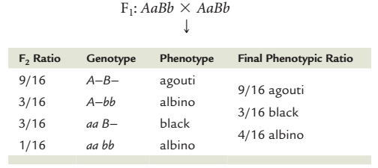

Slide 25
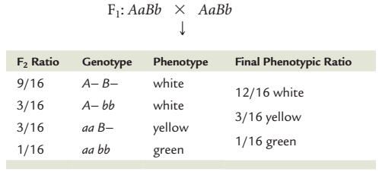

Slide 26
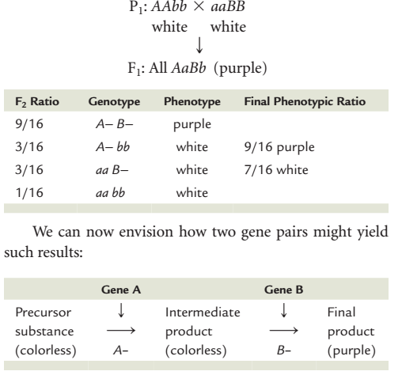

Slide 27
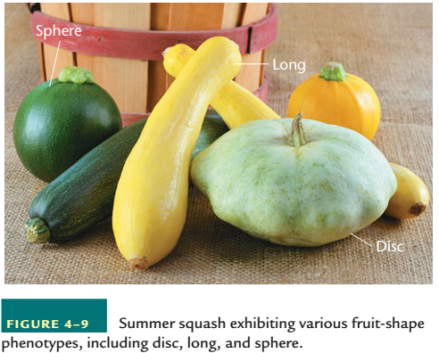

Slide 28
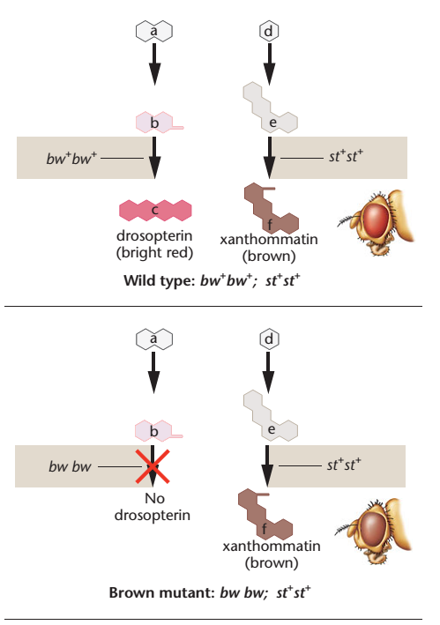

Slide 29
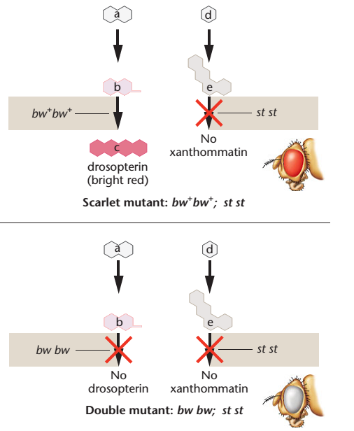

Slide 30
Complementation Analysis Can Determine If Two Mutations Causing a Similar Phenotype Are Alleles of the Same Gene
An analytical procedure called complementation analysis allows us to determine whether two independently isolated mutations are in the same gene—that is, whether they are alleles—or whether they represent mutations in separate genes.
Case 1. All offspring develop normal wings Case 2. All offspring fail to develop wings

Slide 31
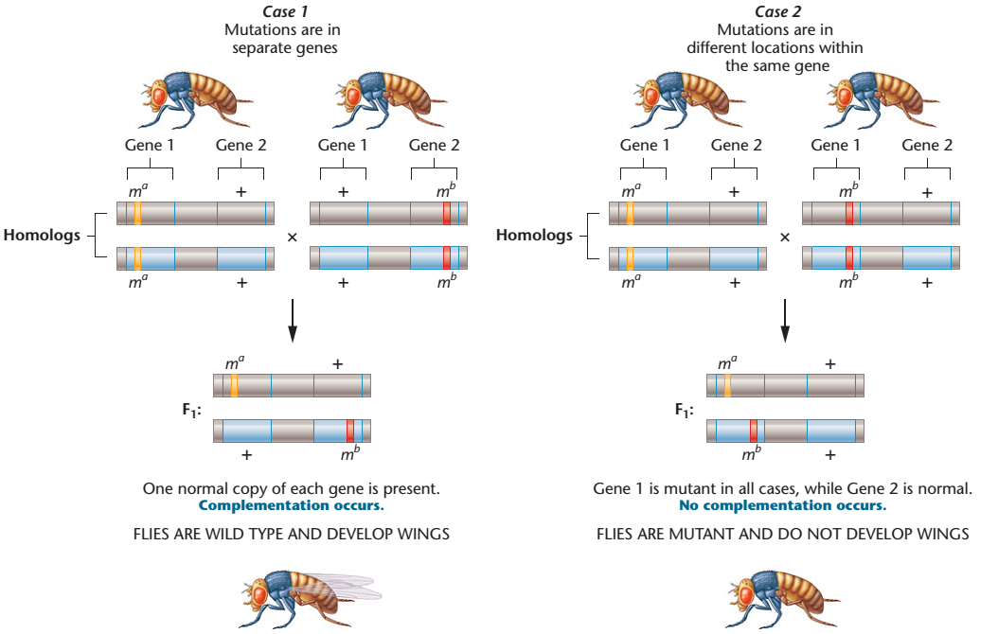

Slide 32
Expression of a Single Gene May Have Multiple Effects
While the previous sections have focused on the effects of two or more genes on a single characteristic, the converse situation, where expression of a single gene has multiple phenotypic effects, is also quite common. This phenomenon, which often becomes apparent when phenotypes are examined carefully, is referred to as pleiotropy. Many excellent examples can be drawn from human disorders, and we will review two such cases to illustrate this point.
Marfan Syndrome and Porphyria Variegata

Slide 33
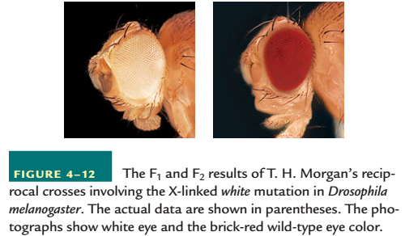

Slide 34
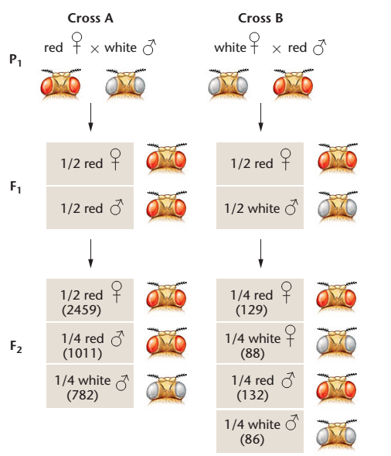

Slide 35
