Slide 1
Root stocks for different fruit species and varieties

Slide 2
Why use rootstock?
Seedlings are not true to type
Delayed precocity
Excessive height

Slide 3
Choice of Root stock
Root stock selection depends upon following qualities:
Tree vigour
Rooting depth
Time to reach fruit maturity
Resistance to cold and water lodging
Disease and pests resistance

Slide 4
Clonal vs Seedling root stock
A clonal rootstock is a vegetatively propagated or cloned rootstock
whereas
seedling rootstock obtained through seeds

Slide 5
Clonal Root Stocks
Propagated of through
Cutting (e.g grapes)
Layering, (Apple)
Apomictic Seed (Citrus, Mango and Apple)
Micropropagation (tissue culture is expensive and not widely used)

Slide 6
Citrus Root Stocks

Slide 7
1) Rough lemon (Citrus jambhiri)
Originated in Himalayan foot hills in India
Advantages:
deep rooting system; drought tolerant; moderate tolerance to salinity; tolerant to tristeza
Disadvantage:
Less cold hardy; Intolerant to blight; susceptible to Phytophthora foot rot and burrowing nematodes; poor fruit quality with more rind, less juice and low TSS contents

Slide 8
2) Sour orange (Citrus aurantium)
Native to southeastern Asia
Advantage:
Good quality fruit; dense deep root system; cold hardy; resistance against gummosis; drought tolerant; cold tolerant
Disadvantage:
Susceptible to citrus tristiza virus and nematodes

Slide 9
3) Sweet orange (Citrus sinensis)
Native to southeastern Asia and Indo-China
Advantages:
Quite hardy; resistance against cold; tolerant to quick decline; good yield and fruit quality; compatible union
Disadvantages:
Sensitive to soil salinity; susceptible to gummosis

Slide 10
4) Kharna Khatta (Citrus aurantium var. Khatta)
Native to tropical Asia and indo-China
Advantages:
Tolerant to cold, drought, salinity and alkalinity
Disadvantages:
Susceptible to tristeza and gummosis

Slide 11
5) Rangpur lime (Citrus limonia)
Originated in India
Advantages:
Tolerant to drought and salinity; Highly resistant to tristeza
Disadvantages:
Sensitive to cold, susceptible to diseases like foot rot, burrowing nematodes and citrus exocortis virus

Slide 12
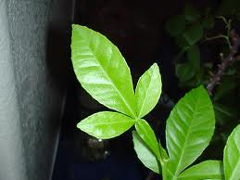
6) Trifoliate orange (Poncirus trifoliata)
Native to central or north China
Advantages:
Resistant to tristeza, Phytophthora and nematodes
Disadvantages:
Sensitive to drought and salinity; slow growth
Dwarf R. Stock used in high density population

Slide 13
7) Cleopatra mandarin (Citrus reshni)
Native to tropical Asia
Advantages:
Cold hardy, tolerate salinity and alkalinity, resistant to tristeza, gummosis and quick decline
Disadvantages:
Sensitive to nematodes and water logging; susceptible to Phytophthora

Slide 14
8) Carrizo citrange
Hybrid of Washington navel orange x Poncirus trifoliata
Developed in 1900 in USA
Advantages:
Cold tolerant; tolerant to tristeza, Phytophthora and nematodes
Disadvantages:
Sensitive to soil salinity and water logging

Slide 15
9) Citrange-35
Hybrid of Poncirus trifoliate X Citrus sinensis
Developed in 1951 in USA
Advantages:
Tolerant to cold, drought, tristeza, Phytophthora and nematodes
Disadvantages:
Sensitive to salinity

Slide 16
10) Volkamar Lemon
(vigorous root stock; fruit quality is slightly better)
11) Citrus sunki
12) Citrus depressa
13) Poncirus trifoliata
14) Citrumelo
15) Gada dahi
16) Yuma Citrange
17) Kharana Khata

Slide 17
Apple Root Stocks
Crab apple (popular in Murree)

Slide 18
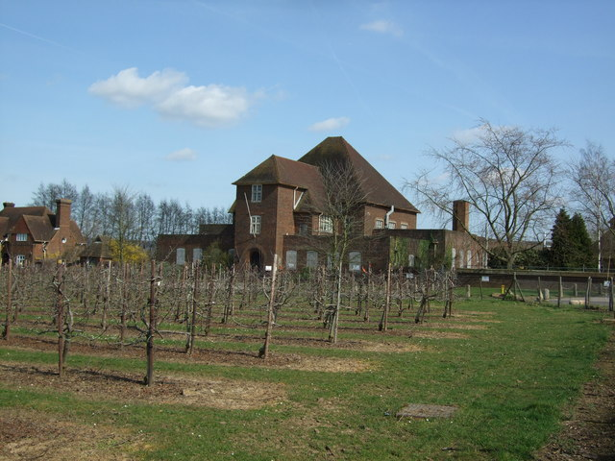
Malling series
Rootstock released by East Malling Research Station are known as Malling series
Research station established on the East Malling Kent, England in 1913

Slide 19
Malling series
M-27
V. Dwarf
Advantages:
Resistant to collar-rot
Disadvantages:
Susceptible to fireblight and milder)
M-9
Dwarf
Advantages:
Resistant to collar or crown rot; tolerate heavy soil
Disadvantages:
Susceptible to mildew; wooly aphid and fireblight)

Slide 20
M-26
semi-dwarf
Advantages:
Cold hardy
Disadvantages:
Susceptible to mildew; wooly aphid and fireblight)
M-7
Semi-dwarf
Advantages:
Resistant to fireblight and mildew;
Disadvantages:
Susceptible to wooly aphid; not cold-hardy)
M-116
semi-dwarf
Advantages:
Resistant to mildew, wooly aphid, collar rot and fireblight)

Slide 21
Malling Merton Series
Rootstock released by John Innes Centre of Marton are known as Malling Merton series
A research station established at London Borough of Marton joined East Malling Research Station in 1917
MM102
MM-106
MM-111

Slide 22
MM102
MM-106
A hybrid of 'Northern Spy' and M.1.
Advantages:
Precocious, well anchored, does not produce many root suckers.
Disadvantages
Prone to winter injury, Susceptible to crown and root rot
MM-111
Advantages:
Drought tolerant, minimal suckering, fairly tolerant of wet sites

Slide 23
Peach Root Stocks
Peach seedling (light sandy soils)
Plum rootstock (heavy and moist soil)
GF667 (Vigorous rootstock; resistant to Fe chlorosis; smaller fruit size; delayed preciosity; Islamabad)
GF 305-1
Montclar
Common peach
Almond (Quetta region)
Yellow Local peach (Peshawar region)

Slide 24
Almond Root Stocks
Peach seedling (vigrous; tolerate high water contents, crown rot and crown gall; Not tolerant to calcareous soils or soil high in Boron)
Almond seedling (Tolerate drought and calcareous soils)
Plum (incompatible with some almond varieties)
Apricot seedling
Almond x Peach hybrids
Hari

Slide 25
Plum Rootstocks
Damascos
Myrobalan (vigorous root stock)
Desi Plum (raised from hardwood cuttings; can survive in water logged areas)
Peach seedling (suitable for well drained sandy soils)
Almond (allows plum to grow in warm, dry soil)

Slide 26
Apricot Root Stocks
Hari
Wild apricot
Peach seedling
Almond

Slide 27
Persimmon Root stock
Seedlings of Diospyros lotus
Seedlings of Diospyros kaki

Slide 28
Pear Root Stock
Common pear Seedling
Japanese Seedling
Batangi (a wild cultivar of common pear)
Quince seedlings

Slide 29
Grape Root Stocks
Freedom
Harmony
Ramsey
Riparia glori
St George

