Slide 1
Components(continuing)

Slide 2
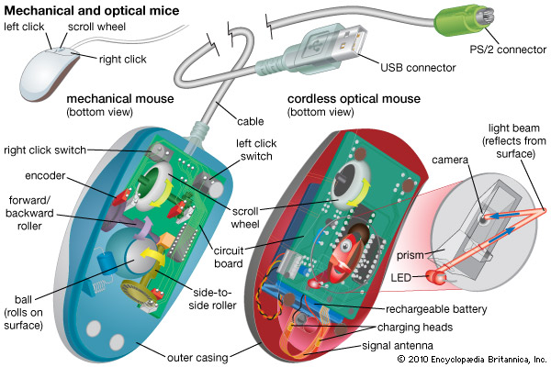
Mouse(Basic parts):
A mouse typically has two buttons: a primary button (usually the left button) and a secondary button (usually the right button).The primary button is the one you will use most often. Most mice also include a scroll wheel between the buttons to help you scroll through documents and Web Pages more easily. On some mice, the scroll wheel can be pressed to act as a third button.
Advanced mice might have additional buttons that can perform other functions.

Slide 3
Most mouse actions combine pointing with pressing one of the mouse buttons. There are four basic ways to use your mouse buttons: clicking, double-clicking, right-clicking, and dragging.
Clicking (single-clicking)
To click an item, point to the item on the screen, and then press and release the primary button (usually the left button).
Clicking is most often used to select (mark) an item or open a menu. This is sometimes called single-clicking or left-clicking.
Double-clicking
To double-click an item, point to the item on the screen, and then click twice quickly. If the two clicks are spaced too far apart, they might be interpreted as two individual clicks rather than as one double-click.
Double-clicking is most often used to open items on your desktop. For example, you can start a program or open a folder by double-clicking its icon on the desktop.
Right-clicking
To right-click an item, point to the item on the screen, and then press and release the secondary button (usually the right button).
Right-clicking an item usually displays a list of things you can do with the item. For example, when you right-click the Recycle Bin on your desktop, Windows displays a menu allowing you to open it, empty it, delete it, or see its properties. If you are unsure of what to do with something, right-click it.

Slide 4
C) SCANNING DEVICES Are devices that capture an object or a document directly from the source. They are classifie according to the technology used to capture data e.g. Scanners and Document readers.
i) Scanners Used to capture a source document and converts it into an electronic form. Example are - FlatBed and HandHeld scanners.

Slide 5
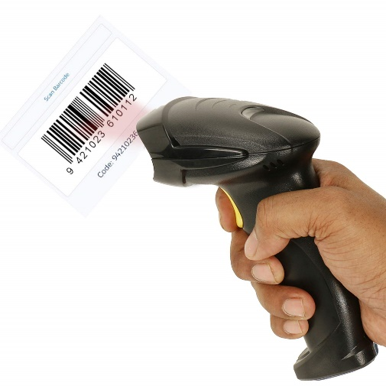
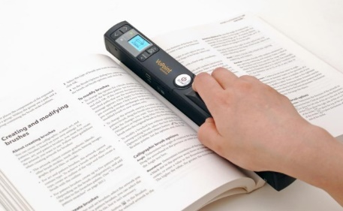
ii) Barcode readers
iii) Optical Character Readers
b) Magnetic Readers Reads data using magnetic ink.t uses principle of magnetism to sense data which have been written using magnetized ink.

Slide 6
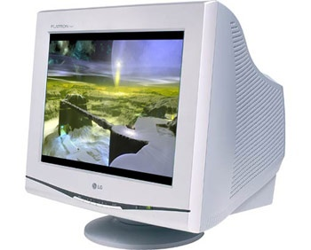
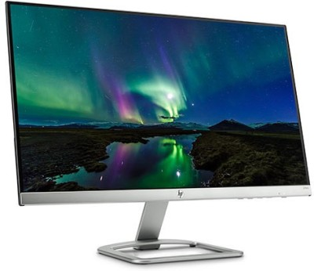
Output Devices:
Computer output devices are all peripheral hardware, and are connected to a computer by cables, or by wireless networking.
Reasons for Having an Output Device
A computer can still function without an output device. However, without an output device, there’s no way to determine what the computer is doing. There is no indicator of errors, nor of the need for additional input. For example, if you detach your monitor from your computer, the computer will still function, but it’s not going to be very helpful.
Examples of Output Devices
Monitor – This is the most common computer output device. It creates a visual display by the use of which users can view processed data. Monitors come in various sizes and resolutions.
Common Types of Monitors:
Cathode Ray Tube – this uses phosphorescent dots to generate the pixels that constitute displayed images.
Flat Panel Screen – this makes use of liquid crystals or plasma to produce output. Light is passed through the liquid crystals in order to generate pixels.
All monitors depend on a video card, which is positioned either on the computer motherboard or in a special expansion slot. The video card sorts out the computer data into image details that the monitors can then show.

Slide 7
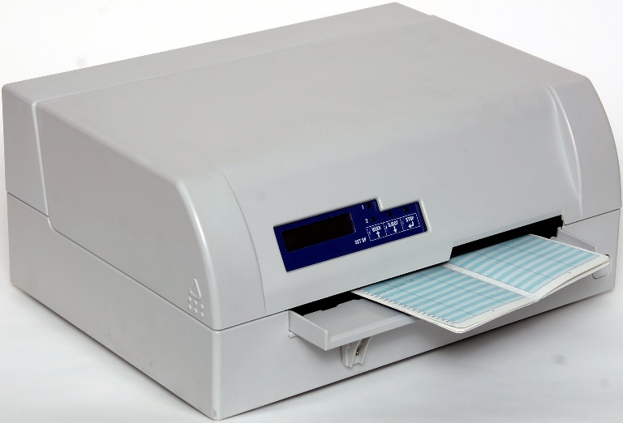
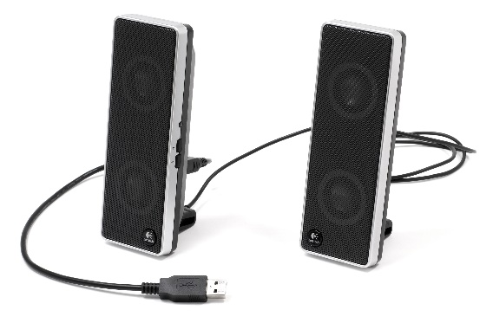
Printer – this device generates a hard copy version of processed data, like documents and photographs. The computer transmits the image data to the printer, which then physically recreates the image, typically on paper.
Types of Printers:
Ink Jet – this kind of printer sprays tiny dots of ink onto a surface to form an image.
Laser – this type utilises toner drums that roll through magnetized pigment, and then transfers the pigment onto a surface.
Dot Matrix – dot matrix printers utilize a print head to set images on a surface, using an ink ribbon. These printers were commonly used between 1980 .
Speakers – speakers are attached to computers to facilitate the output of sound; sound cards are required in the computer for speakers to function. The different kinds of speakers range from simple, two-speaker output devices right the way up to surround-sound multi-channel units.
head

Slide 8
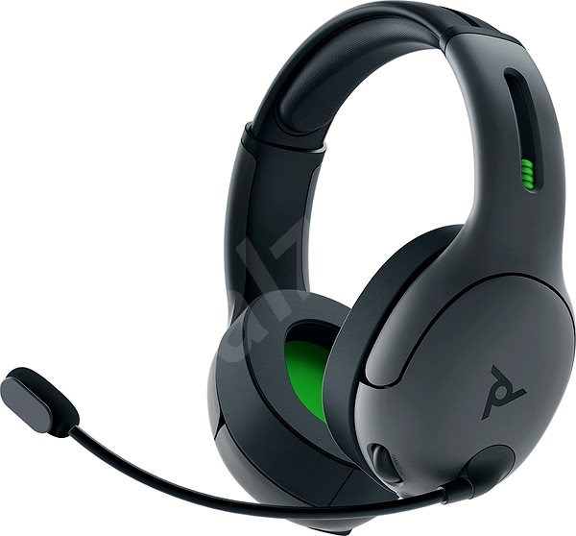
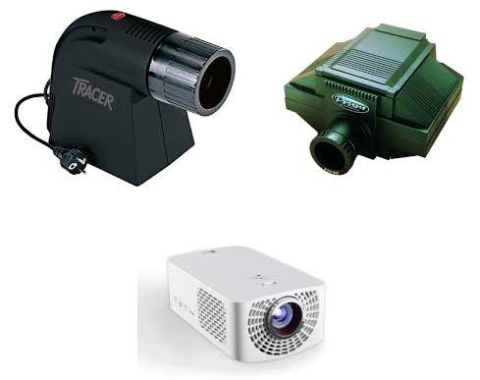
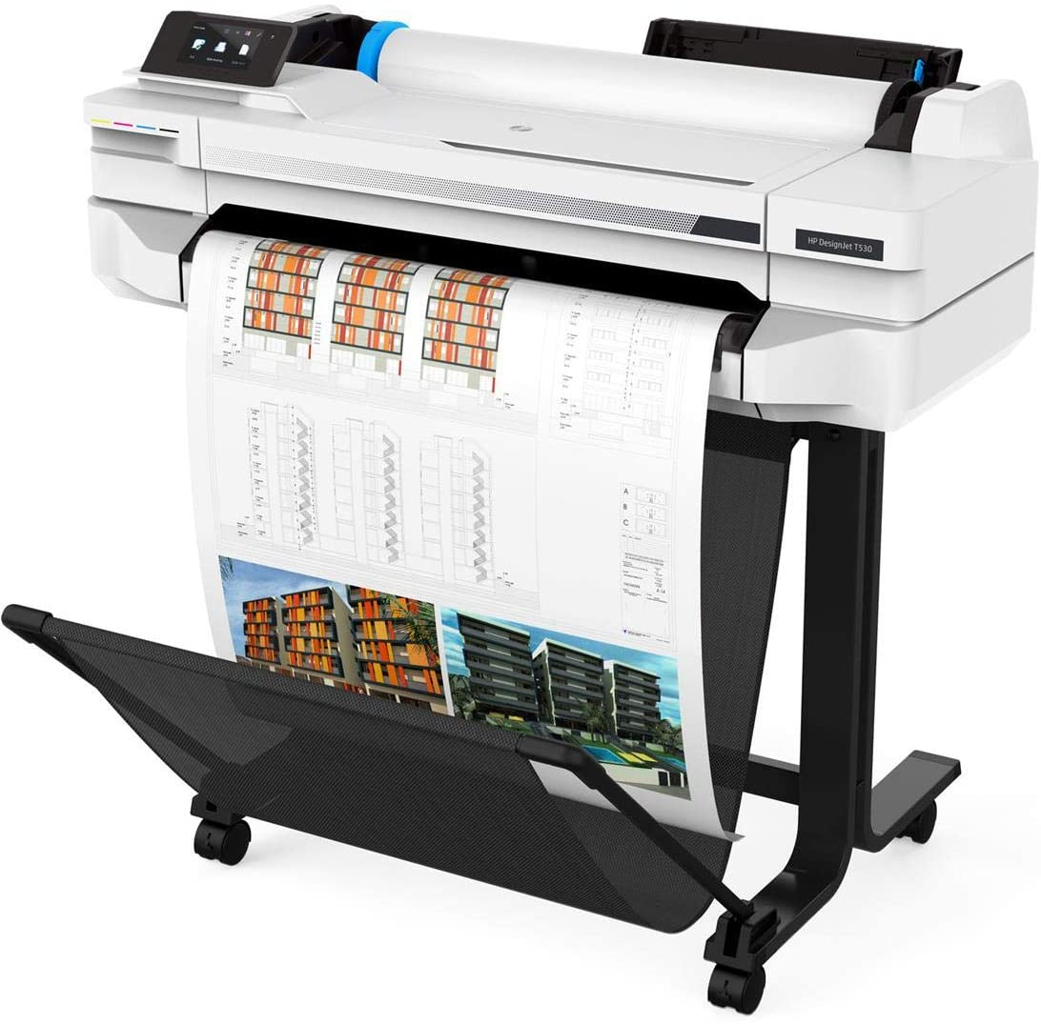
Headset – this is a combination of speakers and microphone. It is mostly used by gamers, and is also a great tool for communicating with family and friends over the internet.
Projector – this is a display device that projects a computer-created image onto another surface: usually some sort of whiteboard or wall. The computer transmits the image data to its video card, which then sends the video image to the projector. It is most often used for presentations, or for viewing videos.
Plotter – this generates a hard copy of a digitally depicted design. The design is sent to the plotter through a graphics card, and the design is formed by using a pen. It is generally used with engineering applications, and essentially draws a given image using a series of straight lines.

Slide 9
Computer software:
Software is a program that enables a computer to perform a specific task, as opposed to the physical components of the system (hardware).
This includes application software such as a word processor, which enables a user to perform a task, and system software such as an operating system, which enables other software to run properly, by interfacing with hardware and with other software.
Practical computer systems divide software into three major classes: system software, programming software and application software, although the distinction is arbitrary, and often blurred.
Computer software has to be "loaded" into the computer's storage (such as a hard drive, memory, or RAM).
Once the software is loaded, the computer is able to execute the software.
Computers operate by executing the computer program.
This involves passing instructions from the application software, through the system software, to the hardware which ultimately receives the instruction as machine code.
Each instruction causes the computer to carry out an operation -- moving data, carrying out a computation, or altering the control flow of instructions.

