Slide 1
Features of Bernoulli’s Equation

Slide 7
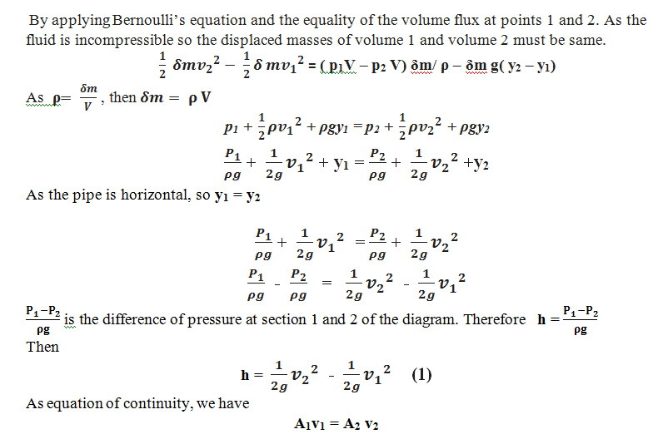

Slide 8
