Slide 1
Security Techniques
MESSAGE INTEGRITY
Hash Functions
MESSAGE AUTHENTICATION
DIGITAL SIGNATURE
ENTITY AUTHENTICATION

Slide 2
MESSAGE INTEGRITY
The electronic equivalent of the document and fingerprint pair is the message and digest pair.
To preserve the integrity of a message, the message is passed through an algorithm called a cryptographic hash function. The function creates a compressed image of the message, called a digest

Slide 3
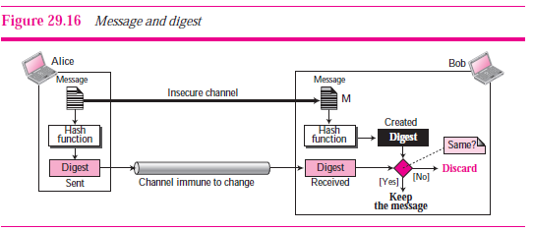
message and digest

Slide 4
Hash Functions
A cryptographic hash function takes a message of arbitrary length and creates a message digest of fixed length
Instead of using a hash function with variable-size input, a function with fixed-size input is created and is used a necessary number of times. The fixed-size input function is referred to as a compression function.
It compresses an n-bit string to create an m-bit string where n is normally greater than m. The scheme is referred to as an iterated cryptographic hash function

Slide 5
Several hash algorithms were designed by Ron Rivest. These are referred to as
MD2, MD4, and MD5
The Secure Hash Algorithm (SHA) is a standard that was developed by the National Institute of Standards and Technology (NIST

Slide 6
MESSAGE AUTHENTICATION
A digest can be used to check the integrity of a message
the data origin authentication—
that Alice is the originator of the message, not somebody else—we need to include a secret held by Alice in the process; we need to create a message authentication code (MAC)

Slide 7
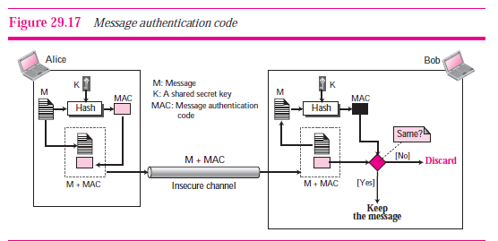

Slide 8
DIGITAL SIGNATURE
Another way to provide message integrity and message authentication is a digital signature
A MAC uses a secret key to protect the digest; a digital signature uses a pair of private-public keys

Slide 9
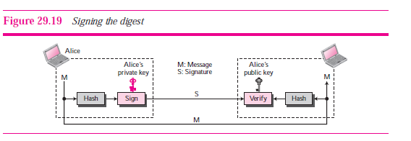
Signing the Digest
In a digital signature system, the messages are normally long ,but we have to use asymmetric-key schemes

Slide 10
ENTITY AUTHENTICATION
Passwords
Challenge-Response

Slide 11
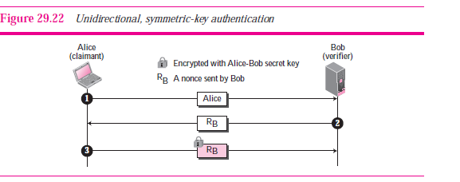
Challenge-Response
Using a Symmetric-Key Cipher

Slide 12
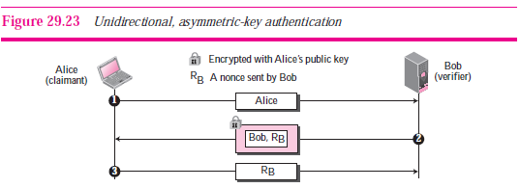
Using a Asymmetric-Key Cipher

Slide 13
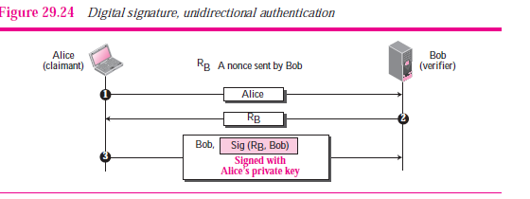
Using Digital Signature

