Slide 1
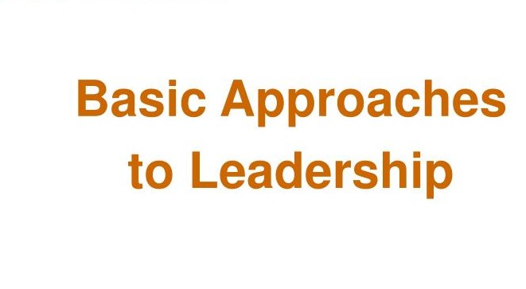
Organizational Behavior
Sofia khakwani

Slide 2
7. Basic Approaches to Leadership
7.1 What is leadership?
Leadership is an interpersonal process in which influence is exercised in a social system for the achievement of organizational goals by others”.
Researchers agree on two characteristics of leadership. First, leadership involves exerting influence over other members of a group or organization. Second, leadership involves helping a group or organization achieve its goals. Leaders of a group or organization are the individuals who exert such influence.
A Leader helps others achieve organizational goals and influences perceptions and behaviors, including attitudes, learning, motivation, stress, performance, decision-making quality, turnover, and absenteeism.

Slide 4
7.2. Trait theories
Early studies identified during personal characteristics and traits that distinguish leaders from followers and effective from ineffective leaders. They were concerned with leaders’ traits, the particular tendencies a person has to feel, think, and act in certain ways. Results from nearly 300 studies suggested that the following traits have the strongest relationship to effective leadership:
Intelligence
Task-relevant knowledge
Dominance (the need to exert influence and control over others)
Self-confidence
Energy/activity levels
Tolerance for stress
Integrity and honesty
Emotional maturity

Slide 6
Cont…
Although understanding leader characteristics is helpful, the trait approach is limited. Whether these traits are key for becoming a leader or result from being a leader is unclear. The trait approach provides little guidance as to how to train or help leaders. Because traits are stable, individuals cannot change traits associated with leadership.
The trait approach fails to explain why or how effective leadership occurs. Many individuals who possess these traits never become leaders, and many leaders who possess them are ineffective.

Slide 7
Cont…
Six traits on which leaders tend to differ from non-leaders are:
• Ambition and energy
• Desire to lead
• Honesty and integrity
• Self-confidence
• Intelligence
• Job-relevant knowledge.
Recent research provides strong evidence that people who are high self-monitors are much more likely to emerge as leaders in groups than low self-monitors.

Slide 9
7.3. Behavioral theories
Researchers using the behavior approach identified specific behaviors that contribute to leaders’ effectiveness at helping individuals, groups, and or organizations achieve goals.
The Ohio State researchers developed scales to measure over 1800 leader behaviors and asked workers to indicate how much their leaders engaged in them. Researchers found that leader behaviors involved either consideration or initiating structure. Consideration is a behavior indicating that a leader trusts, respects, and values good relationships with followers. A considerate leader might be friendly, treat others as equals, give explanations, and show concern for workers’ well-being and their opinions.

Slide 11
Cont…
Initiating structure refers to a leader’s behavior that assures that work is completed and subordinates perform their jobs. This structure includes assigning tasks, planning, setting goals, deciding how tasks are accomplished, and encouraging followers to accomplish them.
Consideration and initiating structures are complementary because leaders can engage in both. They are independent because describing a leader’s consideration does not describe the initiating structure.
Researchers using the behavior approach to leadership have identified behaviors similar to consideration and initiating structure. Researchers at the University of Michigan identified two behaviors corresponding to consideration and initiating structure: employee-oriented and job-centered behaviors. An approach to organizational change, called the Managerial Grid, makes managers effective leaders by focusing how much they show concern for people and production. The Hersey and Blanchard model focuses on consideration and initiating structure behaviors.

Slide 12
Cont…
The Behavior Approach: Leader Reward and Punishing Behavior
Leaders demonstrate other important behaviors. Leader reward behavior occurs when a leader positively reinforces subordinates’ desirable behavior. A leader might acknowledge good performance with praise, compliments, a pay raise, or a promotion. Reward behavior keeps workers performing at a high level.
Leader punishing behavior occurs when a leader reprimands or responds negatively to subordinates who perform undesirably. Punishing is best used only to curtail undesirable behavior as it has unintended side effects such as resentment. Although reinforcement is more effective, leaders often engage in punishing behavior.

Slide 13
7.4. Contingency theories: Fiedler modal
Path-Goal Theory
• One of the most respected approaches to leadership is the path-goal theory developed by Robert House.
• It is a contingency model of leadership which extracts key elements from the Ohio State leadership research on initiating structure and consideration and the expectancy theory of motivation.
• It is the leader’s job to assist followers in attaining their goals and to provide the necessary direction and/or support to ensure that their goals are compatible with the overall objectives of the firm.
• The term path-goal is derived from the belief that effective leaders clarify the path to help their followers achieve their work goals.
• House identified four leadership behaviors:
• The directive leader lets followers know what is expected of them, etc.

Slide 14
Cont…
• The supportive leader is friendly and shows concern for the needs of followers.
• The participative leader consults with followers and uses their suggestions before making a decision.
• The achievement-oriented leader sets challenging goals and expects followers to perform at their highest level.
• In contrast to Fiedler, House assumes leaders are flexible and can display any of these behaviors.
• Two classes of situational or contingency variables moderate the leadership behavior: • Environmental or outcome relationship.

Slide 15
Cont…
These factors determine the type of leader behavior required as a complement if follower outcomes are to be maximized.
• Personal characteristics of the employee. These determine how the environment and leader behavior are interpreted.
• Directive leadership leads to greater satisfaction when tasks are ambiguous or stressful than when they are highly structured and well laid out.
• Supportive leadership results in high employee performance and satisfaction when employees are performing structured tasks.
• Directive leadership is likely to be perceived as redundant among employees with high perceived ability or with considerable experience.
• Employees with an internal locus of control will be more satisfied with a participative style.
• Achievement-oriented leadership will increase employees’ expectancies that effort will lead to high performance when tasks are ambiguously structured.
• Research evidence generally supports the logic underlying the path-goal theory.

Slide 16
7.5 Contemporary issues in leadership
Leader mood at work and levels of emotional intelligence have the potential to influence leader effectiveness. Preliminary research suggests that when leaders tend to be in a good mood at work, their subordinates may perform at a higher level and be less likely to resign.

Slide 17
7.5.1 Trust: the foundation of leadership
7.5.1.1 What is Trust ?
Trust: the belief in the integrity, character and ability of a leader.
Five Dimensions of Trust
• Integrity (honesty and truthfulness)
• Competence (technical/interpersonal)
• Consistency (reliability, predictability and good judgment in handling situations)
• Loyalty (willingness to protect and save face for a person)
• Openness (willingness to share ideas and information freely)

Slide 18
7.5.1.2 Trust and leadership

Slide 19
7.5.1.3 Three types of leadership
Transformational leaders
Leading -- changing the organization to fit the environment – Develop, communicate, enact a vision
Transactional leaders
Managing -- linking job performance to rewards – Ensure employees have necessary resources – Apply contingency leadership theories
Transformational leadership
occurs when a leader changes followers in ways that lead to trust and motivation towards organizational goals. Transformational leaders increase subordinates’ awareness of task significance and high performance levels. Transformational leaders make subordinates aware of their needs for personal growth, development, and accomplishment. They motivate subordinates to work for the good of the organization, not personal gain.

Slide 20
7.5.1.4 Basic principles of trust

