Slide 1
Rice pest
Dr. M. Asam Riaz
Assistant Professor
Entomology, College of Agriculture, University of Sargodha, Sargodha, Pakistan

Slide 2
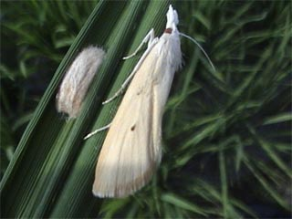
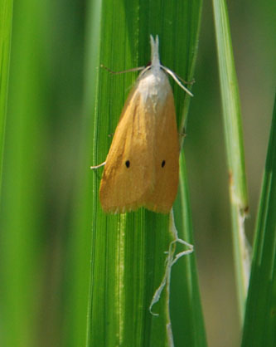
Insect pests of Rice
White stem borer (Scirpophaga innotata)
Yellow stem borer (Scirpophaga incertulus)
Adult: Selender whitish adult with black spot on each fore wing. Female with orange anal tuft.
Larvae; Pale or yellowish white
5-7 generations per y.
Yellowish straw color adults with black spots on forewings.
Larvae; Pale yellow or yellowish white with head-capsule orange-yellow in color. Eggs laid in clusters of 100s.
4-5 generations per y.
Life Cycle: active from April to October
Female 50 eggs in clusters on the underside of leaves.
Hatching; 1 week
Larvae: 4 weeks: hibernate as larvae in stubbles
Pupae: 2 weeks,pupate inside attacked plants
Notes:
Selender whitish adult with black spot on each fore wing. Female with orange anal tuft. Larvae; Pale or yellowish white. 5-7 generations per y.
Damage same as yellow Stem Borer.

Slide 3
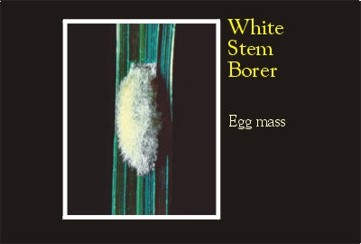
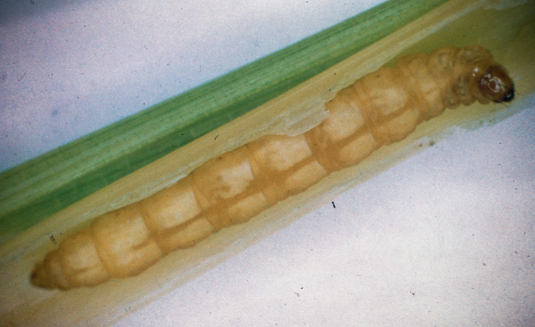
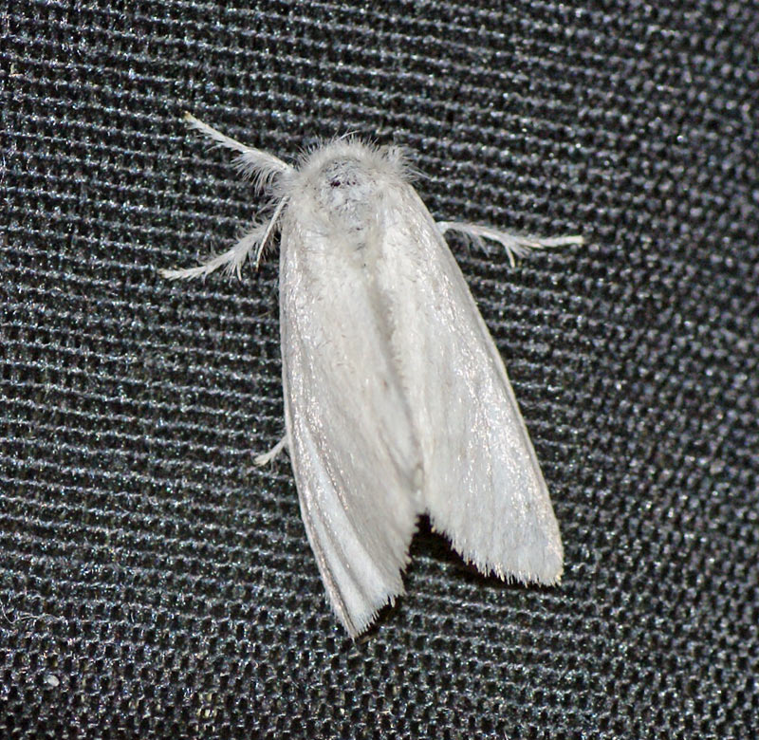
Insect pests of Rice White stem borer (Scirpophaga innotata: Pyralidae)
50 eggs
Notes:
Selender whitish adult with black spot on each fore wing. Female with orange anal tuft. Larvae; Pale or yellowish white. 5-7 generations per y.
Damage same as yellow Stem Borer.

Slide 4
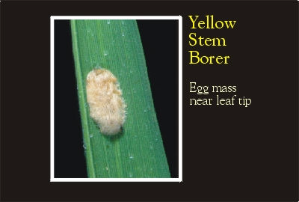
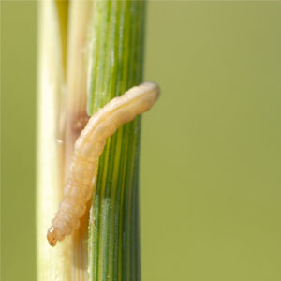
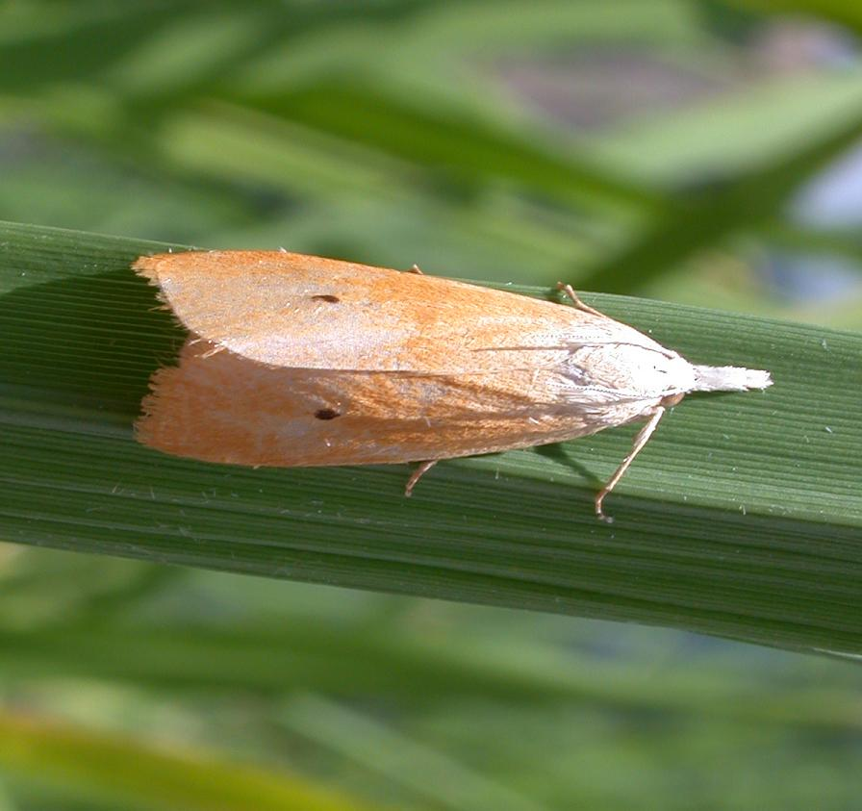
Insect pests of Rice Yellow stem borer (Scirpophaga incertulus: Pyralidae)
Notes:
Yellowish straw color adults with black spots on forewings. Larvae; Pale yellow or yellowish white with head-capsule orange-yellow in color. Eggs laid in clusters of 100s.
4-5 generations per y.
Could cause 90% of crop loss. Growing shoots dries up (dead-heart). Upon attack at flowering stage, whitish ears stands erect in field with no grain formation particularly in August-September.

Slide 5
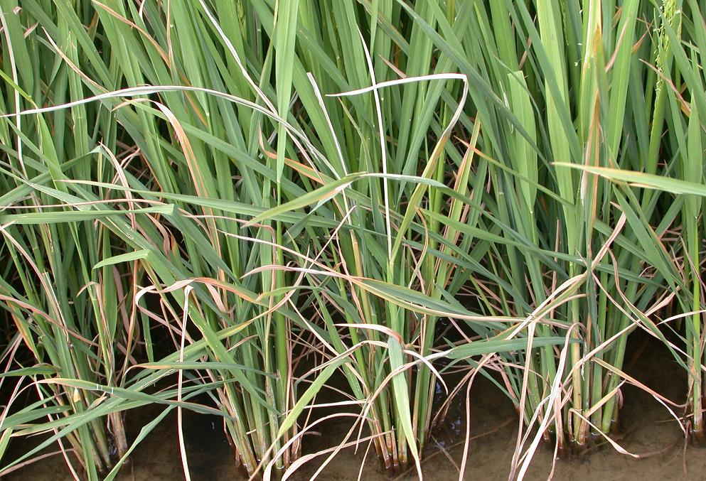
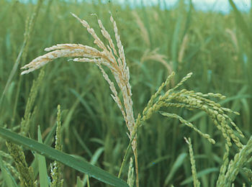
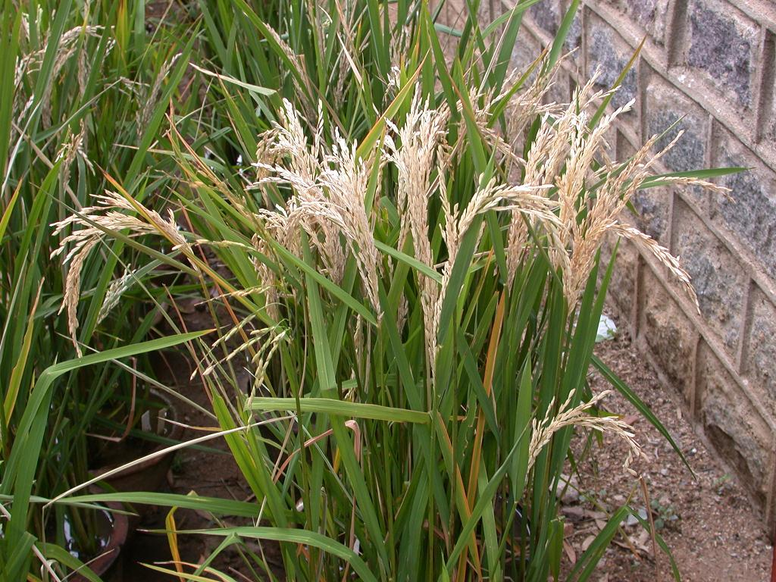
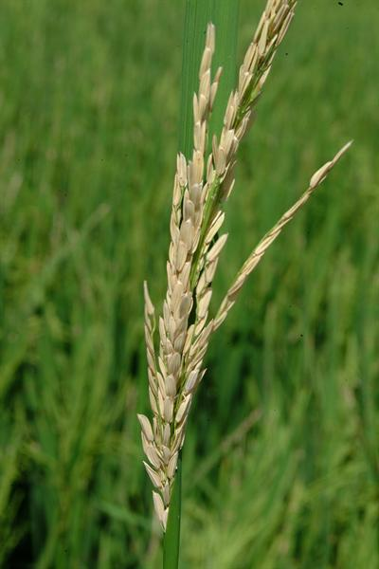
Insect pests of Rice White and yellow stem borer
Damage:
Basmati varieties suffer heavy damage
Could cause 90% of crop loss.
Dead Heart: Growing shoots dries up (dead-heart).
White ears formation: Upon attack at flowering stage, whitish ears stands erect in field with no grain formation particularly in August-September.
Milky or White-ears formation
Dead-hearts formation
Notes:
Selender whitish adult with black spot on each fore wing. Female with orange anal tuft. Larvae; Pale or yellowish white. 5-7 generations per y.
Damage same as yellow Stem Borer.

Slide 6
Insect pests of Rice Damage of Stem Borers
Control:
Cultural Control: Nursery after 20th May, Transplaning essentially in August
clean-cultivation,
stubbles removal,
picking and destroying egg-masses and dead-hearts
Trapping the moth by light traps
Trichogramma
Chemical control
Chlorantraniliprole 0.2% + thiamethoxam 0.4% 4 Kg/A (Virtako 0.6 G) Syngenta
Fipronil 30 -60 gm/A (Regent 80 WG) Bayer CropScience
Chlorantraniprole 4 Kg/A (Ferterra 0.4 G) FMC
Cartap hydrochloride 9Kg/A (Padan 4G) FMC
Carbofuran 10 Kg/A (Furadan 3G) FMC
Notes:
Cultural Control: Nursery after 20th May, Transplaning essentially in August Light traps, clean-cultivation, stubbles removal, picking and destroying egg-masses and dead-hearts
Chemical control: Carbofuran (Furadan 3G) @14kg/acre, Chlorpyriphos or Cartap (Padan 4G) @10Kg/acre, Diazinon (Basudin 10G) @ 9Kg/acre

Slide 7
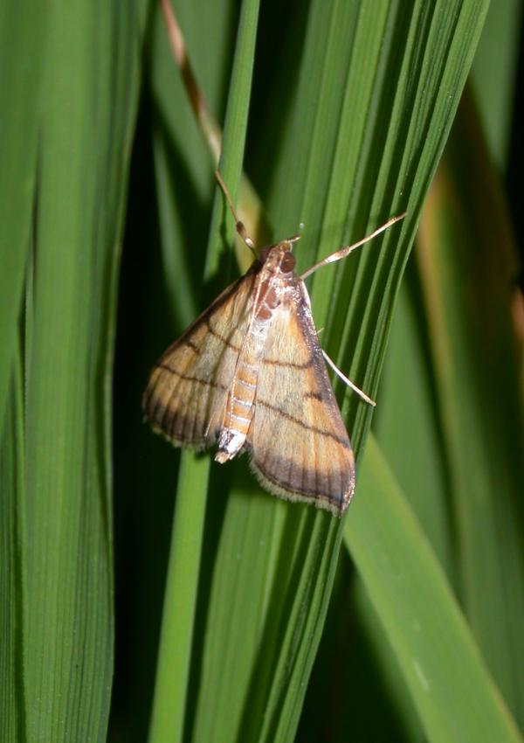
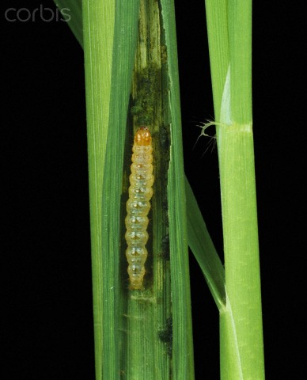
Insect pests of Rice Leaf-folder (Cnaphalocrocis medinalis: Pyralidae)
Active: July to October
Adult: Golden or yellowish brown in color, wings have 2-3 wavy lines
larva:
newly hatched larvae is dull white or light Yellow – later turn green (due to feeding)
Larvae very active and moves quickly in the leaf fold when disturbed
4 generations/y.;
Life cycle
Hatching: 3-4 days
Eggs: 56 oval, creamy white eggs singly or in pairs on leaves and leafsheaths
Larvae: 2-4 weeks
Pupae: 1 week, pupation in loose silken webs between leaves or leafsheaths
Notes:
Adult: Golden or yellowish brown in color, larva: lightly yellow or dull white with brownish orange head capsule. 4 generations/y.;
Young larvae feeds on tender leaves and then lateral larval instars tightens the leaf longitudinal margins with sticky substacne and feeds inside these folds by scraping green matter and leaving membraneous leaf appearance that later dries up.

Slide 8
Evaluation of Different Insecticides Against Rice Leaffolder Cnaphalocrocis medinalis (Guenee) Under Field Conditions
October 2014Pakistan journal of zoology 46(5):1458-1461
Ijaz HaiderMuhammad Azeem AkhterArshed Makhdoom Sabir
Rice leaffolder is considered as a sporadic insect pest of rice in Pakistan. It can cause 30 to 40% leaf infestation and 30% yield loss. A field trial was conducted at Rice Research Institute Kala Shah Kaku Punjab Pakistan in which efficacy of certain insecticides viz.,
Proaxis 60CS (gammacyhalothrin) @ 75ml,
Karate 2.5EC ( lambda cyhalothrin) @ 200ml,
Padan 4G (cartaphydrochloride) @ 9Kg,
Belt480SC (flubendiamide) @ 50ml,
Virtako40WG (thiamethoxam + chlorantraniliprole) @ 40gm,
Coragen 20CS (chlorantraniliprole) @ 50ml per acre
was checked against rice leaffolder Cnaphalocrocis medinalis (Guenee). The experiment was laid out in RCBD with three replications. Insecticides were applied at economic threshold level (ETL) and observations were recorded after seven days of insecticide application. Yield data was taken before harvest of rice crop. All the insecticides effectively controlled the pest and increased grain yield was achieved as compared to control. Belt 480 Sc with 1.12% damaged leaves was the best amongst all treatments followed by Proaxis 60CS 1.28%, Karate 2.5 EC 1.83%, Padan 4G 2.37% Virtako 40WG 2.53%, Coragen 20CS 2.59% and in control 15.83% damage was observed. Highest paddy yield was achieved in case of Belt 480 Sc 3.33 t/h followed by Proaxis 60CS 3.18 t/h, Karate 2.5 EC 3.01 t/h, Virtako 40WG 2.87t/h, Padan 4G 2.75 t/h, Coragen 20CS 2.57t/h and control 2.21 t/h. All the new test insecticides proved very effective for the control of rice leaffolder.

Slide 9
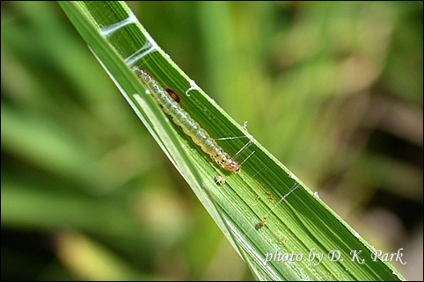
Insect pests of Rice Leaf-folder (Cnaphalocrocis medinalis: Pyralidae)
Damage:
Young larvae feed on tender leaves without folding them
Older larvae fasten the longitudinal margins of leaves with sticky substance
Larvae feed inside the fold by scraping the green matter
Streaks on the leaves and appears whitish from a distance
Leaves become membranous, turn white and dries up.
Photosynthetic activity of leaves is affected
Fungal and bacterial infection takes place after insect damage
Control:
Removal of weeds
Trapping the moth by light traps
Trichogramma
Chemical control
Lambda-cyhalothrin (Karate 2.5 EC) 200ml/A (Syngenta)
Flubendamide (Belt 48% SC/480 SC) 50 ml/A (Bayer)
Cartap (Padan 4G)9 Kg/A ,
Chlorpyrifos 1000ml/Acre
Notes:
Adult: Golden or yellowish brown in color, larva: lightly yellow or dull white with brownish orange head capsule. 4 generations/y.;
Young larvae feeds on tender leaves and then lateral larval instars tightens the leaf longitudinal margins with sticky substacne and feeds inside these folds by scraping green matter and leaving membraneous leaf appearance that later dries up.

Slide 10
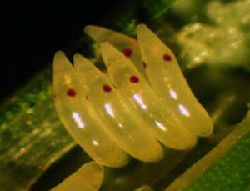
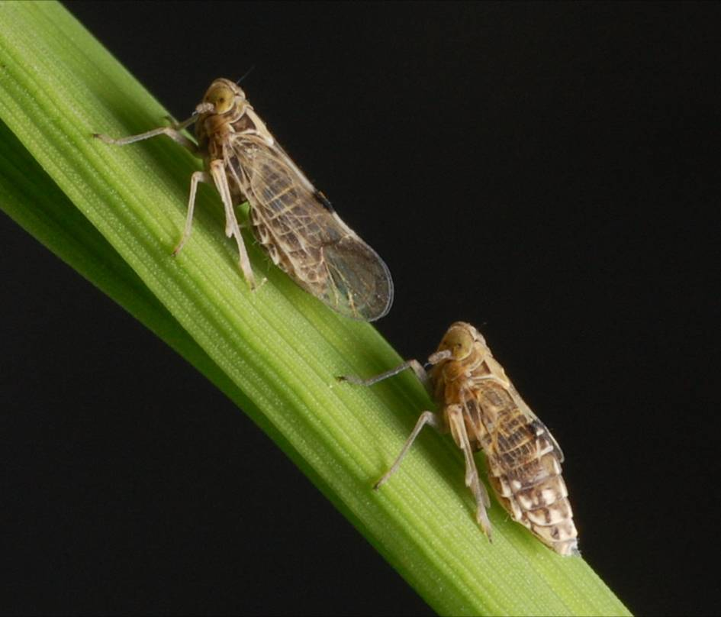
Insect pests of Rice White-backed plant hopper (Sogatella furcifera: Delphacidae)
active period: March to November
Widely distributed in Kallar tract of Pakistan (Sialkaot, Gujranwala, Sheikhupura etc).
Host plants: Rice and wild grasses.
Adults: straw coloured with white back, wedge shaped. mass egg-laying (cylindrical) in leaf-sheaths,
Nymph: greyish white then turns dark grey
Life cycle:
Hatching: 5 days
Nymph: 2 weeks
Adult: 1 weeks
overwinters as egg or nymph, several generations per y.
Notes:
Widely distributed in Kallar tract of Pakistan (Sialkaot, Gujranwala, Sheikhupura etc). Host plants: Rice and wild grasses.
Adults: Greyish straw colored with white back, mass egg-laying (cylindrical) in leaf-sheaths, Nymph: greyish white then turns dark grey
Life cycle: 3-4 weeks, active period: March to November, overwinters as egg or nymph, several generations per y.
Congregate near plant base around leaf sheaths, desaping gives yellowish color and then dries up and gives burnt appearcence to the whole crop. Lower rice yeild

Slide 11
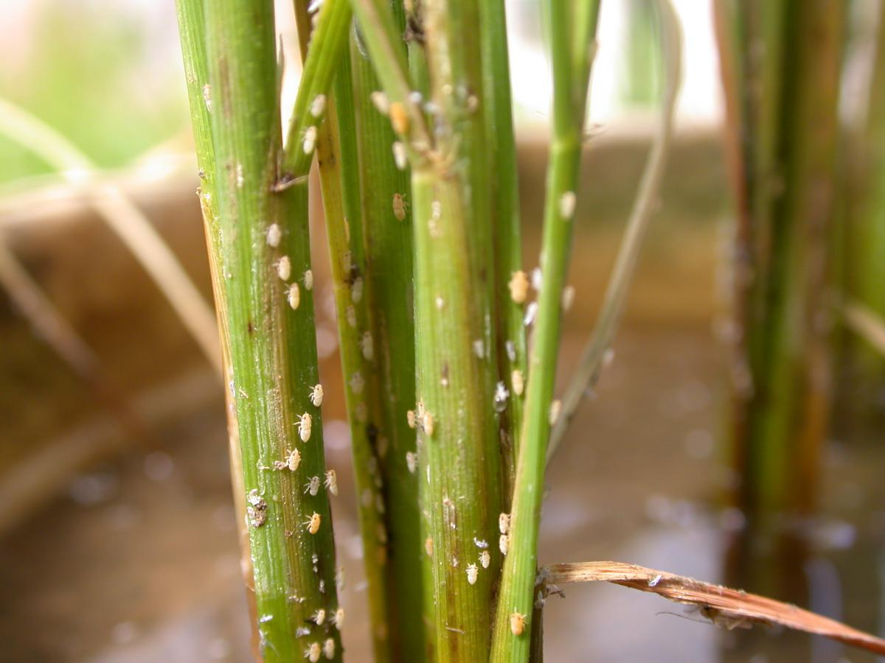
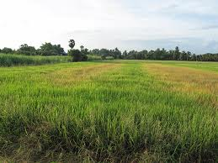
Insect pests of Rice White-backed plant hopper (Sogatella furcifera: Delphacidae)
Damage:
Suck cell-sap
Congregate near plant base around leaf sheaths,
Attached plant turn yellow and later on rust red
Symptoms starts from leaf tips and spread to the rest of th plant
Attacked plants dries up without producing ears
Due to honey dews, sooty mould appears (give smoky color to the paddy field)
gives burnt appearcence to the whole crop.
Lower rice yield
Control:
It likes humid condition. By providing aeration, its population can be managed.
Avoid closer spacing (preferred is 20 x 15 cm)
Alternate drying and wetting the field
Imidacloprid (Confidor 200SL) 60ml/A (Bayer CropScience)
Lambda-cyhalothrin (Karate 2.5 EC) 200ml/A (Syngenta)
Thiamethoxam (Actara 25 WP) 24 gm/A (Syngenta)
Hopper burn
Notes:
Widely distributed in Kallar tract of Pakistan (Sialkaot, Gujranwala, Sheikhupura etc). Host plants: Rice and wild grasses.
Adults: Greyish straw colored with white back, mass egg-laying (cylindrical) in leaf-sheaths, Nymph: greyish white then turns dark grey
Life cycle: 3-4 weeks, active period: March to November, overwinters as egg or nymph, several generations per y.
Congregate near plant base around leaf sheaths, desaping gives yellowish color and then dries up and gives burnt appearcence to the whole crop. Lower rice yeild

Slide 12
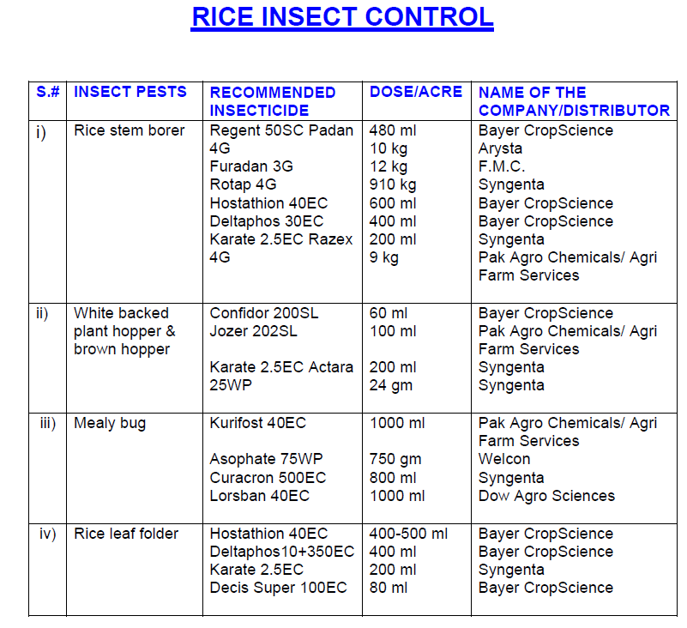

Slide 13
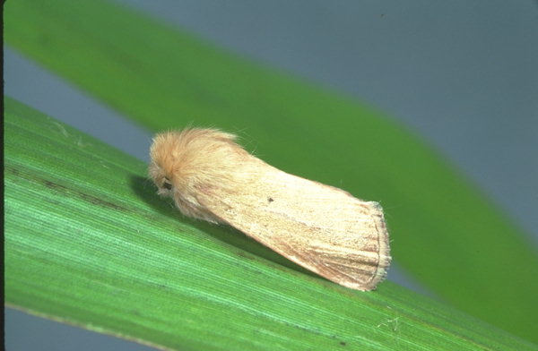
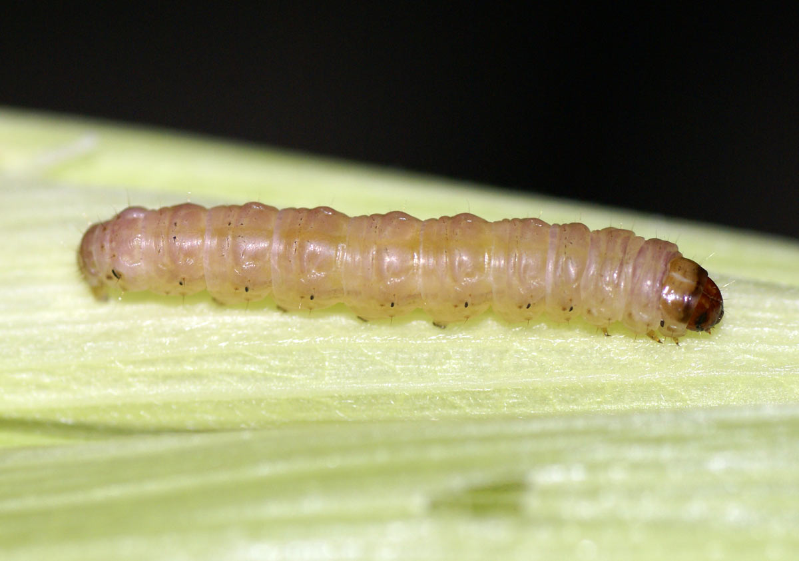
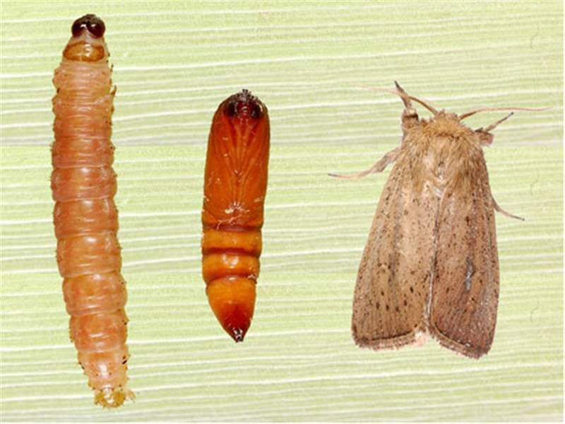
Insect pests of Rice Pink gramineous borer (Sesamia inferens: Noctuidae)
Notes:
Adult: Pale brown with reddish brown dots on forewings, hind wings whitish., larva: Pink in color, 4-6 generations per y.
Larvae feed on leaf sheaths and later on bores in to central core of plant to produce dead-heart (easily pulled out) also feeds on rice grains in ears as well.

Slide 14
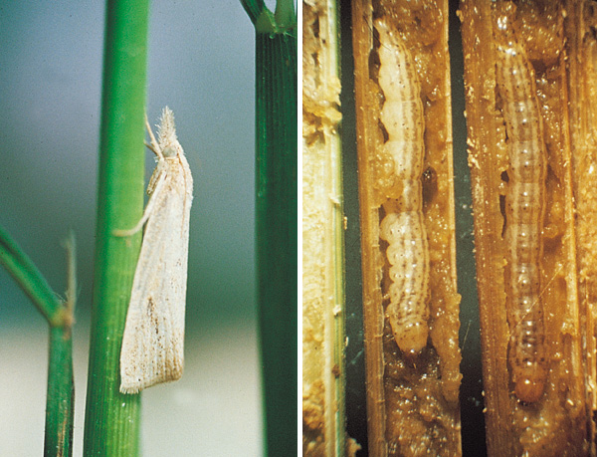
Insect pests of Rice Stripped Stem Borer (Chilo suppressalis: Noctuidae)
Notes:
Adult: straw-colored, Larva: Greenish brown with 5 longit. on dorsal side. Cluster egg-laying (50-70 eggs)
Active period: April-Oct., Maxi. Activity; Sept. Oct., 1-4 generations per y.; Maxi. Damage: 3rd and 4th generations.

Slide 15
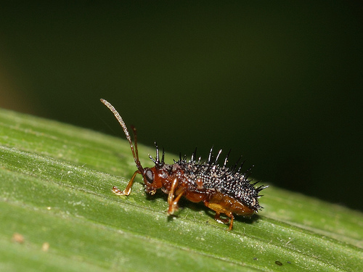
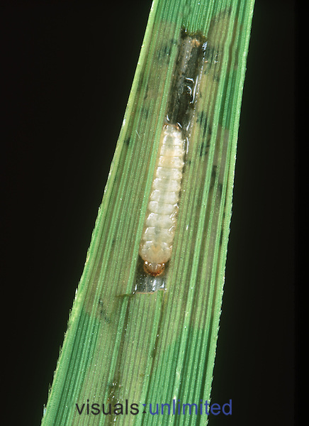
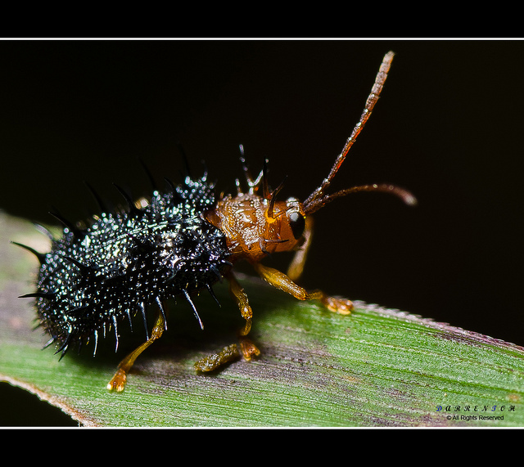
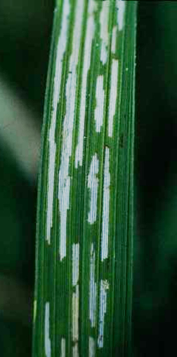
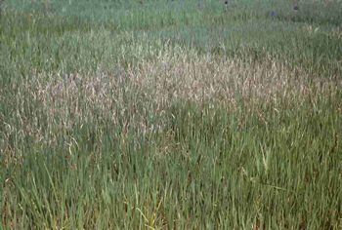
Insect pests of Rice Hispa (Dicladispa armigera: Chrysomelidae)
Nursery more susceptible to damage
Notes:
Adults: spiny black beetles/ Grub: dull pale or yellowish in color : 2-3 generation per y: 20-100 eggs laid singly on leaf upper side. Maximum activiy:June, July
Feeding of larvae in between leaf layers like leaf miners. Green matter scrapings leaving whitish parallel streaks on blades.
Control: while transplanting remove infested tips of leaves., adult beetles removal and destruction after flood irrigation of field or nursery.
Chemical: Carbaryl (Sevin 10D) @ 5kg/acre
Cartap (Padan 4G) @ 10 Kg/acre
Methamidophos @ 500 ml/acre

Slide 16
Minor/Occasional Insect Pests of Rice

Slide 17
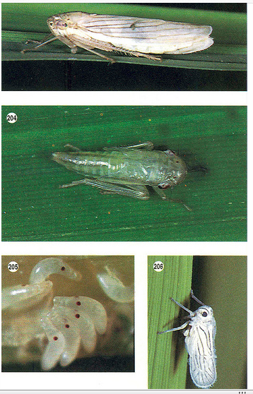
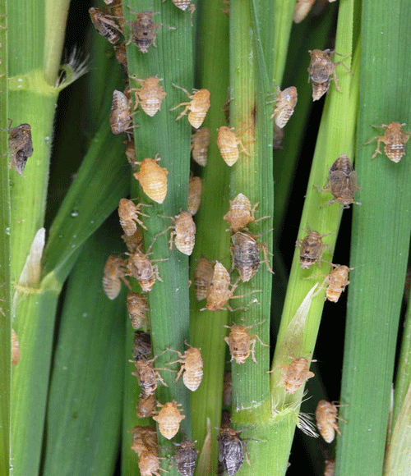
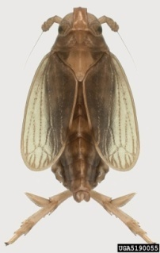
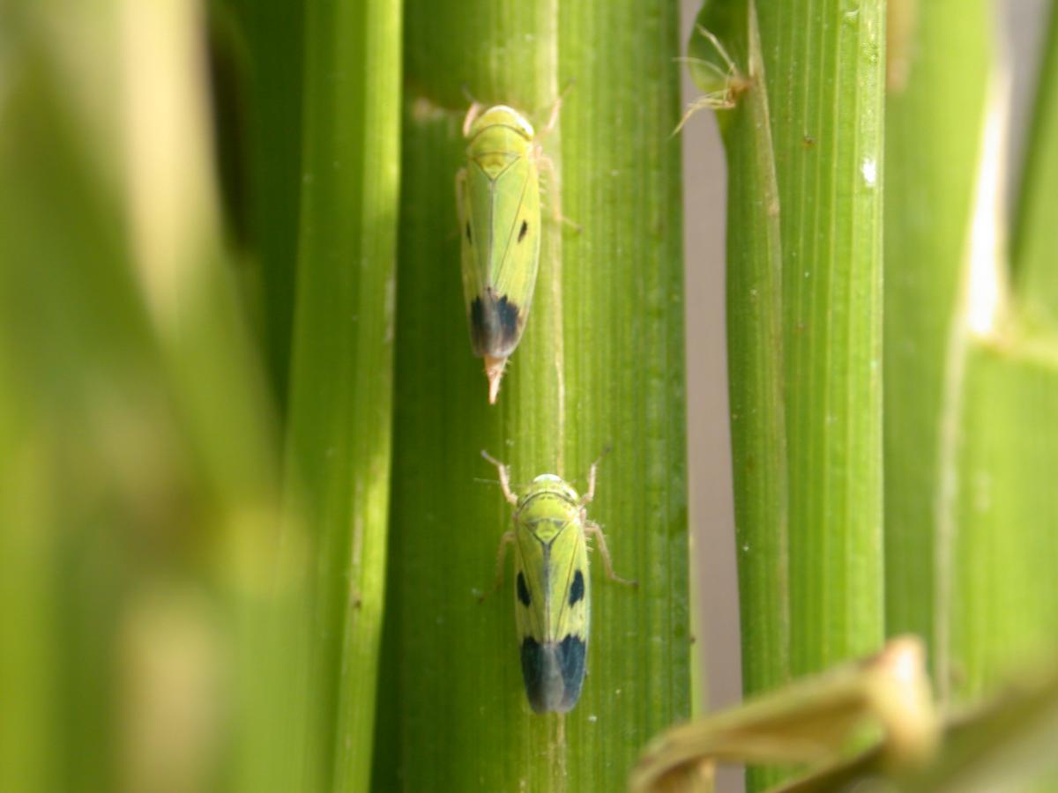
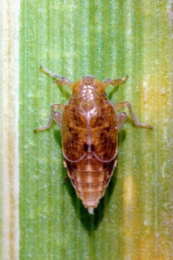
Insect pests of Rice White leaf-hopper (Cofana spectra: Cicadellidae)
Green leaf-hopper (Nephotettix nigropictus: Cicadellidae)
Brown plant-hopper (Nilaparvata lugens: Delphacidae)
Notes:
Desaping leads to yellowish leaf color and later turns brown. Damage symptoms start from leaf tips and goes downward to rest of plant. Several brown spots on feeding sites leads to stunted growth of ears without grain formation.

