Slide 1
PROJECT EVALUATION

Slide 2
Contents
Introduction
Business case
Project portfolio management
Evaluation of Individual Projects
Cost benefit evaluation techniques

Slide 3
Introduction
A business case may be presented for several potential projects, but there may be money or staff time for only some of these projects.
Managers need some way of deciding which projects to select.
This chapter will discuss some ways in which projects can be evaluated and compared for selection.

Slide 4
Business case
The objective of business case is to provide a justification for the project by showing that the benefits of the project will exceed the costs of development, implementation and operation.

Slide 5
Business case
A typical business case contain
Introduction and background to the proposal
The proposed project
The market
Organizational and operational infrastructure
The benefits
Outline implementation plan
Costs
The financial case
Risks
Management plan

Slide 6
Project Portfolio Management
Project portfolio provides an overview of all the projects that an organization is undertaking or considering.
It prioritizes the allocation of resources to projects and decides which new projects should be accepted and which should be dropped.

Slide 7
Project Portfolio Management
The concerns of project portfolio management include
Identifying which project proposals are worth implementation.
Assessing the amount of risk of failure that a potential project has.
Deciding how to share limited resources.
Ensuring that projects do not duplicate work.

Slide 8
Evaluation of Individual Projects
Technical Assessment
Cost-Benefit Analysis
Cash Flow Forecasting
Notes:
Why evaluate?

Slide 9
Technical Assessment
It consists of evaluating whether the required functionality can be achieved with current affordable technologies.
The costs of the technology adopted must be taken into account in the cost benefit analysis.

Slide 10
Cost-Benefit Analysis
Even where the estimated benefits will exceed the estimated costs, it is often necessary to decide if the proposed project is the best of several options.
Not all projects can be undertaken at any one time, therefore the most valuable projects should get most resources.

Slide 11
Cost-Benefit Analysis
A cost benefit analysis comprises of two steps
Identifying all of the costs and benefits of carrying out the project and operating the delivered application.
Expressing these costs and benefits in common units. Each cost and all benefits should be expressed, and the net benefit should then be calculated.
Most direct costs that are easy to quantify in monetary terms are developmental costs, setup costs and operational costs.

Slide 12
Cost-Benefit Analysis
Activity 1
Brightmouth college is considering the replacement of the existing payroll service, operated by a third party, with a customized, off the shelf computer based system. List some of the costs it might consider under the headings of
Developmental Costs
Setup Costs
Operational Costs

Slide 13
Cash-Flow Forecasting
A cash flow forecast indicates when expenditure and income will take place.
A forecast is needed of when expenditure, such as the payment of salaries and any income are to be expected.
Accurate cash flow forecasting is difficult, as it is done early in the project's life cycle and many items to be estimated might be some time in the future.

Slide 14
Cash-Flow Forecasting
While estimating future cash flows, it is usual to ignore the effects of inflation, as inflation rate is uncertain.
Moreover if expenditure is increased due to inflation it is likely that income will increase proportionately.

Slide 15
Cost-Benefit Evaluation Techniques
Net Profit
Payback Period
Return on Investment
Net Present Value

Slide 16
Cost-Benefit Evaluation Techniques
YEAR | Project 1 | Project 2 | Project 3 | Project 4
0 | -100,000 | -1,000,000 | -100,000 | -120,000
1 | 10,000 | 200,000 | 30,000 | 30,000
2 | 10,000 | 200,000 | 30,000 | 30,000
3 | 10,000 | 200,000 | 30,000 | 30,000
4 | 20,000 | 200,000 | 30,000 | 30,000
5 | 100,000 | 300,000 | 30,000 | 75,000
Net Profit | 50,000 | 100,000 | 50,000 | 75,000
Notes:
Rank these projects.

Slide 17
Cost-Benefit Evaluation Techniques
Net Profit is the difference between the total costs and the total income over the life of the project.
ACTIVITY 2: Considering the cash flows of four projects provided in previous table, which project should be selected if using the technique of net profit.
Notes:
Why?

Slide 18
Cost-Benefit Evaluation Techniques
Payback Period is time taken to break even or pay back the initial investment. Normally the project with the shortest payback period is chosen.
ACTIVITY 3: Consider the four projects cash flows given in table and calculate the payback period for each of them. Which of them should be selected using this criterion.

Slide 19
Cost-Benefit Evaluation Techniques
Return on investment provides a way of comparing the net profit to the investment required. It provides a simple and easy to calculate measure of return on capital.
ROI = average annual profit * 100
total investment
ACTIVITY 4: Calculate the ROI for each of the projects given in table and decide which on the basis of this criterion is the most worthwhile.

Slide 20
Cost-Benefit Evaluation Techniques
Net Present Value takes into account the profit of a project and the timings of the cash flows that are produced.
It is based on the view that receiving $100 today is better than having to wait until next year to receive it.
For example invest $100 in a bank today and receive $100 plus the interest in a year's time.

Slide 21
Cost-Benefit Evaluation Techniques
If we say that the present value of $100 in a year's time is $91, we mean that $100 after one year is equal to $91 now.
The equivalence of $91 now and $100 after 1 year means we are discounting the future income by approximately 10%.
The annual rate by which we discount future earnings is known as the discount rate (10% in above example).

Slide 22
Cost-Benefit Evaluation Techniques
Present value of a cash flow can be calculated by multiplying the cash flow by the appropriate discount factor.
The NPV for a project is obtained by discounting each cash flow and summing the discounted values.

Slide 23
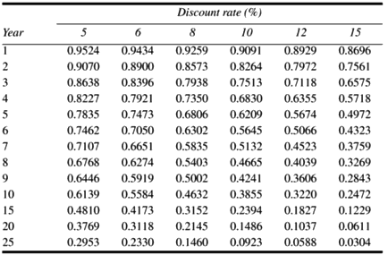
Cost-Benefit Evaluation Techniques
A table for discount factors is

Slide 24
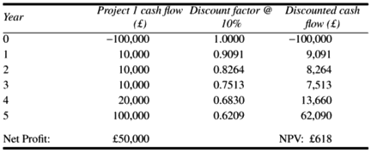
Cost-Benefit Evaluation Techniques
Assuming a 10% discount rate, the NPV for project 1 would be calculated as

Slide 25
Cost-Benefit Evaluation Techniques
ACTIVITY 5: Using a 10% discount rate, calculate the NPVs for projects 2,3 and 4 and decide which, on the basis of this, is the most beneficial to pursue.

Slide 26
Reading
[Chapter 2] “Software Project Management by Bob Hughes and Mike Cotterell, McGraw-Hill Education; 6th Edition (2009). ISBN-10: 0077122798”

