Slide 1
Lecture 8B
Using Business Driven Data Mapping For Integrated Data

Slide 2
Introduction
Data Entity Types
Data Attributes Types

Slide 3
Data Entity Types
There are Six main data entity types:
Principal (supertype) entities.
Type entities
Secondary(subtype)entities
Intersecting entities
Role entities
Structure entities

Slide 4
Principal (super type) entities:
principal entities contain common data that are typically shared by many model views.
The concept of a principal entity is also used by IT-driven IE, but is called a super-type.
A principal entity must be uniquely identified by at least one key attribute, called a primary key. Primary keys originate in principal entities.
An entity list contains the name of the entity in uppercase letters.
Attributes that reside within the entity follow within brackets, separated by commas. These are employee number, employee name, and employee address.
Note that employee number# is underlined, with suffix “#,” which is pronounced “key.” This notation indicates that employee number is a primary key that is used to uniquely identify each occurrence of an employee,

Slide 5
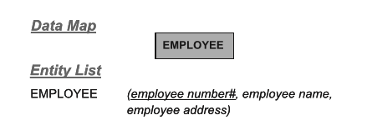
Principal (super type) entities:
Note that employee number# is underlined, with suffix “#,” which is pronounced “key.” This notation indicates that employee number is a primary key that is used to uniquely identify each occurrence of an employee,

Slide 6
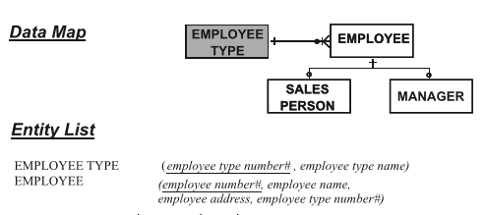
Type Entity:
A type entity indicates that other entities may also exist for each principal entity.

Slide 7
Secondary Entity
Secondary entities contain data that are typically not shared throughout the organization, over which privacy, security, or legislative governance controls may be exercised.

Slide 8
Secondary Entity
SALESPERSON contains the attributes salesperson quota, salesperson sales, and salesperson commission that are of interest only to the sales department model view. This department exercises privacy and security control over these attributes. They consider these attributes to be sensitive data that are not to be shared by other parts of the business.
MANAGER contains the attributes manager title and manager reporting level that are considered of interest only to the management services model view and not to be shared by others.

Slide 9
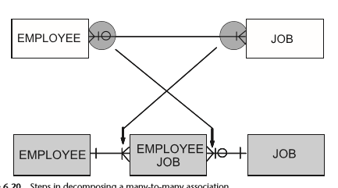
Intersecting Entity
intersection entity are used in the resolution of a many to many relationship.

Slide 10
Data Attribute Types
There are different types of data attributes:
Key Attribute.
Non-key Attributes.

Slide 11
Key Attributes
Primary key
A primary key is an attribute used to identify one, and only one, occurrence of an entity.
Single key that is unique or not null.
In data mapping, primary key should be underlined.
Example: License Number, vehicle Number, CNIC Number etc.
Foreign Key
A primary key can be defined in one entity, but can also reside in another entity where it is not a primary key. In this other entity it is referred to as a foreign key
It identifies a potential association between the two entities

Slide 12
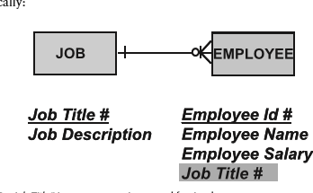
Key Attributes
A foreign key is a key attribute and is written in an entity list. But it is not underlined.
Example:
Job Title# is a primary key in JOB, and so is underlined.
Job Title# is a foreign key in EMPLOYEE, and so is not underlined.

Slide 13
Key Attributes
Candidate key
If there are multiple key in the data model, these can be called Candidate key(the name reflect that they are candidate for the responsible entity of the primary key.
A candidate key is a column that meets all of the requirement of the primary key.
Example : student ID and CNIC are candidate key of student.

Slide 14
Key Attributes
Compound Key:
A compound key consist of more than one attribute to uniquely identify an entity occurrence .

Slide 15
Non-key Attribute
There are several type of non-key attributes.
Selection attribute
Group attribute
Elemental attribute
Repeating group attribute
Derived attribute

Slide 16
Selection Attribute
Selection Attribute
Unique or non unique attribute used to refer to, or access, an entity; also called a secondary key.
Selection key are also called secondary key attribute
Example: employee name etc
Elemental and Group Attributes
A fundamental attribute that cannot be decomposed any further
They are at their atomic level
(Employee Name) is called a group attribute.
Group attributes are written surrounded by a single left and right parenthesis. (Employee Name) is an example of a group attribute. It refers to the indented elemental attributes of Employee First Name and Employee Last Name for the full name of an employee.

Slide 17
Non-key Attribute
Repeating Group Attributes
Some attributes can have two or more values for each occurrence of the entity in which they reside . These are called repeating groups an
They are written in an entity list with the attribute name surrounded by ((double parentheses)).
Example:((skills)).
Derived attribute
An attribute whose value is calculated from other attributes.
Derived attributes are written in an entity list with the relevant attribute name surrounded by left and right {curly braces}.
Example:{age} can be derived from date of birth to todays age

