Slide 1
Lesson 1(Firearm Injuries)
By Dr Nadir Ali

Slide 2
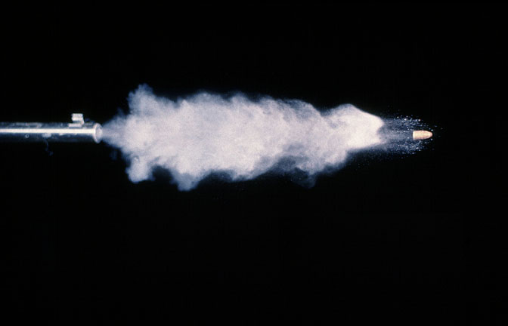
Firearm Injuries
By
Dr Nadir Ali Rana
Incharge
Department of Forensic Medicine

Slide 3
FIREARM WOUNDS
01: Introduction of firearms
Definition of Firearms.
Epidemiology of firearm injuries.
History of Firearms.
02: Anatomy of firearms
Structure of firearm weapon.
Types of Firearms.
Types of Firearm Ammunition.

Slide 4
03: Ballistics(science/study of firearms)
Types of Ballistics
Firearm injuries
04: Forensic Laboratory Procedures.
05: Medicolegal Aspects of Firearm
Injuries.

Slide 5
01. Introduction of firearm
A: DEFINITION
Firearm is defined as:
“Any weapon from which a projectile is discharged by explosive means.”
Legal definition may vary from country to country.

Slide 6
B: Epidemiology
Firearm weapon is the leading cause of death in Pakistan as well as in all over the world.
Percentage of firearm weapon as cause of death.
In the world
In Pakistan
In Sargodha

Slide 8
Percentage of Causes of Death in Sargodha city (from 01-01-2012 to 31-12-2012)
Cause of Death | Number of cases | Percentage
Firearm | 55 | 71.4%
Blunt | 07 | 09.0%
Sharp/pointed | 10 | 13.0%
Asphyxia | 05 | 06.6%
Total | 77

Slide 9
C: HISTORY OF FIREARMS
Idea of launching a projectile / arrow is prevalent since centuries.
Invention of gunpowder led to the development of firearms.
Gunpowder was used in China thousands of years ago in fire crackers. Later on, its use was extended to military weapons.

Slide 10
C: HISTORY OF FIREARMS (contd,)
In 14th century, knowledge of manufacturing of gunpowder reached Europe. After that, use of firearms started proliferating rapidly.
Old gunpowder (black powder) was a mixture of sulphur, charcoal and salt peter (potassium nitrite).

Slide 11
Gunpowder used to be put in an enclosed space of metallic tube and ignited to produce large volume of gas to drive a projectile at high speed in a specific direction.
World War I & II gave impetus to the research work for improving the effectiveness of firearms.
Now smokeless powder has mostly replaced the black powder.

Slide 12
Journey of Progress in firearm weapon
Arrow/Bow → Firearm Weapon
Black Powder → Smokeless Powder
Muzzle Loading → Breach Loading
Matchlock ignition → Percussion ignition
Single Fire → Multiple Fire
Single Action → Automatic
Simple Bore → Rifled Bore
Low Velocity → High Velocity
Simple Lead Bullets → Jacketed Bullets

Slide 13
02. Anatomy of firearms
Structure of firearm weapon.
Classification of Firearms.
Types of Firearm Ammunition.

Slide 14
A: Structure of firearm weapon
Grip Action Barrel

Slide 15
Structure of firearm weapon (contd.)
1. Grip
It is the part of firearm which is gripped in the hand
2. Action
It is the part where whole the mechanism of a projectile discharge is operated. It has different parts-the firing pin, trigger and the chamber with cartridge etc.

Slide 16
Structure of firearm weapon (contd.)
3. Barrel
It is a hollow metallic tube having two ends one closed ( breech end ) and the other opened ( muzzle end ).
Breech end is for loading of ammunition and muzzle end is for its ejecting out of the barrel.
Its inner aspect may be grooved( Rifled ) or Smooth

Slide 17
B: Classification of Firearm
It may be smooth or rifled firearm weapon depending upon the internal diameter of the barrel (bore).
Rifling
Cutting of internal aspect of barrel walls into spiral grooves, longitudinally from the breech to the muzzle end.

Slide 18
Lands and Grooves.
Elevated areas between two grooves is called lands and depressed areas as grooves.
Bore
(Internal diameter of barrel)
It is measured as the distance
between two lands.

Slide 19
Purpose of Rifling
It helps the bullet to achieve a gyroscopic movement, which in turn gives the steadiness during its flight.
Gives the bullet greater power of penetration.
Enables bullet to cover longer range.
Improves the accuracy of hitting the target aimed.
Prevents wobbling of bullet due to air resistance .

Slide 20
Projectile
Definition
Any object propelled by the force of rapidly burning gases or the other means.
Bullets– these are fired from rifled weapons such as revolver or pistol.
Lead shots/pallets– these are fired from smooth bored weapons like shotgun.
Slugs– are used in air guns.
Metal scrap& stones etc– used in muzzle loading guns.

Slide 21
a) Types of smooth bored firearms
(projectile used in this weapon is pellets)
Shotgun.
Grip Action Barrel

Slide 22
Classification of smooth bored weapon (contd.)
Depending upon
i) Length of barrel
a) long barreled
b) short barreled
ii) Number of barrels
a) single barreled
b) double barreled

Slide 23
Classification of smooth bored weapon (contd.)
03. Route of loading
a) Muzzle loading
b) Breach loading
04. Barrel choking
a) Choked
b) Non-choked

Slide 24
Choking
Definition of choking
It means the constriction of barrel towards the muzzle end.
Purpose of choking
Normally the pallets travel as a single mass up to one yard after their exit and then they start to spread out. The degree of dispersion increases with the range of firing. Choking control to some extent the area of dispersion of the pallets ad they travel more as a single mass.

Slide 25
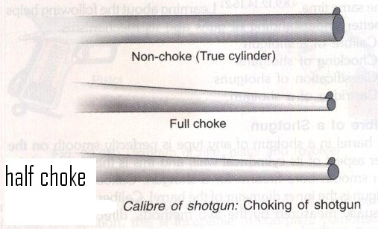
Choking means the constriction of barrel towards the muzzle end

Slide 26
b) Types of Rifled firearm weapons:
(projectile used in this weapon is bullet )
i) Short Barreled e.g.
Revolvers and Automatic pistols.
ii) Long barreled e.g. Rifles.

Slide 27
Short Barrel Rifled Weapons

Slide 28
Long Barrel rifled weapon
Rifles.

