Slide 1
ENTO-306
Agricultural pests and their management
Identification of important agricultural pests
Their mode of damages
Control measures
By: Dr. Muhammad Zeeshan Majeed

Slide 2
Insect Pests of Citrus Fruit Crop in Pakistan

Slide 3
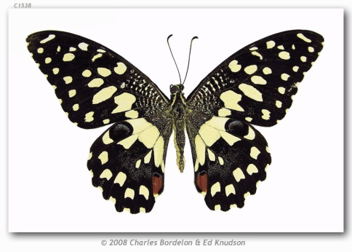
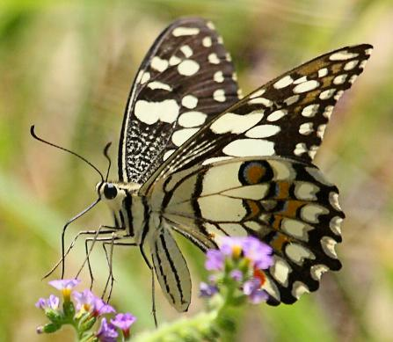
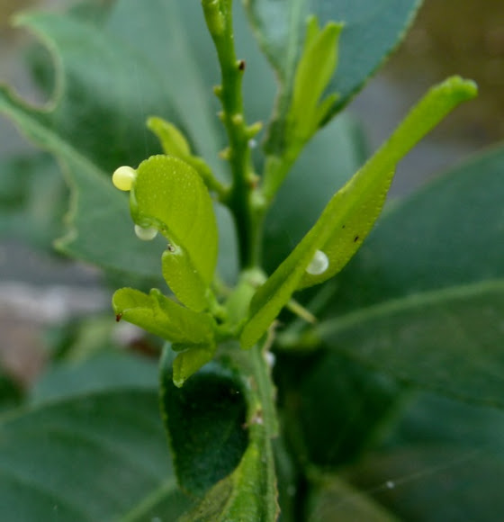
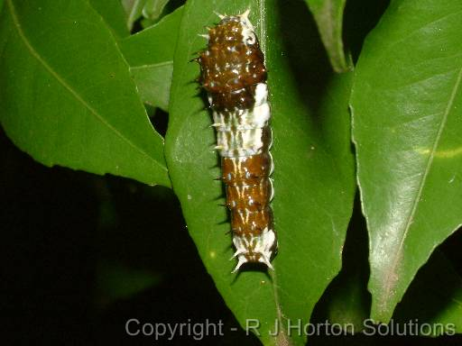
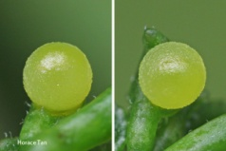
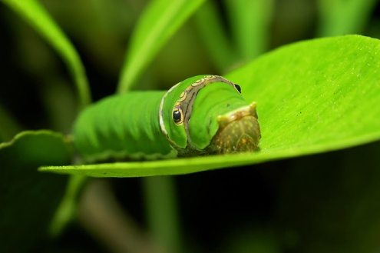
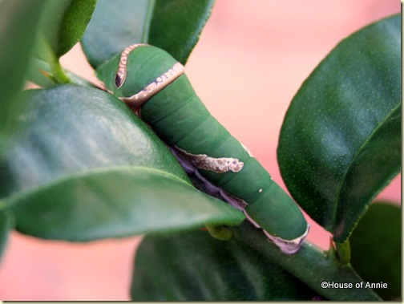
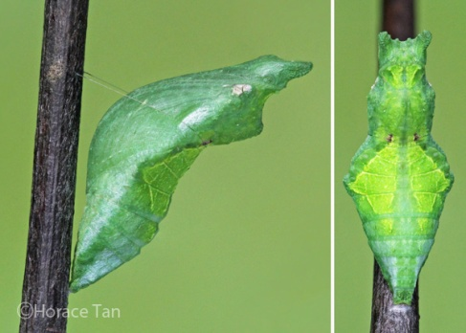
ENTO-306 Agricultural pests and their management 4(3-1)
Insect pests of Fruit Crops Citrus caterpillar (Papilio demoleus: Papilionidae, Lepidoptera)
Also called Citrus swallowtail butterfly or lime butterfly
Host plants: Major pest of Rutacae (citrus family) and also of Fabaceae.
Identification
Adult: Bluish green wings with irregular black and whitish-yellow patches.
Red tornal spot with blue edges on upper hindwing. (80-100mm)
Eggs: Small creamy yellowish spherical eggs (1.5mm) are laid singly on tender plant parts including shoots or twigs near edges (approx. 100 eggs per female)
Larvae: First instar (5mm) larvae-bird dropping look, stays in the leaf middle portion on upper side. Full grown larvae green in color with oblique brownish strips on abdomen. (40 mm 5th instar larva)
Pupa: Rugose (wrinkled), dimorphic
Life history:
Life cycle: 1 – 1.5 month
Adult: 1 week / Larvae: 2 to 4 weeks / Pupa: 2 – 3 weeks
No. of generations: 6 – 8 per annum
Damage:
Active period: April to Nov. (maxi. Damage July/ August)
Vigorously and voraciously eating leaves from edge to midrib.
Damage tender shoots and young sprouts.
Complete defoliation of citrus nursery or no fruiting on trees.
Control:
Manual picking and destruction of larvae
Biological control (larval parasitoids like Apanteles spp., Bracon hebetor)
Pupal parasitoids like of genus Brachymeria (Chalicidae)
Chemical control (Foliar spray with Imidacloprid, Cypermethrin, Spinosad etc.)
Notes:
Females lay eggs singly near the edges of the host plant leaves.
Lime butter fly / citrus swallowtail butterfly
The pupa is supported by the silk girdle across the thorax and attachment on cremaster

Slide 4
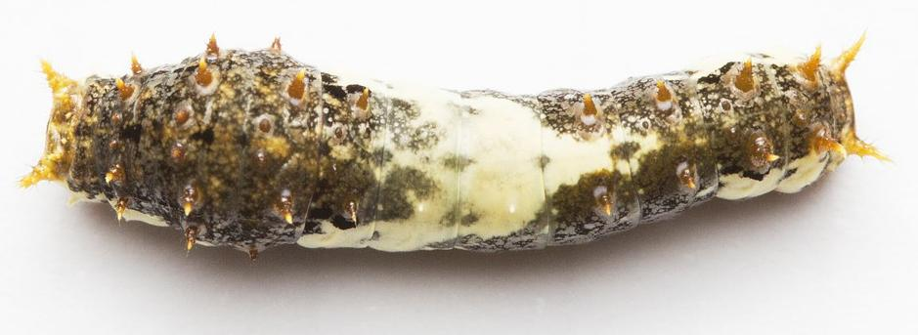
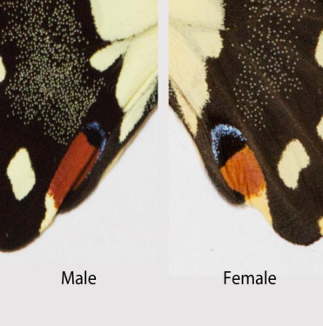
3rd and 5th instars of P. demoleus
http://butterflycircle.blogspot.com/2011/11/life-history-of-lime-butterfly-v20.html
Notes:
3rd and 5th instars of P. demoleus
http://butterflycircle.blogspot.com/2011/11/life-history-of-lime-butterfly-v20.html
In the male, this spot is capped with a narrow blue lunule with a very narrow intervening black gap. In contrast, the red spot and the blue lunule in the female have a rather large black spot between them

Slide 5
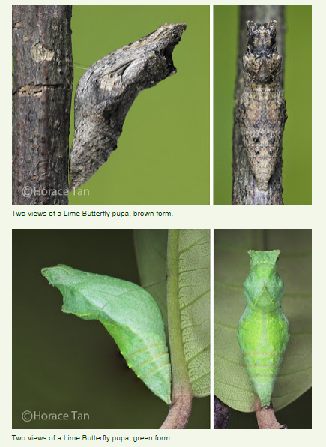
Notes:
As in the case of all Swallowtail butterflies, the Lime Butterfly caterpillars in all instars possess a fleshy organ called osmeterium in the prothoracic segment. Usually hidden, the osmeterium can be everted to emit a foul-smelling secretion when the caterpillar is threatened.
https://2.bp.blogspot.com/-52VPb3Sy_f8/WuFVf_OzYjI/AAAAAAAAsbs/sfdlNL6uoRwU9z77Jn3XHTUeTnRgKrN6gCLcBGAs/s1600/Lime_osmeterium_eversion.gif

Slide 6
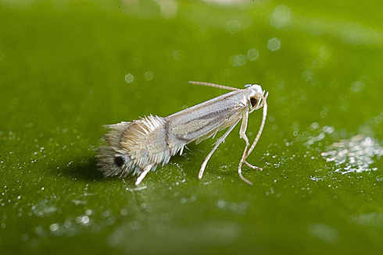
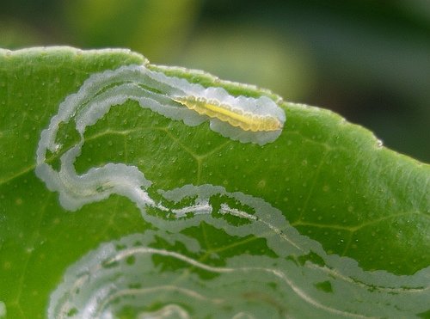
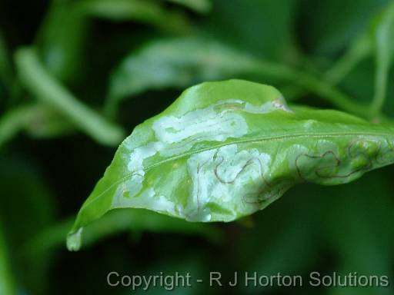
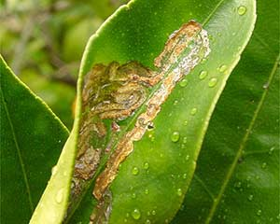
ENTO-306 Agricultural pests and their management 4(3-1)
Insect pests of Fruit Crops Citrus Leafminer (Phyllocnistis citrella : Gracillariidae , Lepidopt.)
Host plants: Major pest of citrus plants and widely distributed in citrus growing areas of Pakistan.
Identification
Adult: Silvery white tiny (2 mm long) moth with hair-fringes on fore- and hind-wings.
Eggs: Minute round eggs (looks like tiny water droplets in mines) laid singly under side of plant tender sprouts and leaves. (50 eggs / female)
Larvae: Pale greenish in color
Pupa: Tiny brownish in color, pupate in mine near rolled-leaf edge.
Life history:
Life cycle: 3 – 10 weeks
Adult: 2 – 4 weeks/ Larvae: 1 to 4 weeks / Pupa: 1 – 2 weeks
No. of generations: 12 plus
Damage:
Active period: March to Nov. (maxi. Damage July/ August)
Zigzag galleries on young foliage silvery when on young leaves
turns into brown patches on older leaves
Leaves and sprouts twisting and retarded growth occurs later on attacked portion
Rarely infest the stems and fruits.
Control:
Horticultural oil sprays (to reduce egg laying)
Fertilization in late winter/ Limited irrigation in late summer
Biological control: Chrysoperla carnea (lacewings)*
Cirrospilus coachellae (Eulophid wasps) larval parasitoid
Chemical control difficult (low efficiency).

Slide 7
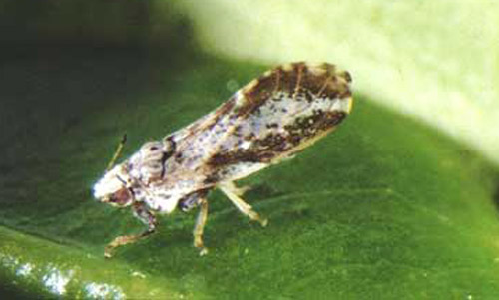
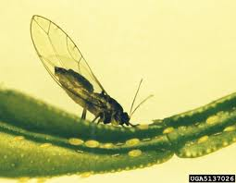
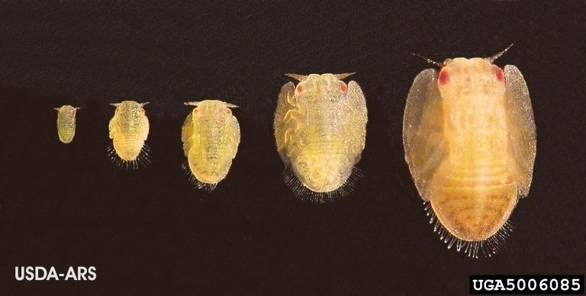
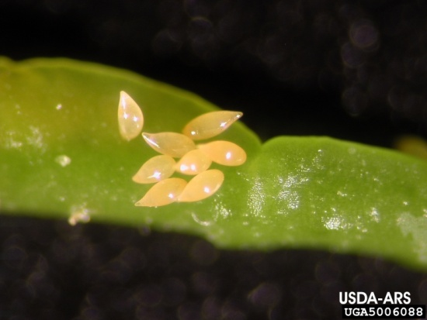
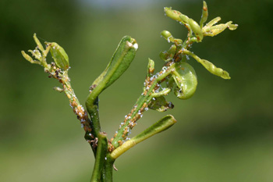
ENTO-306 Agricultural pests and their management 4(3-1)
Insect pests of Fruit Crops Citrus psylla (Diaphorina citri : Psyllidae, Homoptera
Also called Asian Citrus Psyllid
Host plants: Major pest of citrus.
Identification
Adult: Small (4 mm long) hopper with brown and white patches on wings (mottled body)
Aphids are sedentary and psyllids are active.
Egg: Pale yellow almond shaped small eggs laid on young foliage near leaf veins.
Nymph: Five nymphal instars with light yellow color of full grown nymph
Life history:
Life cycle: 3- 7 weeks
Damage:
Active period: March to October
(maxi. Damage March-April)
Desaping of young foliage
Withering , deformation and yellowing of plant leaves and twigs
Dieback of tips due to toxins injected during desaping
Pre-mature fruit dropping and defoliation
Sooty mold on sugary secretions produced by Psyllids
Vector of citrus greening disease
Control:
Biological control (Tamarixia radiata hoverflies, lacewings, several species of ladybird
Systemic insecticide
Notes:
Citrus greening disease (Chinese: 黃龍病; pinyin: huánglóngbìng; literally: "Yellow Dragon Disease"),^{[2]} abbreviated as HLB, is a disease of citrus caused by a vector-transmitted pathogen. The causative agents are motile bacteria, Candidatus Liberibacter spp.

Slide 8
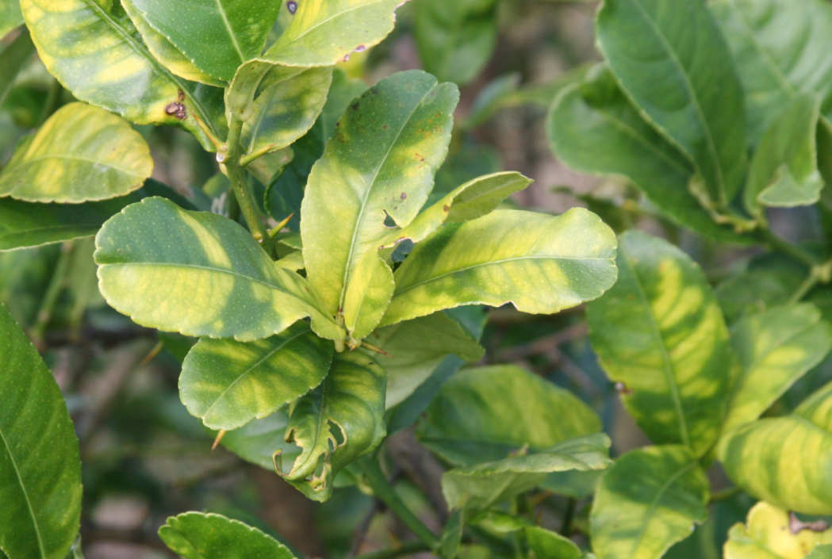
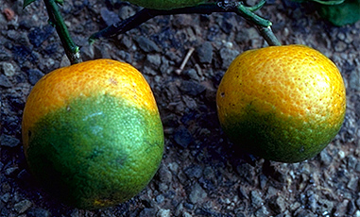
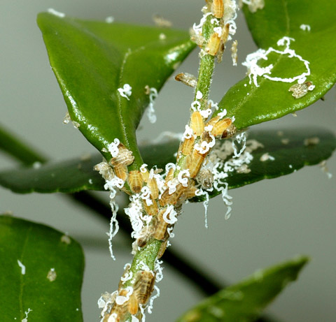
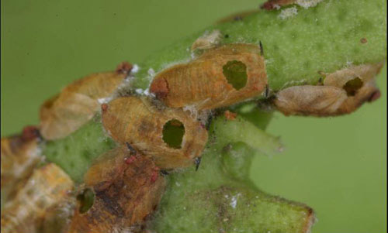
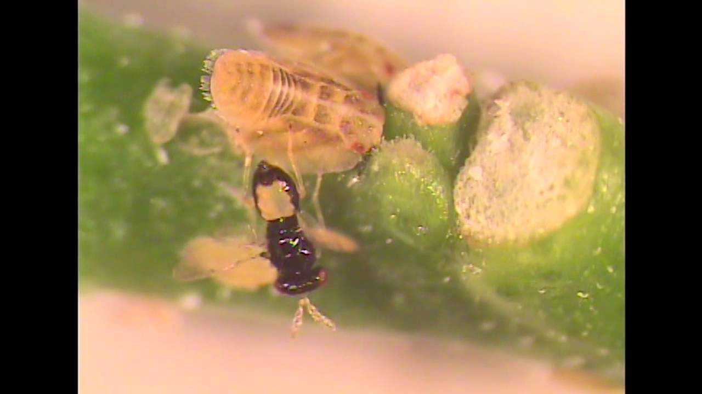
Tamarixia radiata
(Eulophidae)

Slide 9
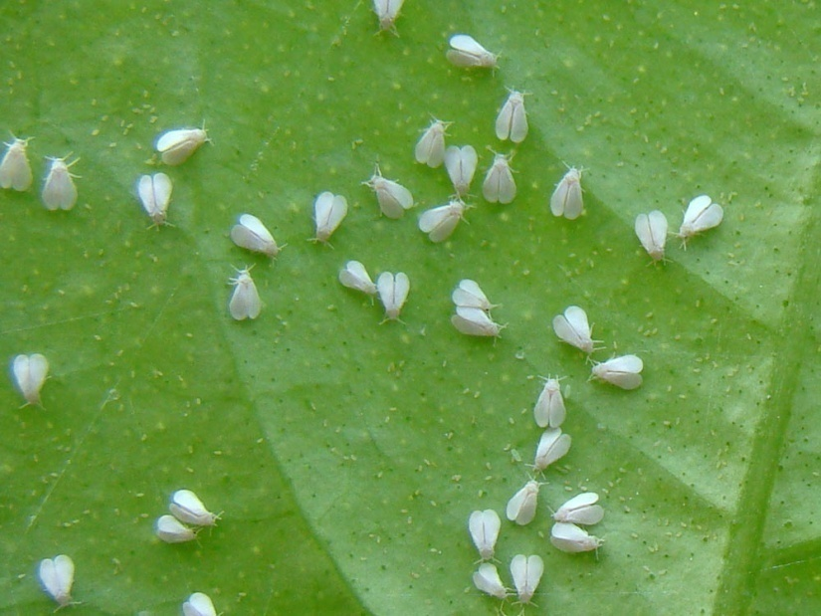
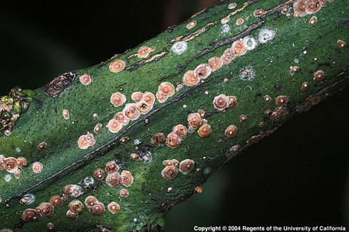
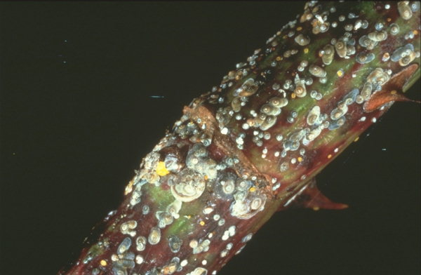
ENTO-306 Agricultural pests and their management 4(3-1)
Insect pests of Fruit Crops
Citrus whitefly
(Dialeurodes citri: Aleyrodidae, Homoptera)
Citrus red scale
(Aonidiella aurantii)
(Aspidiotus perniciosus: Diaspididae, Homoptera)

