Slide 1
Major environmental threat in Pakistan and their solution

Slide 3
Examining the various threats to the Earth's environment must include the human impact on the planet. Catch phrases such as carbon footprint, global warming, deforestation, and other commonly used terms have become the everyday jargon for those concerned about the environment.

Slide 4
1. Human Population and Pollution
Consumers place more and more demands on the earth's natural resources as the population increases year after year.
These demands leave pollution and waste in the wake of human daily activity. Compound this with each world government doing its own brand of commerce, many without environmental consciences, and you get the formula for environmental chaos and disaster.

Slide 5
Deforestation
When a region loses its biodiversity, it becomes more vulnerable to other environmental elements.
Deforestation disrupts the natural balance of ecological systems in the area where the trees have been harvested and far beyond.
Food production can be impacted due to drought and erosion directly linked to the loss of forests.
Deforestation comes in many forms, including fires, clear-cutting for agriculture, ranching and development, unsustainable logging for timber, and degradation due to climate change.
This impacts people’s livelihoods and threatens a wide range of plant and animal species. Some 46-58 thousand square miles of forest are lost each year—equivalent to 48 football fields every minute.

Slide 6
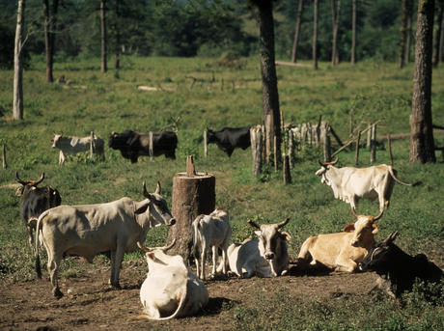

Slide 7
Illegal Logging
National laws regulate the production and trade of timber products at all stages, from harvesting to processing to sales. These laws can be violated in any number of ways, such as taking wood from protected areas, harvesting more than is permitted and harvesting protected species. Illegal logging occurs around the world, and in some places, illegal logging is more common than the legal variety.
This destruction threatens some of the world’s most famous and valuable forests, including rainforests in the Amazon, Congo Basin, Indonesia and the forests of the Russian Far East. Illegal logging also depresses the price of timber worldwide, disadvantaging law-abiding companies, and depriving governments of revenues normally generated by duties and taxes. Poor communities near forests are often vulnerable when outsiders try to gain control over the timber nearby, which can lead to repression and human rights violations.

Slide 8
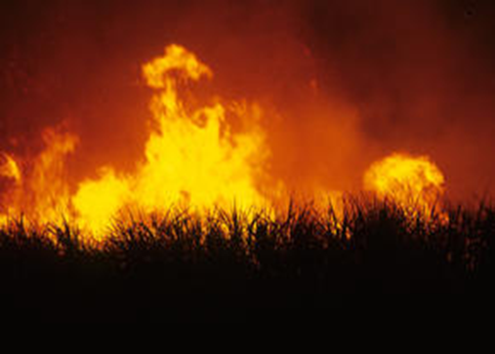
Fires
Fires are a natural and beneficial element of many forest landscapes, but they are problematic when they occur in the wrong place, at the wrong frequency or at the wrong severity.
year, millions of acres of forest around the world are destroyed or degraded by fire. The same amount is lost to logging and agriculture combined.
is often used as a way to clear land for other uses such as planting crops. These fires not only alter the structure and composition of forests, but they can open up forests to invasive species, threaten biological diversity, alter water cycles and soil fertility, and destroy the livelihoods of the people who live in and around the forests.

Slide 9
Fuel wood Harvesting
Wood is still a popular fuel choice for cooking and heating around the world, and about half of the illegal removal of timber from forests is thought to be for use as fuel wood.

Slide 10
Ozone Deterioration
Chemicals and chlorofluorocarbons pollutants are created by industry and agriculture.
They have a negative impact the ozone layer. The lack of strict enforcement of laws to prevent the use of such pollutants compounds the situation.
governments that continue to allow various pollutants into the environment impede the recovery of the ozone layer.

Slide 11
Acid Rain
Acid rain is created by excessive sulfuric and nitric acid being pumped into the atmosphere, rivers, oceans, and land.
While some acid rain is the byproduct of the natural processes of decaying vegetation and volcanic activity, the current crisis comes directly from the burning of fossil fuels.
Water becomes toxic when acid rain imbues the oceans or lakes with an absorption quality that cause the water to absorb soil-based aluminum and poisons the aquatic plant and marine life.

Slide 12
Dead Zones in the Ocean
Another harmful source of excessive nitrogen being dumped into the oceans can be traced back to agricultural practices of over-fertilization of crops, lawns and gardens. The end result has been the creation of over 160 dead zones throughout the world's oceans.
The oceans' eco-systems are dependent upon the natural process of organic ocean matter known as phytoplankton, which is found on ocean surfaces. This eventually breaks down and filters to the bottom of the ocean floor where it's broken down further by ocean floor bacteria. This process is called bacterial respiration.

Slide 13
Species Extinction
An alarming rate of species extinction is happening worldwide. As of 2010, the rate of loss is estimated to be more than 1,000 times the normal rate.
Greater preservation tactics and strategies are needed with laws put into place to protect species. Once more, manmade pollution is the culprit along with land encroachment by developers.
Both causes are created by consumer demands as people branch out into areas that were once remote habitats for various species

Slide 14
Natural Resource Depletion
: Natural resource depletion is another crucial current environmental problems. Fossil fuel consumption results in emission of Greenhouse gases, which is responsible for global warming and climate change. Globally, people are taking efforts to shift to renewable sources of energy like solar, wind, biogas and geothermal energy. The cost of installing the infrastructure and maintaining these sources has plummeted in the recent years.

Slide 15
Waste Disposal:
The over consumption of resources and creation of plastics are creating a global crisis of waste disposal. Developed countries are notorious for producing an excessive amount of waste or garbage and dumping their waste in the oceans and, less developed countries. Nuclear waste disposal has tremendous health hazards associated with it. Plastic, fast food, packaging and cheap electronic wastes threaten the well being of humans. Waste disposal is one of urgent current environmental problem.

Slide 16
Urban Sprawl:
Urban sprawl refers to migration of population from high density urban areas to low density rural areas which results in spreading of city over more and more rural land. Urban sprawl results in land degradation, increased traffic, environmental issues and health issues
The ever growing demand of land displaces natural environment consisting of flora and fauna instead of being replaced.

Slide 17
Public Health Issues:
The current environmental problems pose a lot of risk to health of humans, and animals. Dirty water is the biggest health risk of the world and poses threat to the quality of life and public health. Run-off to rivers carries along toxins, chemicals and disease carrying organisms. Pollutants cause respiratory disease like Asthma and cardiac-vascular problems. High temperatures encourage the spread of infectious diseases like Dengue.

Slide 18
Genetic Engineering
Genetic modification of food using biotechnology is called genetic engineering. Genetic modification of food results in increased toxins and diseases as genes from an allergic plant can transfer to target plant. Genetically modified crops can cause serious environmental problems as an engineered gene may prove toxic to wildlife. Another drawback is that increased use of toxins to make insect resistant plant can cause resultant organisms to become resistant to antibiotics.

Slide 19
Climate Change
Sea levels are rising and oceans are becoming warmer. Longer, more intense droughts threaten crops, wildlife and freshwater supplies. From polar bears in the Arctic to marine turtles off the coast of Africa, our planet’s diversity of life is at risk from the changing climate.
Climate change poses a fundamental threat to the places, species and people’s livelihoods WWF works to protect. To adequately address this crisis we must urgently reduce carbon pollution and prepare for the consequences of global warming, which we are already experiencing. WWF works to:
advance policies to fight climate change
engage with businesses to reduce carbon emissions
help people and nature adapt to a changing climate

Slide 20
Climate change has an impact on turtle nesting sites. It alters sand temperatures, which then affects the sex of hatchlings

Slide 21
Scientists in the United States and the world have reached an overwhelming consensus that climate change is real and caused primarily by human activity. Respected scientific organizations such as the National Academy of Science, the Intergovernmental Panel on Climate Change (IPCC) and World Meteorological Association (WMO) have all identified climate change as an urgent threat caused by humans that must be addressed.

Slide 22
Fossil Fuels
Burning fossil fuels, such as coal, oil and natural gas, to generate energy has the greatest impact on the atmosphere than any other single human activity. Globally, power generation is responsible for about 23 billion tonnes of CO2 emissions per year – in excess of 700 tonnes every second. Coal is especially damaging to our atmosphere, releasing 70% more carbon dioxide than natural gas for every unit of energy produced

Slide 23
Bycatch
Wherever there is fishing, there is bycatch—the incidental capture of non-target species such as dolphins, marine turtles and seabirds

Slide 24
Thousands of miles of nets and lines are set in the world's oceans each day. Modern fishing gear, often undetectable by sight and extremely strong, is very efficient at catching the desired fish species—as well as anything else in its path
A staggering amount of marine life—including turtles, dolphins and juvenile fish—is hauled up with the catch, and then discarded overboard dead or dying.

Slide 25
In pakistan
Air pollution is rapidly growing environmental problem in Pakistan.
Inefficient energy use, accelerated growth in vehicle population and vehicle kilometers traveled, increasing industrial activity without adequate air emission treatment or control, open burning of solid waste including plastic, and of ozone depleting substances (ODSs) are some of quality.

Slide 27
1. Pressure
Rapidly growing energy demand, high-energy intensity(a measure of energy inefficiency), and an expected change in fuel composition based on recoverable reserves are the key factors contributing to air pollution in Pakistan.
Energy Demand Projections
Energy system in Pakistan is traditionally demand based.
The level, structure, and evolution of this is derived from the level of economic activity and the intensity of energy use at the sector level.

Slide 28
Households
The household sector is the largest single energy-consuming sector in Pakistan. Biomass fuel, fuel-wood, crop residue and dung account for 95% of energy consumed by households in rural areas, with the share dropping
to 56% in urban areas. However, this figure conceals its disproportionately high concentration in the income settlements. Biomass combustion is a major source of indoor air pollution and primarily affects the
health of women and children. In this context, the expected switch to conventional fuels as a result of depleting
biomass stocks will be an encouraging development
Transport
Increasing prosperity and population growth in developing countries have resulted in accelerated growth in
vehicle numbers and kilometers traveled. Pakistan is no exception. The total road length measured at 94,000
kilometers in 1981 has incr
eased to 232,000 kilometers in 1998, an overall increase of 147%. The number of
vehicles has increased almost precipitously, from 0.8 million to about four million within 20 years, an overall
increase of more than 400%.

Slide 29
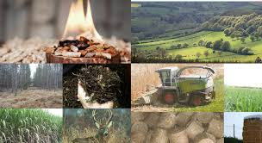

Slide 30
Industry
Industrial activity without adequate air emission treatment
or control is one of the major causes of the ambient air quality’s deterioration. It has not been possible to asse ss the magnitude of industrial air pollution, as there is little information available. However, figure 2 illustrates the problem reasonably well. Industrial discharges have increased significantly over th
e past 20 years. Emission of carbon dioxide and sulfur
dioxide has increased by a factor of four and five hundred, respectively.

Slide 31
fuel Substitution.
Inter-fuel substitution trends indicate a move towards high emitting fuels. This is likely to continue, based on diminishing reserves of the less polluting energy sources, such as natural gas and hydroelectricity.

Slide 32
energy Inefficiency
Pakistan is an energy deficient country but uses the commercial energy at its disposal in a highly inefficient manner. Some of the factors contributing to high-energy intensity are (a) transmission and distribution losses in power generation (an average 25% over the past 20 years), (b) tariff concessions on imported, second-hand machinery, (c) fuel price subsidies on diesel, (d) an ageing vehicle fleet (50% over 10 years old), which is primarily diesel powered (75%), (e) relative inefficiency of vehicle production, and (f) rapid penetration of new appliances (air conditioners, refrigerators, heaters) in private homes (Energy Wing, GOP, 1998). Energy inefficiency in developing countries is a source of growing concern.

Slide 33
Ozone Depleting Substances ODSs
In Pakistan, the ODSs are used mainly in deep freezers, refrigerators, car air-conditioners, foam, fire extinguishers and solvents. The country does not produce any ODS and imports all of its requirements. Total consumption of ODS in 1995 was 0.0319 lakh tons. This translates into an annual per capita consumption of roughly 0.018 kg. Twelve ODS were identified in use in 1999.

Slide 34
Others
For a developing country like Pakistan, urbanization has been one of the significant factors contributing to environmental degradation and air pollution in particular. The number of cities with a population of over one million increased from three in 1981 to seven in 1998. Air pollution in urban centers, particularly in the larger cities, has assumed alarming proportions. Open burning of solid wastes, including plastic bags, is a common in the urban and rural areas, and is compounded by biodegradation of such wastes.

Slide 35
Solutions
Our actions have negatively impacted the ecology and biophysical environment of the globe for decades. Ever since we started using carbon based fossils as a source of energy to fuel our industries, machineries, and homes, we have been impacting the globe through carbon emissions and other forms of pollution.
Carbon and other equivalent green house gases have already exceeded 400 parts per million, which is considered the tipping point, or the threshold, where greenhouse gases can cause harmful environmental changes. Below we will discuss top global impacts due to human activities.

Slide 36
Impact of human activities on climatic changes
When we connect the dots, we can easily find the correlation between global warming, climatic changes, extreme weather and effects on human health.
record heat, floods, droughts, forest fires, hurricanes and storms should make the message clear that we are doing something very wrong to the globe. Scientists are discovering that the extreme weather patterns are effects of global warming. The main reasons why our globe is getting hotter is carbon emission, greenhouse gases, and pollution.

Slide 37
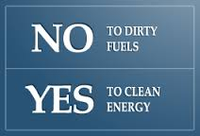
Clean energy sources
Say “no” to dirty
energy sources

Slide 38
The United States is the largest oil consuming nation in the world and we are at a crossroads today with choosing the right source of energy. Scientists predict that using fossil fuels as a source of energy will soon become a thing of the past.
Using alternative sources of energy, such as wind and solar power, aren’t more costly than using fossil fuel and have long term environmental and health benefits. Renewable energy sources do not pollute the environment by emitting harmful gases, so we remain healthier. Our economy will prosper too if we create new jobs that do not depend on fossils and reduce global warming.

Slide 39
Below is a list of alternate energy sources with a Few Great References
Wind energy
WWEA Continues Support For
Pakistan Wind Energy Market

Slide 40
Solar energy
The country has solar plants in Pakistani Kashmir, Punjab, Sindh and Balochistan. Initiatives are under development by the International Renewable Energy Agency, the Japan International Cooperation Agency, Chinese companies, and Pakistani private sector energy companies

Slide 41
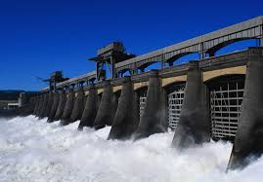
Hydraulic energy
The Water and Power Development Authority (Wapda) was established for the development of water and power resources.

Slide 42
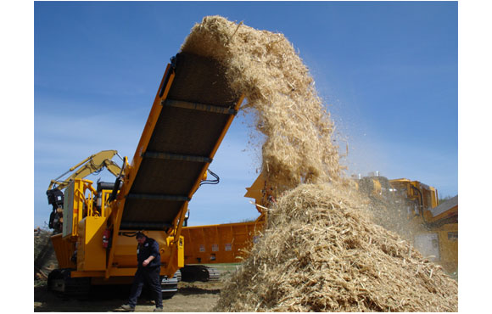
Biomass energy
Agricultural Residues
Animal Manure
Municipal Solid Waste

Slide 43
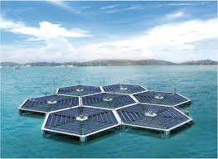
Offshore wind and wave energy

Slide 44
Political leaders, policymakers, businesses, and everyone else must come together to protect environmental resources such as air and water quality, natural habitat, preserving forestry and building a sustainable future for all of us.
If we do not take action, the quality of our ecosystem, environment, and the habitat of aquatic and wildlife will continue to deteriorate. There is plenty we can do to reduce the negative impacts on the globe.

Slide 45
Take action
We can all reduce our dependency on carbon based fossil fuels to reduce emission.
Use of clean reusable energy sources is already gaining popularity around the globe. Using clean energy would significantly reduce carbon emissions and air pollution, improving our health and environment.
Air quality and human health are closely related, and so reducing air pollution can lead to a healthier sustainable human race.

