Slide 1
Respiration in Plants

Slide 2
This is a process by which living cells break down complex high energy food molecules into simple low energy molecules, i.e., CO₂ and H₂O, releasing the energy trapped within the chemical bonds.
The energy released during oxidation of energy rich compounds is made available for activities of cells through an intermediate compound called adenosine triphosphate (ATP).

Slide 3
The reaction that occurs in common respiration of glucose may be summed up as follows:
Here, 686 kcal or 2870 kJ of energy is released per molecule of glucose. Formerly, this calculated value was 673 kcal.

Slide 4
Respiratory substrates
Respiratory substrates are those organic substances which are oxidized during respiration.
They are high energy compounds and are called respiratory substrates. They may be carbohydrates, fats and proteins.

Slide 5
Types of Respiration:
There are two main types of respiration:
(i) Aerobic, and
(ii) Anaerobic.

Slide 6
(i) Aerobic Respiration:
This type of respiration leads to a complete oxidation of stored food (organic substances) in the presence of oxygen, and releases carbon dioxide, water and a large amount of energy present in respiratory substrate. Such type of respiration is generally found in higher organisms.

Slide 7
(ii) Anaerobic respiration:
This type of respiration occurs in complete absence of oxygen. In the absence of free oxygen, many tissues of higher plants, seeds in storage, fleshy fruits, and succulent plants, such as cacti temporarily take to a kind of respiration, called anaerobic respiration. Such respiration generally occurs in lower organisms like bacteria and fungi.
This results in incomplete oxidation of stored food and formation of carbon dioxide and ethyl alcohol, and sometimes also various organic acids, such as malic, citric, oxalic etc. Very little energy is released by this process to maintain activity of protoplasm.

Slide 8
Glycolysis
During process of respiration, carbohydrates are converted into pyruvic acid through a series of enzymatic reactions. This series of reactions is known as glycolysis.
This term has originated from Greek words, glycos = sugar and lysis = splitting.

Slide 9
Phosphorylation of Sugar (i.e., First Phosphorylation)
Step [1] begins with the phosphorylation of glucose into glucose 6-phosphate,
using an ATP and a kinase enzyme.

Slide 10
Isomerization
Step [2] isomerizes glucose 6-phosphate to
fructose 6-phosphate with an isomerase enzyme.

Slide 11
Phosphorylation of Fructose-6-Phosphate (i.e., Second Phosphorylation)
Step [3] is the phosphorylation of fructose 6-phosphate into fructose 1,6-bisphosphate
with a kinase enzyme.

Slide 12
Splitting
Step [4] cleaves the fructose ring into a dihydroxy-acetone phosphate
and a glyceraldehyde 3-phosphate.

Slide 13
Isomerization
Step [5] isomerizes the dihydroxyacetone phosphate into another glyceraldehyde 3-phosphate.
Thus, the first phase of glycolysis converts glucose into 2 glyceraldehyde 3-phosphate units and 2 ATP is used.

Slide 14
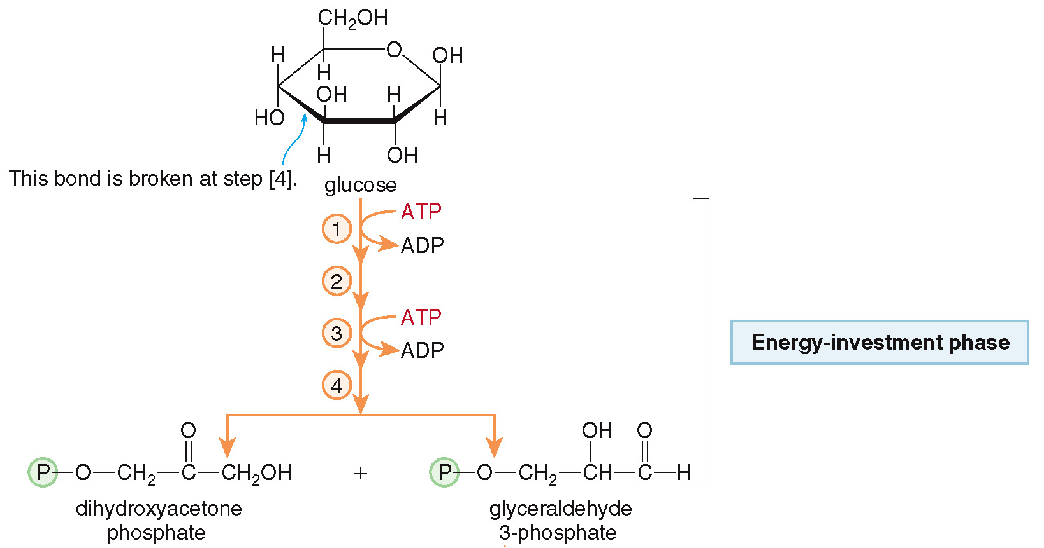
Glycolysis
Steps [1] – [5] energy investment phase:
2 ATP molecules are hydrolyzed.
The 6-carbon glucose molecule is converted into two 3-carbon segments.

Slide 15
Oxidative Dehydrogenation:
In step [6] the aldehyde end of the molecule is oxidized and phosphorylated by a dehydrogenase enzyme and NAD⁺+ pi;
this produces 1,3-bisphospho-glycerate and NADH.

Slide 16
Formation of ATP:
In step [7], the phosphate group is transferred onto an ADP with a kinase enzyme, forming 3-phosphoglycerate and ATP.

Slide 17
Isomerisation:
In step [8], the phosphate group is isomerized to a new position in 2-phosphoglycerate.

Slide 18
Dehydration:
In step [9], water is lost to form phosphoenol-pyruvate (PEP).
In step [10], the phosphate is transferred to an ADP, yielding pyruvate and ATP with a kinase enzyme.

Slide 19
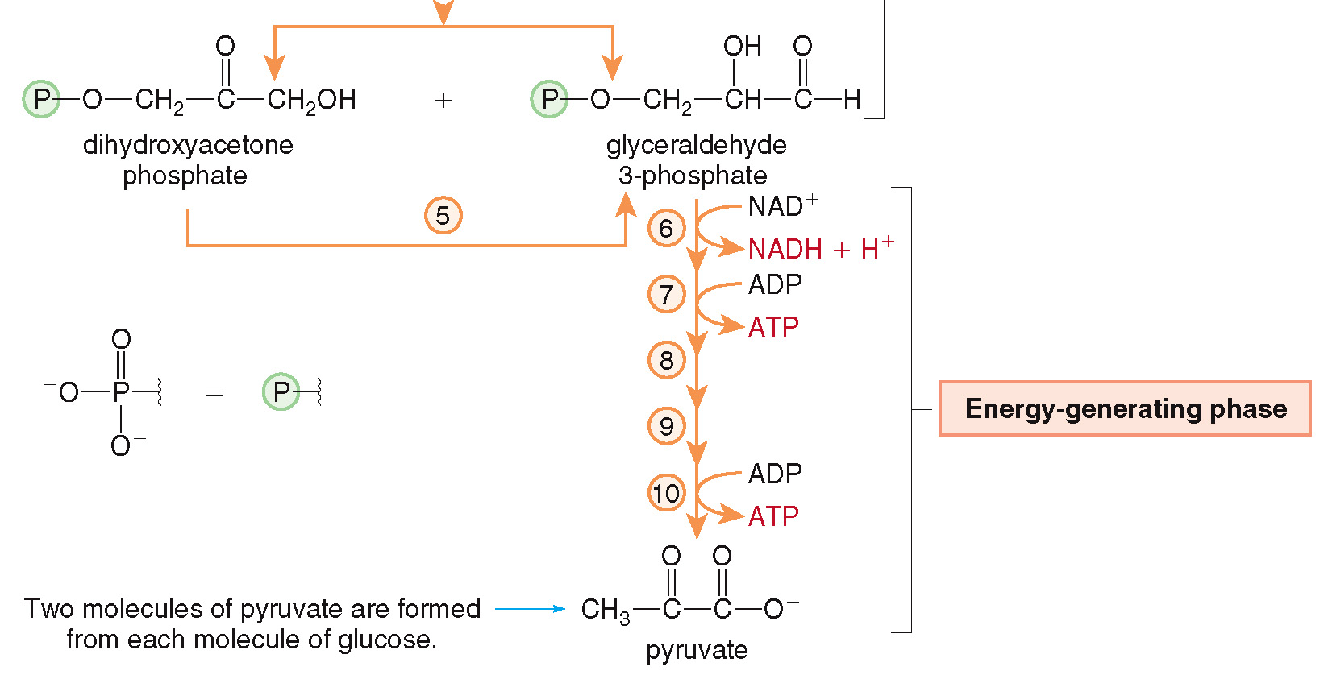
Glycolysis
Steps [6] – [10] energy-generating phase:
producing 1 NADH and 2 ATPs for each pyruvate formed.

Slide 21
In the end of glycolysis net gain of ATP:
(i) During glycolysis two triose phosphate molecules are formed from one glucose molecule, and 4 ATP molecules are produced.
(ii) Out of 4 ATP molecules, 2 ATP molecules are utilized in first few steps in converting glucose to fructose-1, 6 bisphosphate.
(iii) Moreover, three ATP molecules are produced from oxidation of each of two molecules of NADH produced during catabolism of glucose.
(iv) In all, a net gain of 8 molecules occurs during process of glycolysis.
(v) However, in anaerobic respiration, NADH + H^ is not converted to ATP, and therefore, only 2 ATP molecules are produced.

Slide 22
5. Oxidative Decarboxylation Pyruvic Acid:
Now, pyruvic acid generated in cytoplasm through glycolysis is transferred to mitochondria. This is initiation of second phase of respiration.
Acetyl Co-A can enter into mitochondria while pyruvate acid cannot.

