Slide 1
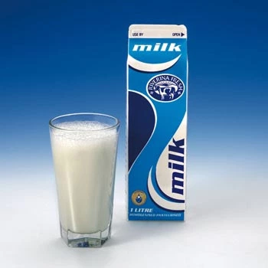
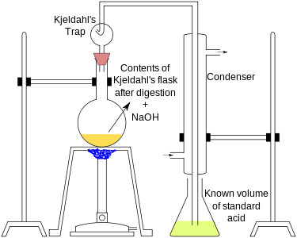
DETERMINATION OF TOTAL NITROGEN CONTENT IN MILK BY KJELDAHL METHOD

Slide 2
Introduction
The most widely used method for determining protein content is by kjeldahl method for nitrogen determination
Since nitrogen is characteristics element in protein, by its accurate determination, protein concentration can be calculated
In 1883, John Kjeldahl developed the basic procedure to analyze organic nitrogen

Slide 3
Introduction
The method involves two major steps:
Protein is digested using concentrated sulphuric acid in the presence of catalyst (in this step all organic material is oxidized except nitrogen, the reduced form of which is retained in digest as ammonium sulphate)
Metallic catalyst such as copper sulphate is used to hasten the digestion and clearing the reaction mixture
The digest is neutralized with alkali to liberate ammonia
In the second step ammonia is distilled off, collected in boric acid and titrated with standard acid
Boric acid provides the most convenient absorbent for ammonia
Boric acid itself is not involved in the titration but simply react with ammonia to form an ammonium borate complex

Slide 4
Introduction
The strongly basic ammonium borate that is formed is titrated directly with acid in the presence of methyl red-bromocresol green indicator until green distillate changes colorless to pink (methyl red and methylene blue indicator can also be used
The quantity of acid required for titration is equivalent to the concentration of ammonia in the distillate and to the nitrogen content of the original protein containing sample

Slide 5
Introduction
The reagent black should be run to subtract reagent nitrogen from sample nitrogen
The result of analysis represents the crude protein content of the sample since some nitrogen also comes from non-protein components of milk
On the average milk protein contain 15.65% nitrogen
Thus, for milk sample of unknown composition, the total amount of protein may b calculated using the conversion factor of 6.38 (100/15.65)

Slide 6
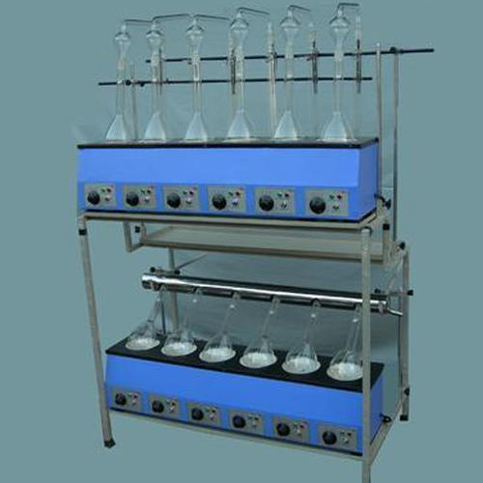
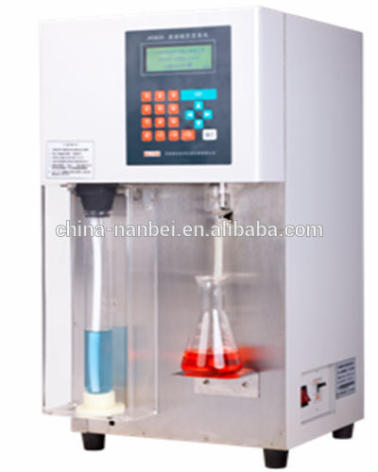
METHOD
This method employs the use of traditional Kjeldahl apparatus using Kjeldahl flask

Slide 7
Reagents
Potassium sulphate (K2SO4): Nitrogen free or low in nitrogen content
Copper sulphate solution (CuSO4.5H2O): Dissolve 5.0g of copper sulphate pentahydrate in water and make up final volume to 100ml in a 100 ml volumetric flask
Concentrated sulphuric acid: At least 95-98% (m/m ), nitrogen free, approximately = 1.84g/ml
Sodium hydroxide solution:50% (m/m), low in nitrogen: Dissolve 50g NaOH pellets in water and finally make to 100g

Slide 8
Reagents
Indicator solution: Dissolve 0.1g of methyl red in 95% (v/v) ethanol and dilute to 50 ml with ethanol. Dissolve 0.5g of bromocresol green in 95% (v/v) ethanol and dilute to 250 ml with ethanol. Mix 1 part of methyl red solution with 5 parts of bromocresol green solution or combine all of both solutions
Boric acid solution (H3BO3): Dissolve 40 g of boric acid in hot water, allow the solution to cool and dilute to 1L. Add 3 ml of methyl red-bromocresol solution, mix and store the solution in borosilicate glass bottle. The solution will be light orange in color

