Slide 3
MYASTHENIA GRAVIS
Presented to: Sir Tahseer Ahmad
Presented BY:
Aneeba Rubab
Attia Khanam
Rimsha Nazir

Slide 4
Contents
Introduction
Causes
Signs and symptoms
Types
Complications
When to see doctor
Factors worsening the myasthenia gravis.
Diagnostic test
Medicinal management
Therapy
Treatment through Yoga.

Slide 5
Introduction
The name “myasthenia gravis” which is latin and greek in origin literally means “grave muscles weakness.”
Myasthenia gravis is a complex, autoimmune disorder in which antibodies destroy neuromuscular connections.
It leads to problems with the nerves that communicate with muscles
Affects the voluntary muscles of body specially the eyes, mouth,throat and limbs.

Slide 6
Conti…..
Key concept
It is due the decrease in the number of available acetyl choline receptor at neuromuscular junction due to antibody mediated autoimmune attack .

Slide 8
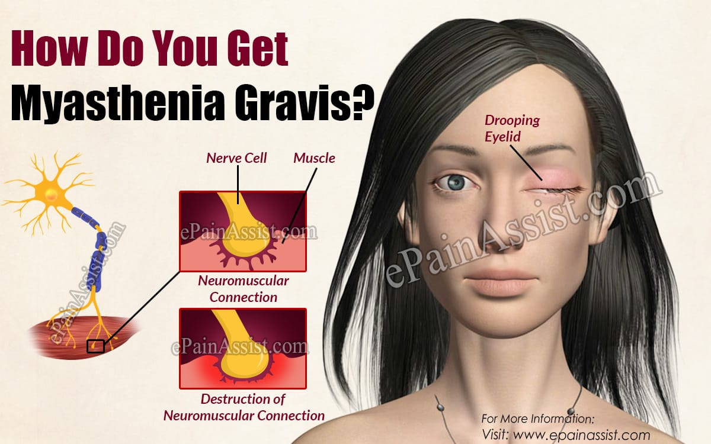

Slide 10
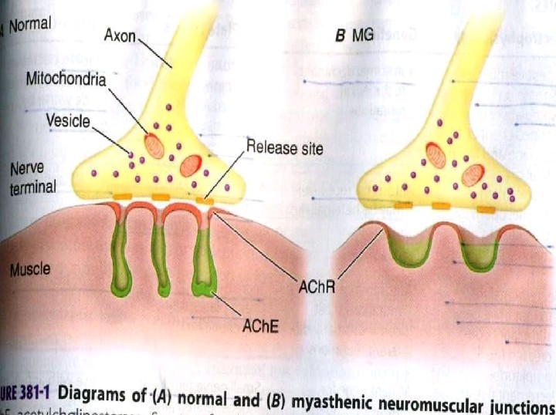

Slide 11
Causes
Myasthenia gravis may be inherited as a rare genetic disease acquired by babies born to mothers with MG or the disorder may develop spotaneously later in childhood.
Nerves communicate with the muscles by releasing neurotransmitters which fit precisely into receptor sites on the muscle cells.
In the MG , immune system produces antibodies that block or destroy many of the receptor sites for a neurotransmitter called acetylcholine Ach.

Slide 12
With few receptor sites available muscle receives few nerve signals resulting in weakness. Its believed that thymus gland, a
part of the immune system located in the chest beneath the breast bone may trigger or maintain the production of antibodies..
Some people have tumors of the thymus but these are non cancerous

Slide 13
Symptoms
Effect on Eye muscles includes drooping of one or both eyelids(Ptosis) , double vision i.e Diplopia
It effects Face and throat muscles
Altered speaking (dyasarthria)
Difficult swallowing
Problem chewing
Limited facial expression
Neck and limb muscles
Weakness of arms,legs,neck and fingers
Weakness in chest muscles, sometime occurs
If this is severe myasthenia crisis may occur

