Slide 1
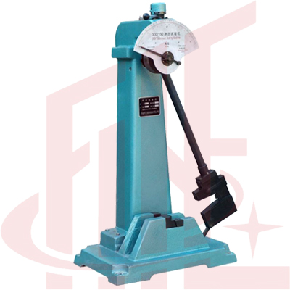
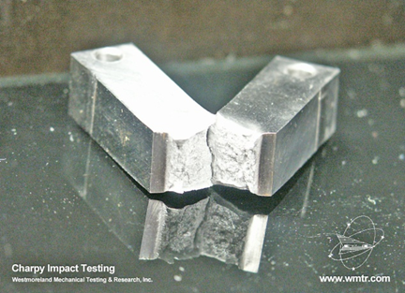
Lecture - 04

Slide 2
CHARPY IMPACT TEST ASTM Standard E-23
Charpy impact machine can perform following test
Tension
Bending
The Charpy impact test, also known as the Charpy V-notch test, is a standardized high strain-rate test which determines the amount of energy absorbed by a material during fracture.

Slide 3
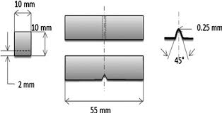
CHARPY IMPACT MACHINE & SPECIMEN

Slide 4
h = h1
h = h2
h = 0
At Impact

Slide 5
CHARPY IMPACT TEST
Strikes from higher position with 300 Joules.
Test specimen is held horizontally.
Notch faces away from striker.

Slide 6
CHARPY IMPACT TEST
Toughness;
Toughness is the resistance of a substance against a sudden impact of load.
Modulus of toughness= energy absorbed/volume

Slide 7
FATIGUE
Fatigue is the lowering of strength or the failure of a material due to repetitive stress, which may be above or below the yield strength.
Many engineering materials such as those used in concrete, steel structure etc. are subjected constantly to repetitive stresses in the form of tension, compression, bending, vibration, thermal expansion and contraction or other stresses.

Slide 8
FATIGUE
There are typically three stages to fatigue failure.
First, a small crack is initiated or nucleates at the surface and can include scratches, pits, sharp corners due to poor design or manufacture, inclusions, grain boundaries or dislocation concentrations.
Second, the crack gradually propagates as the load continues to cycle.
Third, a sudden fracture of the material occurs when the remaining cross-section of the material is too small to support the applied load.

Slide 9
FATIGUE
At a local size scale the stress intensity, K_{IC} , exceeds the yield strength.
For fatigue to occur at least part of the stress in the material has to be tensile.
Fatigue is most common in metals and plastics, whereas ceramics fail catastrophically without fatigue because of their low fracture toughness.

Slide 10
FATIGUE
Fatigue failures are often easy to identify.
The fracture surface near the origin is usually smooth. The surface becomes rougher as the crack increases in size.
Microscopic and macroscopic examination reveal a beach mark pattern and striations.
Beach mark patterns indicate that the load is changed during service or the load is intermittent.
Striations are on a much finer scale and show the position of the crack tip after each cycle.

Slide 11
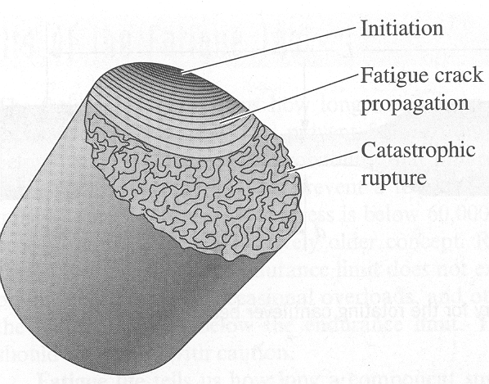
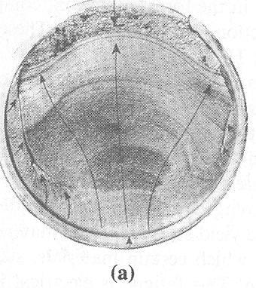
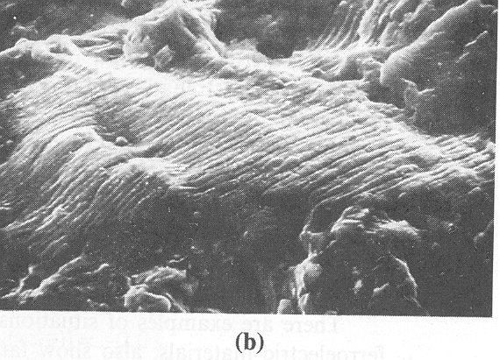

Slide 12
FATIGUE
The most important fatigue data for engineering designs are the S-N curves, which is the Stress-Number of Cycles curves.
In a fatigue test, a specimen is subjected to a cyclic stress of a certain form and amplitude and the number of cycles to failure is determined.
The number of cycles, N, to failure is a function of the stress amplitude, S.
A plot of S versus N is called the S-N curve.

Slide 13
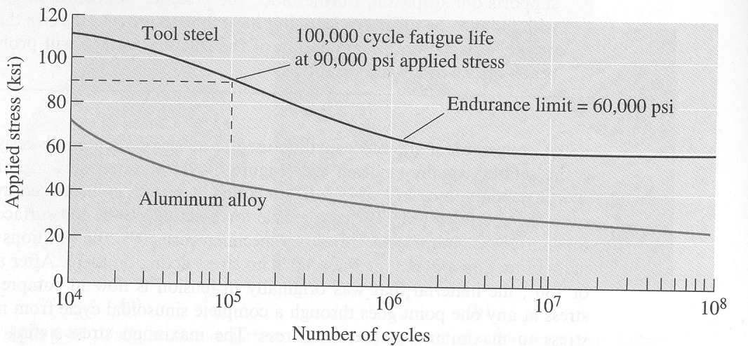
The S-N curves for a tool steel and an aluminum alloy showing the number of cycles to failure

