Slide 1
Functional Food & Nutracuticals

Slide 2
Phenolic

Slide 3
Introduction
The natural phenolic compounds have received increasing interest in the last years, since a great amount of them can be found in plants and consumption of vegetables and beverages with a high level of such compounds may reduce the risk of development of several diseases due to their antioxidant power, among other factors.

Slide 4
It is known that the metabolism of plants is divided in primary and secondary. The substances that are common to living things and essential to cells maintenance (lipids, proteins, carbohydrates, and nucleic acids) are originated from the primary metabolism. On the other hand, substances originated from several biosynthetic pathways and that are restricted to determined groups of organisms are results of the secondary metabolism. Phenolic compounds are constituted in one of the biggest and widely distributed groups of secondary metabolites in plants.

Slide 5
Biogenetically, phenolic compounds proceed of two metabolic pathways: the shikimic acid pathway where, mainly, phenylpropanoids are formed and the acetic acid pathway, in which the main products are the simple phenol. Most plants phenolic compounds are synthesized through the phenylpropanoid pathway .The combination of both pathways leads to the formation of flavonoids, the most plentiful group of phenolic compounds in nature.

Slide 6
Additionally, through the biosynthetic pathways to the flavonoids synthesis, among the not well elucidated condensation and polymerization phases, the condensed tannins or non-hydrolysable tannins are formed. Hydrolysable tannins are derivatives of gallic acid or hexahydroxydiphenic acid.

Slide 8
Therefore, phenolic compounds have, as a common characteristic, the presence of at least one aromatic ring hydroxyl-substituted. Another characteristic of these substances is that they are presented commonly bound to other molecules, frequently to sugars (glycosyl residue) and proteins. The existence of phenolic compounds in free form also occurs in plant tissues. However, it is less common, possibly because they are toxic when present in the free state and detoxified, at least in part, when bound.
As a result, phenolic compounds play a role of protection against insects and other animals to the plants. The different types of bond between the glycosyl residue and the flavonoids, such as anthocyanin, also lead to the different derivatives that add colors and color gradation to flowers.

Slide 9
This way, phenolic compounds are essential to the physiology and cellular metabolism. They are involved in many functions in plants, such as sensorial properties (color, aroma, taste and astringency), structure, pollination, resistance to pests and predators, germinative processes of seed after harvesting and growth as well as development and reproduction, among others.
Phenolic compounds can be classified in different ways because they are constituted in a large number of heterogeneous structures that range from simple molecules to highly polymerized compounds.

Slide 11
Main Classes
Flavonoids
According to the degree of hydroxylation and the presence of a C₂-C₃ double bond in the heterocycling pyrone ring, flavonoids can be divided into 13 classes, the most important being represented by the flavonols, flavanols, flavones, isoflavones, anthocyanidins or anthocyanins and flavanones. Within these classes there are many structural variations according to the degree of hydrogenation and hydroxylation of the three ring systems of these compounds. Flavonoids also occur as sulfated and methylated derivatives, conjugated with monosaccharides and disaccharides and forming complexes with oligosaccharides, lipids, amines, carboxylic acids and organic acids, being known approximately 8000 compounds.
The basic chemical structures of the main classes of flavonoids are presented in Figure 3.

Slide 13
While members of certain classes of flavonoids (eg., flavonones) are colorless, the other (eg, anthocyanins) are always colored, such as flowers pigments and other plant parts.
Flavonoids are important constituents of the human diet and are the most widely distributed phenolic compounds in plant foods and also the most studied ones.
It is known that flavonoids are among the most potent antioxidants from plants. The excellent antioxidant activity of these substances is related to the presence of hydroxyl groups in positions 3' and 4' of the B ring, which confer high stability to the formed radical by participating in the displacement of the electron, and a double bond between carbons C₂ and C₃ of the ring C together with the carbonyl group at the C₄ position, which makes the displacement of an electron possible from the ring B. Additionally, free hydroxyl groups in position 3 of ring C and in position 5 of ring A, together with the carbonyl group in position 4, are also important for the antioxidant activity of these compounds. However, the effectiveness of the flavonoids decreases with the substitution of hydroxyl groups for sugars, being the glycosides less antioxidants than their corresponding aglycons.

Slide 14
Conclusion
Phenolic compounds are widely distributed in plant foods (cereals, vegetables, fruits and others), stressing among them the flavonoids, tannins, chalcones, coumarins and phenolic acids. Although some studies have shown few statistically significant correlations between the levels of total phenolics and antioxidant capacity in foods, in others the content of total phenolic compounds was highly correlated with the antioxidant power of samples. Among the plant foods with a high content of phenolic compounds and antioxidant capacity, we can stand out the dark green leafy and brightly-colored vegetables, in addition to cocoa, soyabean, spices and fruits such as cherries and citrus.

Slide 15
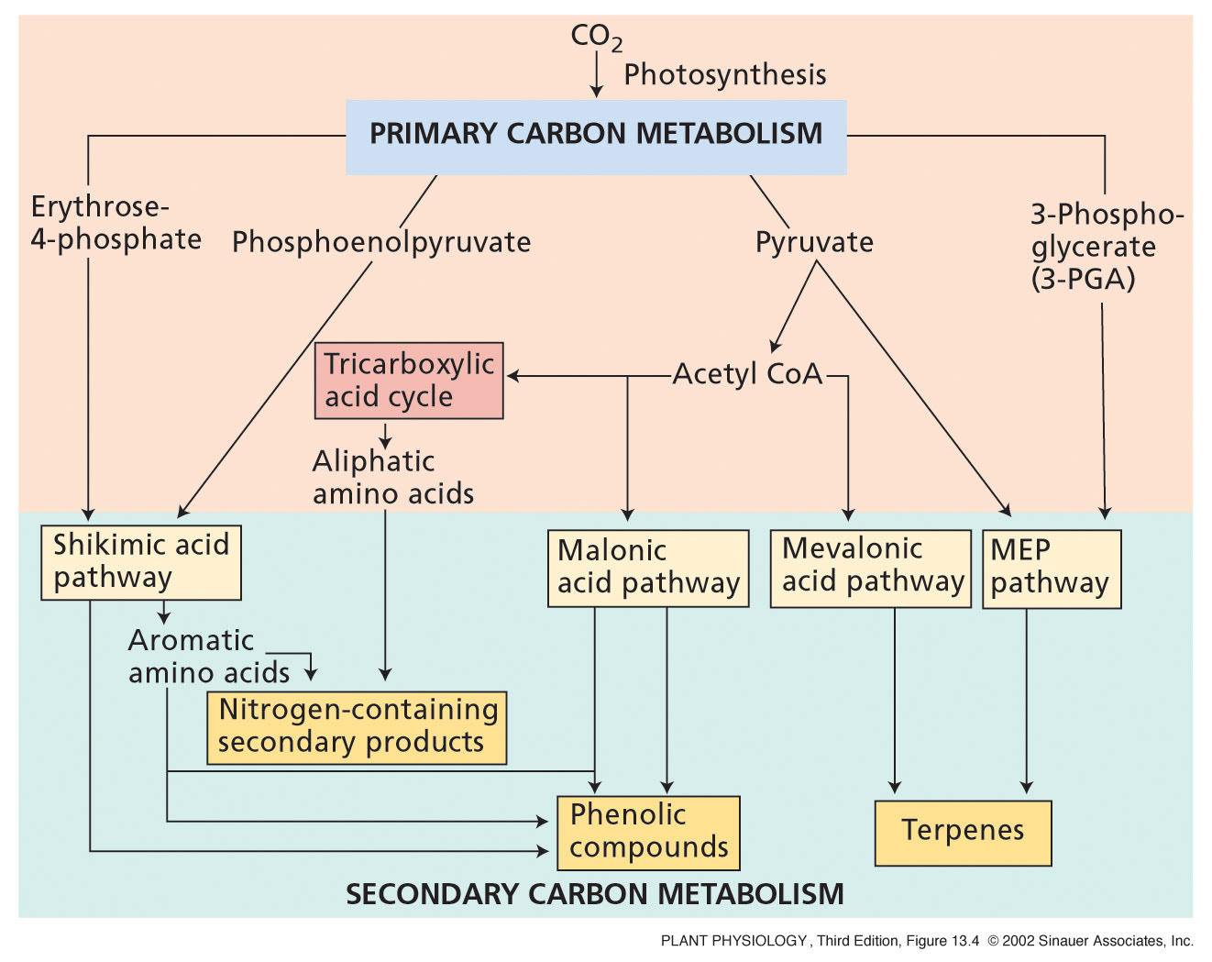
Notes:
PP13040.jpg

Slide 17
Major types of phenolics
1. Simple phenolics - e.g. coumarins
2. Lignin - 2nd most abundant compound in plants
3. Flavonoids - two aromatic rings, 2 pathways
anthocyanins, flavones/flavonols
4. Condensed tannins
polymerized flavonoids
5. Hydrolyzable tannins
made of phenolic acids and sugars
smaller molecules than condensed tannins

