Slide 1
Types of Relative Measure of Dispersion

Slide 2
Corresponding to measures of absolute dispersion, we have measures of relative dispersion. These measures are
Coefficient of Variation
Coefficient of Range
Mean Coefficient of Dispersion

Slide 3
Coefficient of Variation
The variability of two or more than two data cannot be compared unless we have a relative measure of dispersion.
The most commonly used measure of relative dispersion is the coefficient of variation abbreviated C.V. introduced by Karl Pearson. which expresses the standard deviation as a percentage of the arithmetic mean of a data set. Symbolically, it is defined as
$C.V=\frac{S}{\overline{X}}×100, for sample data,$
$C.V=\frac{σ}{\overline{X}}×100, for population data,$

Slide 4
The coefficient of variation is independent of unit, it is therefore used to compare the variation in two or more data sets that are measured in different units, e.g one may be measured in hours and other in kilograms or rupees.
It is based on the most commonly used measure of absolute dispersion.
A large value of C.V indicates that the variability is great and a small value of C.V indicates less variability.

Slide 5
Example 1: Goals scored by two teams A and B in a football season were as follows:
By calculating the co-efficient of variation in each case , find which team may be
considered more consistent.
No. of goals scored in a match(x) | NO of matches | No of matches
 | A | B
0 | 27 | 17
1 | 9 | 9
2 | 8 | 6
3 | 5 | 5
4 | 4 | 3

Slide 6
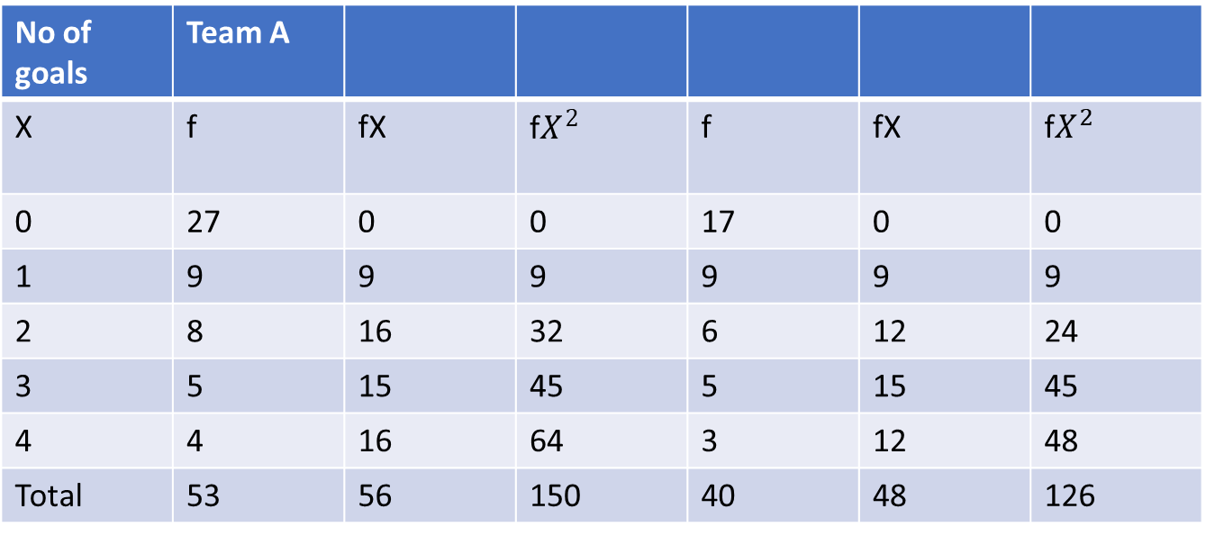
No of goals | Team A
X | f | fX | f$X^{2}$ | f | fX | f$X^{2}$
0 | 27 | 0 | 0 | 17 | 0 | 0
1 | 9 | 9 | 9 | 9 | 9 | 9
2 | 8 | 16 | 32 | 6 | 12 | 24
3 | 5 | 15 | 45 | 5 | 15 | 45
4 | 4 | 16 | 64 | 3 | 12 | 48
Total | 53 | 56 | 150 | 40 | 48 | 126

Slide 7
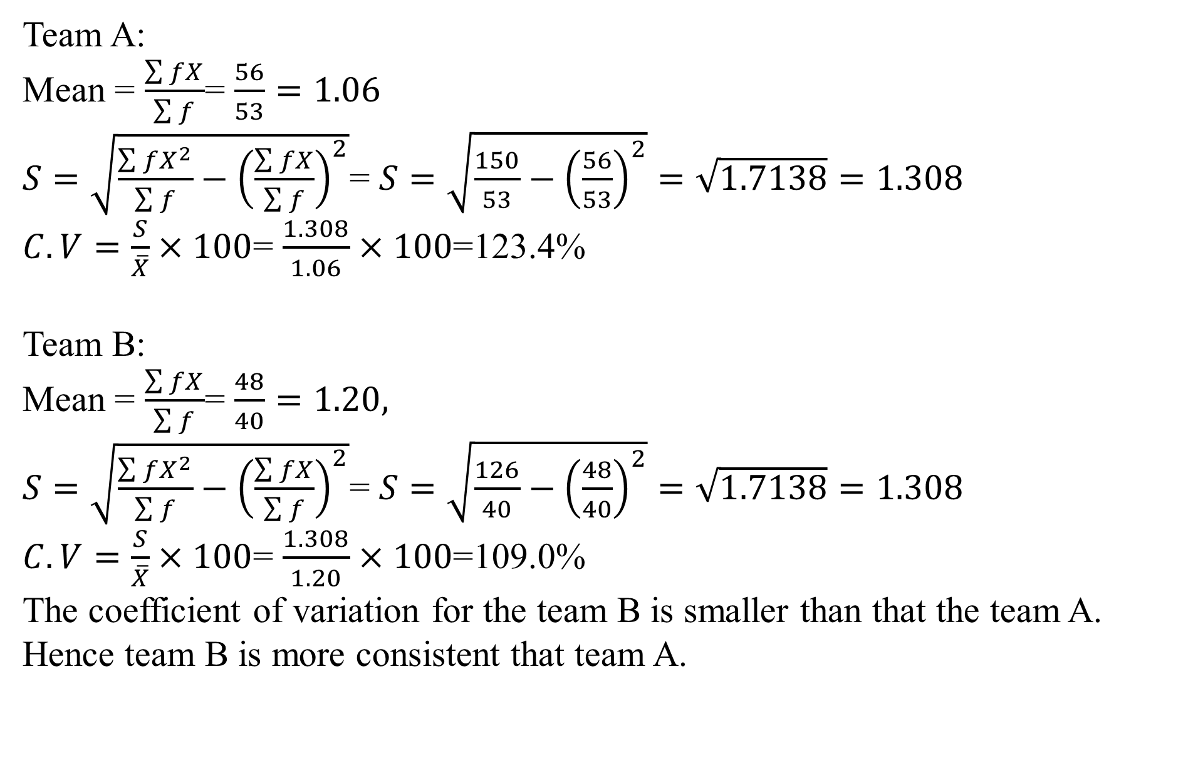
Team A:
Mean = $\frac{\sum{fX}}{\sum{f}}$= $\frac{56}{53}=1.06$
$S=\sqrt{\frac{\sum{fX^{2}}}{\sum{f}}−{\left(\frac{\sum{fX}}{\sum{f}}\right)}^{2}}$= $S=\sqrt{\frac{150}{53}−{\left(\frac{56}{53}\right)}^{2}}=\sqrt{1.7138}=1.308$
$C.V=\frac{S}{\overline{X}}×100$= $\frac{1.308}{1.06}×100$=123.4%
Team B:
Mean = $\frac{\sum{fX}}{\sum{f}}$= $\frac{48}{40}=1.20,$
$S=\sqrt{\frac{\sum{fX^{2}}}{\sum{f}}−{\left(\frac{\sum{fX}}{\sum{f}}\right)}^{2}}$= $S=\sqrt{\frac{126}{40}−{\left(\frac{48}{40}\right)}^{2}}=\sqrt{1.7138}=1.308$
$C.V=\frac{S}{\overline{X}}×100$= $\frac{1.308}{1.20}×100$=109.0%
The coefficient of variation for the team B is smaller than that the team A. Hence team B is more consistent that team A.

