Slide 1
Biological Model of Abnormality
Prepared by Ms. Sumaya Batool for BS V Psychology

Slide 2
The Biological Model
Takes a medical perspective
Main focus is that psychological abnormality is an illness brought about by malfunctioning parts of the organism
Typically focused on the brain

Slide 3
Biological Theories of Mental Disorders
Structural Theories
Abnormalities in the structure of the brain cause mental disorders
Imbalances in the levels of neurotransmitters or hormones, or poor functioning of receptors cause mental disorders
Biochemical Theories
Disordered genes lead to mental disorders
Genetic Theories

Slide 4
Structural Causes of Dysfunction
Can occur in three areas of the brain:
Amygdala
Prefrontal Cortex
Anterior Cingulate Cortex
Hippocampus
Can result from injury, such as an automobile accident, and from diseases that cause deterioration.

Slide 5
Role of brain areas in psychopathology
Amygdala—The brain's "fear hub," which activates our natural "fight-or-flight" response to confront or escape from a dangerous situation. The amygdala also appears to be involved in learning to fear an event, such as touching a hot stove, and learning not to fear, such as overcoming a fear of spiders. Studying how the amygdala helps create memories of fear and safety may help improve treatments for anxiety disorders like phobias or post-traumatic stress disorder (PTSD).
Prefrontal cortex (PFC)—Seat of the brain's executive functions, such as judgment, decision making, and problem solving. Different parts of the PFC are involved in using short-term or "working" memory and in retrieving long-term memories. This area of the brain also helps to control the amygdala during stressful events. Some research shows that people who have PTSD or ADHD have reduced activity in their PFCs.

Slide 6
Role of brain areas in psychopathology
Anterior cingulate cortex (ACC)— the ACC has many different roles, from controlling blood pressure and heart rate to responding when we sense a mistake, helping us feel motivated and stay focused on a task, and managing proper emotional reactions. Reduced ACC activity or damage to this brain area has been linked to disorders such as ADHD, schizophrenia, and depression.
Hippocampus—Helps create and file new memories. When the hippocampus is damaged, a person can't create new memories, but can still remember past events and learned skills, and carry on a conversation, all which rely on different parts of the brain. The hippocampus may be involved in mood disorders through its control of a major mood circuit called the hypothalamic-pituitary-adrenal (HPA) axis.

Slide 7
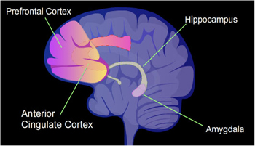

Slide 8
Biochemical Causes of Abnormality
The brain needs a number of chemicals to operate properly.
Neurotransmitters are biochemical “messengers.”
Reuptake occurs when the neuron which initially released the neurotransmitter into the synapse reabsorbs the neurotransmitter.
Degradation occurs when the receiving neuron releases an enzyme into the synapse that breaks down the neurotransmitter into other biochemicals..

Slide 9
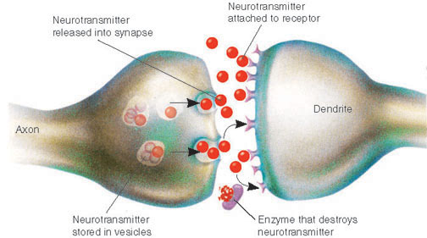

Slide 10
Neurotransmitters and Psychopathology
Serotonin—helps control many functions, such as mood, appetite, and sleep. Research shows that people with depression often have lower than normal levels of serotonin. The types of medications most commonly prescribed to treat depression act by blocking the recycling, or reuptake, of serotonin by the sending neuron. As a result, more serotonin stays in the synapse for the receiving neuron to bind onto, leading to more normal mood functioning.
Dopamine—mainly involved in controlling movement and aiding the flow of information to the front of the brain, which is linked to thought and emotion. It is also linked to reward systems in the brain. Problems in producing dopamine can result in Parkinson's disease, a disorder that affects a person's ability to move as they want to, resulting in stiffness, tremors or shaking, and other symptoms. Some studies suggest that having too little dopamine or problems using dopamine in the thinking and feeling regions of the brain may play a role in disorders like schizophrenia or attention deficit hyperactivity disorder (ADHD).

Slide 11
Neurotransmitters and Psychopathology
Glutamate—the most common neurotransmitter, glutamate has many roles throughout the brain and nervous system. Glutamate is an excitatory transmitter: when it is released it increases the chance that the neuron will fire. This enhances the electrical flow among brain cells required for normal function and plays an important role during early brain development. It may also assist in learning and memory. Problems in making or using glutamate have been linked to many mental disorders, including autism, obsessive compulsive disorder (OCD), schizophrenia, and depression.

Slide 13
Genetic Factors in Abnormality
Chromosomes are made up of individual genes.
Alterations in the structure or number of
chromosomes can cause major defects.
Polygenic process: it takes multiple genetic
abnormalities to create one disorder.

Slide 14
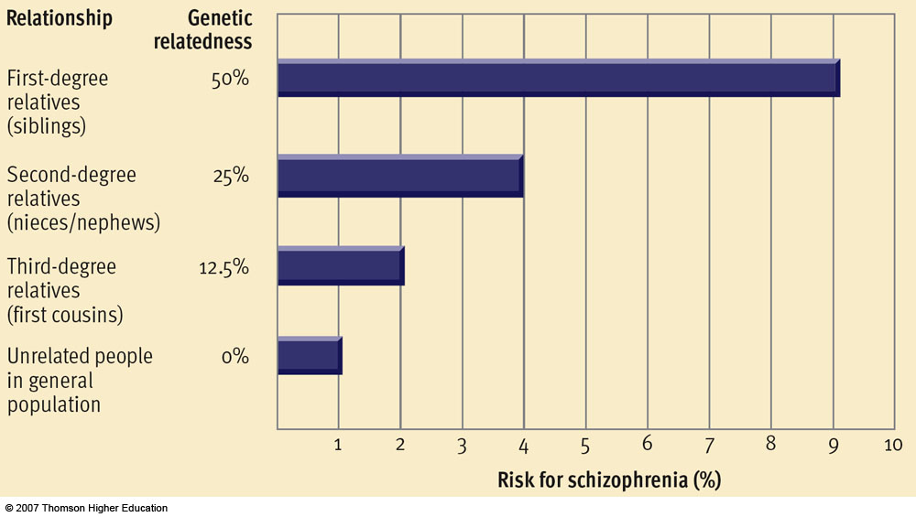
Genetic Factors in Abnormality

Slide 15
Sources of biological abnormalities – Viral infections
Infection provides another possible source of abnormal brain structure or biochemical dysfunction
Example: schizophrenia and prenatal viral exposure
Interest in viral explanations of psychological disorders has been growing in the past decade
Example: anxiety and mood disorders

Slide 16
Biological Treatments
Biological practitioners attempt to pinpoint the physical source of dysfunction to determine the course of treatment
Three types of biological treatment:
Drug therapy
Electroconvulsive therapy (ECT)
Psychosurgery

Slide 17
Drug Therapy
Some psychological disorders are always treated with drugs, like schizophrenia. Schizophrenia is generally treated with antipsychotic drugs such as Thorazine or Haldol. These drugs generally block the receptor sites for the neurotransmitter dopamine (dopamine reuptake inhibitors). You should know why if you remember the link that dopamine and schizophrenia have from previous chapters. The problem with these drugs is that they often have Parkinson like muscle tremor side effects called tardive dyskinesia.
Mood disorders are also often treated with drugs. The most common types of drugs that are used to treat depression (unipolar) are tricyclic antidepressants (Adapin or Elavil), monoamine oxidase (MAO) inhibitors (Nardil or Marplan) and serotonin reuptake inhibitors drugs (Prozac). All these drugs tend to increase the activity of the neurotransmitter serotonin. Lithium, a metal, is most often used to treat bipolar disorder.
Anxiety disorders (phobias, GAD or panic attacks) are most often treated with anti-anxiety drugs with depress the nervous system. Barbituates such as Valium or Xanax are most common.

Slide 18
Electroconvulsive Therapy
electroconvulsive therapy (ECT) where an electrical current is passed through the brain of a patient. Most often the current is passed through only one hemisphere, because although two hemispheres is more effective, there can be some negative side effects, such as loss of memory. Although ECT has been used to deal with all types of disorders, it is most commonly used today for severe depression. We still have no idea why it works (imagine the first doctor to think up "hey maybe shocking the crap out of the guy will make him better"), but we think it has to do with blood flow to the brain.

Slide 19
Psyhcosurgery
It is rare, but sometimes doctors may use psychosurgery. This is where a portion of the brain is lesioned or destroyed to alter a person's behavior. This type of surgery is only used as a last resort. One of the first and most widespread types of psychosurgery was the prefrontal lobotomy, where the neural connection to the frontal lobe are cut from the rest of the brain. This procedure calmed patients down immensely, but left many in a semi-vegetative state.

Slide 20
Assessing the Biological Model
Strengths:
Enjoys considerable respect in the field
Fruitful
Creates new therapies
Suggests new avenues of research
Weaknesses:
Can limit rather than enhance our understanding
Too simplistic
Evidence is incomplete or inconclusive
Treatments produce significant undesirable (negative) effects

