Slide 1
Lecture # 8(Cardinalities)

Slide 2
Cardinality of Relationship
Cardinality is defined as how many number of Entity type instances can participate in a relation ship with another entity type instances.
In another words say we have Entity named X and Y , so how many instances of X can make Relation with the instances of Y entity.
Cardinality limit the number of instances which can make relationship.

Slide 3
Types of Relationship Cardinalities
The maximum number of instances of one entity that may associated with each instance of another entity is known as maximum cardinality.
The minimum number of instances of one entity that may associated with each instance of another entity is known as minimum cardinality.

Slide 4
Types of Cardinalities

Slide 5
Notations for Cardinality

Slide 6
Description of Cardinalities

Slide 7
Examples of Different Cardinalities

Slide 8
The cardinality shown in First Part of the Figure-1 is shown using a relationship between a student and book; this can be a library scenario where students are borrowing books from the library.
We can see in the diagram the shape adjacent to the student entity it shows that the maximum cardinality for the student relationship is one and minimum cardinality is zero.
Where as on the other side of the diagram the shape adjacent to the book entity show that at most there can be many instances of the book associated with a single instance of student entity, and that there can be at-least no instance associated with the student entity.
In general library scenario we can say that one student can borrow at least no and at most many books.

Slide 9
In the second part of the Figure-1 we can see a relationship between the Employee and project entities, the relationship describes one to many association between the project and the employees,.
It shows that there can be one project having a number of employees, but for the existence of one employee at one project is necessary.
So the minimum and maximum cardinality on the project side of the relationship is one, and employees associated with each project can be many at most and none at-least.

Slide 10
Third part of the Figure-1 shows the association between the student and the course entities.
Here we can see that the relationship between the student and the course is zero at least and many at most on both the sides of the relationship.
The minimum cardinality with zero minimum is also called the optional cardinality.
It also shows that one student can have registered more that one subjects and one subject can also be taken by many students.
Also it is not necessary for a student to get registered one subject.

Slide 11
In the fourth part of the Figure-1 we can see the one to many cardinality between the hobby and student entities.
The cardinality descriptors show that a student may have no or at most one hobby, but it is worthwhile to notice that the cardinality of the hobby with the student in many but optional, now we can say that one hobby can be associated to many student but there is a chance that no hobby is associated to one student at a certain time.

Slide 12
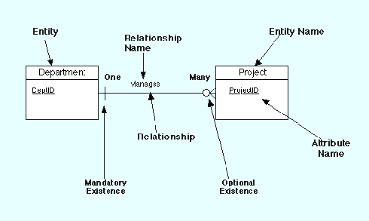
Example Model

Slide 13
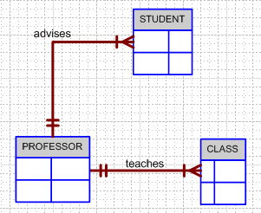
Business Rule Example 1
Finalized business rules are bi-directional.
A professor advises many students (professor to student). Each student is advised by one professor (student to professor).
A professor must teach many classes. Each class must be taught by one professor.

Slide 14
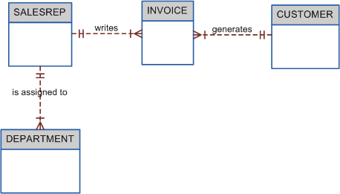
Business Rule Example 2
A sales representative must write many invoices. Each invoice has to be written by one sales representative.
Each sales representative must be assigned to many department. Each department has only one sales representative.
A customer has to generate many invoices. An invoice is generated by only one customer.

