Slide 1
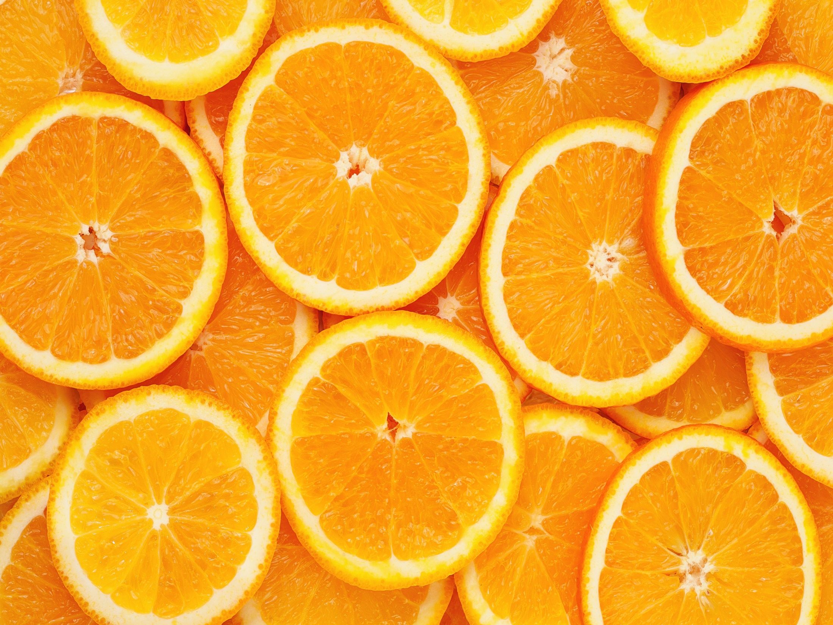
Orange
Prof. Dr. Sarfraz Hussain
FST 508

Slide 2
Introduction
The sweet orange (Citrus sinensis L. Osbeck) is a dicotyledonous, perennial evergreen of the Rutaceae family that leads other Citrus species in both production area and value
Fruit vary from spherical to oblong and are seedless (0to 6 seeds) to seeded (>6 seed)
Peel color at maturity ranges from light to deep orange but may remain green under warm conditions
Late season oranges may turn from orange to green (“regreen”) under warm conditions.

Slide 3
Quality Characteristics and Criteria
A high-quality orange is mature, with good color intensity that is uniformly distributed over the surface.
Fruit must be firm with a fairly smooth texture and shape that is characteristic of the variety.
Fruit should be free from decay, defects and blemishes.

Slide 4
Horticultural Maturity Indices
The best indices of maturity for citrus (internal) are internal
Brix (sugar)
Acid content
Brix/acid ratio (mandarin 12-14º brix, sweet orange 12º brix)
Change of skin color from dark-green to light-green with some yellow at the blossom end (color break)

Slide 6
Precooling Conditions
Rapid cooling is often neglected in many citrus packinghouses but should be seriously considered as a means of improving fruit quality at destination markets
Common cooling methods for oranges include room-cooling and forced-air cooling. Oranges can also be hydro cooled, but this practice is seldom used because of the increased risk of spreading fungal diseases

Slide 7
Storage conditions
Under normal weather conditions, fruit store better on the tree than in cold storage
Cold storage should not be attempted if the fruit storage potential has been expended by prolonged tree storage
Once harvested, fruit quality will not improve
Oranges can be stored for up to 12 weeks under optimum storage conditions
Ultimate storage life depends on cultivar, maturity, pre harvest conditions, and postharvest handling
During storage, fruit should be inspected often for signs of decay or disorders.
Such problems will advance rapidly once the fruit are removed from cold storage
The storage temperature for orange is 3 to 8⁰ C

Slide 8
Controlled Atmosphere (CA) Considerations
CA of 5 to 10% O₂ and 0 to 5% CO₂ may aid in retaining quality of oranges.
Decreased O₂ levels help maintain firmness and retard senescence
High CO₂ levels can inhibit the development of chilling injury

Slide 9
Retail Outlet Display Considerations
Oranges should be displayed on non refrigerated shelves and inspected often to remove damaged or decaying fruit.

Slide 10
Chilling Sensitivity
Symptoms of chilling injury include pitting, brown staining, increased decay, internal discoloration, off ﬂavors, and watery breakdown become evident 1 to 2 days after moving to room temperature (about 72 °F)
After removing fruit from chilling temperatures, respiration and ethylene production both increase

Slide 11
Ethylene production
Citrus produce very little ethylene: <0.1 μL kg-1h-1 at 20 °C (68 °F). Ethylene is used to degreen oranges, especially early in the season when natural degreening has been delayed because of warm night temperatures

Slide 12
Respiration Rates
Temperature
mg CO2 kg-1 h-1
0 °C
5 °C
10 °C
15 °C
20 °C
2 to 6
4 to 8
6 to 10
11 to 22
20 to 31

Slide 13
Physiological Disorders
Granulation is caused by gel formation within juice vesicles that greatly reduces extractable juice content
Oil spotting (oeocellosis) arises when mechanical damage releases oil from the oil glands. When fruit are very turgid, even slight pressure from bumps and abrasions can result in oil release and spotting.
Postharvest pitting is characterized by clusters of collapsed oil glands (often 5 to 20) scattered over the fruit surface. It can begin to develop 2 days after packing. Collapsed regions turn bronze-brown or brown-black over time
Stem-end rind breakdown (SERB) is characterized by the irregular collapse and darkening of rind tissue around the stem end of the fruit
Rind staining is associated with physiologically over mature fruit that are easily injured by mechanical abrasions

Slide 14
Post Harvest Pathology
Oranges are susceptible to a wide variety of fungal diseases, including
green mold (Penicillium digitatum),
blue mold (Penicillium italicum),
diplodia stem-end rot (Diplodia natalensis),
phomopsis stem-end rot (Phomopsis citri),
brown rot (Phytophthora citrophthora),
sour rot (Geotrichum candidum),
anthracnose rot (Colletotrichum gleosporioides).

Slide 15
Continued . . .
Factors such as growing region, production practices, cultivar, rootstock, and postharvest practices inﬂuence susceptibility to each of these pathogens

Slide 16
Transportation
Oranges are mainly transported in cartons, standard boxes, half-boxes, wire-bound boxes and fruit crates made of corrugated board or wood
They are sometimes also transported in net bags
Refrigerated container with fresh air supply or controlled atmosphere

