Slide 1
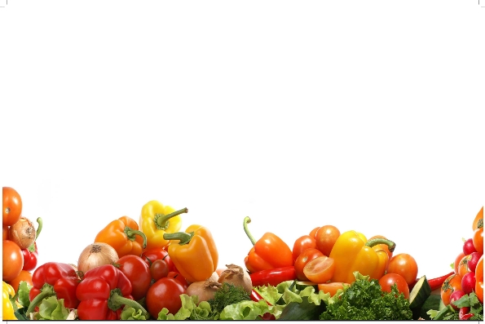
IONIZING RADIATION
Prof. Dr. SARFRAZ HUSSAIN
FST 508

Slide 2
Ionizing Radiation
Ionizing radiation is used in food preservation
Sources like cobalt -60 and cesium- 137 and X-rays and electron accelerated beam
In 1986 use of radiation was allowed for treatment of fresh fruits and vegetables,
Doses were 1kGy (100krad)

Slide 3
Ionizing Radiation
It has limits of application and can be used as a supplement to many other techniques as refrigeration & other post harvest techniques,
Fresh fruits & vegetables are subjected to higher rates of respiration and due to injuries subjected to irradiation

Slide 4
Ionizing Radiation
Formation of free radicals may cause injury to plant tissues on irradiation
Fresh fruits contain about 80-95% moisture and about 25% inter spaces where free radicals of oxygen and moistures are formed,
In an inert atmosphere the treatment can be more beneficial but it may also lower the effect of treatment and kill total mold cells.

Slide 5
Ionizing Radiation
Necrosis can occur in cell in tubers high as doses of irradiation,
Sprouting is inhibited in ginger, beet root, potato, sweet potato, turnip, carrot onion and Garlic,
The treatment is most effective when in dormancy,
Doses of 0.15 are safe and no side effects are produced but above this wound healing may be affected

Slide 6
Ionizing Radiation
Succeptability to infection is increased, sugar contents increased, vitamins reduced, tissue darkening occurs,
In Japan and USSR has been approved on onion and potatoes,
Chloroisopropyle carbamate for potato sprout inhibition and maleic hydrazide for onions is used,

Slide 7
Irradiated Mushrooms
Dozes up to 0.06 kGy has reduced veal opening, browning of tissues and enlargement of stalk,
Above 0.5 kGy flavor & taste changes are observed in canned mushrooms,
Mushrooms should be kept at reduced temperature at 0⁰C,

Slide 8
Facilities of Irradiation in Pakistan
PARS Lahore & Ternab Peshawar
Being used for irradiation of Mangoes and other fruits and spices
Known as cold sterilization and low dozes can be applied to retain volatiles.
Small irradiation mobile plants are needed in the country

Slide 9
Response to Irradiation
Factors influencing
Commodity,
Climate, production area
Maturity at harvest,
Initial quality,
Post harvest handling procedures

Slide 10
Irradiation procedure
Dose, and rate,
Environmental conditions during Irradiation,
Temperature,
Atmospheric composition of gasses

Slide 11
Dozes and effects
0.05 – 0.15 sprout inhibition in tubers
0.15 to 0.75 Insect disinfection,
0.25 to 0.5 delayed ripening in mango, papaya, banana,
>1.75 Control of post harvest diseases,
1.0 to 3.0 Accelerated softening

Slide 12
Tolerence to Irradiation
High peppers
Dates, Guava, mango, tomato, papaya,
Moderate
plum, banana, pineapple, fig, apricot,
Low
leafy vegetables, cucumber, olive, lime

Slide 13
References
Bautista, O.K. and Esguerra, E.B. (eds.) 2007. Postharvest technology for Southeast Asian perishable crops. University of the Philippines Los Banos, Laguna and Department of Agriculture, Quezon City, Philippines. 447p.
Borarin, B. 2009. Impacts of producing fruits and vegetables for supermarkets on farming practices: Lettuce and longan case studies in Cambodia. Food and Agriculture Organization of the United Nations-Regional Office for Asia and the Pacific (FAO-RAP), Bangkok, Thailand.
Castle A., (2007). Chemical migration into food: an overview. In: Barnes KA, Sinclair CR, Watson DH, editors. Chemical migration and food contact materials. Cambridge, U.K.: Wood head Publishing Ltd. pp1–14.
Sarfraz Hussain, 2004. Studies on long term storage of mushroom. Ph.D Thesis, University of Agriculture, Faisalabad, Pakistan.

