Slide 1
HMP SHUNT

Slide 12
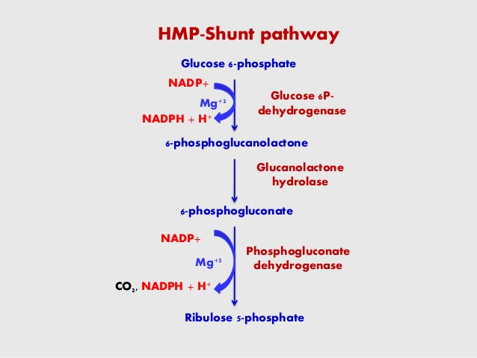

Slide 13
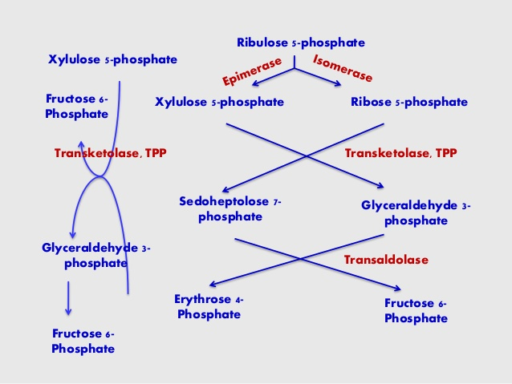

Slide 14
