Slide 1
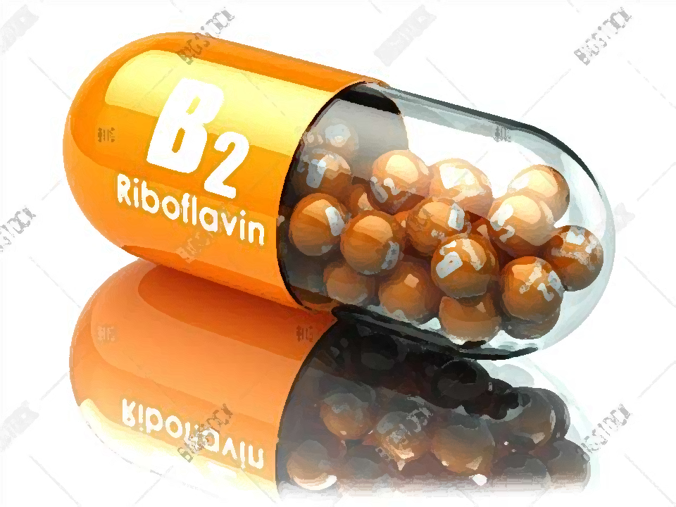
Absorption, transport and
metabolism of riboflavin

Slide 2
Absorption of riboflavin
I.
2

Slide 3
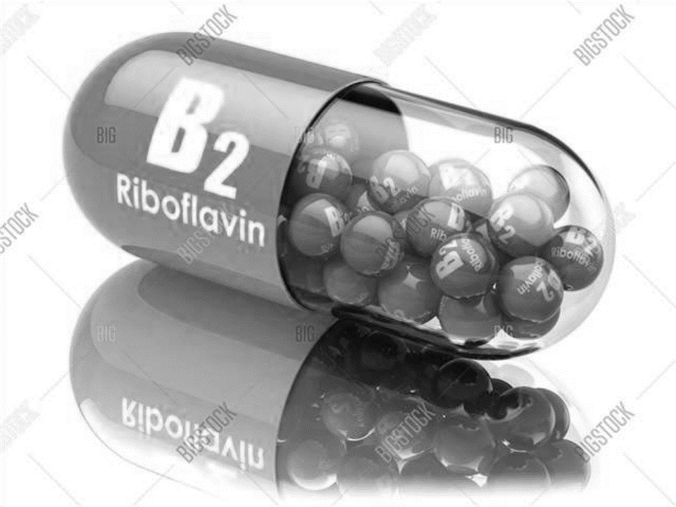
Hydrolysis of coenzyme forms
• Because riboflavin occurs in most foods as protein complexes of the coenzyme forms FMN and FAD, the utilization of the vitamin in foods depends on their hydrolytic conversion to free riboflavin.
• This occurs by the proteolytic activity of the intestinal lumen, which releases the riboflavin coenzymes from their protein complexes, and the subsequent hydrolytic activities of several brush border phosphatases that liberate riboflavin in free form.
3

Slide 4
Hydrolysis of coenzyme forms
Important enzymes are:
• alkaline phosphatase
• FAD-pyrophosphatase (converts
FAD to FMN)
• FMN-phosphatase (converts FMN
to free riboflavin)
4

Slide 5
Hydrolysis of coenzyme forms
FMN, FAD
Riboflavin occurs in most
foods as protein complexes of the coenzyme forms FMN and FAD.
FAD-pyrophosphatase
Converts
FAD to FMN.
Hydrolysis
Alkaline phosphatase
Both FAD and FMN
are split to yield
free riboflavin.
FMN-phosphatase
Converts FMN to
free riboflavin.
5

Slide 6
Active transport of free riboflavin
• Riboflavin is absorbed in the free form by means of carrier-mediated processes in the proximal small intestine and colon.
• This process has been found to be at least partially dependent on Na and may also involve the Ca /calmodulin, protein kinase A and G pathways.
+
2+
6

Slide 7
Active transport of free riboflavin
The upper limit of intestinal absorption has been estimated to be about 25 mg.
Riboflavin absorption is enhanced by riboflavin deficiency, bile salts and psyllium gum.
Absorption is downregulated by high doses of the vitamin.
7

Slide 8
Absorption linked to phosphorylation
The free form of riboflavin is transported
into the intestinal mucosal cell.
Much of free form is quickly trapped within the enterocyte by phosphorylation to FMN.
This is accomplished by an ATP-dependent
flavokinase.
Riboflavin enters the portal circulation as
both the free vitamin and FMN.
8

Slide 9
Transport of riboflavin
II.
9

Slide 10
Protein binding
• Riboflavin is transported in the plasma as both free riboflavin and FMN, both of which are bound in appreciable amounts (about half of the free riboflavin and 80% of FMN) to plasma proteins.
• This includes tight binding to globulins and fibrinogen, and weak binding to albumin.
10

Slide 11
Cellular uptake
• Riboflavin uptake appears to occur by a manner similar to its enteric absorption, by a Na -dependent, carrier-mediated process probably also involving the Ca /calmodulin, protein kinase A and G pathways.
+
2+
• Receptor-mediated endocytosis has also been implicated, particularly in the transport of riboflavin across the placental barrier.
April 15, 2018
11

Slide 12
Tissue distribution
• Riboflavin is transported into cells in its free form.
• In the tissues, riboflavin is converted to the coenzyme form, predominantly as FMN (60- 95% of total flavins), but also as FAD (5-22% of total flavins in most tissues, about 37% in kidney), both of which are found almost exclusively bound to specific flavoproteins.
12

Slide 13
Tissue distribution
The greatest concentrations of the vitamin are found in the liver, kidney and heart.
In most tissues, free riboflavin comprises
<2% of the total flavins.
Significant amounts of free riboflavin are found only in retina, urine and cow ’s milk.
In cow´s milk riboflavin is loosely
bound to casein.
13

Slide 14
Tissue distribution
The riboflavin content of the brain is not great, but the turnover of the vitamin in that tissue is high and the concentration of the vitamin is relatively resistant to gross changes in riboflavin nutriture.
14

Slide 15
Tissue distribution
Riboflavin is found in much lower concentrations in maternal plasma than in cord plasma (in the ratio 1:4.7): the presence of a transplacental
transport mechanism.
15

Slide 16
Metabolism of riboflavin
III.
16

Slide 17
Conversion to coenzyme forms
17

Slide 18
Conversion to FMN
The ATP-dependent phosphorylation yields riboflavin- 5′-phosphate (flavin mononucleotide, FMN).
This occurs in the cytoplasm of most cells and is catalyzed by the enzyme flavokinase.
FMN so produced can be complexed with specific apoproteins to form several functional flavoproteins.
18

Slide 19
Conversion to FAD
Most FMNs are converted to the other coenzyme form, flavin adenine dinucleotide (FAD), by a second ATP dependent enzyme, FAD-synthase.
This step appears to be feedback-inhibited by FAD, which is complexed in tissues with a variety of dehydrogenases and oxidases
mostly by noncovalent associations in discrete dinucleotide-binding domains.
19

Slide 20
Catabolism of FAD and FMN
• Flavins that are bound to proteins are resistant to degradation.
• When those proteins are saturated with flavins, the unbound forms are subject to catabolism.
• Both FAD and FMN are catabolized by intracellular enzymes in ways directly analogous to the breakdown of these forms in foods during their absorption across the intestinal mucosal cell.
20

Slide 21
Catabolism of FAD and FMN
FAD is converted to FMN by FAD-pyrophosphatase (releasing AMP).
FMN is degraded to free riboflavin by FMN-phosphatase.
Both FAD and FMN are split to yield free riboflavin by alkaline phosphatase.
April 15, 2018
Combs GF. The Vitamins. Fundamental Aspects in
21
Nutrition and Health. Elsevier Inc. 2008.

Slide 22
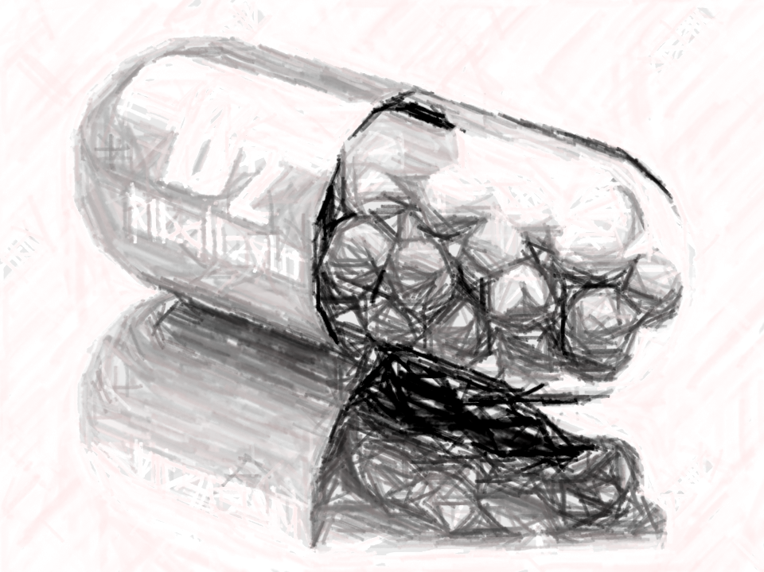
Catabolism of riboflavin
• The degradation of riboflavin per se initially involves its hydroxylation at the 7α- and 8α- positions of the isoalloxazine ring by hepatic microsomal cytochrome P-450-dependent
processes.
• As a result of this metabolism, human blood plasma contains FAD and FMN as the major riboflavin metabolites, as well as small amounts of 7α-hydroxyriboflavin.
22

Slide 23
Excretion
Riboflavin is rapidly excreted.
Dietary needs for the vitamin are determined by its
rate of excretion, not metabolism.
Riboflavin is excreted primarily in the urine.
In a riboflavin-adequate human adult, nearly all of a large oral dose of the vitamin will be excreted, with peak concentrations
showing in the urine within about 2 hours.
23

Slide 24
Excretion
The vitamin is excreted mainly (60-70%) as the free riboflavin, with smaller amounts of:
• 7α-21 and 8α-hydroxyriboflavin
• 8α-sulfonylriboflavin
• 5′-riboflavinylpeptide
• 10-hydroxyethylflavin
• riboflavin 5′-α-D-glucoside
• lumichrome
• 10-formylmethylflavin
Small amounts of riboflavin degradation products are found in the feces (<5% of an oral dose).
24

Slide 25
Excretion
• Riboflavin is secreted into human milk mostly as free riboflavin and FAD, and the antagonistic metabolite 10-(2′-hydroxyethyl)- flavin.
Milk also contains small amounts of other metabolites including:
• 7- and 8-hydroxymethylriboflavins
• 10-formylmethylflavin
• lumichrome
25

Slide 26
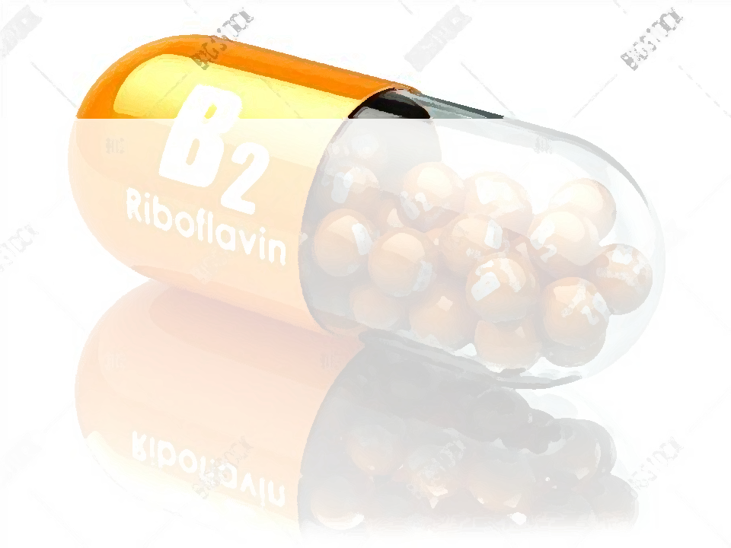
Literature
• Combs GF. The Vitamins. Fundamental Aspects in Nutrition and Health. Elsevier Inc. 2008.

