Slide 1
Dodder (Cuscuta):

Slide 2
Description:
Widely distributed, Hosts (alfalfa, onions, sugar beats & several ornamentals)
Loss slight to complete destruction
Also transmit plant viruses

Slide 3
Symptoms:
Orange or yellow strands around plant parts up to 10 feet areas
White, pink or yellowish flowers lead to seed formation
Infected host weekend, declined, poor yield & finally killed

Slide 4
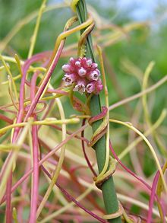
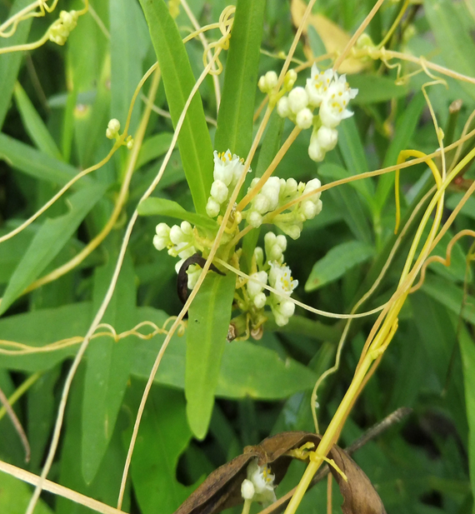
Cuscuta spp.
White flower
Pink, white flower

Slide 5
Disease cycle:
Seed over winter in infested fields or mixed with seed of crops
In growing season, seed germinating to produce slender like shoots with haustoria
It is a shoot parasite

Slide 6
Management:
Preventing introduction
Clean implements
Limiting movement of domestic animals
Spray contact herbicides
Frequent tillage & flaming

