Slide 1
Biostatistics
What is Statistics?
Statistics is the science of conducting studies to collect, organize, summarize, analyze and draw conclusions from data.
Statistics is a group of methods used to collect, analyze, present and interpret data and to make decisions.
Biostatistics
Biostatistics is the branch of biological science which deals with the study and methods of collection, presentation, analysis and interpretation of data of biological research. In biostatistics, statistical methods are applied to solve biological problems.

Slide 2
Population
A population is the set of all possible items, usually relating to a group of people or objects, which is of interest in a particular study.
Sample
Sample is the representative part of population. Sample is a selection of items taken from a population which is used for analysis.

Slide 3
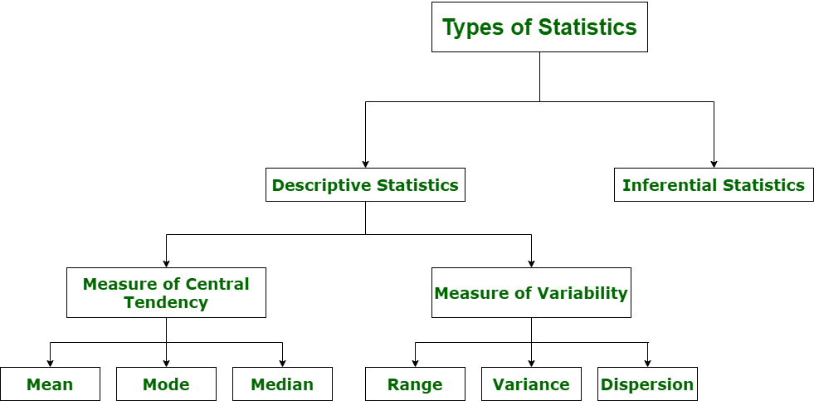

Slide 4
Types of Statistics
There are two types of applied statistics
Descriptive Statistics
Inferential Statistics
Descriptive statistics deals with the concepts and methods of summarization and description of data.
Example: Measure of central tendency and measure of dispersion etc.
2. Inferential Statistics is used to make inferences (suggestions, conclusion) about some characteristics.

Slide 5
Data and Types of Data
Data: The collection of different observations is called data. (individual units of information)
Different Types of Data with Examples
Text: Text data consists of words, sentences and paragraphs.
Numeric data: Numeric data consists of numeric digits from numeric digits from 0 to 9.
Image: This type of data includes chart, graph, pictures and drawing.
Audio: Sound is a representation of audio. Audio data includes music, speech or any type of sound.

Slide 6
There are two types of Statistical data
Primary data
Secondary data
1. The first collection of data by any person without any arrangement is called primary data.
This data includes the data collected through direct interviews, surveys and experiments. Biological studies, particularly experimental studies depends on primary data.
When we arrange the data by any statistical rule is called secondary data.
Many important and current data which was initially a primary data can be published in books, research papers, journals or can be kept in record books to be used as the secondary data for another researcher.

Slide 7
Methods of Data Collection
The sources of primary data are
Interview method
Questionnaire method
The sources of secondary data are
Books, internet etc.

Slide 8
Variable and its types
A variable is a phenomenon that may vary from one individual or object to another. OR
A characteristics that can have different values or outcomes is called variable.
Types of Variable
Qualitative variable OR categorical variable
Quantitative variable
The variable which cannot be measured numerically is called qualitative variable(un-measurable or non-numerical variables). For example Religion, honesty, beauty, intelligence, color of flower, shape of leaves, shape of seeds etc.
The variable which can be measured numerically is called quantitative variable. It is obtain either by counting or measuring.
There are two types of quantitative variable.
Discrete variable ii. Continuous variable

Slide 9
Discrete variable: The variable which is obtained just by counting is called discrete variable. For example Number of petals in a flower etc.
Continuous variable: The variable which is obtained by some measurement is called continuous variable. For example height of a plant etc.
Height, weight, length, speed etc.

